Slide 1
Technology Program Assessment: Why and How of It in Accreditation
by
Prof. Sam Obi
San José State University
November 10, 2022

Slide 2
This presentation will focus on the following points:
Purpose of Technology programs assessments
The role of assessments in ATMAE accreditation
Steps in conducting Technology assessments
How to design assessment tools
Documenting assessment tools and reports

Slide 3
Meaning and Purpose of Assessment
Assessment means:
Evaluation or estimation of the nature, quality, or ability of programs
  Program learning outcomes (PLOs) are used in assessments
  PLOs are designed by program planners
  PLOs are found in course syllabi
  PLOs should be approved by industry advisory board and faculty
Purposes of assessment are:
To measure how many students are learning the outcomes
Those gaps or lapses provide opportunities for continuous improvement of the courses
To ensure courses are addressing their design intent
To ensure intended student needs are being met by courses

Slide 4
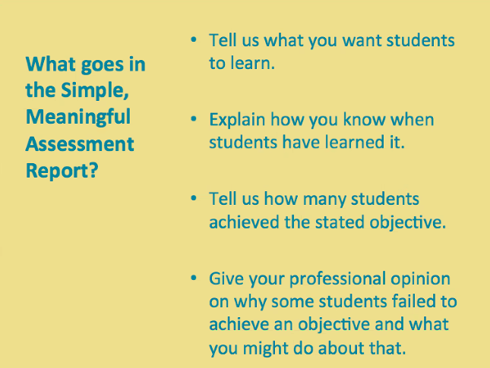

Slide 5
The Role of Assessments in ATMAE Accreditation
Standard 5 - Program Learning Outcomes Identification & Validation:
Measurable program learning outcomes shall be identified, assessed and validated for each program/option. These program/option learning outcomes must align with the program goals established for the program/option and validation shall be accomplished through a combination of external experts, an industrial advisory committee. Each Student Learning Outcomes (SLO’s) usually seen in individual course syllabi shall be mapped to the program/option learning outcomes. After the program is in operation, follow-up studies of direct and indirect measures for each outcome Shall be conducted.

Slide 6
The Role of Assessments in ATMAE Accreditation
Demonstrates program agility and functionality
Makes accreditation process easier and less complex
Makes ATMAE accreditation more genuine

Slide 7
Steps in Conducting Course Assessment
  Understand your program learning outcomes or PLO(s)
  Design/identify your PLO’s assessment measure (assignment, quiz, project, exam etc.)
  Conduct the measure (give the assignment, quiz, project, exam etc.)
  Complete assessment tool
  Forward the completed assessment tool to assessment coordinator

Slide 8
Understand Your PLOs: CNSM PLOs
Demonstrate strong communication, critical thinking, and interpersonal skills
Use skills in team development, dynamics, and management to work as team players
Demonstrate ethical behavior and concern for colleagues, society, and the environment
Demonstrate leadership skills for a technology professional.
Implement and manage computer and network systems
Solve problems related to daily interruptions of information flow
Design and interface components for connected products
Manage databases and cloud computing systems and services
Implement and manage Internet of Things (IoT) systems
Apply cybersecurity techniques to protect networks from attacks

Slide 9
Understand Your PLOs: Manufacturing Systems PLOs

Slide 10
Steps in Conducting Course Assessment
  Understand your PLO(s)
  Map your PLOs with program’s individual courses
  Design/identify your PLO’s assessment measure (assignment, quiz, project, exam etc.)
  Conduct the measure (give the assignment, quiz, project, exam etc.)
  Complete assessment tool
  Forward the completed assessment tool to assessment coordinator

Slide 11
PLOs Mapped to Tech 31 (Quality Assurance & Control)

Slide 12
Steps in Conducting Course Assessment
  Understand your PLO(s)
  Map your PLOs with program’s individual courses
  Design/identify your PLO’s assessment measure (assignment, quiz, project, exam etc.)
  Conduct the measure (give the assignment, quiz, project, exam etc.)
  Complete assessment tool
  Forward the completed assessment tool to assessment coordinator

Slide 13
Design/Identify Your PLO’s Assessment Measure
The measure must align with the PLO(s)
The measure can be an assignment, quiz, project, exam etc.
The measure should be a major part of the course
The measure should be designed as early as possible
Notes:
The measure must align with the PLO(s)
The measure can be an assignment, quiz, project exam etc.
The measure should be a major part of the course
The measure should be designed as early as possible

Slide 14
Steps in Conducting Course Assessment
  Understand your PLO(s)
  Map your PLOs with program’s individual courses
  Design/identify your PLO’s assessment measure (assignment, quiz, project, exam etc.)
  Conduct the measure (give the assignment, quiz, project, exam etc.)
  Complete assessment tool
  Forward the completed assessment tool to assessment coordinator

Slide 15
Conduct the Measure
Can be given at any time during the semester
Instructor needs to ensure the results are not lost
This is the measure that the assessment coordinator will ask for
Notes:
Can be given at any time during the semester
Instructor needs to ensure the results are not lost
This is the measure that the assessment coordinator will ask for

Slide 16
Steps in Conducting Course Assessment
  Understand your PLO(s)
  Map your PLOs with program’s individual courses
  Design/identify your PLO’s assessment measure (assignment, quiz, project, exam etc.)
  Conduct the measure (give the assignment, quiz, project, exam etc.)
  Complete the assessment tool
  Forward the completed assessment tool to assessment coordinator

Slide 17
Complete the Assessment Tool
Identify the course, semester, and year
Identify the instructor
Give M, E, or N to students according to their performances
M = 70-86%; E = 87-100%; N < 70%
Replace students’ names with alphabets or something else as this will become public record
Send completed form to the assessment coordinator
Notes:
Identify the course, semester, and year
Identify the instructor
Replace students’ names with alphabets or something else this will become public record
Give M, E, or N to students according to their performances
Send completed form to the assessment coordinator

Slide 19
Steps in Conducting Course Assessment
  Understand your PLO(s)
  Map your PLOs with program’s individual courses
  Design/identify your PLO’s assessment measure (assignment, quiz, project, exam etc.)
  Conduct the measure (give the assignment, quiz, project, exam etc.)
  Complete assessment tool
  Forward the completed assessment tool to assessment coordinator

Slide 20
Forward the Completed Assessment Tool to Assessment Coordinator
The assessment coordinator collects all assessment tools from all instructors
The assessment coordinator enters the data in Nuventive system
Nuventive system analyzes and generates results
ATMAE accreditation visiting team will see this documentation
Notes:
The assessment coordinator collect all assessment tools from all instructors
The assessment coordinator enters the data in Nuventive system
Nuventive system analyses and generates results

Slide 21
Interpreting Assessment Data
PLO 7: Implement automation, advanced and smart manufacturing
Bench mark: 80% of students must score at least 70% in this
3 out of 19 students (16%) did not meet the required 70% score
Conclusion: Benchmark was met. 84% of students met the criteria
Action: No action needed

Slide 22
Interpreting Assessment Data
PLO 10: Demonstrate skill in the planning and design of manufacturing
Bench mark: 80% of students must score at least 70% in this
9 out of 37 (24%) did not meet the required 70% score
Conclusion: Benchmark was not met. Only 76% of students met the criteria
Action: Instructor to be contacted by chair of curriculum committee to address this

Slide 23
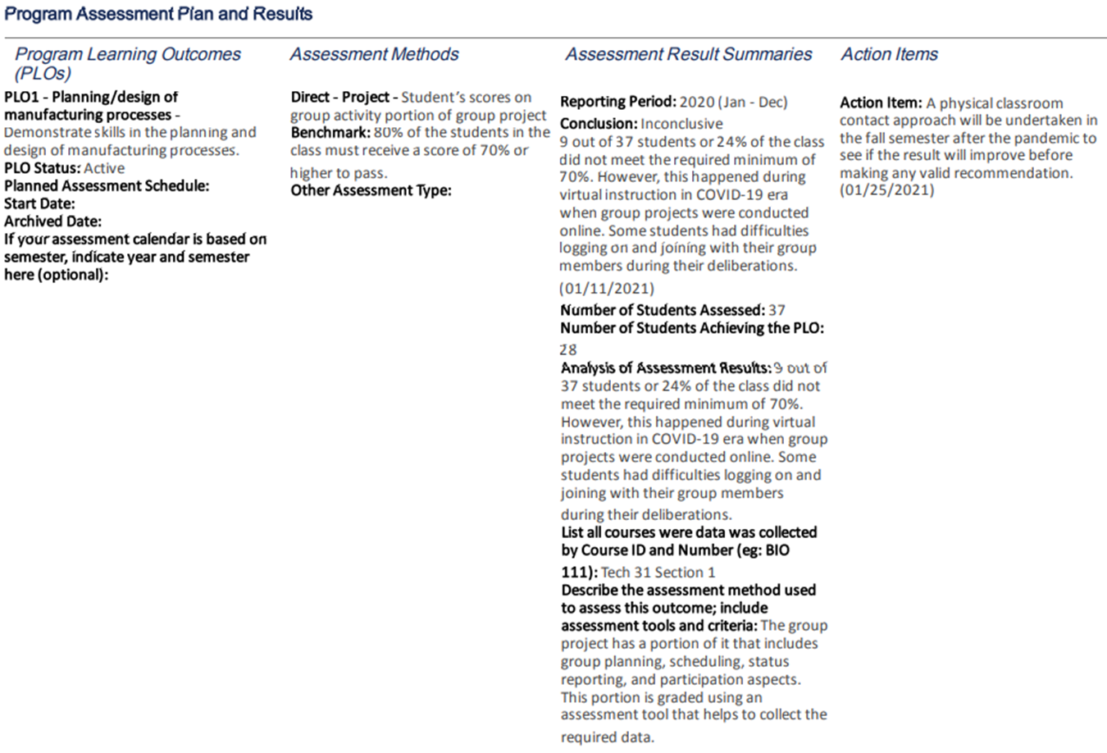
Sample Results

Slide 24
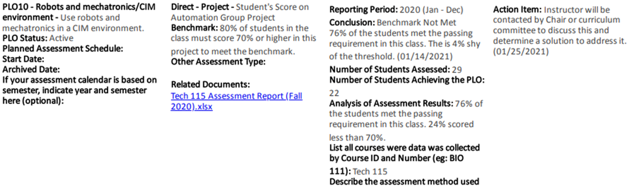
Sample Report

Slide 25
When a Course Does Not Meet the Benchmark*
The instructor is invited by the Chair or Curriculum Committee
The information is shared with the instructor
The instructor explains why it happened
Together, a solution (including suggestions) is discussed, designed and noted
The solution is implemented in the class
The solution is tested in the next assessment cycle
*Note that not meeting assessment benchmark does not necessarily mean that the students will fail the course.

Slide 26
Review of Technology Programs Assessment Tools
https://www.sjsu.edu/people/samuel.obi/Technology%20Courses%20Rubric%20%20SLOs%20New.xlsx

Slide 27
Nuventive Assessment System: Main Menu
Program Summary
General Program Information
Program Assessment
PLOs and Assessment Methods
Assessment Results
Annual Executive Summaries
Alignment Maps
Program Learning Outcome Maps
Curriculum Map
Reports
Four Column Report with Program Information
Standard Reports
Ad Hoc Reports
Documents and Resources
Assessment Report Feedback

Slide 28
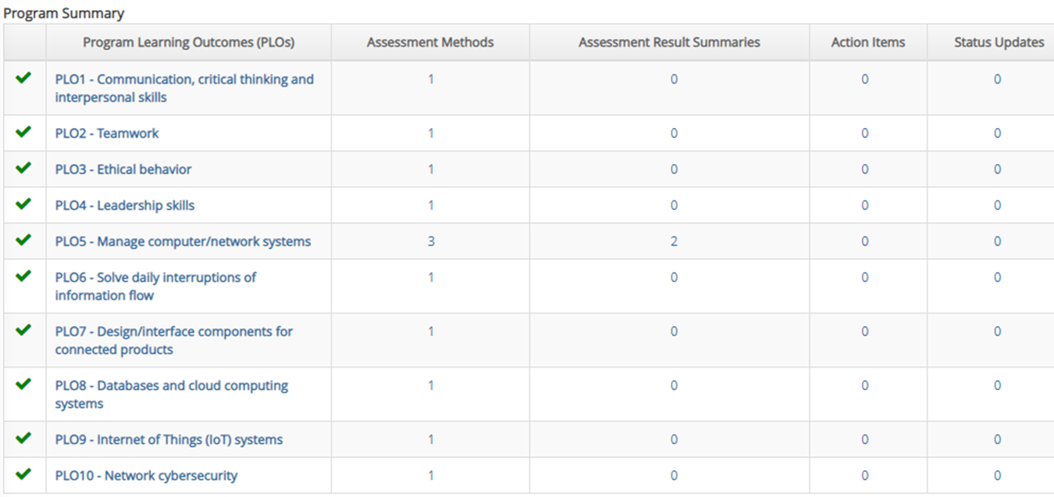

Slide 29
