Slide 1
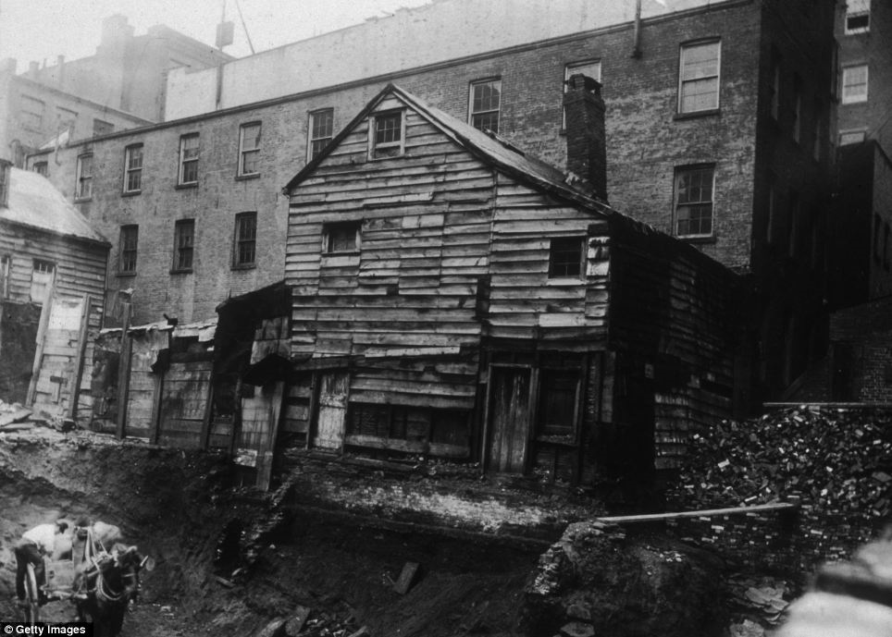
The Industrial City

Slide 2
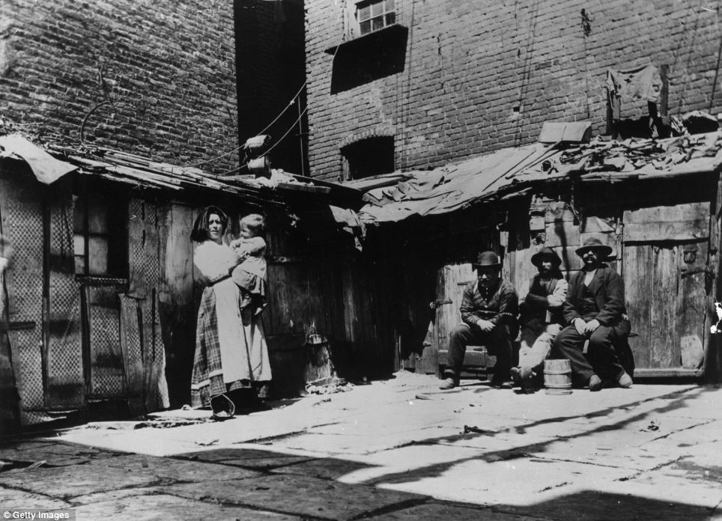
The Slums of New York, late 1800s

Slide 3
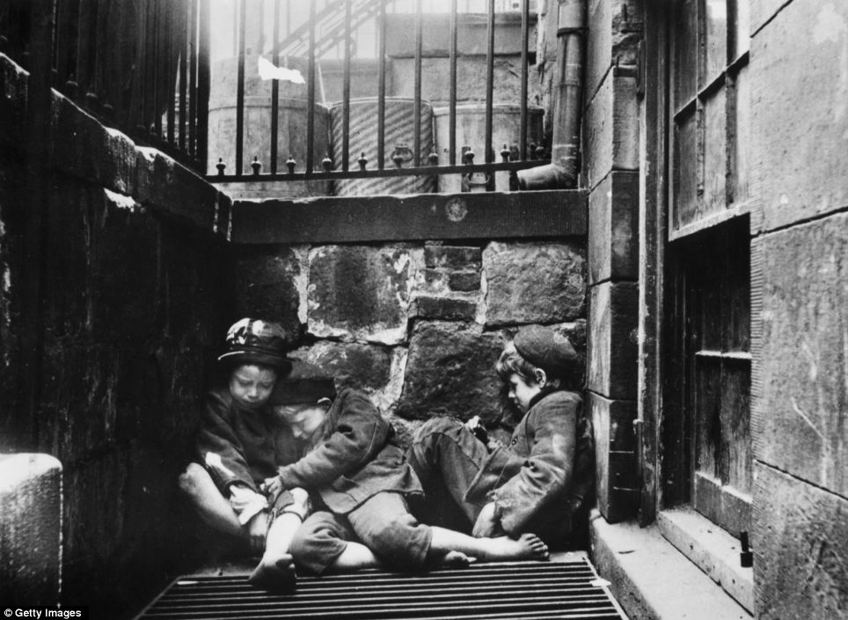
Three Orphaned Children, New York, late 1800s

Slide 4
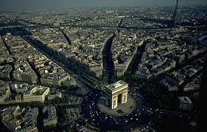
Framing the City
Haussman’s Paris, Arc de Triomphe

Slide 5
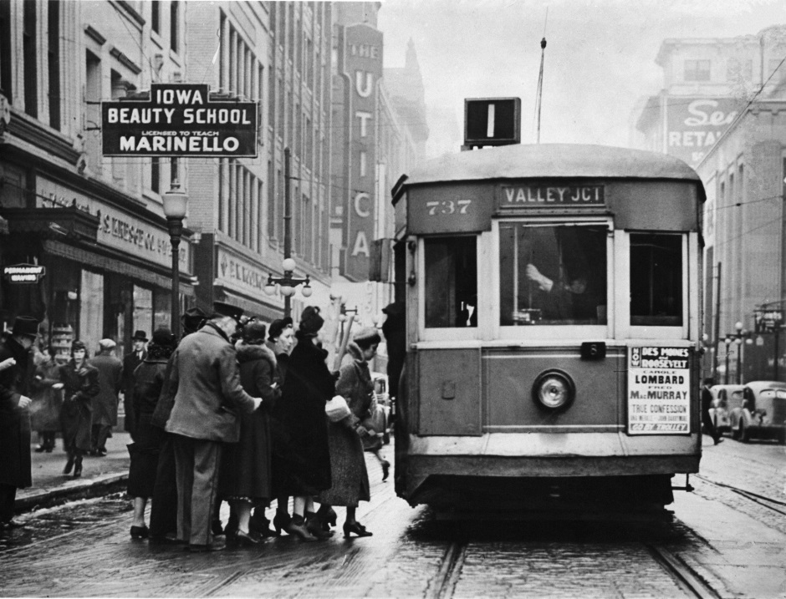
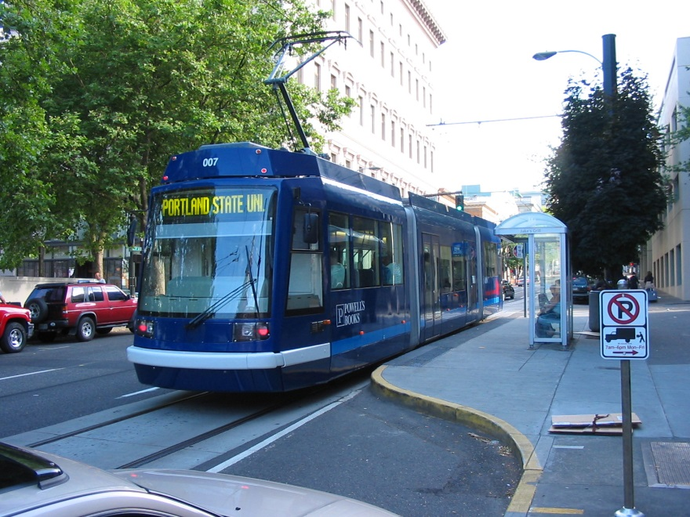
Streetcar Suburbs

Slide 6
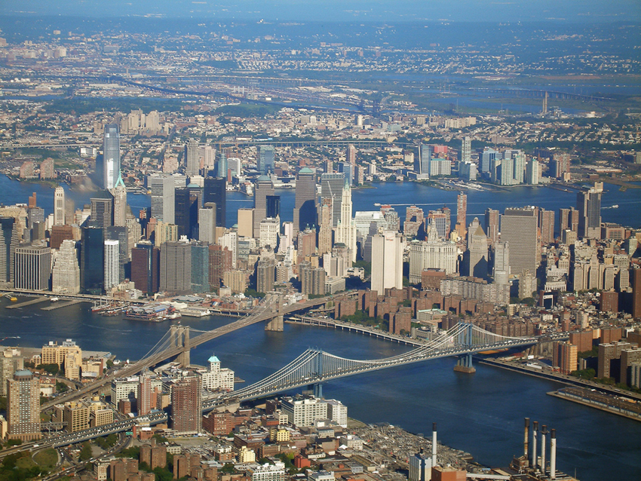
Central Business Districts
Urban structure in the industrial era established a physical template for the modern city
Three aspects of the character of urbanization emerged: the growth of Central Business Districts, location choice according to the principals of rent; and the emergence of patterns of residential segregation

Slide 7
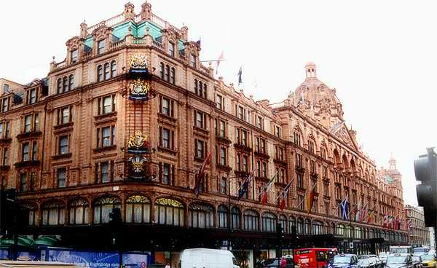
CBD and Shopping Districts
Central Business Districts – Sign of status based on size & degree of differentiation of CBD; its function set the framework of downtown development for next 75 years
Department Stores & Shopping Districts – Affordable streetcars and now rapid transit encouraged suburban housewives to come to central city. Had to be compact for easy walking (300 yards in radius)

Slide 8
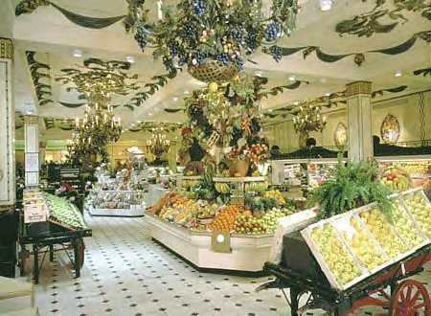
Food Court, Harrods, London, England

Slide 9
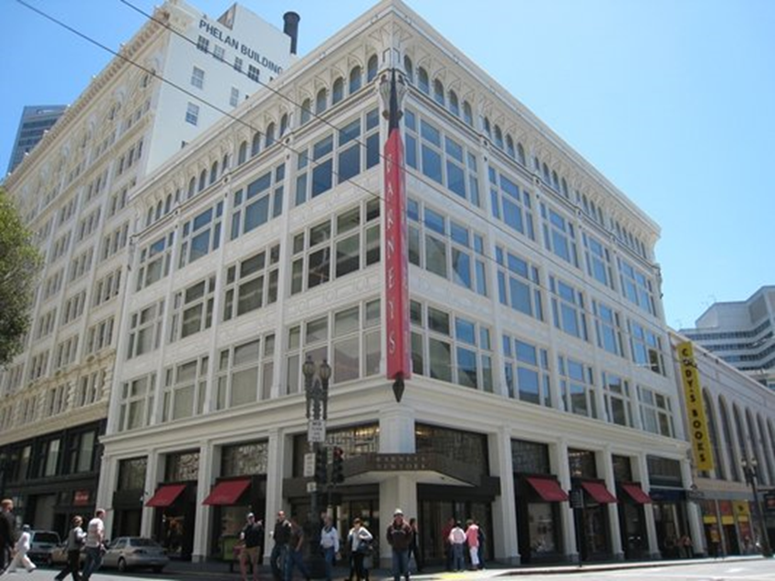

Elite Shopping Districts
Elite shopping is moved slightly away from major department stores (and the middle class)

Slide 10
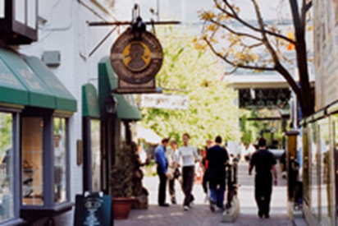
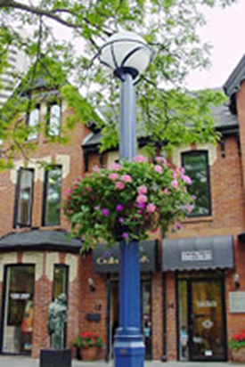

Yorkville Shopping District in Downtown Toronto, CANADA

Slide 11
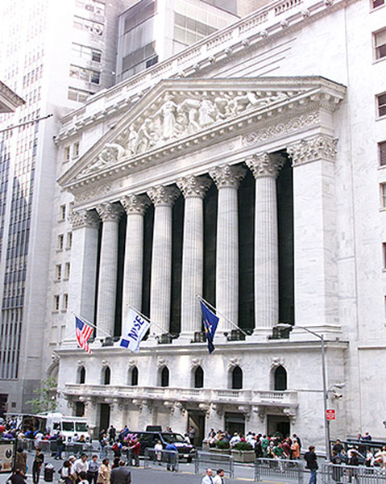
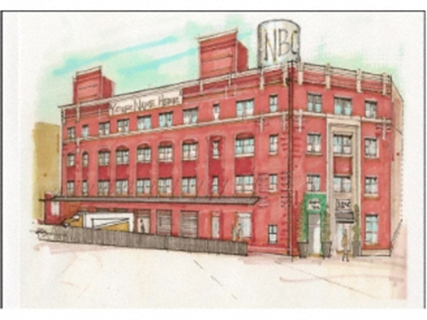
Central Business District
DT Office District – Also dependent on mass transit (workers & business visitors); usually houses insurance firms and publishing houses
Warehouse Zones – Increase in scale of city, plus access needs to smaller towns and shipping facilities. Located on the edge of a CBD next to freight yards

Slide 12
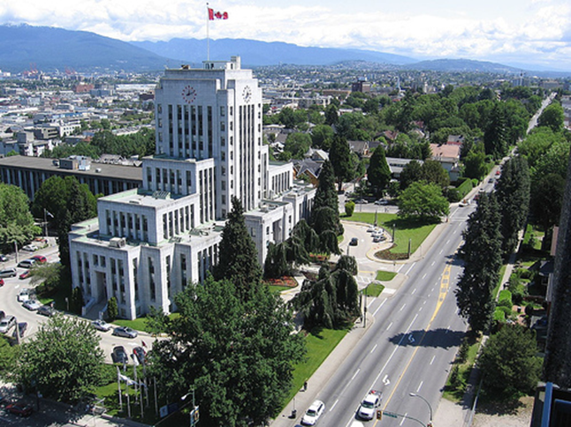
Central Business District
City Hall – Be in the hub of activity, but also for civic symbolism – created another distinct walking zone

Slide 13
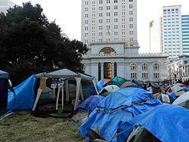
Occupy Oakland, (City Hall in background)

Slide 14
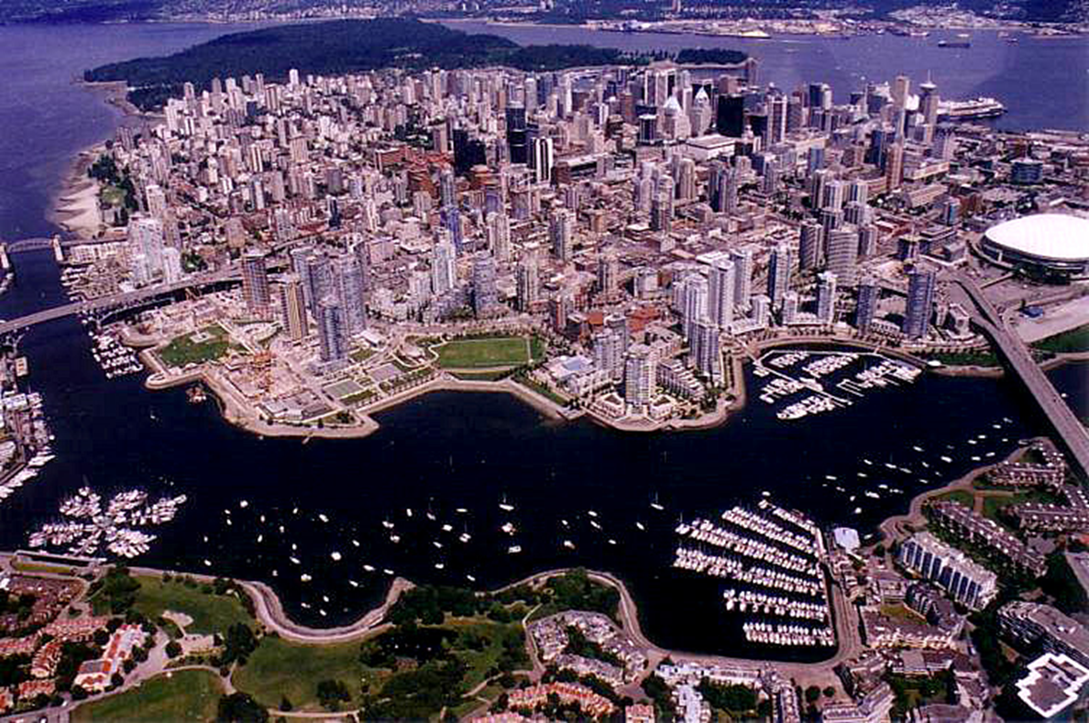
Spatial Organization of CBDs

Slide 15
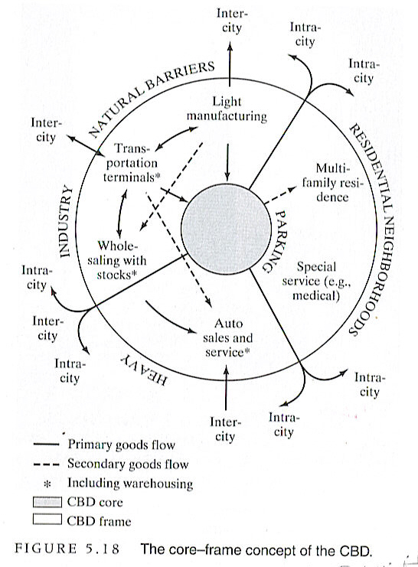
Core Frame Concept
CBDs – Have a high density Core
Of retail, offices & entertainment
“Framed” by lower density warehouses, hotels, medical facilities and so on.
Characterized by constant change.
-Zones of Assimilation – Core moves towards higher status newer elements in frame
Zones of Discard – Core moves away from older lower status elements

Slide 16
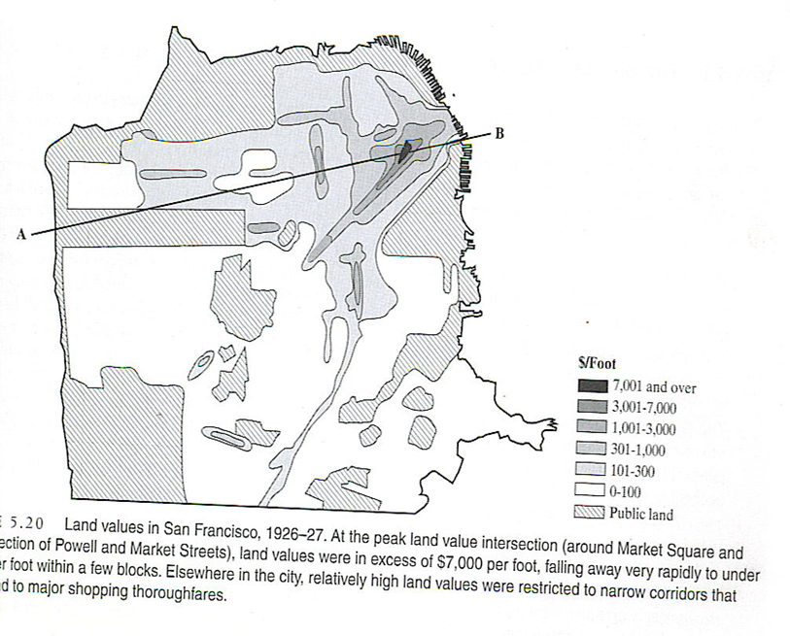
Land Value and Urban Land Use
The CBD points to the importance of accessibility and relative location in in land value and use.
Basically value depends on “nearness”
Notion of “Ground Rent” or location rent. Defined as the surplus rent paid to a land owner above the minimum amount that is needed to use the land at all. It reflects the overall utility of a particular site for a particular activity. Activities that can derive the greatest utility from a given site should outbid all other activities (Bid-Rent Theory of Urban Land Use)

Slide 17
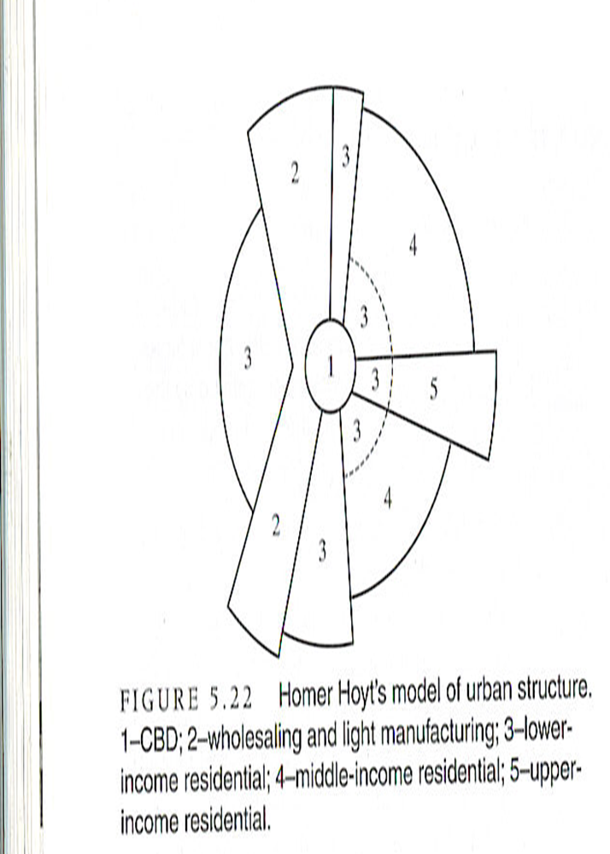
Sectors and Zones (Residential Segregation)
Land use in industrial cities did conform to some land use patterns.
Homer Hoyt looked @ rental values of 142 US cities from 1878 – 1928. Developed a Sector Model based on the following:
Rent (socio economic status) varied within cities by radial sectors (wedges)
Highest rents were found in a single sector that extended out from CBD
Middle income neighborhoods were commonly found on either side of high rent, high status sector

Slide 18
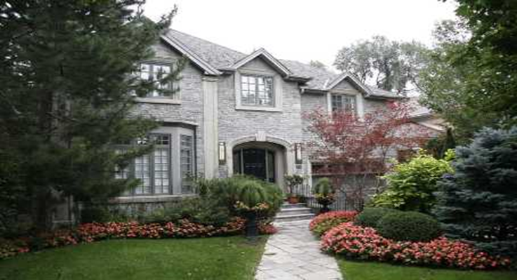
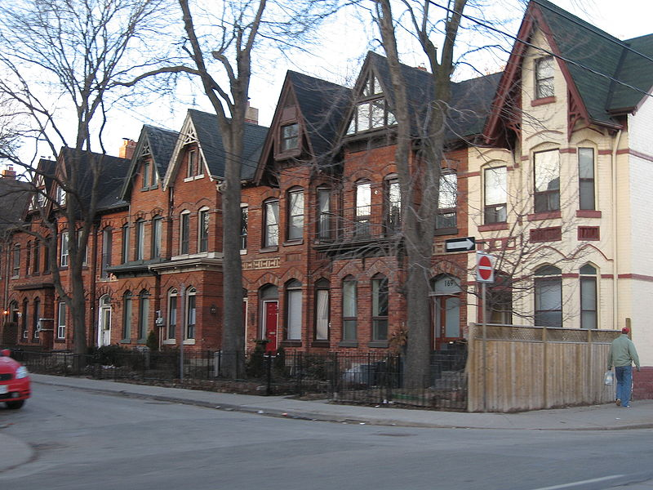
Sectors and Zones
Low rents, associated with working class and low-income housing were found the side of the city opposite the high-rent sector
High rent sector tended to:
Grow outward along major transportation routes
Extend along ridges of high ground (house on the hill)
Drawn towards house of community leaders

Slide 19
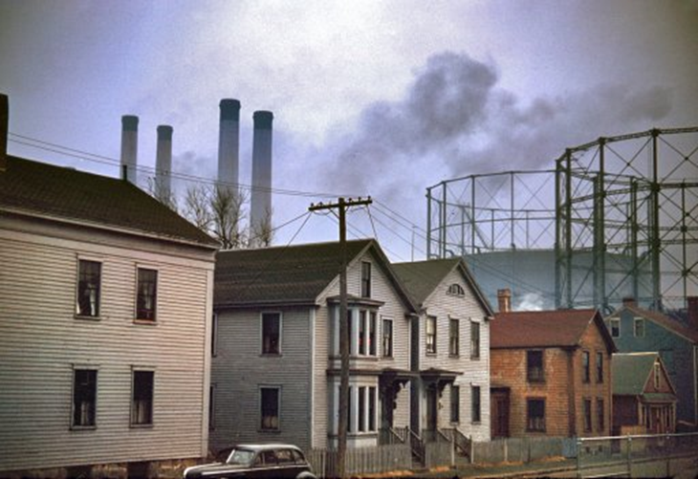
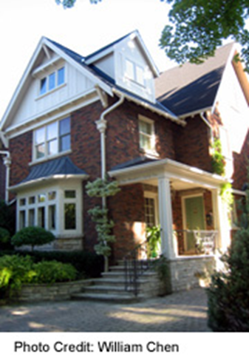
Sectors and Zones
Overall, the sector model places an importance on Relative Location of the different sectors:
Industry & warehouses will always be surrounded by the working class
Middle class will always be in between working class & elite
Elites will always have first pick of most desirable sites: Away from industry & masses, but close access to city and near country (“House in the Hamptons”)

Slide 20

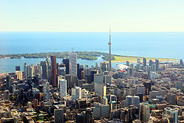
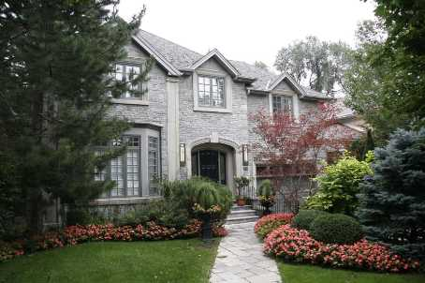

Images of Homer Hoyt’s Model

Slide 21
Early Fordism, the Auto, the Suburbs and the Great Depression (1920-1945)
Decline of small towns and communities dependent on coal and RR centers
Development of satellite cities and “bedroom communities” led to Regional Decentralization (signature process of US cities)
Rise of large companies through Horizon Economic Integration – cutting out similar smaller firms via price reduction
Vertical Economic Integration-Taking over companies that provide inputs/purchase outputs
Diagonal Economic Integration – Purchasing profitable companies that have activities unrelated to original firm.
Resulted in loss of local ties to companies situated in many cities
Rise of the internal combustion engine & Fordism post WW I – Great Change
Auto competes w/ transit
Continued mechanization of farm equipment
“Great Migration” of Americans of African heritage to northern cities 1916-1918

Slide 22
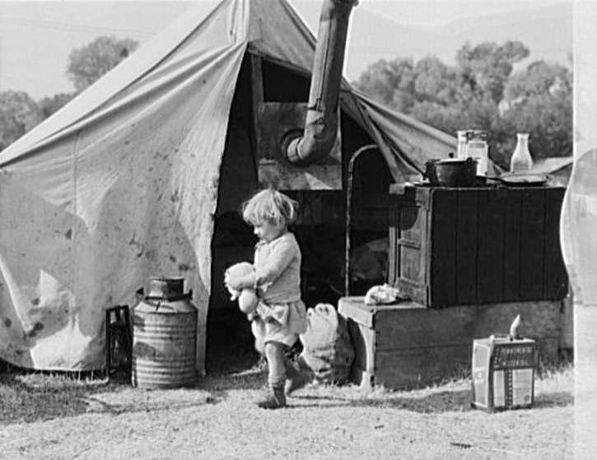
The Depression and Macroeconomic Management
Late 1920s, economy took a downward slide of the third Kondratiev cycle – October 1929 Stock Market Crash!
Followed Price Deflation (type B economic growth) “Roaring Twenties”
Resulted in Ag. Being a victim of its own success (Bushel of Wheat fell from $1.80 in 1920 to $.50 in 1930
Smoot-Hawley Tariff Act-led to recession of world wide trade
Industrial and financial markets were over-speculated
Led to unemployment rates rising from 3% in ’29 to 25% by 1933!

Slide 23
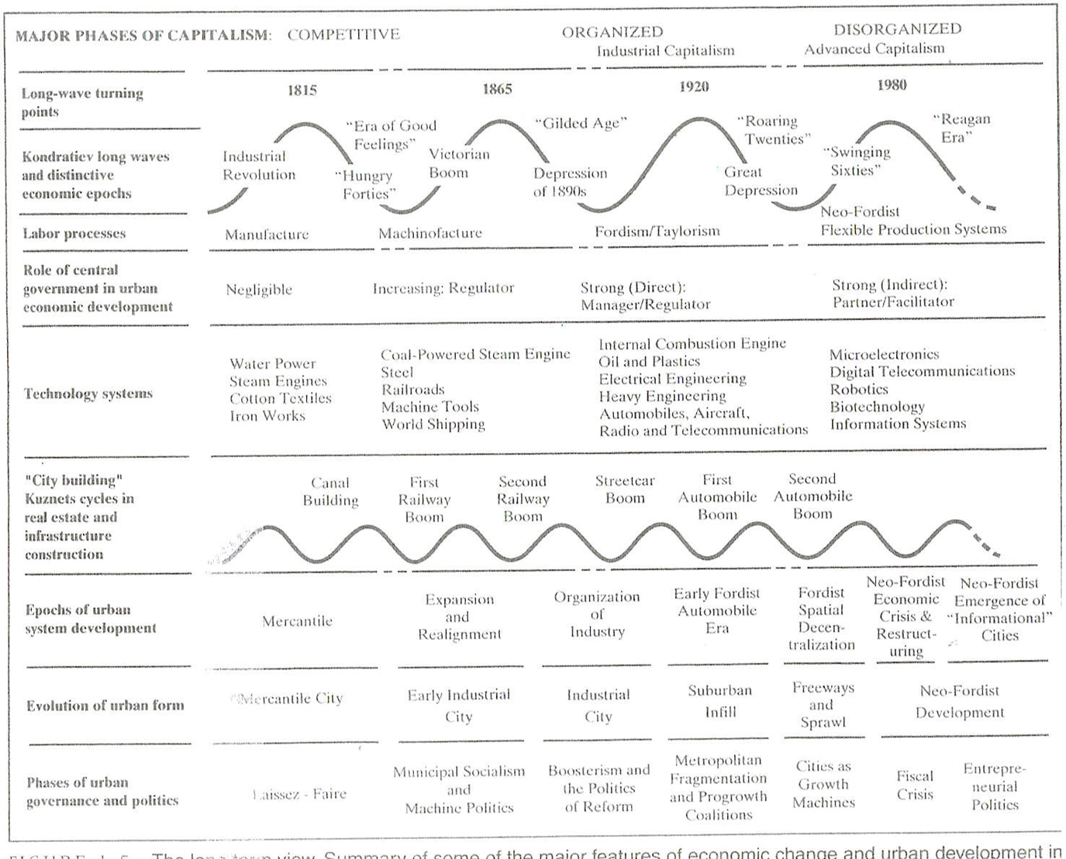

Slide 24
The Depression
Heavily industrial cities like Pittsburgh & Detroit were around 50%
Seattle and Philadelphia were more diversified-Unemployment between 20%-30%
Overaccumulation Crisis – Surplus labour, surplus production capacity, surplus capital or “underconsumption” insufficient demand in relation to capabilities of economic system
Circuits of Capital Investment into Secondary Circuits (machinery equipment & buildings) could not absorb surplus capital.

Slide 25
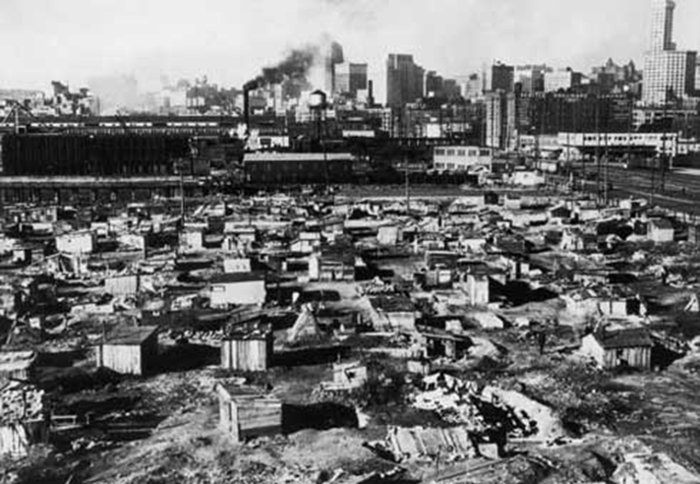
Slum on the edge of Pittsburg during the Great Depression

Slide 26
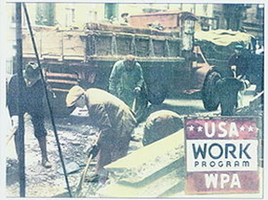
The Depression and Macroeconomic Management
The calamities of the Great Depression led to increased government intervention in the economy
Taxes were used to channel capital into Tertiary circuit (R&D, education, health, and welfare)-Maintain economies productivity and healthy workforce
Know as Keynesianism-Increased public expenditures used to stimulate demand, provide public employment – absorb surplus labor (Keynesian Suburbs)

Slide 27

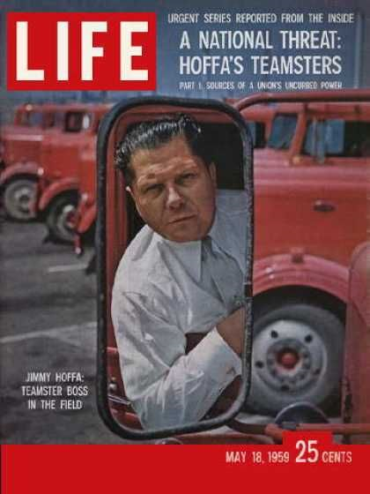
The Depression and Macroeconomic Management
Ideology of “Free Enterprise” or Competitive Capital was severely shaken
FDR was elected in 1932 on a platform of government intervention that provided relief, reform, and recovery.
Increased role of government had great effects on notions of urbanization and urban planning
Also gave rise to a pact between government, big business, and organized labor – Established the foundation of the era of Organized Capital

Slide 28
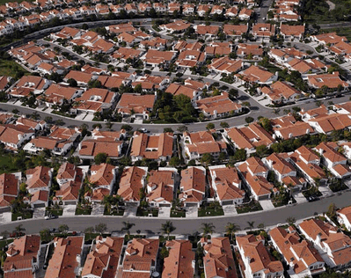
The Rise of Suburbia

Slide 29
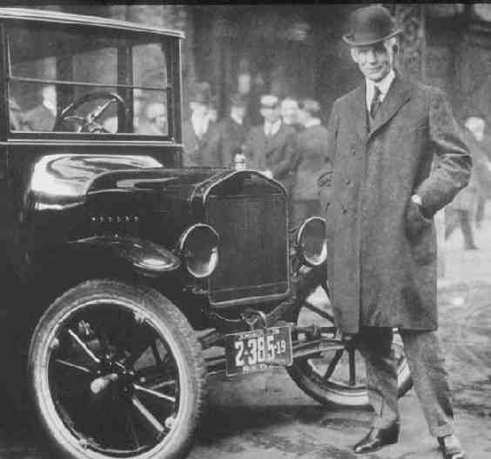
Fordism and the Auto

Slide 30
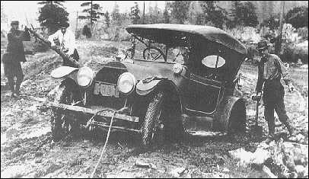
Paving the Way for Suburbanization
Federal Aid Roads Act of 1916 and rise of State Highway Departments
1930s Federal Fund were dedicated to road improvements within Cities

Slide 31
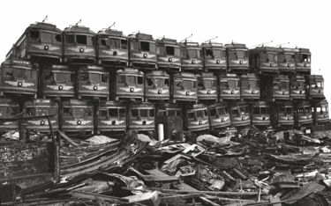
The Decline of Mass Transit
“Taken for a Ride” - The great American Streetcar Scandal

Slide 32
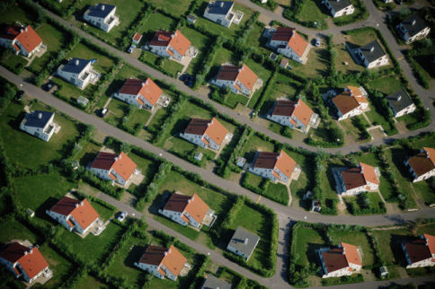
Auto Suburbia
Village of Euclid, Ohio v. Ambler Realty Co. 1926

Slide 33


Activities prohibited under Euclidean Zoning

Slide 34
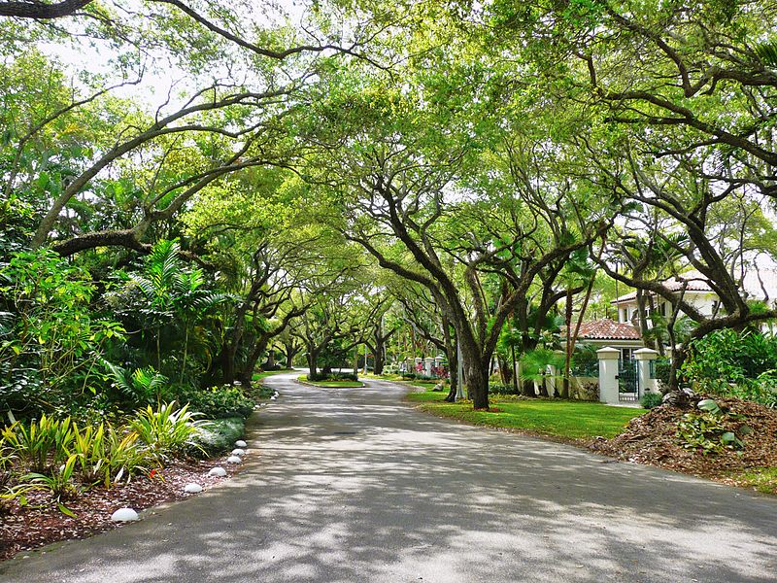
Planned Suburbs – Coral Gables, Florida

Slide 35
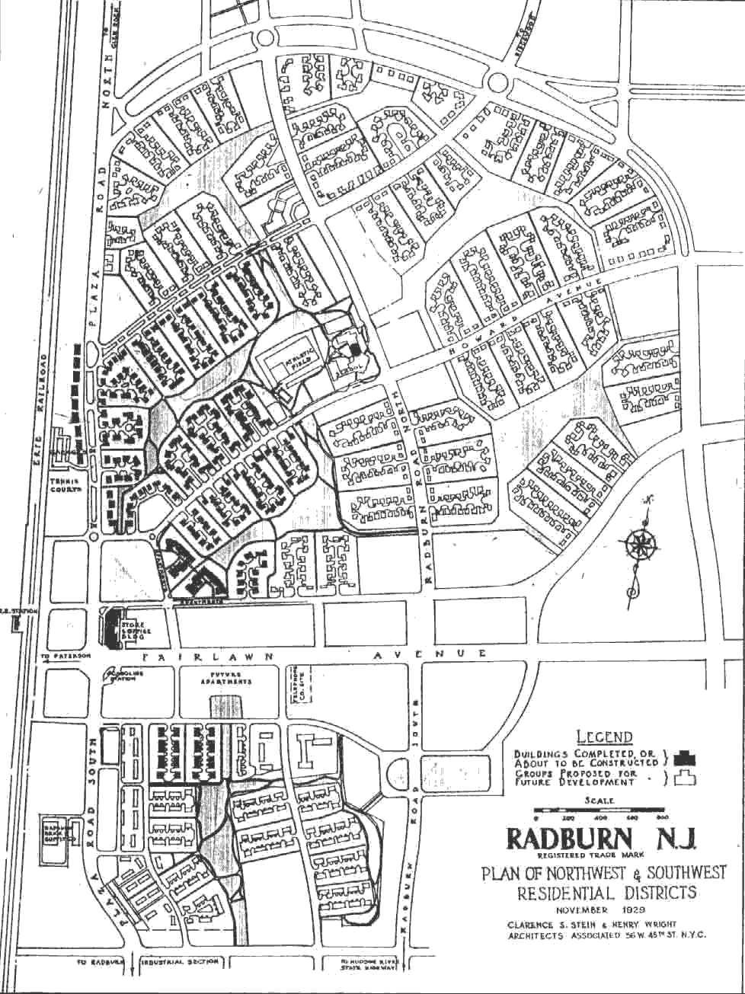
Radburn, New Jersey

Slide 36
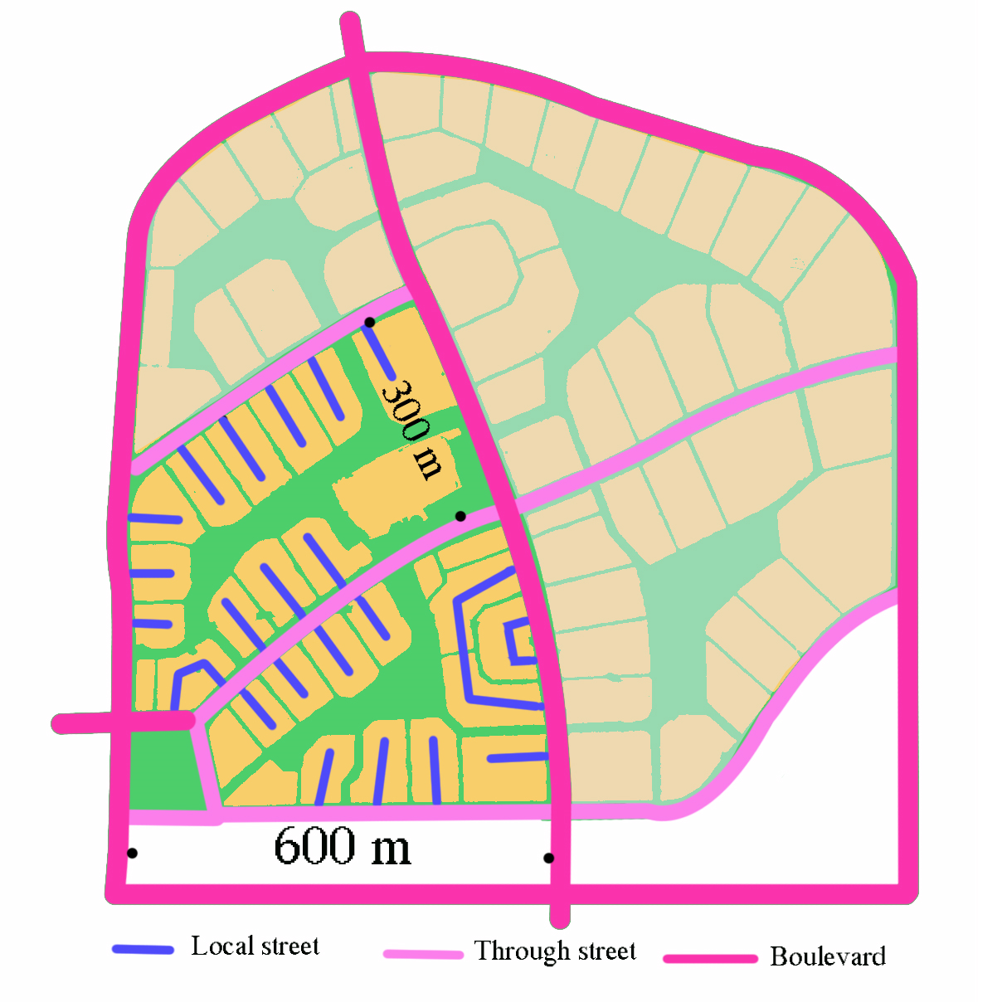
Radburn, New Jersey

Slide 37
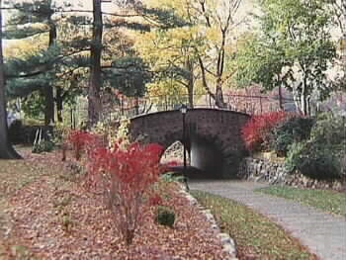
Radburn, New Jersey

Slide 38
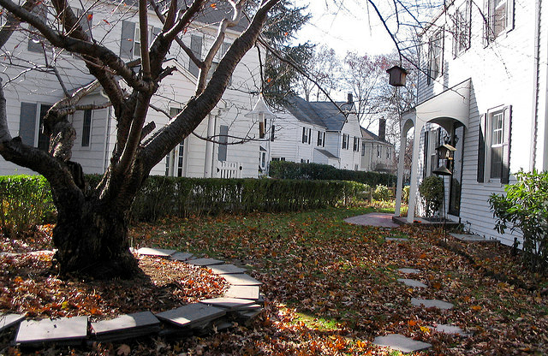
Radburn, New Jersey

Slide 39
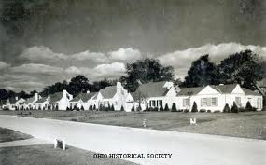
Suburbanization and Federal Policy

