Slide 1
EE130
Electromechanics
2013
J. Arthur Wagner, Ph.D.
Prof. Emeritus in EE
wagneretal@sbcglobal.net

Slide 2
Fig. 6.1 Electric Machine
Examples to the right?
Examples to the left?
Examples both ways?
Which way is the most common?

Slide 3
HEV PM motor
cylindrical in shape
shaft
mounting holes
cooling ports
electrical terminal box

Slide 4
Fig. 6.2 Motor Construction
Shaft
Cylindrical outside appearance
Cross section
Why do we need the air gap?

Slide 5
Fig. 6.3 Structure of Machines
Think of 3-phase
differently wound stator to create 4-poles
induction motor rotor (could be the same as the 2-pole)
salient (“sticking out”) poles plus windings on the salient pole rotor. 3-phase stator winding.
the stator has a winding producing a rotating flux
induction motor rotor

Slide 6
Homework Chapter 6: Due Tuesday, Sep. 24. No Classes next Tuesday and Thursday. These days will be made up TBD.
Problems 6.1, 6.2, 6.3, 6.4, 6.5

Slide 7
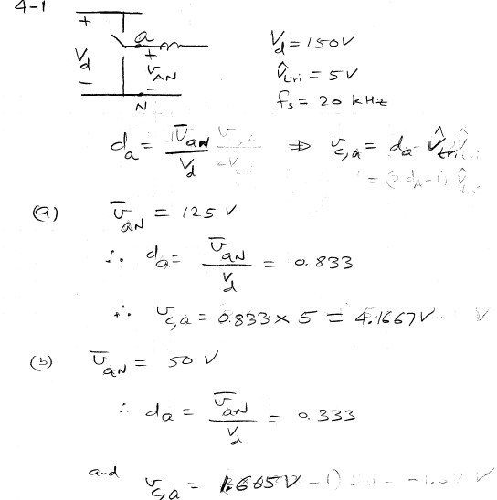
Hk 4.1

Slide 8
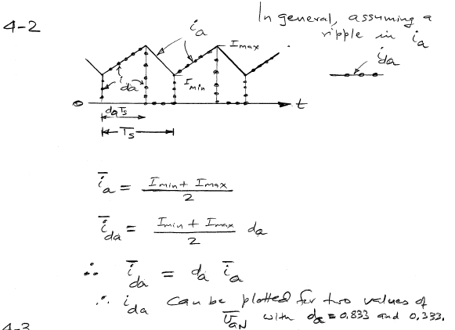
Hk. 4-2

Slide 9
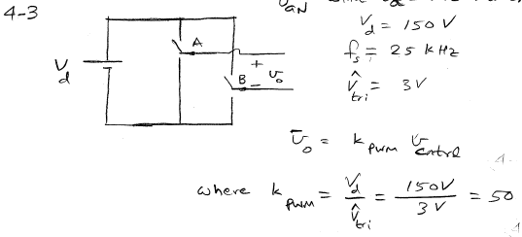
Hk. 4-3

Slide 10
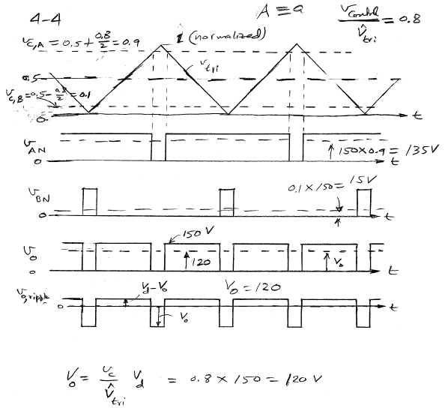
Hk. 4-4
Note vo = 150 within v,control

Slide 11
Fig. 6.4 Production of Magnetic Field
mmf = Ns is(t) set up by the stator --
right hand rule
flux lines --
current causes magnetic intensity --
H = 0 in Fe --
two air gaps in one flux path --
We end up with H, F and B in the air gap.

Slide 12
Questions
Explain how the magnetic axis is defined.
What are the three magnetic quantities in the air gap?

Slide 13
Fig. 6.4 cont Plot of air gap flux density
This is a “developed” form, that is unrolled, or spread out.
The air gap is between the solid line and the dashed line.

Slide 14
Fig. 6.5 Electric Force (Lawrence Force)
el * i cross B
right hand rule
force on the conductor

Slide 15
Question
What is the order of the cross product between
current and flux density to determine force
direction?

Slide 16
Fig. 6.7 Conductor Moving in a Magnetic Field
velocity cross flux density
u cross B

Slide 17
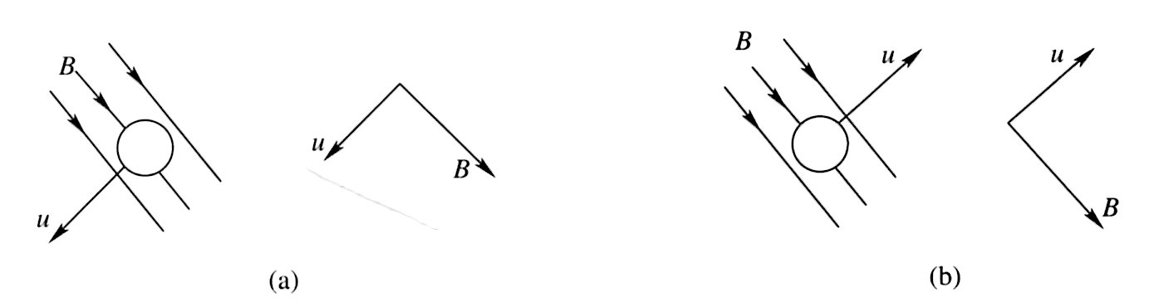
Fig. 6.8 Example 6.3
Determine the polarity of the induced emf.
Top side or bottom side?

Slide 18
Fig. 6.9 Motoring Mode
The stator sets up B. An external source sets up ir. Ignore resistance.
Determine the polarity of the torque Tem as a function of delta.
Determine the polarity of the bemf er as a function of delta.

Slide 19
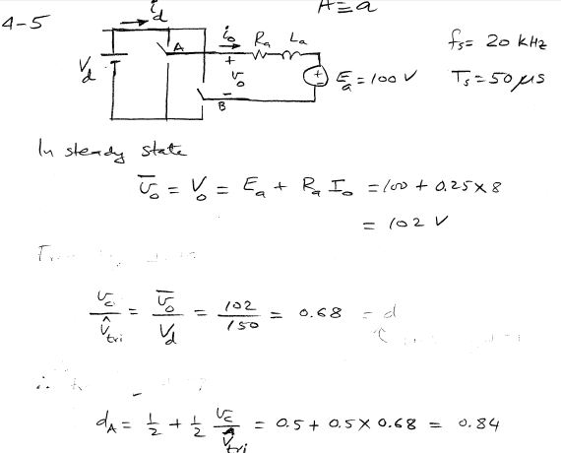
Hk. 4-5
Vd = 150
Check the sum and the difference.

Slide 20
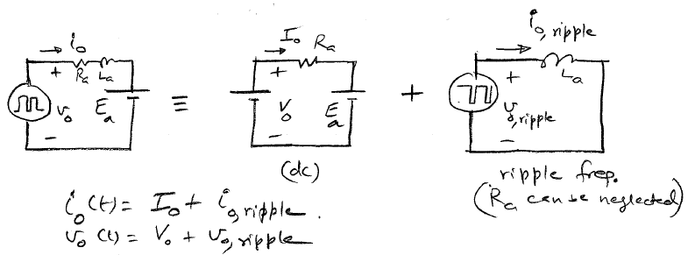
4.5

Slide 21
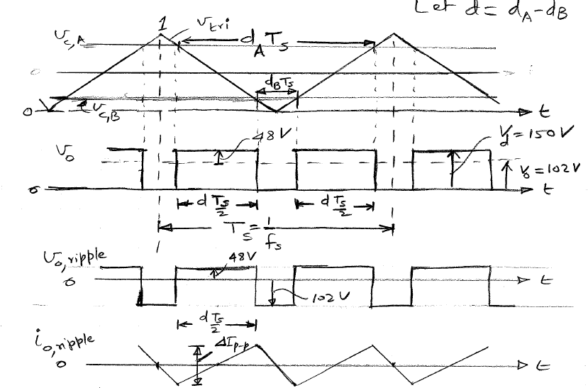
Hk. 4.5

Slide 22
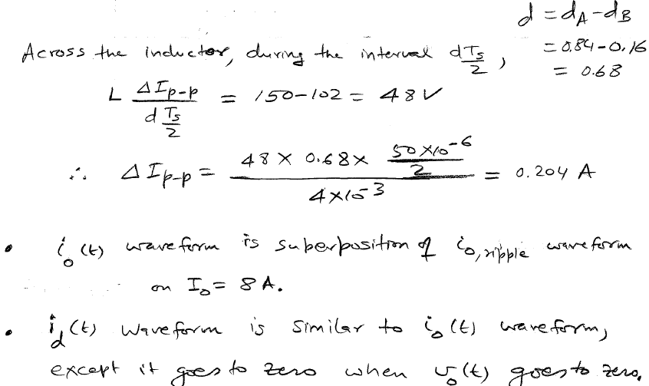
Hk. 4.5

Slide 23
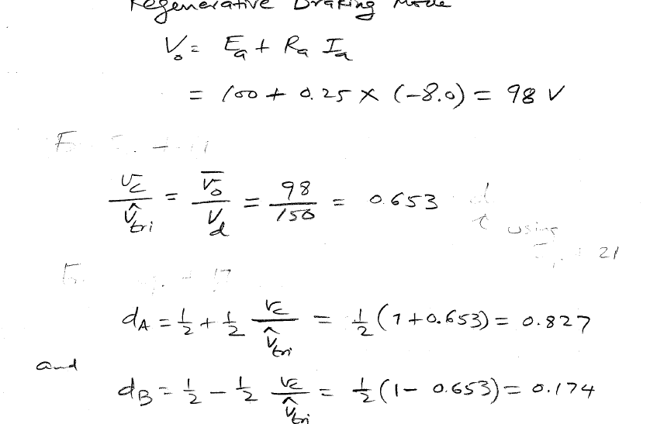
Hk. 4-6

Slide 24
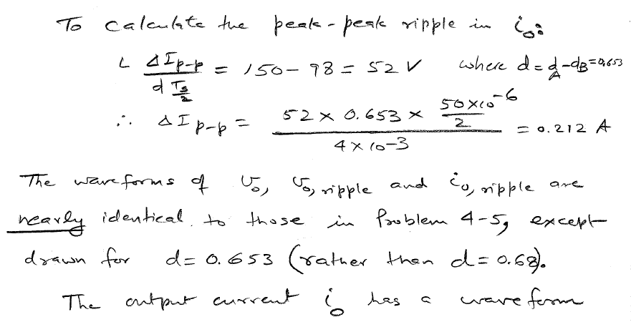
Hk. 4-6

Slide 25
Hk. 4-6

Slide 26
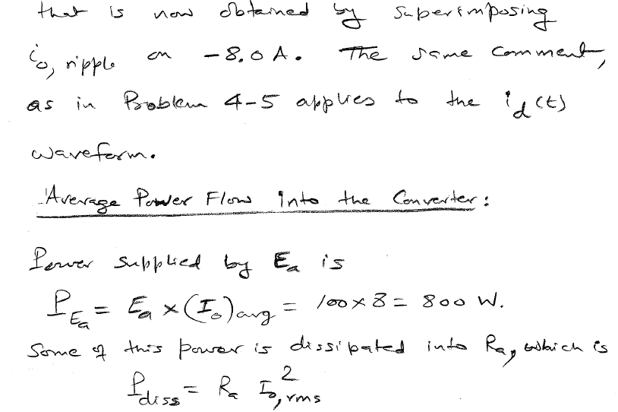
Hk. 4-6

Slide 27
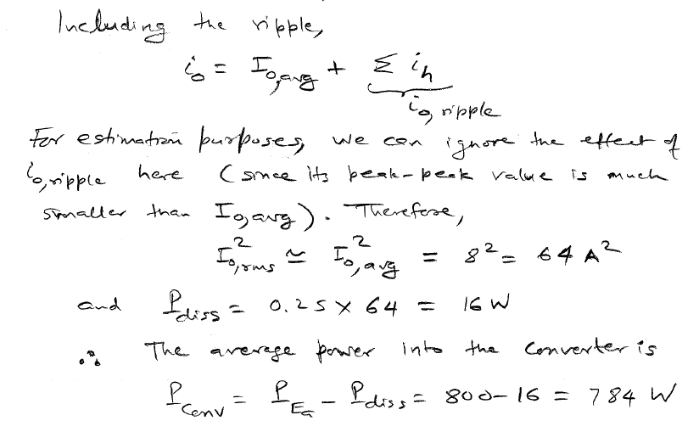
Hk. 4-6

Slide 28
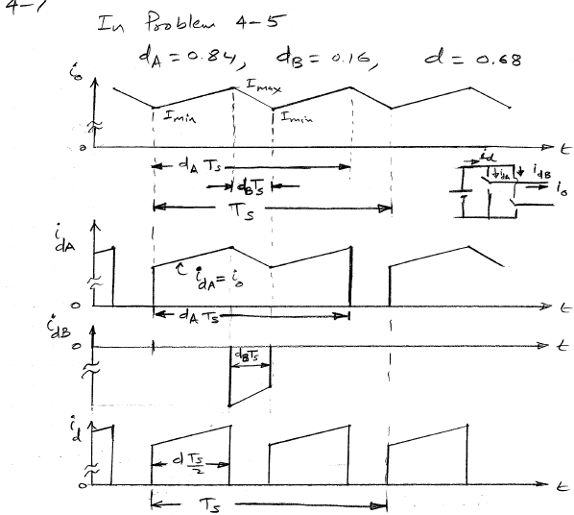
Hk 4-7

Slide 29
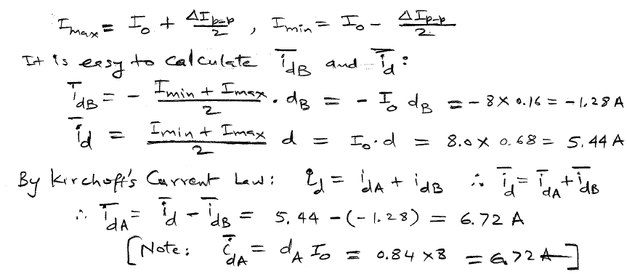
4.7

Slide 30
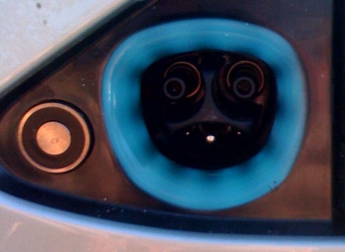
Tesla Connector
Connectors are always a headache. Why?
Note cuts in surface of dc bus pins
Battery, or dc bus pins
equipment ground, sticks out the farthest
sensor pins
Latch

Slide 31
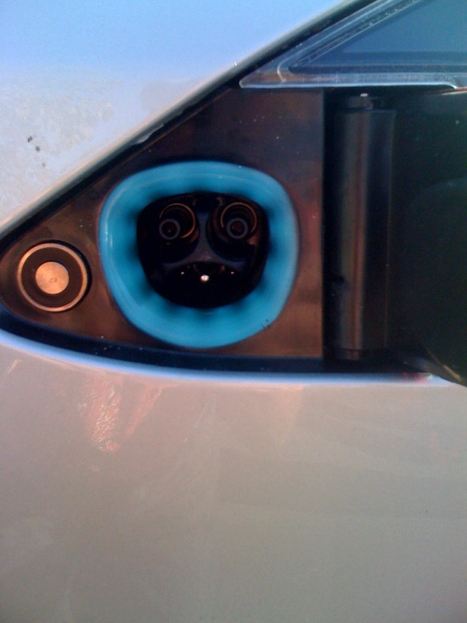
Tesla connector Shows spring-loaded door hinge and holding latch

