Slide 1
EE130
Electromechanics
2013
J. Arthur Wagner, Ph.D.
Prof. Emeritus in EE
wagneretal@sbcglobal.net

Slide 2
Fig. 5.1 Magnetic field: Ampere’s Law
Right hand rule
Ampere’s Law
Magnetic intensity H is a line density of magnetic field “caused” by current.

Slide 3
Question
State Ampere’s Law
What “causes” magnetic intensity?

Slide 4
Magnetic Flux Density
Magnetic Flux is an amount of magnetic field, webers [Wb].
Magnetic Flux density is an area density of magnetic flux.
Something like pressure, which is an area density of force.

Slide 5
Question
What is the difference between magnetic flux and magnetic flux density?

Slide 6
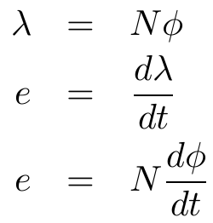
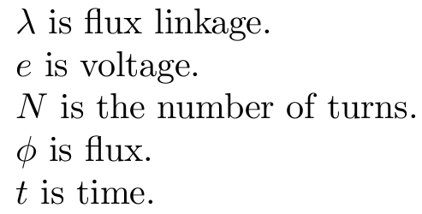
Faraday’s Law
Flux is “caused” by voltage,
or voltage is “caused” by change of flux.

Slide 7
Fig. 5.8 Signs for Faraday’s Law
right hand rule for current and flux.
Load designation,
i.e. the current goes in where the voltage e is positive.

Slide 8
Homework Chapter 5, Due Tuesday, Sep. 24. No Classes next Tuesday and Thursday. These days will be made up TBD.
Problems 5.1, 5.2, 5.3, 5.4, 5.9
Read Chapter 5 (even though we don’t show all of it in class)

Slide 9
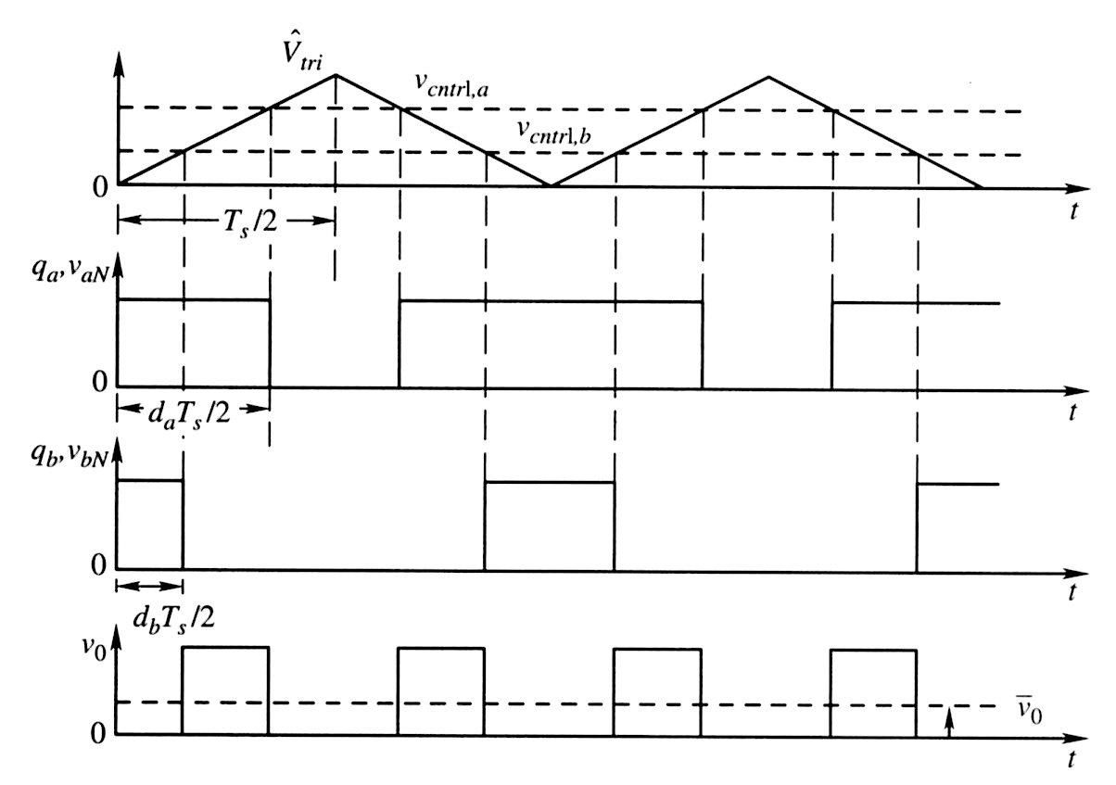
Fig. 4.14 Switching voltage waveforms
Check qa, vaN, qb, vbN during Ts/2.
Discuss how vo is formed from vaN and vbN. What is the ON time for vo?
Compare the first harmonic of vo with the first harmonic of vaN.

Slide 10
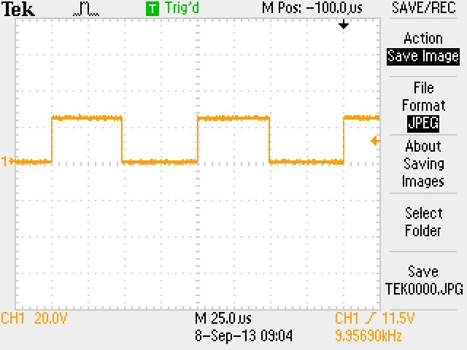
Voltage vaN
Pk-Pk =
duty cycle =
period =
freq =

Slide 11
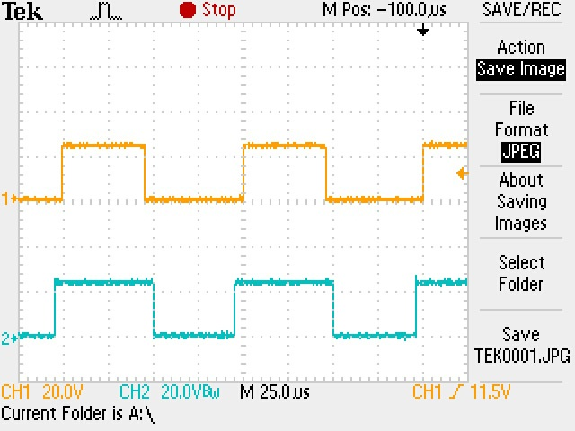
Voltages vaN and vbN
Pk-Pk =
duty cycle =
period =
freq =

Slide 12
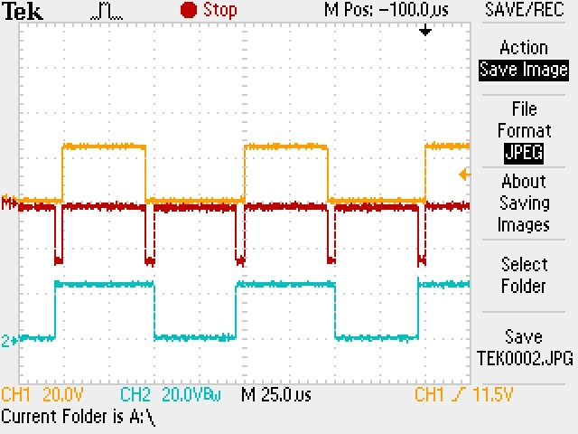
vaN, vbN, and vo = vaN - vbN
Pk-Pk =
duty cycle =
period =
freq =

Slide 13
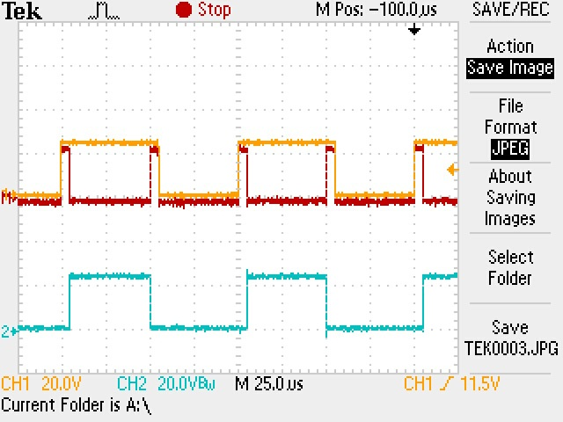
vaN, vbN, and vo = vaN - vbN
sign of vo bar =
direction of current io =

Slide 14
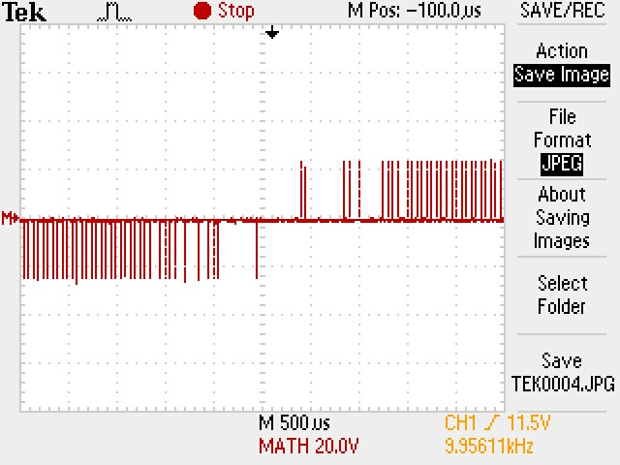
vo
Pulses are missing due to the display sample rate.
What is happening to the current io bar?

Slide 15
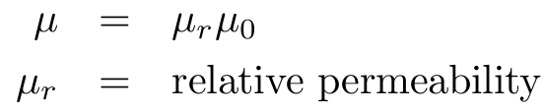
Permeability, relative permeability, and permeability of air
Flux density is linear with magnetic intensity in air, and
most other materials that we see around us.
Permeability is the proportionality constant.
The exception are materials with iron, Fe, cobalt, Co, nickel, Ni, and molybdenum (not so important).

Slide 16
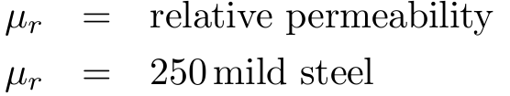
Relative Permeability
When people say, “permeability”, they usually mean “relative permeability”.

Slide 17
Question
Calculate the permeability when the relative
permeability is 250.

Slide 18
Fig. 5.3 B-H characteristics
We have said, “Current causes magnetic intensity and voltage causes flux”. What ties these magnetic terms together? Answer: the material.
No magnetic material is linear, only approximately. A B-H hysteresis loop is always present. Think of Hm as “exciting” the material below.

Slide 19


Fig. 5.4 Toroid with flux
How can we state the flux density in terms of

Slide 20
Fig. 5.5 Magnetic Structure with Air Gap
All motors have an air gap. Why?
current
flux
magnetic material
air gap length

