Slide 1
Observation and
Qualitative Fieldwork
ScWk 242 – Session 5 Slides

Slide 2
Summary Guidelines for Qualitative Fieldwork
Design fieldwork to be clear about your role as observer (degree of participation); the tension between insider (emic) and outsider (etic) perspectives; degree and nature of collaboration with co- researchers; disclosure and explanation of the observer’s role to others; duration of observations (short vs. long); and focus of observation (narrow vs. broad).
Field notes are descriptive, thick, deep and rich descriptions.
Stay open. Gather a variety of information from different perspectives. Be opportunistic, follow leads and sampling purposefully to deepen understanding. Allow the design to emerge flexibly as new understandings open up new paths of inquiry.
Cross validate/ triangulate: observations, interviews, documents, artifacts, recordings and photographs. Use multiple & mixed methods.

Slide 3
Additional Observation Guidelines
Use participant quotations and own words to capture views and experiences.
Select key informants wisely and use them carefully. Use wisdom of drawn perspectives, but realize that their perspective is selective (like everyone else).
Be aware of the different stages of fieldwork
  Build trust; since you are being evaluated as well
  Attend to relationships throughout fieldwork e.g. hosts, sponsors, co researchers, participants in collaborative and participatory research
  Stay alert and disciplined during the more routine, middle phase of fieldwork.
  Focus on pulling together a useful synthesis as fieldwork draws to a close. Move from generating possibilities to verifying emergent patterns and confirming themes.
  Be disciplined and conscientious in taking detailed field notes at all stages of fieldwork.
  In evaluations and action research, provide formative feedback as part of the verification process of fieldworks. Time that feedback carefully. Observe its impact.

Slide 4
More Observation Guidelines
Be as involved as possible in experiencing the setting as fully and as appropriate and manageable while maintaining an analytical perspective grounded in the purpose of the fieldwork.
Separate description from interpretation and judgment.
Be reflective and reflexive. Include in your field notes and reports and your own experiences, thoughts, and feelings. Consider and report how your observations may have affected the observed as well as how you may have been affected by what and how you’ve participated and observed. Ponder and report the origins and implications of your own perspective.

Slide 5
Taking Field Notes
Go with the flow
  Does not need to be cohesive – can move around some.
  Reminders to yourself about what you saw, felt, observed, and interpreted for your self.
  Leave space of additions/corrections to all observations
Protect Identities/Confidentiality
  Use pseudonyms from the beginning
  Change identifying details but not substance (e.g. do not change race, but change number of children or siblings, do not change setting such as home, but change objects or types of furniture in the home that are not character relevant.

Slide 6
Taking Field Notes
Use yourself as a filter to describe your reactions to a situation and a means to describe the difference in the reactions of others
  Example: You observe a car accident in the course of studying an urban community. I am horrified and taken by surprise. I am caught between thought and action, call the police, call an ambulance; you observe a man in his mid 30’s pull over and get out his cell phone while walking toward the overturned vehicle.
  Challenge your own perception with the perspective of others
Notes can be written in the field or sometime soon after the observation period
  No hard fast rules about when the notes should to be written.
  Reread your notes a few days later and make or notes any corrections, impressions or interpretations

Slide 7
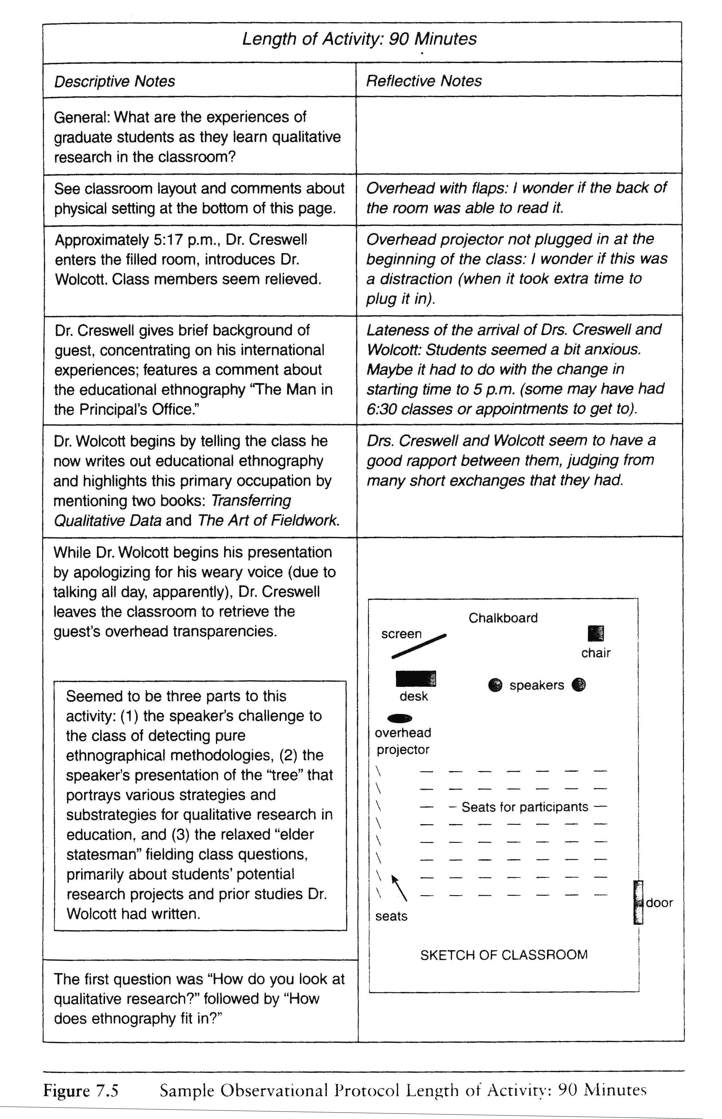
Taking Field Notes – Example
Observation Protocol Example (Creswell, 2007, p. 137)

Slide 8
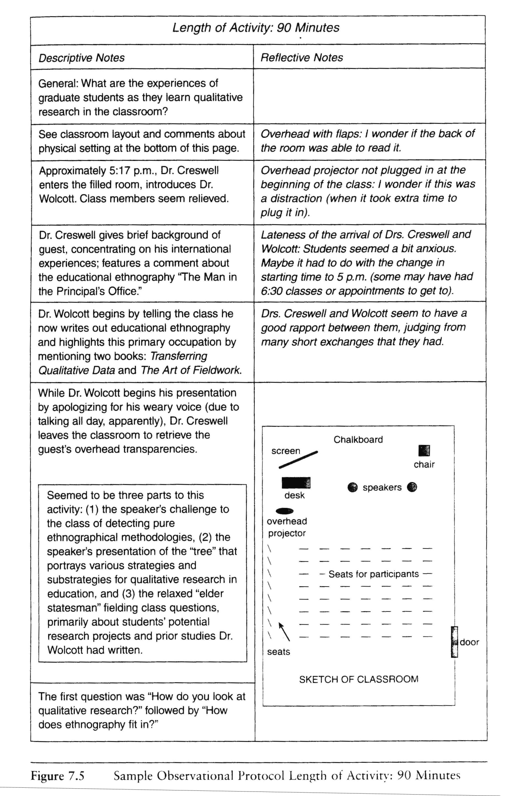
Taking Field Notes - Example
Observation Protocol Example (Creswell, 2007, p. 137)

Slide 9
Content Analysis
What is a content analysis?
  Standardized means of analyzing text/field notes/minutes/documents
  Software programs
  Most frequently used analysis
  Quantifies qualitative data
  Objectifies qualitative data
  Advantages
      Unobtrusive measure
      Inexpensive
      Analyze past occurrences/history/personal letters/diaries
  Disadvantages
      Questionable validity
      Only permanent records/recorded data/secondary source analysis

Slide 10
Content Analysis (Continued)
Purpose of Content Analysis
  Make inferences to the source of communications
    Understand the motives, values or intensions of those who wrote them
    Understand the symbolic meaning/communication
Diaries/personal documents
  Letters to the editor
Inferences to populations
  Used to ascribe the values of the audiences intended for the communication to reach (the demographic)
  Movie content
Evaluate the effects of communications
  Treatment effectiveness
  Notes, video of behavior/interactions (reduction in behavior based upon certain types of responses by therapist to client
Structured observations
  Use with other data collection methods
  Content analysis of observational data can specify what is observed and what measurements are to be used10

Slide 11
Process of Content Analysis
  Systematic:
    Follow the same procedures to examine each occurrence
    Reliable, can be replicated by someone else
Objective:
  Ensure validity and avoid bias
  Rules to count an observation must be impartial
  Define the criteria to be applied
  Make explicit the rules to be applied to control for any special interest or ideology that might impact analysis

Slide 12
Steps in Content Analysis
Develop the research question
    Establish what you want to study
    Ask the appropriate questions
Select a sample
  What is the sampling strategy?
    What is the available universe?
    How best to represent the population?
    Which has the best content?
    What is the best cohort?

Slide 13
Units of Analysis
Select the Unit of Analysis
  Specify what you will count:
    Words, phrases, or concepts
    Establish complex categorical systems
      Coding rules (pictures of minorities)
      Procedures
Coding, Tallying and Data Analysis
  Coding is dependent upon the unit of analysis
  Gender: 2 categories, (e.g.., male = 1 female = 2)
    Grade Level Completed: (e.g., up to 20)
  Construct a tally sheet

Slide 14
Latent vs. Manifest Content
Latent vs. Manifest Content
  Latent content is an indicator of the underlying meaning of what is communicated.
  Manifest content is specific, objective and easy to record.
  Developments during the review of manifest content
    recurring themes
    keep reviewing the content
    look for similarities
    look for what makes this consistent
Have another rater use same criteria for coding the manifest content to establish inter-rater reliability
Report the results

Slide 15
Qualitative Analysis Lab # 3: Observations
The class will review the the five brief video clips listed on the next page in class. These provide a variety of perspectives on observational research and examples of settings and situations. The class will watch the videos using observational data collection procedures, and will have a brief discussion after each clip going over the items listed below.
The first video is a quick summary about observational research. The other four clips involve specific observational examples. For each of these, students should take field notes that include your observations (descriptive notes), and your reactions or interpretations of those observations (reflective notes). In your field notes, describe and reflect on the following components (as applicable):
Physical setting
Activities that are occurring
Social interactions (verbal) between individuals
Non-verbal communication
Behaviors
Things you might have expected to see—but didn’t

Slide 16
Observational Videos to be Viewed in Class
Video Clip 1: Understanding Observational Research – Dr. Nancy Dreyer – 1.40 minutes
http://www.youtube.com/watch?v=O6xgINQ0bUw
Video Clip 2: Pregnancy Assessment and Observation Unit and Birth Suites
– Mater Health Services in South Brisbane, Australia – 5.01 minutes
http://www.youtube.com/watch?v=QffU0A0m4m8
Video Clip 3: Homeless Veteran Demands Housing at Giant VA Campus – 1.45 minutes
http://www.youtube.com/watch?v=Y0Q54E--9ss
Video Clip 4: Ethnography for design: Handicapped aboard plane in China – 9.33 minutes
http://www.youtube.com/watch?v=QzNLdN44r7Y&feature=related
Video Clip 5: Some American families and the way they eat – Lincoln, Nebraska – 5.38 minutes
http://www.youtube.com/watch?v=GMdwGxreYcM&context=C31f8039ADOEgsToPDskKD-P0sDJR29mcunGFmJR2z

