Slide 1


Moog-Animatics Class 4 SmartMotor Laboratory for SJSU ME 190 Mechatronics Course Project
San Jose State University
Department of Mechanical Engineering
ME 190 – Fall 2014
Dr. Burford Furman
Josh Cobain
Ryan Reardon
December 8, 2014

Slide 2

Presentation Agenda
Project Purpose
Introduction to the SmartMotor
Equipment Used for the Labs
All About Day One – Intro Lab
All About Day Two – Advanced Controls Lab
What We Learned
Moving Forward
Acknowledgement
Questions / Comments

Slide 3
Project Purpose
Introduce ME students to the Moog-Animatics SmartMotor (SM)
Educate ME students on the benefits of using a SM
Give ME students hands-on experience with SM
  Basic functionality
  Programming
  PID controls and tuning
Create an on-going relationship with Moog-Animatics

Slide 4
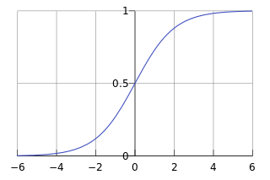
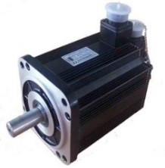
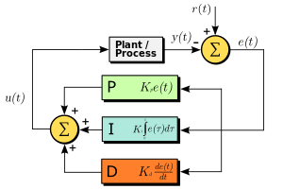
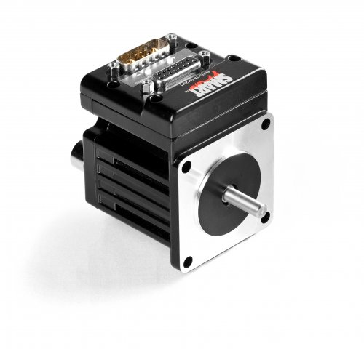
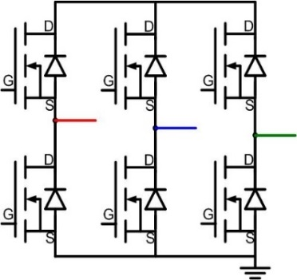
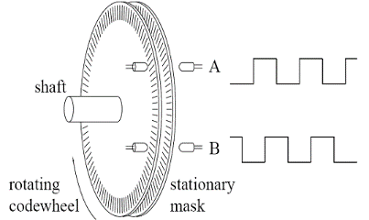
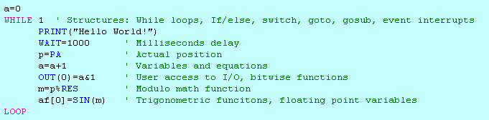
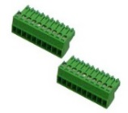
The Moog-Animatics SmartMotor
Position
trajectory
generation
Digital
Communications
Brushless motor
PID
Encoder
Program execution in motor
3-phase drive
I/O
Moog-Animatics SmartMotor = Integrated servo system with advance motion control capabilities

Slide 5
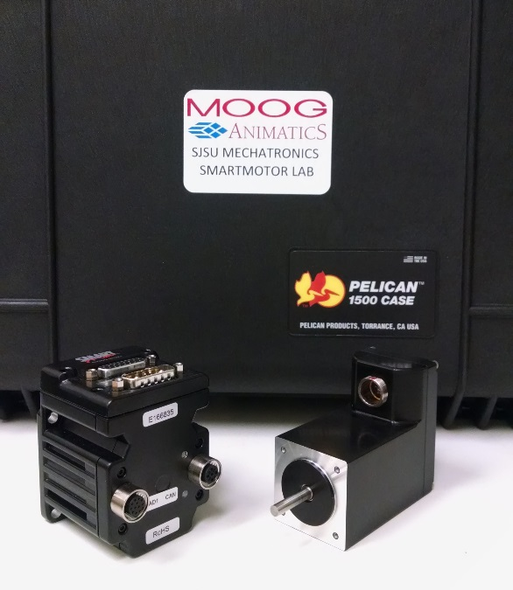
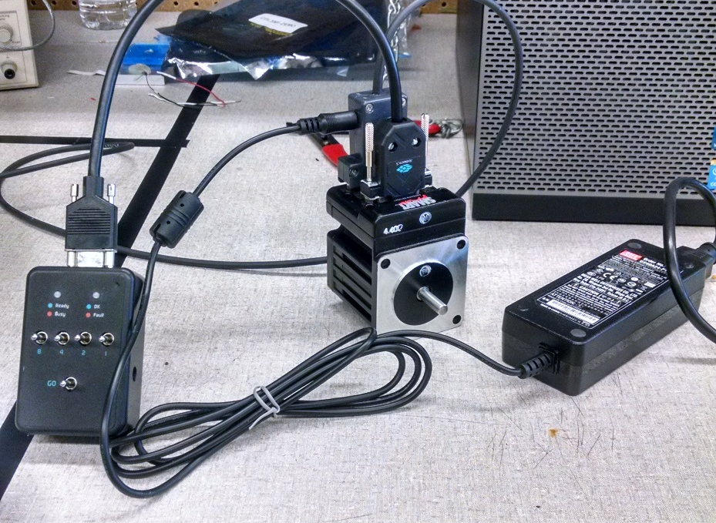
Equipment Used for the Labs
All equipment donated by Moog-Animatics
Moog-Animatics SM2315D SmartMotor
24V Power Supply
RS-232 Communication cable with USB adapter
BCD SmartBox for interaction with I/O
Pulleys (for use in a mass & pulley system)

Slide 6
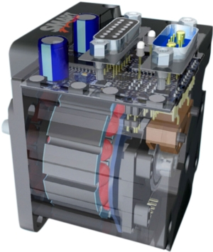
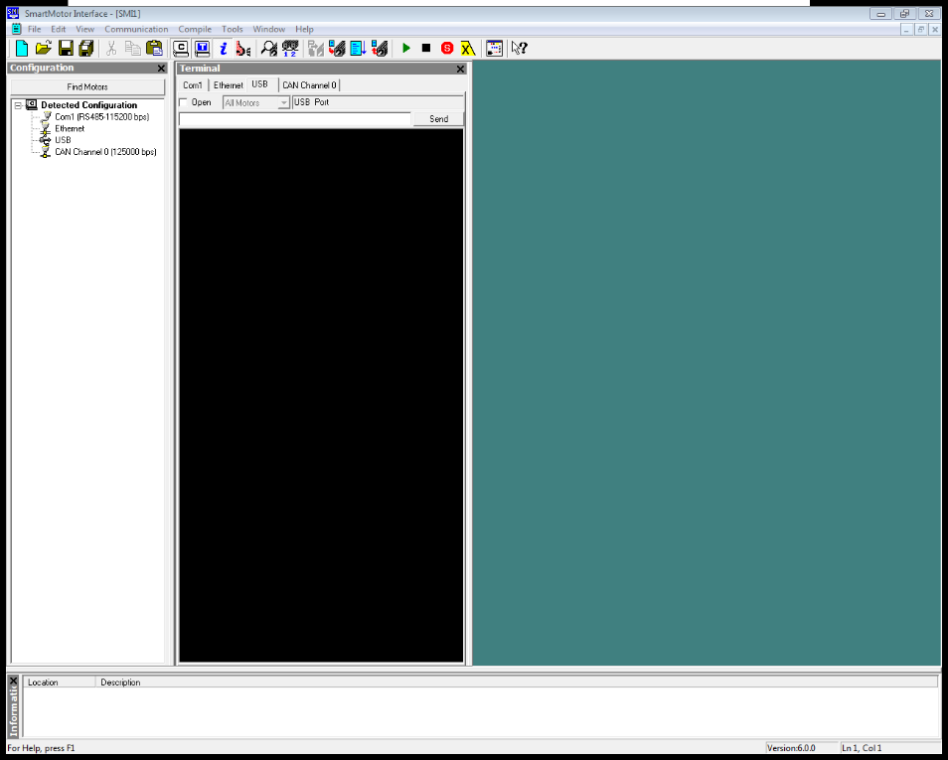
Day One Lab - Introduction
Students are introduced to the SM and SMI software
Basic communication and interaction with the SM
Basic programming and accessing of SM I/O using BCD SmartBox

Slide 7
Day Two Lab – Advanced Controls
Students use the SmartMotor’s onboard PID controller
P, I, and D gains are changed to simulate a P, PI, and PID controller
The response of the system is observed based on controller type
Students apply control systems knowledge to create their own PID controller as a motor program

Slide 8
What Was Learned
Great learning experience working with Moog-Animatics to create a lab exercise for University students
The benefits and advancements of SmartMotors for motion control applications
Scripted PID controller programming and tuning

Slide 9
Moving Forward
Implement in ME 190 Lab lesson plan for 2015
Pilot testing of the lab with a graduate-level class in beginning of 2015
Possible additions to the lab:
  Coordinated Motion between 2+ SmartMotors
  Communication between a third-party MCU or PSoC using serial communication protocols
  SmartMotor Sizing based on application requirements and desired motion profiles

Slide 10
Acknowledgements
Special Thanks to:
  Dr. Burford Furman
    San Jose State University; Department of Mechanical Engineering
  Dave Pap Rocki & Doug Parentice
    Moog-Animatics
    www.animatics.com

Slide 11
Questions / Comments
Thank you for your time and attention!
Any questions or comments?
For more information on the Moog-Animatics SmartMotor product line, visit:
www.animatics.com
View our project video at:
http://youtu.be/o5zpyyb6gjM

