Slide 1
Serial Communication
BJ Furman
ME 106 Fundamentals of Mechatronics
15NOV2012

Slide 2
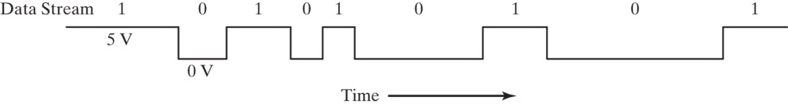
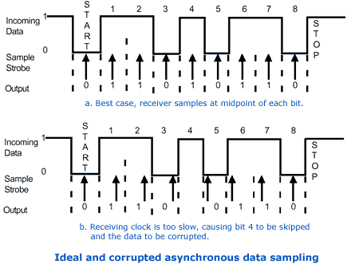
Bit serial communication concepts
Serial → one bit at a time
Most often using logic level signals
Timing information needs to be shared between sender and receiver
  Transitions between bits, duration of a bit
Introduction to Mechatronics, Figure 7.2 p. 107.
Two major types of bit serial protocols
  Synchronous (shared clock)
    Ex. SPI, I²C
  Asynchronous (no shared clock)
    Sender and receiver maintain independent clocks
      Ex. RS-232, USB
http://www.quatech.com/support/figures/async1.gif

Slide 3
Synchronous serial communication
Characteristics of synchronous serial
  At least one connection for serial data
  A clock connection
  Shared ground
Common types
  Serial Peripheral Interface (SPI, developed by Freescale)
  Inter-Integrated Circuit bus (I²C, developed by Philips (NXT))
Arduino support
  I²C and SPI
    See next slide

Slide 4
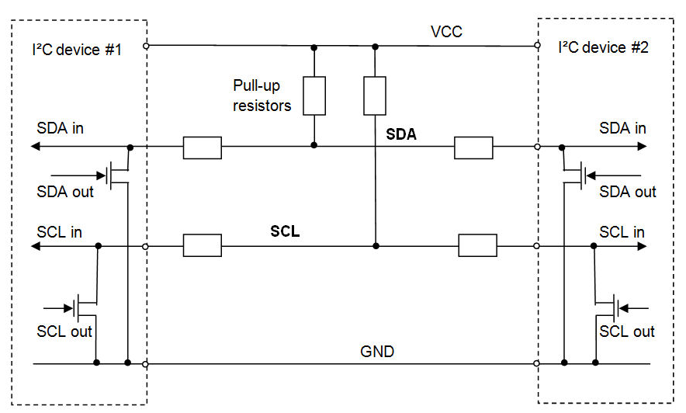
I²C
Developed in 1982 by Philips (now NXP)
  To connect CPU to peripherals in televisions
Two signal lines, both are ‘open drain’, thus pull-up resistors are needed
  SDA (serial data)
  SCL (serial clock)
Devices are either masters or slaves
  Master is the device that always drives SCL and initiates a transfer
Each device has an address
Data is sent in 8 bit bytes
http://www.byteparadigm.com/kb/article/AA-00255/22/Introduction-to-SPI-and-IC-protocols.html
Use 1.2k - 2.2k pull up resistors for Vcc = 3.3 V
or 1.8 - 3.3k resistors for Vcc = 5 V

Slide 5
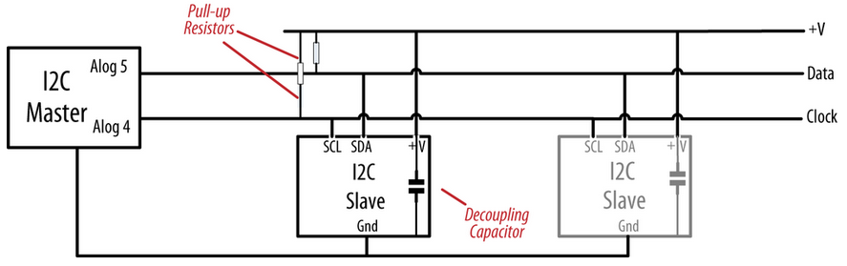
Analog pins 4 (SCL) and 5 (SDA) must be pulled up, and a common ground is needed
Margolis, M. (2012). Arduino Cookbook, O’Reilly Media, Inc., Sebastopol, CA, p. 422.

Slide 6
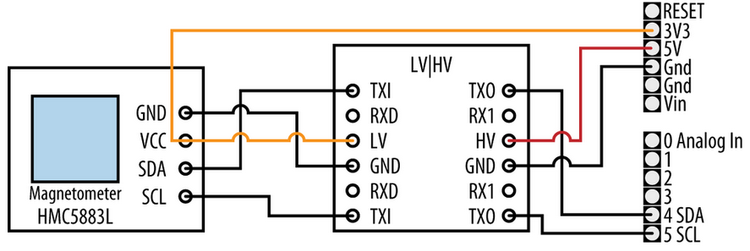
You may need to shift the voltage level from 5 V (Arduino) to 3.3 V for some sensors
Margolis, M. (2012). Arduino Cookbook, O’Reilly Media, Inc., Sebastopol, CA, p. 423.

Slide 7
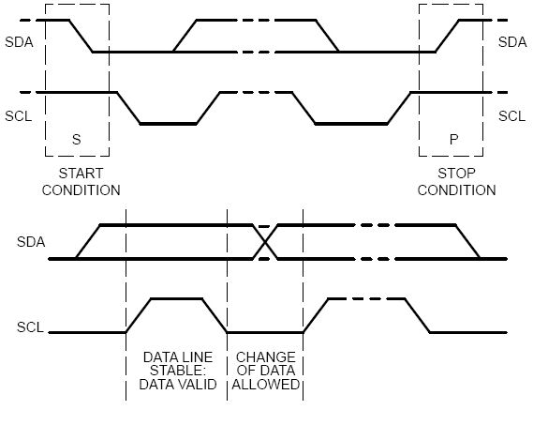

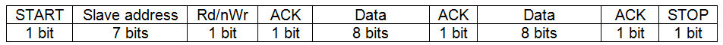
I²C protocol
Master initiates transfer with a START bit (SDA from high to low while SCL is high
Slave address (7 or 10 bits, 7 is most common)
Transfer type (1 bit: 0 to write, 1 to read)
  All ICs compare address to their address
    If address matches, device sends an ACKNOWLEDGE signal
    If address does not match, device waits until bus is released by
    STOP condition
Once master receives ACKNOWLEDGE,
it then sends (writes) or receives (reads) data
  Receiver sends back ACKNOWLEDGE for each byte
  received
Master concludes the transfer with STOP bit
General structure of a 2-byte transfer
http://www.robot-electronics.co.uk/acatalog/I2C_Tutorial.html
Writing 2-bytes (shaded bits are put on the bus by the master)
Reading 2-bytes (shaded bits are put on the bus by the master)
http://www.byteparadigm.com/kb/article/AA-00255/22/Introduction-to-SPI-and-IC-protocols.html

Slide 8
Many digital components use I2C
See the list from:
http://forums.parallax.com/showthread.php?99160-List-of-I2C-devices

Slide 9
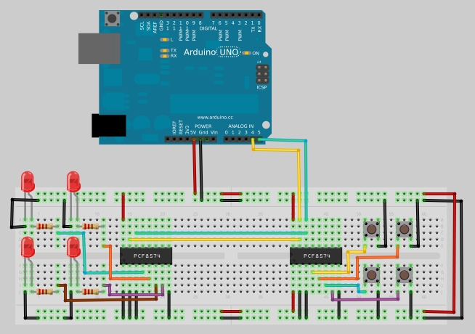
The Arduino can be ‘expanded’ using an I2C port expander device (pcf8574)
http://garagelab.com/profiles/blogs/tutorial-arduino-i-o-port-expander-with-pcf8574

Slide 10
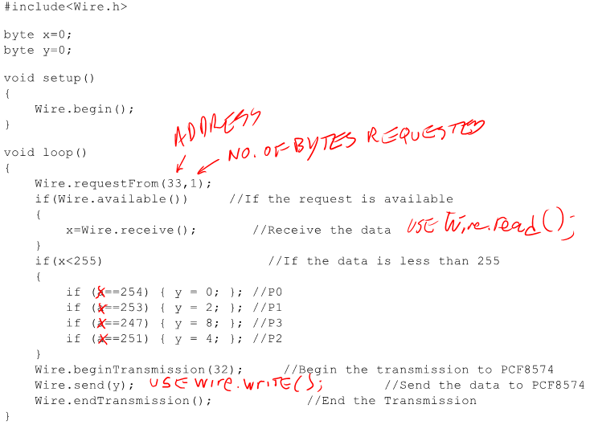
The Arduino can be ‘expanded’ using an I2C port expander device (pcf8574)
http://garagelab.com/profiles/blogs/tutorial-arduino-i-o-port-expander-with-pcf8574

Slide 11
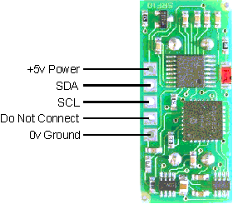
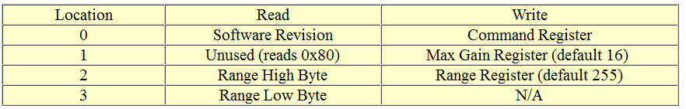
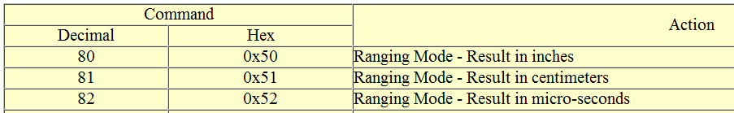
I²C device – SRF10 Ultrasonic Range Finder
Devantech SRF10
  3 cm – 6 m range
  20 Hz max rep rate
  Range results in in., cm., or μs (time of flight)
  Always a slave (default address is 0xE0)
  Four registers:
http://www.robot-electronics.co.uk/htm/srf10tech.htm
  Three commands:

Slide 12
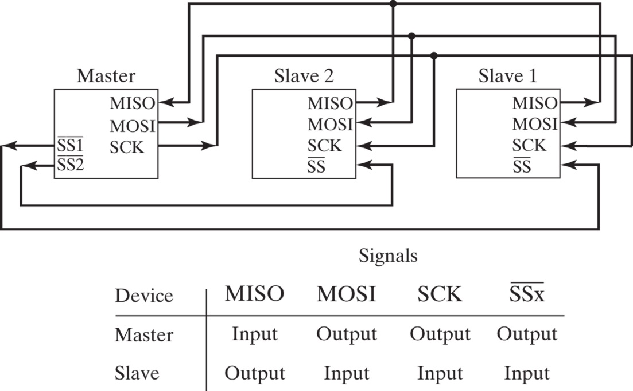
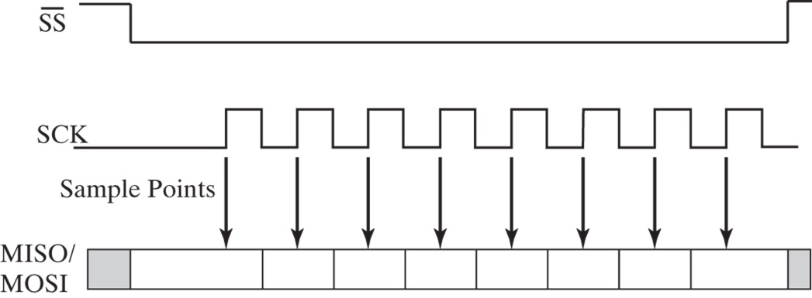
SPI interface and protocol
At least one ‘master’ and ‘slave’ needed
Master controls:
  Unidirectional data line, MOSI
    Master Out, Slave In (data from the master to the slave)
  Shared clock line, SCK (synchronizes the data transfer)
  Slave select line(s), SS*
    Which slave to be addressed
Slave controls:
  Unidirectional data line, MISO
    Master In, Slave Out (data from slave to the master)
    Shared by slaves
    Non-selected slaves, “tri-state” their MISO outputs
SPI is a ‘data exchange’ protocol
  As a bit is clocked out of the master and received by the slave, the slave clocks out a bit that is received by the master
Introduction to Mechatronics, Figure 7.4 p. 109.
Introduction to Mechatronics, Figure 7.5 p. 110.

Slide 13
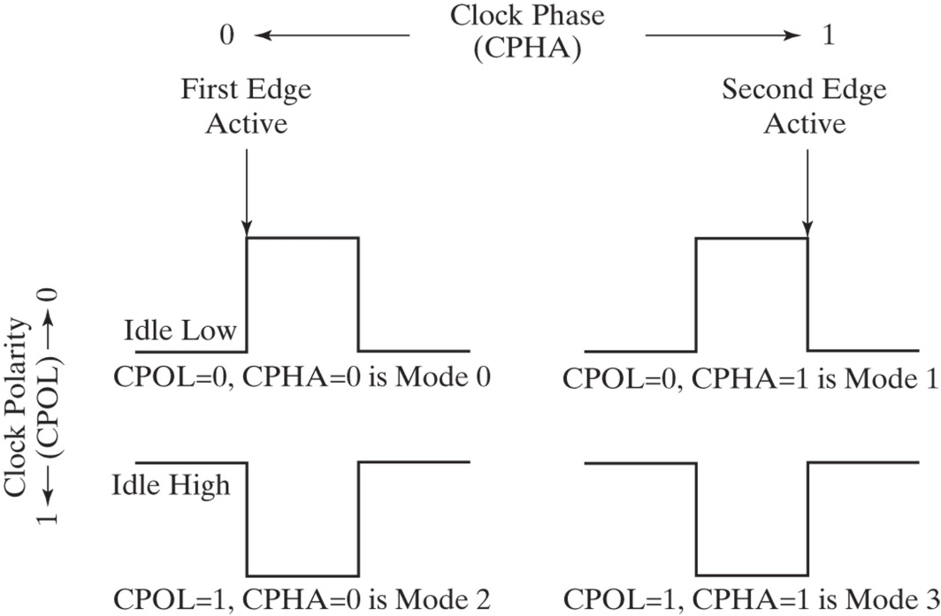
SPI data transfer modes
Four transfer modes
  Mode 0: SCK idle low, rising edge
  Mode 1: SCK idle low, falling edge
  Mode 2: SCK idle high, falling edge
  Mode 3: SCK idle high, rising edge
    Used most often
Mode 0
Mode 1
Mode 2
Mode 3
Introduction to Mechatronics, Figure 7.6 p. 111.

Slide 14
Many digital components use SPI
See the (partial) list of SPI devices:
http://www.mct.net/faq/spi.html

