Slide 1
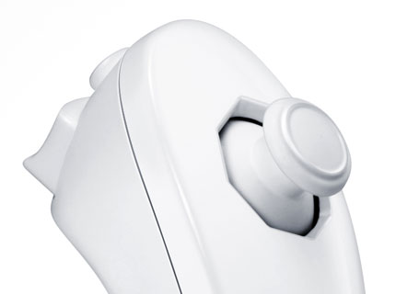
ME106 Sensor Presentation:
WII Nunchuck
Evan Ly , Marcus Solis
31OCT2012

Slide 2

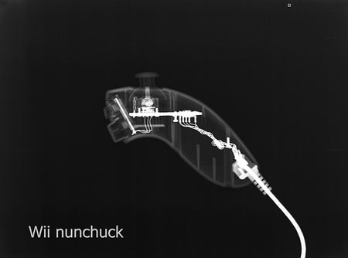
What is the wii nunchuck?
Developed by Nintendo Corp for use with the Wii game system.
Seventh generation controller,
  The joystick design came from the game cube controller (6th gen)
Is an attachment for the Wii-mote
  Designed to work in tandem
Called a nun chuck because… it resembles a nunchaku…..

Slide 3
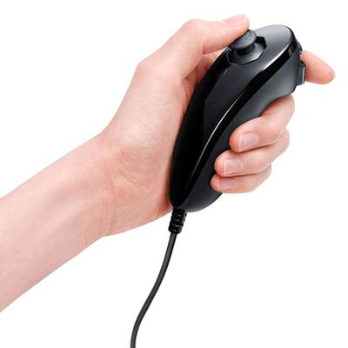
How does it work?
Designed to work on either hand.
Primarily as an interface to an application or game
Features a joy pad, two buttons, and an accelerometer
Connects to a game system or any MCU (Arduino) through a 3.5 m cord, or wireless
Can be found at nearly any electronics media store
Has third party counterparts with the same or more functionality.

Slide 4
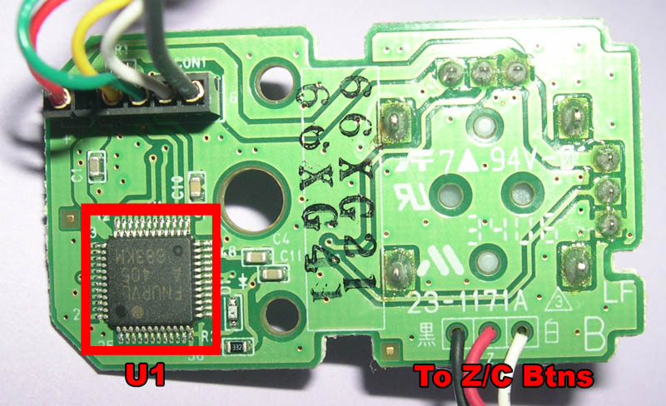
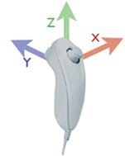
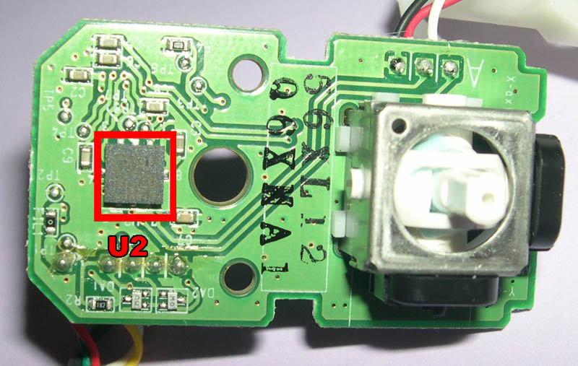
Whats inside?
I2C (Inter-Integrated Circuit) or commonly called “two wire communication”
Uses serial Data line (SDA) to transfer bits, and Serial Clock (SCL) , to transmit, and synchronize.
3 Axis accelerometer.
Can capture X, Y and Z motion
STMicroelectronics LIS3L02AL
2 axis analog joystick with analog to digital converter
2 buttons (Z and C)

Slide 5
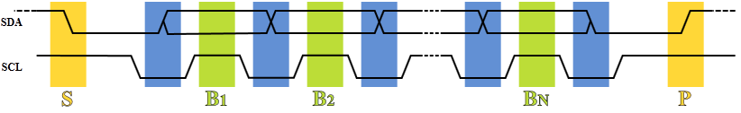
What is i2c?
Data start (s): SDA low SCL high
(blue) SDA sets transferred bit while SCL low, data is received at B1 (Green )
When data is finished sending, the P signal (rising SDA and high SCL)
I2c chip 10 bit (8 to 10 bit resolution possible) (255 – 1024)
Bus has two nodes:
  Master node (issues clock and addresses slaves)
  Slave node (received clock line and address)
After every 8 data bits in one direction, an "acknowledge" bit is transmitted in the other.
7 bits of data sent.
SCL (clock stretching) controls the flow of data. It ensures one transmitter at a time.
SDA data line

Slide 6
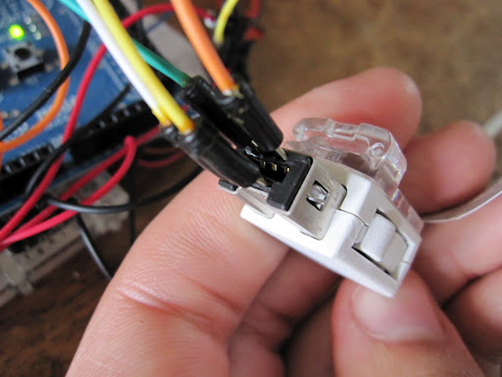
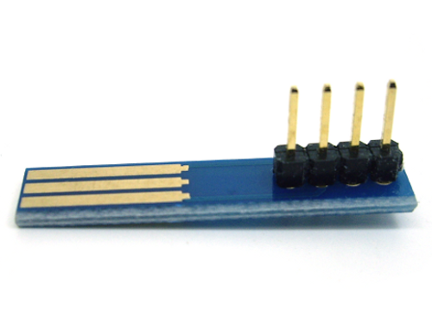
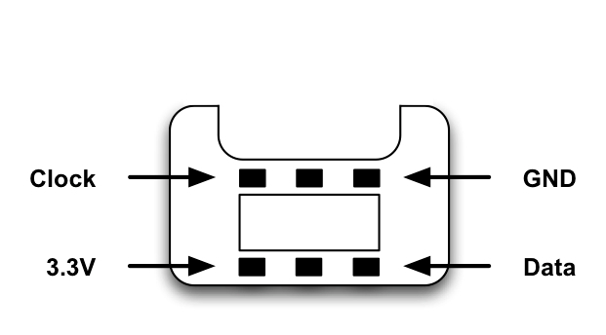
How to interface with arduino?
Using the WiiChuckClass library on Arduino CC
http://www.arduino.cc/playground/Main/WiiChuckClass
Wii I2C port | Arduino
I2C data (SDA) | Pin 20 (A4)
I2C clock (SCL) | Pin 21 (A5)
Power 3.3V | 3.3V or 5V will work
Ground | Ground

Slide 7
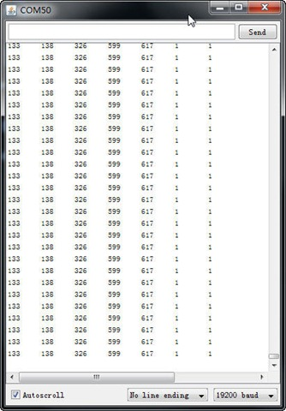
Serial interface
Joy X 0-255
Joy Y 0-255
AccelX 0-548
Accel Y 0-548
Accel Z 0-548
C=1 pressed C=0 unpressed
Z=1 pressed C=0 unpressed

Slide 8
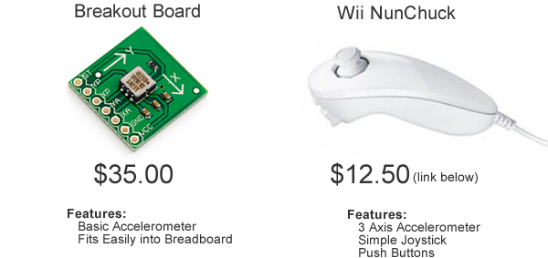
Why wii nunchuck?
Great for testing
Extremely cheap
($14 used and ~$20 new)
Built in accelerometer
I2C frees up pins on your Arduino (2 pins instead of 5)
It is cool

Slide 9
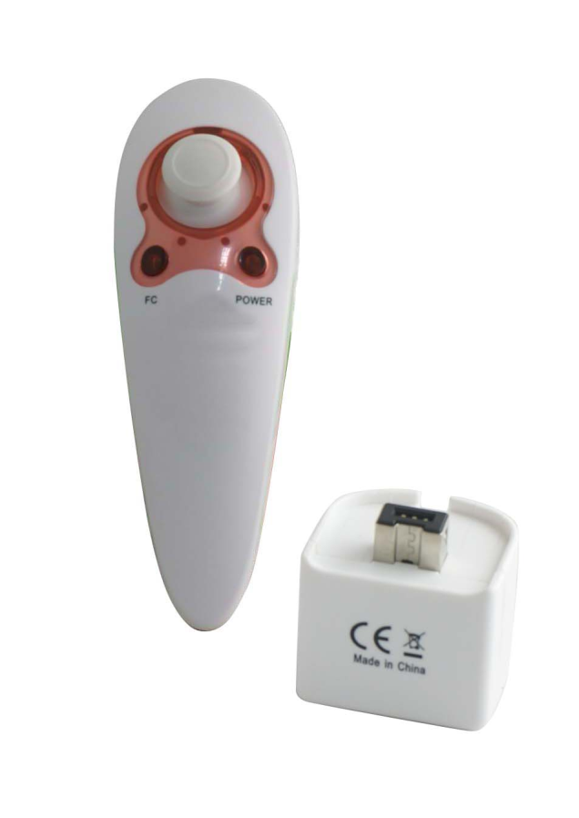
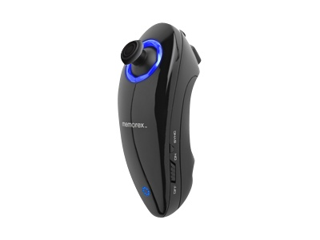
“Clones”
Memorex “sidekick”
Wireless
Extra buttons
Rechargable NiMh battery
Made in china
Extra buttons?
wireless
Slightly ugly
Can be found at any electronics store: best buy, frys etc…
Note: hex address for i2c communications may differ using 3rd party.

