Slide 1
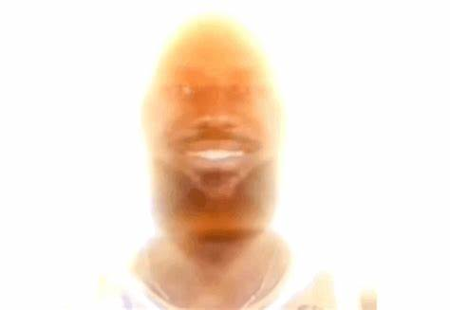
Chapter 29: The Power of Love
The Bible and its Influence

Slide 2


Who is Paul?
Eventual follower of Jesus
  Spread gospel of Christ to first-century
From Saul to Paul
  Saw resurrected Christ
Reached out to Gentiles
  Made Christianity inclusive
  Salvation for all
Wrote epistles to Christian communities
  Letters got into New Testament

Slide 3
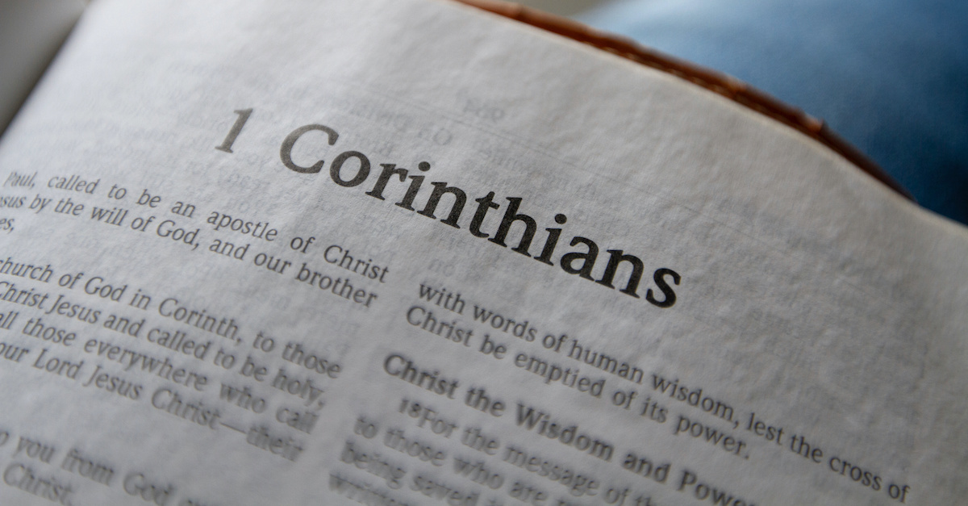
1 Corinthians
Chloe
  Member of Corinthian Christian community
    Reports on issues with Corinth church
      Disunity, sexual immorality, lawsuits among faithful
  Marriage and Divorce
    Prostitution was common for his time
      Solution: Must have own spouse
      Unmarried members of Corinthian congregation (widows too)
        Remain unmarried (like Paul) but must marry if can’t stay chaste
      Discourage marriage between believers & nonbelievers
        If already married, remain married (potential influence on spouse and kids)
      If couples are divorced, remain unmarried or reconcile (prefers divorce to not be a thing, but very understanding of cases like adultery)

Slide 4
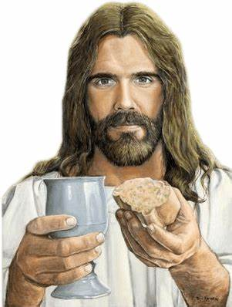
1 Corinthians Continued
The Lord’s Supper
  In first letter to commemorate Jesus Christ’s death & resurrection
    Tells believers to partake in bread/wine for Jesus
      “For whenever you eat this bread and drink this cup, you proclaim the Lord’s death until he comes” (1 Corinthians 11:26)
  Act of gratitude and remembrance of Jesus’s sacrifice
  Christian faith would be in vain if Christ did not raise
    No point in preaching
    Forever stuck with sins

Slide 5



1 Corinthians Continued…. Again
The Greatest Gift
  Love!!!!!
    Beyond spiritual gifts
      Speaking in tongues or faith
        “If I speak in tongues of mortals and of angels, but do not have love, I am a noisy gong or a clanging cymbal” (1 Corinthians 13:1)
Love never falters
  Love above all else
  Will always persevere
    Does not delight in heinousness but celebrates truth

Slide 6
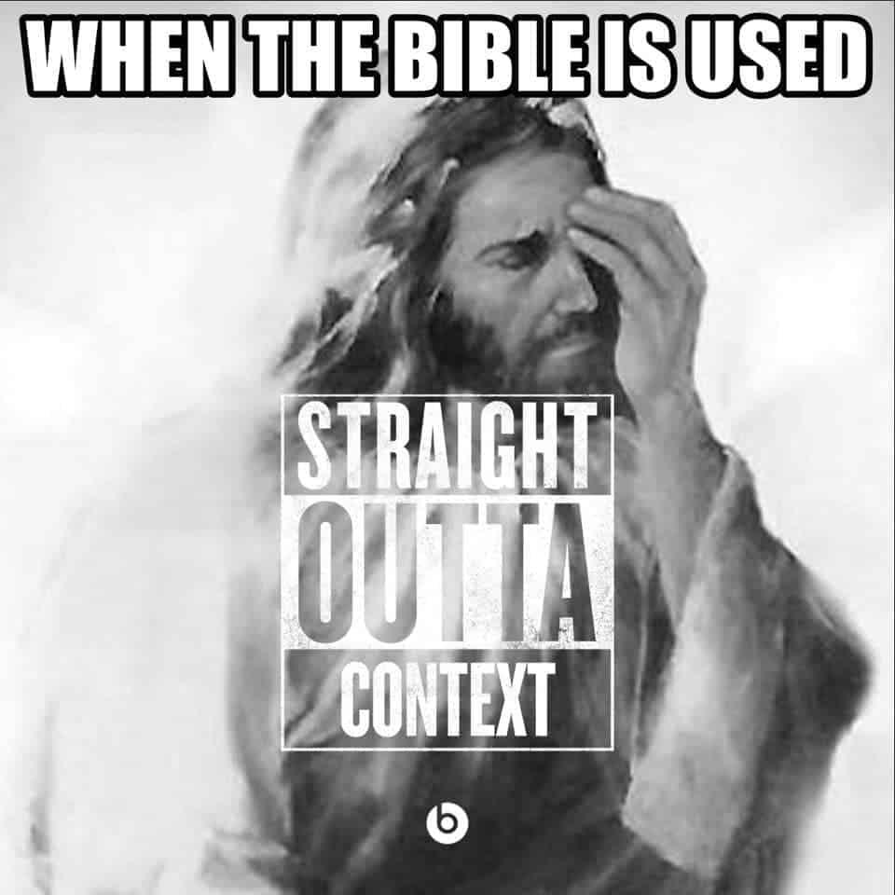
2 Corinthians (Finally)
A lot more personal
  Defends authority and integrity against criticism from false educators
  Boasted about weakness
    Reliance on God, not by oneself
    Great indicator of God’s strength and power to transform and give grace to believers
  Gave blessing at the end
    Wants the best out of everyone
      Experience God’s presence and love to the fullest extent
        “May the grace of the Lord Jesus Christ, and the love of God, and the fellowship of the Holy Spirit be with you all” (2 Corinthians 13:14)

Slide 7
Galatians
Founded Galatian church with non-Jewish followers of Christ in Central Asia
Addressing unidentified teachers trying to convince Paul’s converts (formerly pagans) to be circumcised
  Observe Jewish laws and rituals like Sabbath and food laws
Wanted to point out that the teachers were perverting the gospel message by dictating the Galatians practices
A Magna Carta of Christian freedom
  Followers of Jesus no longer slaves to laws
    Free due to baptism of Jesus
    “There is no longer slave or free, there is no longer male and female, for all of you are one in Christ Jesus” (Galatians 3:28)
      Powerful statement
        Most of the world was non-Roman (less rights, women were property, slavery was very acceptable)

Slide 8

Galatians Continued
Paul mentions Roman adoption laws as reference to freedom
  Adopted person cannot be disinherited
    Parent adopting chose to do so
    Parents with natural kids had not made such as choice
      Could be disinherited
        Message is that followers of Jesus are adopted by God
          Cannot be disinherited
Referred to the fruit of the Holy Spirit as:
  “Love, joy, peace patience, kindness, generosity, faithfulness, gentleness, and self-control” (Galatians 5:22)
At the end of the day, it doesn’t matter what sex or race or even slave status you are
  “If you belong to Christ, then you are Abraham’s offspring, heirs according to the promise” (Galatians 3:29)

Slide 9
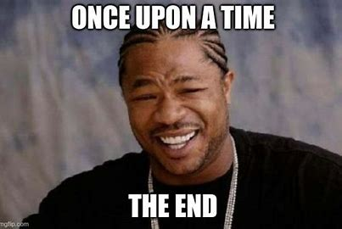
The End!!!

