Slide 1
The Bible and Its Influence:
“The Promised Land”
Micaela Veglia

Slide 2
The Book of Joshua
Joshua, Moses’ assistant, is chosen by God to lead the Israelites to the Promised Land after Moses died
Known for his courage and military prowess
Undivided faithfulness in the covenant
  Different from others, like Moses, who question God
“Only be strong and resolute”
  “Be strong and courageous”

Slide 3
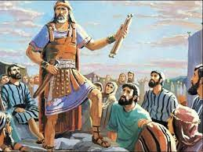
God of Battles
The Book of Joshua recounts military history from the Israelites point of view
God gets credit for military victory
Faithless humans are blamed for military defeat
  Caused because humans dessert God, not the other way around

Slide 4
Rahab of Jericho
“Earliest example in literature of the prostitute with a heart of gold”
She hears of the events in Egypt and converts
She hides Israelite spies, and they promise to spare her family in the siege if she marked her house with a red cord hanging from the window
This leads to the first major conquest lead by Joshua and the Israelites

Slide 5
The Time of Judges
Success depended on faith
Joshua had no successor and decided to split authority between the 12 tribes
After his death, there was no unity and the Promised Land was filled with chaos
Judges (“deliverers”) appear over the years to provide guidance
  Earned God’s favor and people’s support by exhibiting certain virtues and characteristics

Slide 6
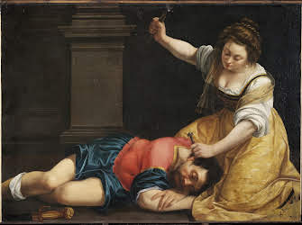
Deborah
First figure in the Book of Judges
One of the only Judges to mediate legal disputes
Virtues: courage and wisdom
  A Prophet– wisdom was divine
  Lead Israelite troops alongside General Barak
Heavily associated with Jael
  Lured their enemy, General Sisera, to her tent
  Killed him by driving a peg through his skull

Slide 7
Gideon
40 years after Deborah’s victory, the Israelites are attacked by the Midianites
God sends an angel to Gideon, but he doesn’t believe the angel is from God so he tests the angel until he’s sure
Gideon summons a huge army but only goes to battle with 300 men
  God did not want the might of the soldiers to be a sign that they won without God’s help
Surrounded the enemy, blew horns, broke jars, and screamed, which scared them off
Virtues: Willingness and humility

Slide 8
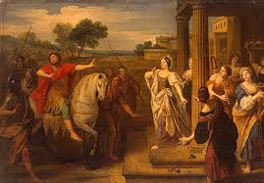
Jephthah
40 more years, more trouble for the Israelites
  This time, they fight the Ammonites!
Son of a prostitute, a good fighter, not necessarily a good person
In return for support, he promised God he’d sacrifice the first living thing he’d see once he got home
  His daughter
Virtues (?): lack of faith in God leads to strife

Slide 9
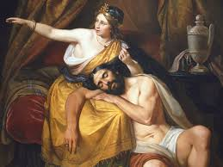
Samson and Delilah
Best resembles the hero’s journey
His mother vowed to dedicate him to God’s service as a nazirite
  God gifted him with immense physical strength that he used self-indulgently
  “The sweetness of deliverance would come from his strength, tempered in captivity”
Delilah agreed to discover the secret of Samson's strength for money
  Sampson reveals that his powers come from God and are symbolized by his uncut hair of the Nazarite
  She cuts his hair, and he is captured and blinded by the Philistines
Samson asks for just enough strength to take down their temple
Taking God’s power for granted blinds you from God’s protection and you can be lured into temptation from other gods

Slide 10
Samuel
Israelites are in a constant flux of war and anarchy with no moral compass/figurehead
Samuel’s mother, Hannah, was barren and directly asked God for a son in exchange for his service to God
Samuel lived with the high priest, Eli, and received a call from God
  God doesn’t speak to chosen Israelites as often as he did in the times of Moses and his ancestors
Samuel is declared as a prophet

Slide 11
Influence
MLK, “I Have a Dream” Speech
  “I just want to do God’s will. And He’s allowed me to go up to the mountain. And I’ve looked over it. And I’ve seen the Promised Land.”
William Shakespeare, Henry V
  “O God of Battles”
William Shakespeare, Hamlet
  Act 2, Scene 2: Polonius compared to Judge Jephthah
Oratorios (2 Act, sung biblical stories) and Operas
  Messiah by George Friedrich Handel, Samson et Dalila by Camille Saint-Saens
Philistine– used to describe an uncouth or uncultured person

