Slide 1
Divine Covenant and Human Fidelity: The Marriage Metaphor in Hosea
Tara Baisley-Gomes
English 115

Slide 2
Introduction
Exploration of Hosea's divine command to marry a harlot.
Use of marriage as a metaphor to discuss fidelity, betrayal, and restoration.

Slide 3
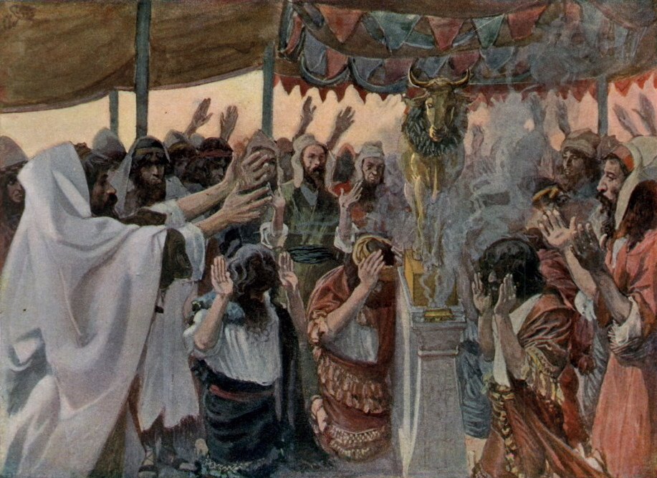
Context of Hosea's Time
Era marked by political unrest and spiritual decline in Israel.
Idolatry and violation of the covenant with God were rampant.
https://www.patternsofevidence.com/wp-content/uploads/2019/06/Tissot_The_Golden_Calf.jpg

Slide 4
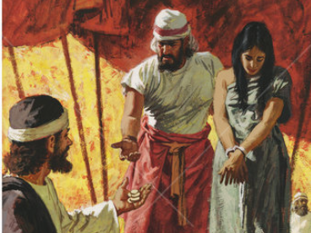
Marriage as a Covenant
Hosea's marriage to Gomer mirrors Israel's covenant with God.
Gomer’s disloyalty reflects Israel's betrayal of God.
https://reformedforum.org/wp-content/blogs.dir/1/files/2016/06/Hosea-Marriage.png

Slide 5
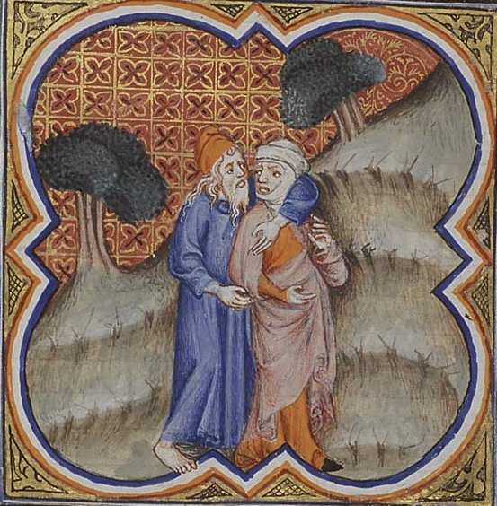
Divine Response to Human Infidelity
Hosea's unconditional love for Gomer despite her infidelity symbolizes God's enduring love and forgiveness.
https://upload.wikimedia.org/wikipedia/commons/6/6d/Hosea_and_Gomer_%28cropped%29.jpg

Slide 6
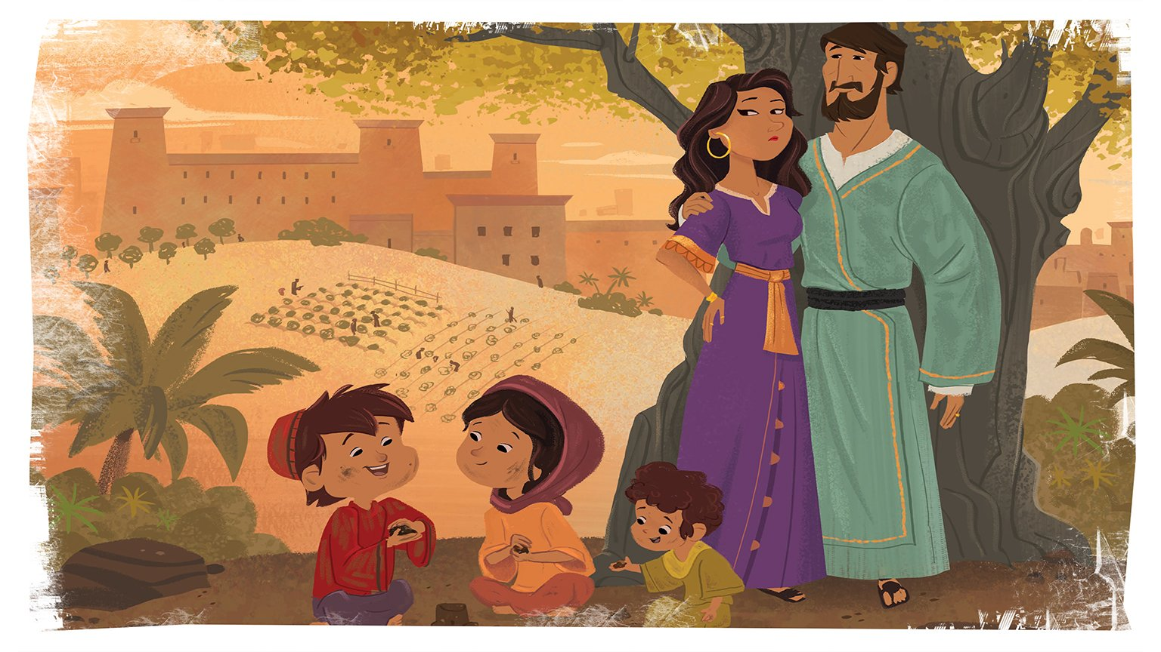
Themes of Rebirth and Restoration
Hosea's narrative promises renewal and strengthening of the covenantal relationship.
https://images.squarespace-cdn.com/content/v1/585448efd1758e8eb89fef72/3f266af4-4021-4d60-8f75-47d1a0a41229/TGP+Kids+%28A+Nation+Divided%29+-+Bible+Story+Picture+-+Unit+14%2C+Session+2.jpg

Slide 7
Conclusion
Relevance of the marriage metaphor in understanding spiritual themes of loyalty, betrayal, and forgiveness.

Slide 8
References
The New Oxford Annotated Bible, New York, Oxford University Press, 2001.

