Slide 1
The Bible and its Influence:
“Warning and Comfort”
Sarai and Hannah

Slide 2
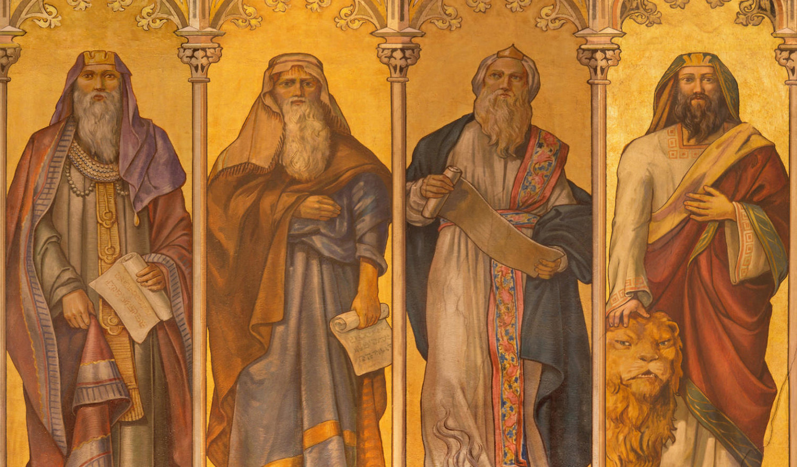
The responsibilities of the Prophets
Prophets provided warning of punishments from God for straying from him and comfort through assurance that restoration would be brought about through the people’s renewed commitment to His commandments.
Prophets had authority and power, but were isolated and faced the scorn of listeners when delivering news no one wanted to hear.
https://credomag.com/2020/11/introduction-to-the-major-prophets-of-the-old-testament/

Slide 3
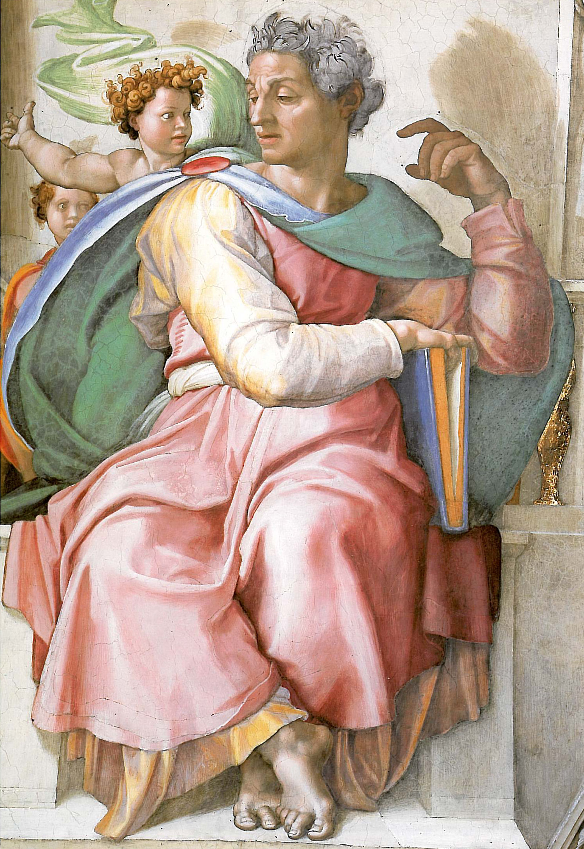
The Book of Isaiah
Classic archetypal plot: redemption and calling
Disaster strikes with King’s death, causing shock and upheaval
God appears as the eternal king, offers path to redemption
Isaiah acknowledges and openly confesses unworthiness
Redemption comes through cleansing fire, symbolized by coal touching Isaiah’s lips
Isaiah is purified by fire, marking redemption and readiness for calling
Isaiah expresses gratitude, accepts spiritual responsibility
https://en.wikipedia.org/wiki/Isaiah

Slide 4
Isaiah’s Hope
Although Isaiah is angry with the people and warns them of the consequences of breaking their covenant with God, his message also carries sentiments of optimism and hope.
Symbolic children’s names
  Immanuel: “God-with-us”
  Shear-Jashub: “A remnant shall return”
Isaiah placed his trust in the “remnant” of those who remained faithful: “From them God would bring forth a messianic, eternal reign of peace and justice” (106).
“Comfort, O comfort my people
says your God.
Speak tenderly to Jerusalem,
and cry to her
that she has served her term,
that her penalty is paid,
that she has received from the Lord’s hand
double for all her sins.”
Isaiah 40:1-2

Slide 5
The Power of Poetry
Poetic language granted more power and meaning to a prophetic message.
Messages meant for a specific time and place become timeless through the language of poetry.
Starts, ends with water
Transition from actual water to water of blessing
As water turns the wasteland into a fruitful garden, God’s blessing promises the people of Israel a bright future
“For I will pour water on the thirsty land,
and streams on the dry ground;
I will pour my spirit upon your
descendants,
and my blessing on your offspring.
They shall spring up like a green
tamarisk,
like willows by flowing streams.”
Isaiah 44:3-4

Slide 6
Jeremiah- The Prophet of Doom
Warning
“It was a time when the people and their leaders were smugly comfortable in their mistreatment of the poor and their adoption of pagan religious practices.
“Then the LORD put out his hand and touched my mouth; and the LORD said to me “Now I have put words in your mouth. See today I appoint you over nations and over kingdoms to pluck up and pull down, to destroy and overthrow to build and to plant” Jeremiah 1:9-10
Described as people hardening their hearts to God.
People react very negatively to Jeremiah and imprison him.
“Why did I come forth from the womb to see toil and sorrow, and spend my days in shame?” Jeremiah 20:18

Slide 7
Jeremiah- Prophet of Doom
Comfort
After the suffering (The destruction of Israel by Babylon) there will come a new covenant.
The text calls it a “new exodus” and expands on the creation of the commandments.
He envisioned after 70 years of exile they would return and a descendant of David would rule
The refer to this as the “righteous branch”
“See, A time is coming– declares the LORD– when I will make a new covenant with the House of Israel and the House of Judah. It will not be like the covenant I made with their fathers, when I took them by the hand to lead them out of Egypt, a covenant which they broke. . . . I will put My Teaching into their inmost being and inscribe it on their hearts. Then I will be their God, and they shall be my people”
Jeremiah 31:31-33

Slide 8
Ezekiel - The Multimedia Prophet
Warning
He was a priest and prophet. He received his call while living among the first group of captives transported to Babylon
The wickedness of the people will bring about the destruction of the temple and in their exile they will be tempted to assimilate.
His mission is to call out the Israelites for rebelling against their traditions, but he saw it as encouraging them to remain faithful.
“Divide the hair, one third of the hair you shall burn in the fire inside the city, when the days of siege are completed; one third you shall take and strike with the sword all around the city, and on third you shall scatter to the wind, and I will unsheathe the sword after them” Ezekiel 5:1-2

Slide 9
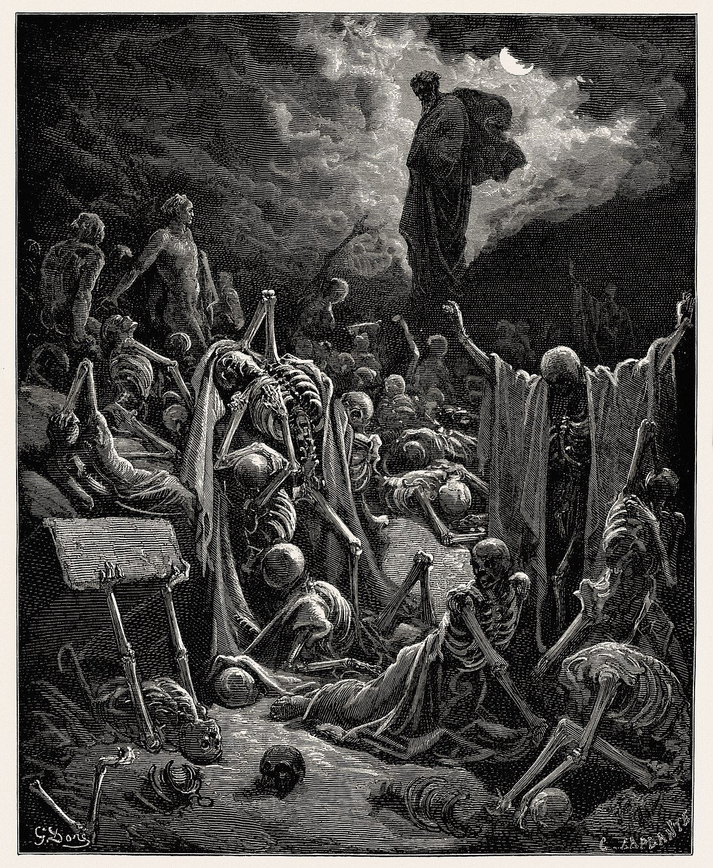
Ezekiel - The Multimedia Prophet
Comfort
He has a vision of a rebuilt temple with the people who returned home.
“Thus says the Lord God: I am going to open your graves, and bring you up from your graves, o my people: and I will bring you back to the land of Israel. . . I will put my spirit within you, and you shall live, and I will place you on your own soil; then you shall know that I, the lord, have spoken and will act. Ezekiel 31: 12,14

Slide 10
Modern Influence
When the shuttle Columbia exploded on reentry George W. Bush quoted the prophet to bring comfort to the people.
“Lift your eyes and look to the heavens. Who created all these? He who brings out the starry hosts one by one and calls them each by name. Because His great power and mighty strength, not one of them is missing (Isaiah 40:25)

