Slide 1
The Bible and its Influence
Chapter 34: “Crisis and Persecution”
Hannah & Patrick

Slide 2
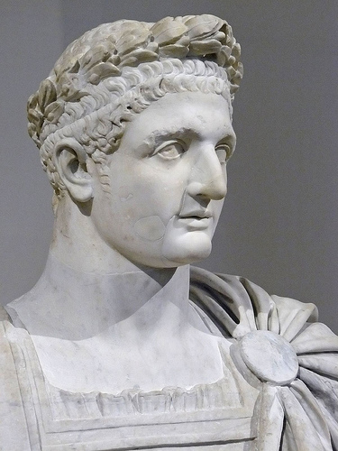
Suffering and
Execution
Emperor Domitian
  Wanted people to call him “Lord and God,” and treat him as a Roman deity
  Caused problem for Christians
  Some who refused to worship Emperor were imprisoned, tortured, even murdered
Romans saw Christians as disloyal
Revelations written during time of suffering and persecution for Christians
  Temptations to abandon faith to avoid persecution
Revelation revealed value & meaning of suffering, what was coming next
Includes symbolism to hide meaning
  Confusing read as a result
https://bible.fandom.com/wiki/Domitian

Slide 3
Revelation as a Letter
“The revelation of Jesus Christ, which God gave him to show his servants what must soon take place; he made known by sending his angel to his servant John, who testified to the word of God and to the testimony of Jesus Christ, even to all that he saw” -Revelation 1:1-2
Revelation is apocalyptic but shares characteristics with prophecy and narrative biblical forms
Written as letter from John to seven existing churches
  John exiled from Ephesus to Patmos, where Revelation was written
Visions mirror author’s surrounding scenery
  Patmos is an island 10 miles long, 6 miles across, w/ 37 miles of coastline

Slide 4
Apocalyptic Literature & “Sign”
Language
Unlike the Romans, first-century Christians were familiar w/ apocalyptic literature
Use of terms, symbols, numbers to communicate with audience
  Son of Man = Messiah
    Echoes vision from chapter 7 of the Book of Daniel:
    “I saw one like a human being coming with the clouds of heaven” (Daniel 7:13)
The number seven
  Appears 57 times in Book of Revelation
  Seven days of creation, seven festivals, seven days to build a temple, seven churches

Slide 5
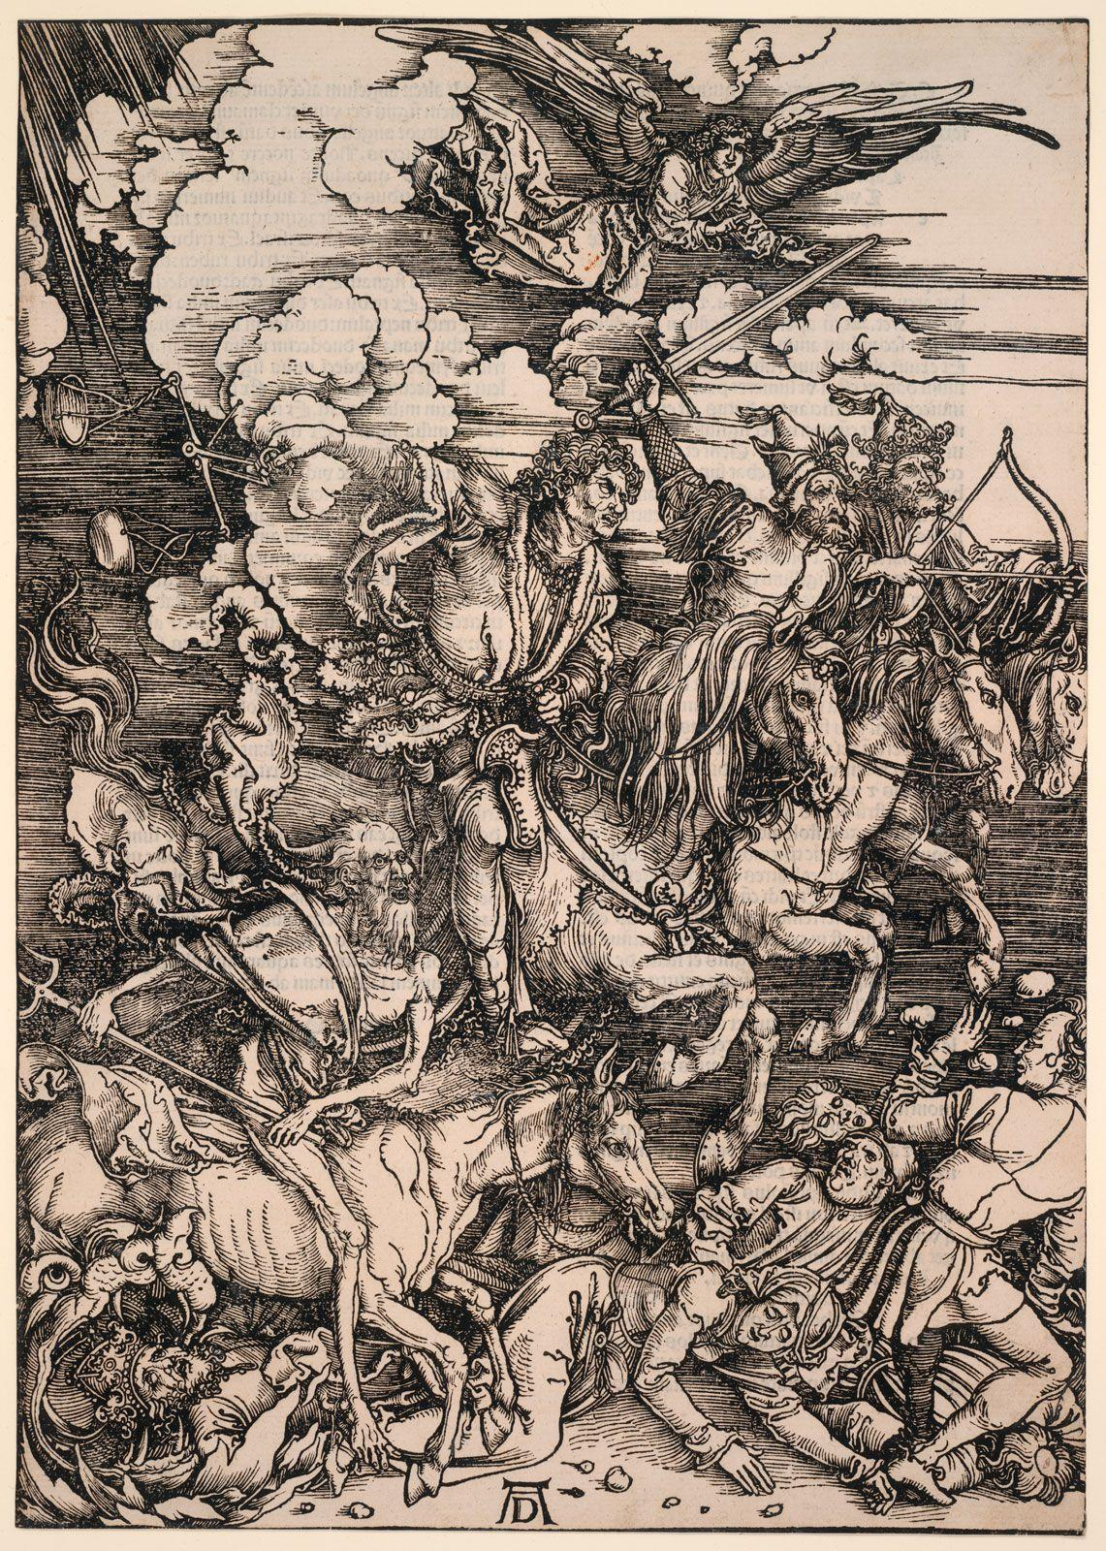
Pattern of Apocalyptic Literature
Addresses communities undergoing some kind of suffering or difficulty
Reassures communities that the evil force causing the difficulty will be destroyed and a new era will begin
Warns the communities that at first the suffering may become extreme
https://www.britannica.com/art/apocalyptic-literature#/media/1/29733/268974

Slide 6
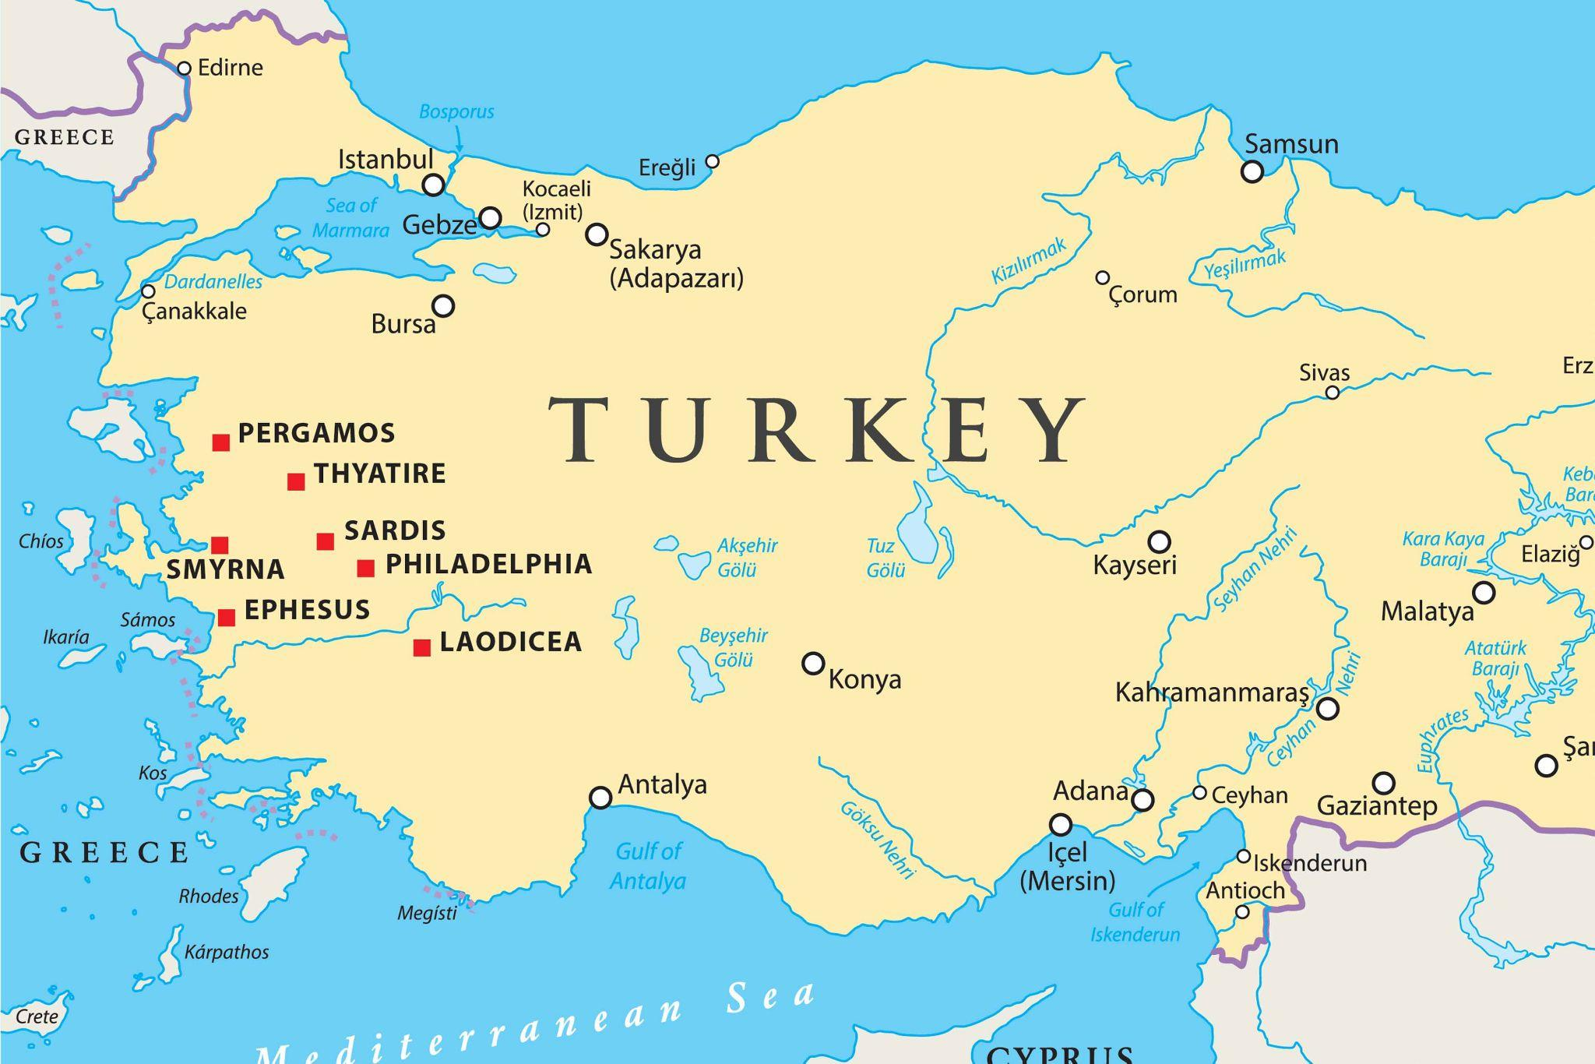
The Seven Churches
\
Ephesus - First Love (2:1-7)
Challenged their community to return to their “first love”,
reward would be to eat from the tree of life.
Smyrna - Persecution (2:8-11)
Their community had suffered poverty and affliction, but
because of their faith they would be rewarded with the crown of life and avoidance of the second death.
Pergamum - Adversity (2:12-17)
Their community remained faithful in a city full of idolatry,
reward would be hidden mana
Thyatira - Endurance (2:18-28)
Remained faithful despite the strong temptations of sin, reward
would be authority over the nations and the morning star.
https://www.bibleinfo.com/en/questions/seven-churches-revelation

Slide 7
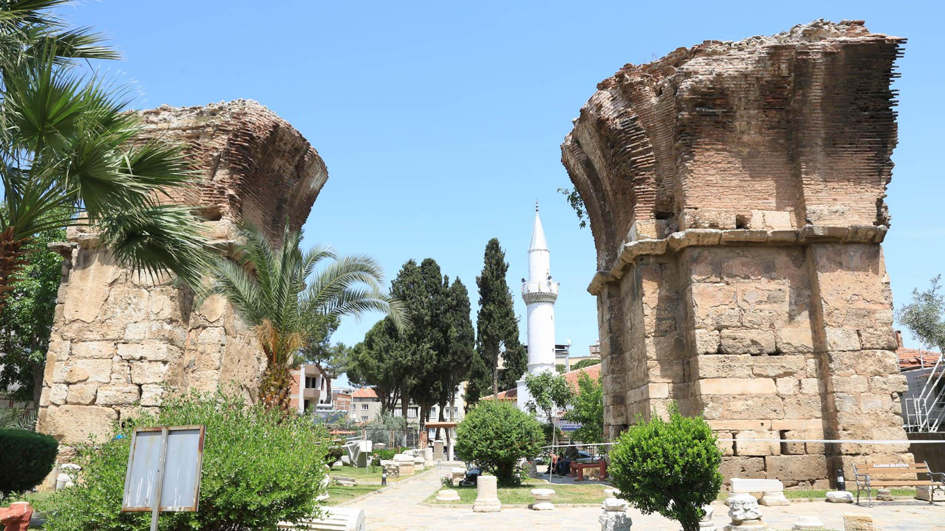
The Seven Churches
Sardis - Repent (3:1-6)
Community in a city often invaded, encouraged to remember,
obey, and repent, reward would be white robes and names
recorded in the book of life.
Philadelphia - The Key (3:7-13)
Community often clashed with a Jewish community here, their
reward would be to become a symbolic pillar in the temple and
to have the name of God written on them.
Laodicea - Lukewarm (3:14-22)
Called the community to reform and repent, their reward would
be a place on the throne.
https://www.imb.org/2018/06/01/what-happened-to-the-seven-churches-of-revelation/

Slide 8
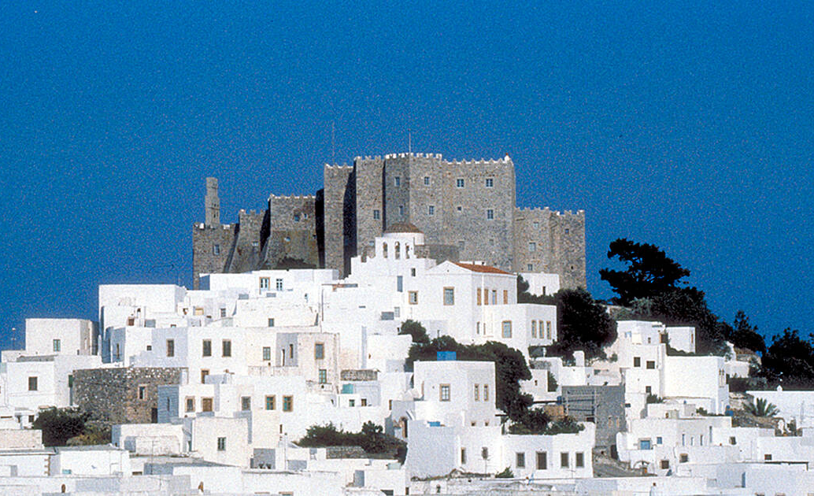
Cultural Connections: Geography
It is believed that John wrote Revelation in a cave halfway up the islands highest point: Mount St. Elias
Holy place
Monastery of Saint James
  Museum
  Library
Designated “sacred island” in 1981 by Greek Parliament
Celebrated 1900th anniversary of the Book of Revelation in 1995
The Isle of Patmos
https://whc.unesco.org/en/list/942/

Slide 9
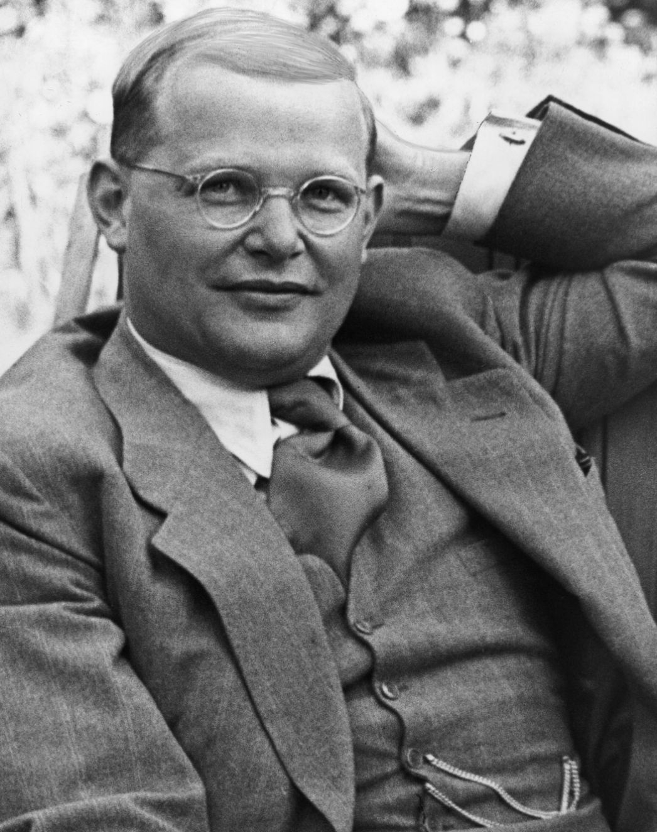
Cultural Connections: World History
Lutheran pastor in Germany
Arrested and imprisoned by Nazis during WWII
Wrote letters and sermons in prison, Letters and Papers from Prison
Executed by Nazis on April 9, 1945
Dietrich Bonhoeffer (1906-1945)
https://www.buchenwald.de/en/geschichte/biografien/ltg-ausstellung/dietrich-bonhoeffer

