Slide 1
Genesis: A Living Conversation
“Exile”
Kristen Uyesugi and Micaela Veglia

Slide 2
Table of Contents
Joseph rejecting Potiphar’s wife
Themes of misogyny
Joseph as an underdog
Joseph as an immigrant
Divine interventions

Slide 3
Joseph Rejecting Potiphar’s Wife
Caution against foreigners
  Threats of people leaving the community
  Threats of foreigners’ gods
Joseph is a symbol of beauty
  Islamic tradition emphasizes choosing between human beauty/love and divine beauty/love
  Jewish tradition also agrees that Joseph was beautiful and attractive
The relationship between master and slave
  Seeing Potiphar as a father figure
  Owing one’s master fidelity
  Doesn’t want to commit adultery
  “ . . . she doesn’t try to seduce him or persuade him. She just says, lie with me. It’s an imperative. It’s — get in bed with me. She’s trying to make use of him. So she has been rebuffed in something that she thought she could get away with because he was a slave.” Francisco Garcia-Treto

Slide 4
Themes of Misogyny
Potiphar’s wife’s purpose in the narrative is to punish Joseph for rejecting her sexual advances.
  Women were taught to be a symbol of evil to keep young men focused on religious studies
Is this the word of God?
  “If someone were to read the Potiphar story in such a way that the message was women are sexually aggressive, oppressive beings. In other words, in a misogynistic way, that would of course not be the word of God. I would agree with you. On the other hand, we can’t very well excise that. It’s part there.” Francisco Garcia-Treto
She is in a position of power over Joseph. She does not ask Joseph, but orders him to sleep with her and she is still rejected.
  Joseph holds the moral high ground
In Islamic tradition, she is seen as a romantic heroine that beholds the beauty of Joseph as a creation of God

Slide 5
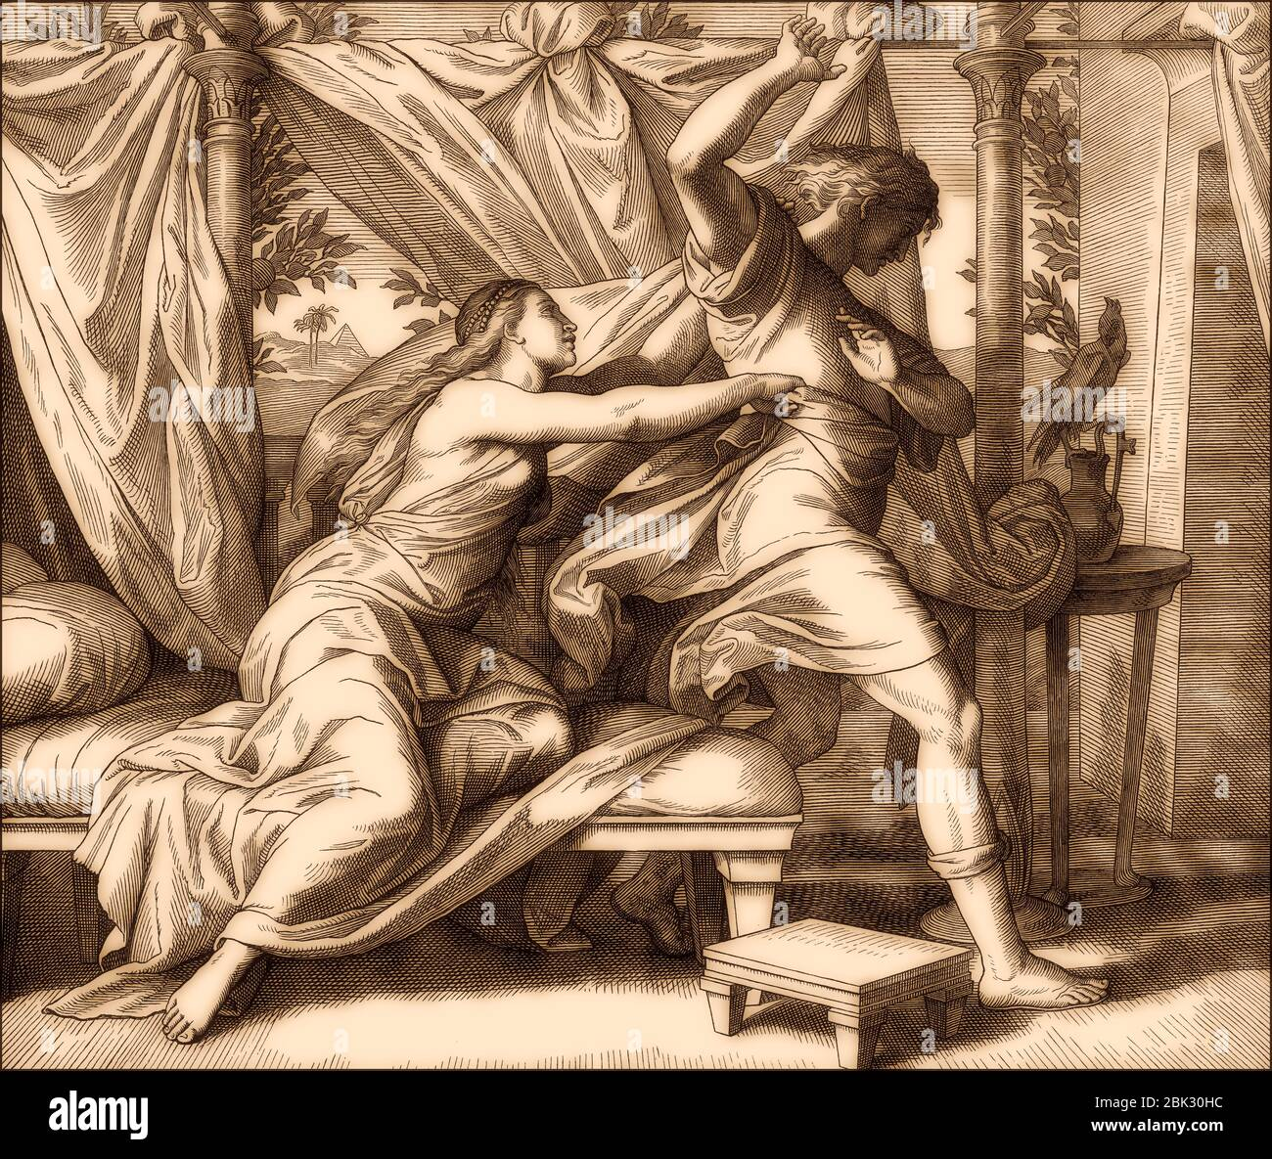
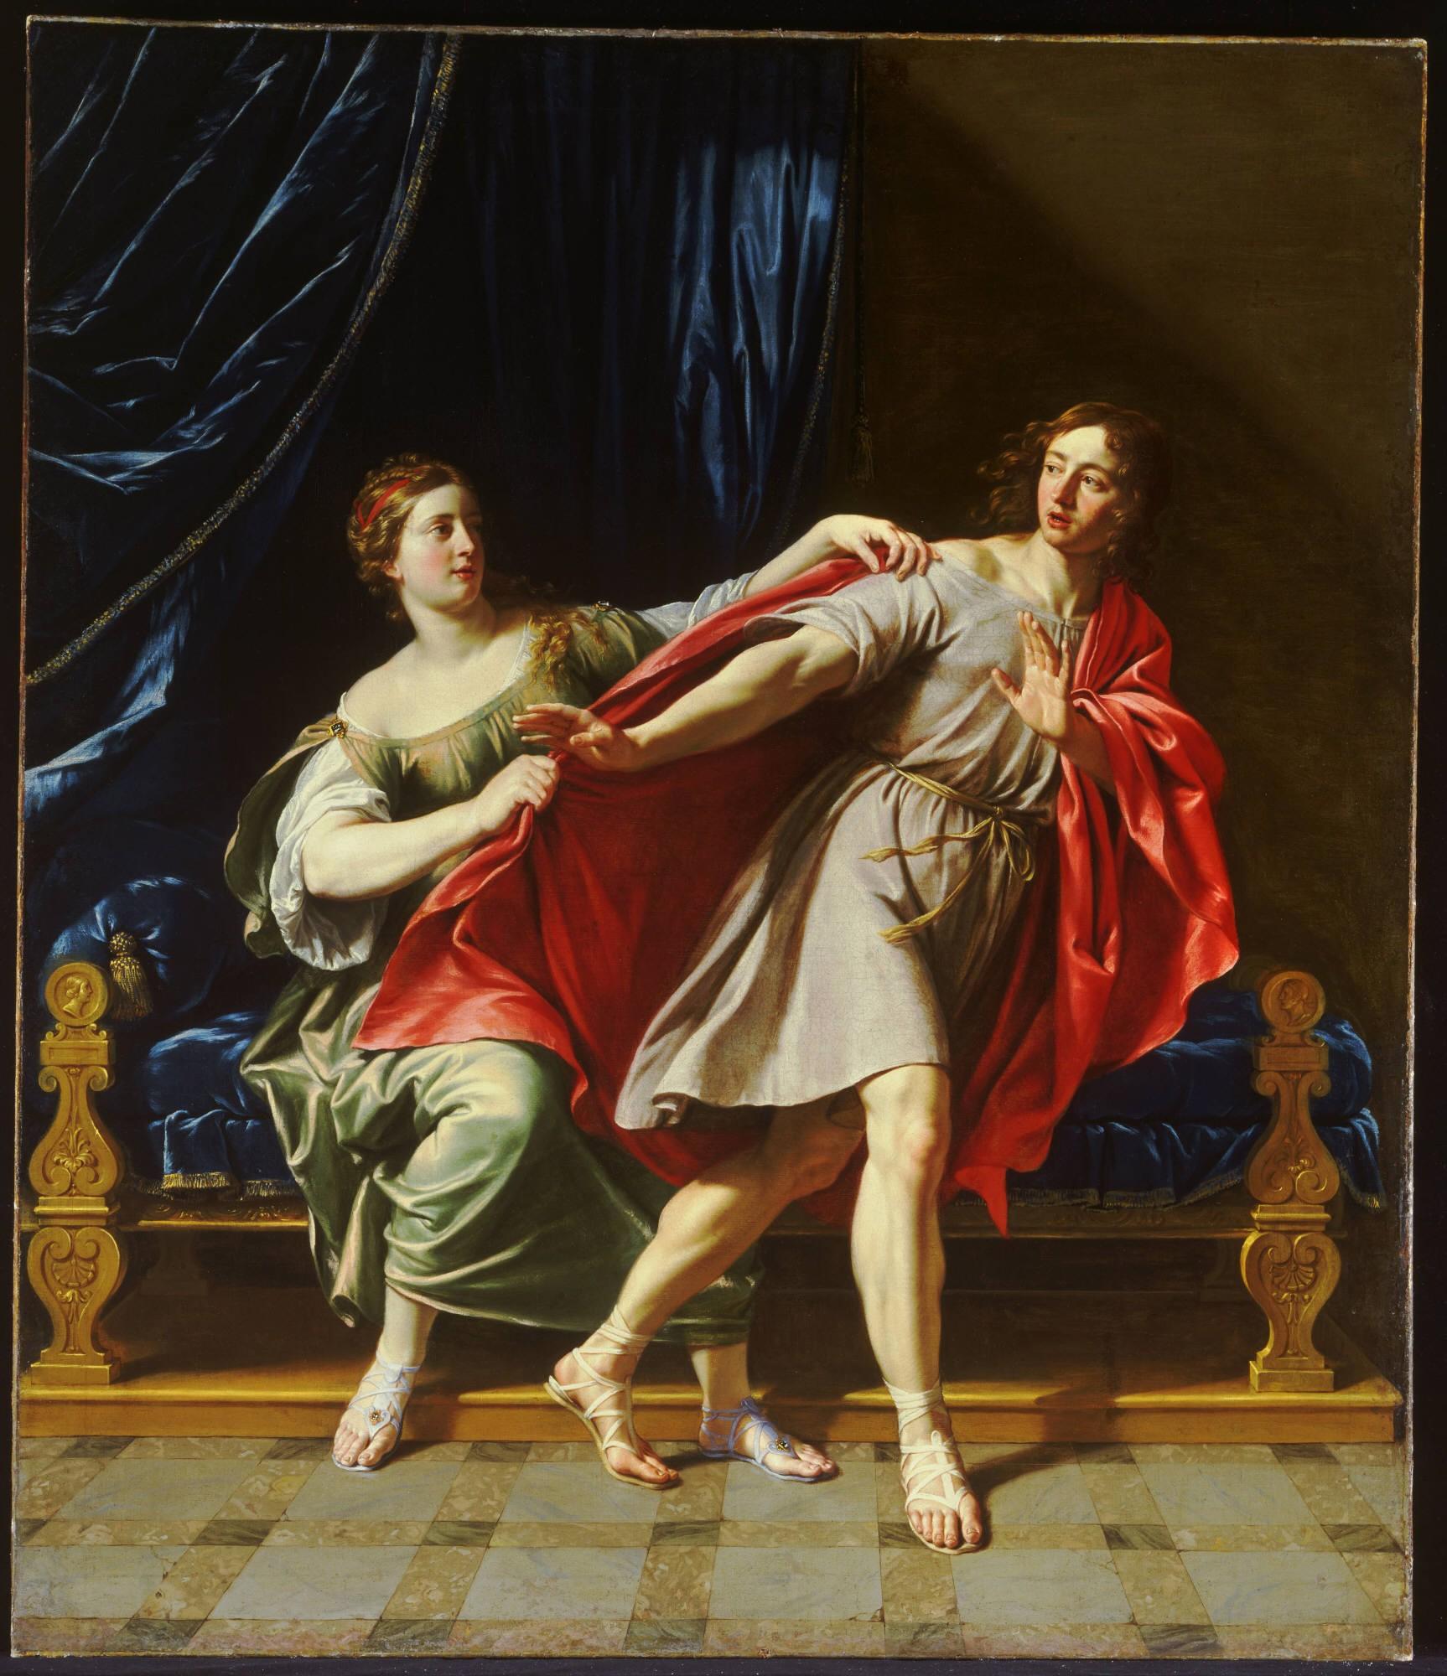
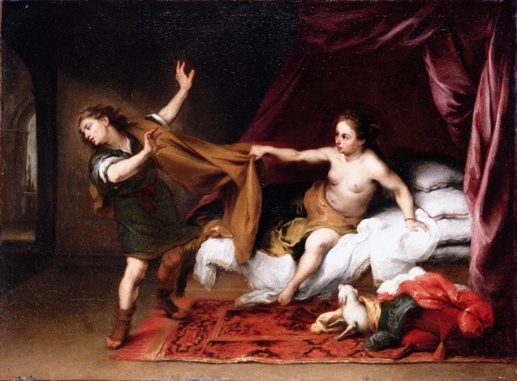

Slide 6
Joseph as an Underdog
Joseph makes his way up the social ladder
  Joseph is sold into slavery, exiled, and imprisoned. He keeps his faith, God remains with him, and he eventually becomes one of the most powerful people in Egypt.
  “The ones who are lowly are raised up.” Dianne Bergant
“From a Jewish perspective, Egypt on some level is the quintessential exile. . . He names his [second child] Ephraim. The meaning of the name in Genesis 41 is God made me fertile — where? In the land of my affliction. . . He’s fertile. He rises. He finds himself. But Egypt is yet the land of his affliction.” Norman Cohen
  Joseph as an immigrant
    Exodus Pharaoh lords over the Jewish people and commits acts of evil.
    Genesis Pharaoh accepts Joseph as Egyptian and puts him in a position of power even though he is a foreigner and a slave

Slide 7
Divine Intervention
Joseph’s brothers hate him for the dreams he tells them about, and they sell him to Potiphar, one of Pharaoh’s officers, but “The Lord was with Joseph, and he became a successful man; he was in the house of his Egyptian master.” (39.2)
Joseph gains favor from the pharaoh because of this presence and makes him an overseer of the house; and the Lord blesses the Egyptians’ house for Joseph’s sake
“God’s not in the story as a character, but God’s not in my life or your life as a character either… God is in my life as feelings, promptings, inclinations. The kind of thing that you can easily miss… And I see Joseph sort of picking the right vibes in this situation…” -Francisco Garcia-Treto

