Slide 1
Female Initative
Kenny Fung

Slide 2
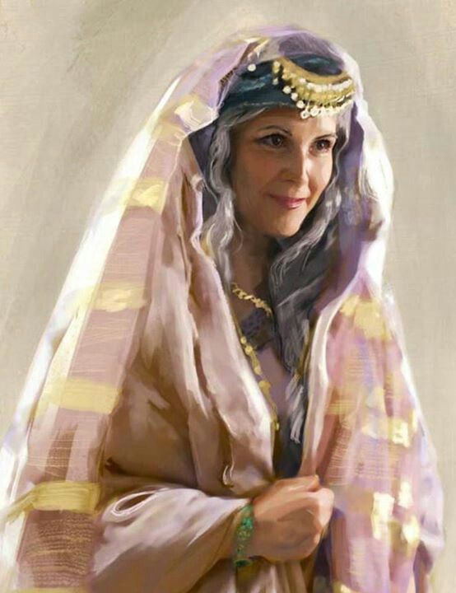
Sarai/Sarah

Slide 3
Genesis 12:13
“Say you are my sister, so that it may go well with me because of you, and that my life may be spared on your account.”

Slide 4
Genesis 16:2
“And Sarai said to Abram, “You see that the Lord has prevented me from bearing children; go in to my slave-girl; it may be that I shall obtain children by her.” And Abram listened to the voice of Sarai.

Slide 5
Genesis 21:10
“So she said to Abraham, ‘Cast out this slave woman with her son; for the son of this slave woman shall not inherit along with my son Isaac.’”

Slide 6
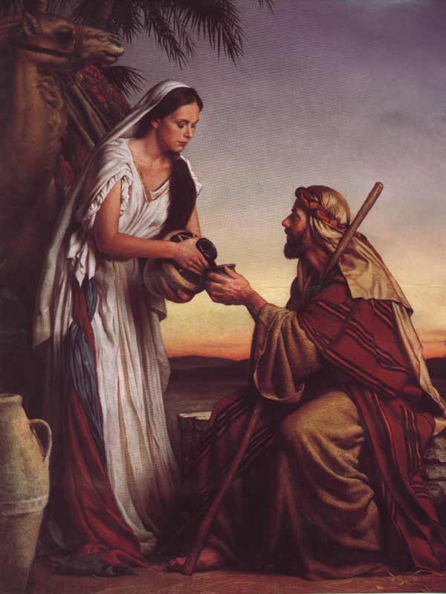
Rebekah

Slide 7
Genesis 24:57-58
“They said, “We will call the girl, and ask her.”
“And they called Rebekah, and said to her, ‘Will you go with this man?’ She said, ‘I will.’”

Slide 8
Genesis 25:23
“And the Lord said to her,
‘Two Nations are in your womb, and two peoples born of you shall be divided; the one shall be stronger than the other, the elder shall serve the younger.’ ”

Slide 9
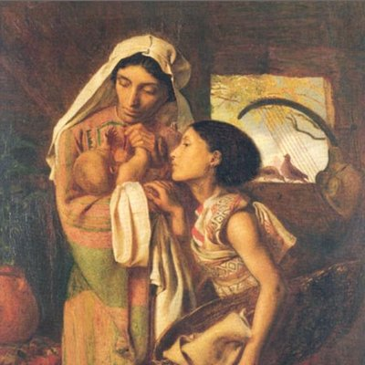
Shiphrah and Puah

Slide 10
Exodus 1:16
“‘When you act as midwives to the Hebrew women, and see them on the birthstool, if it is a boy, kill him; but if it is a girl, she shall live.’”

Slide 11
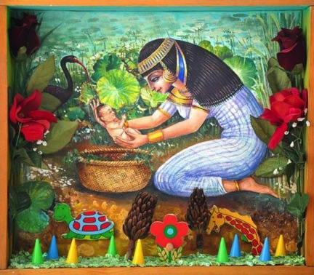
Pharaoh’s Daughter

Slide 12
Exodus 2:10
“When the child grew up, she brought him to Pharaoh’s daughter, and she took him as her son. She named him Moses, ‘because,’ she said, ‘I drew him out of the water.’”

Slide 13
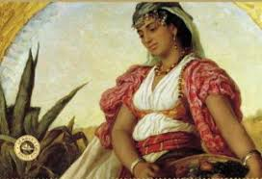
Zipporah

Slide 14
Exodus 4:24-26
“On the way, at a place where they spent the night, the Lord met him and tried to kill him.”
“But Zipporah took a flint and cut off her son’s foreskin, and touched Moses’ feet with it, and said, ‘Truly you are a bridegroom of blood to me!”
“So he let him alone. It was then she said. ‘A bridegroom of blood by circumcision.”

