Slide 1
Annotated Bibliography
By Chris Aronson

Slide 2

Supernatural
Courage
Death
Decision-making

Slide 3

Supernatural
Family Relationships
Courage
Survival

Slide 4

Supernatural
Facing Violence
Decision-making
Survival

Slide 5

Supernatural
Peer relationships
Identity issues
Discrimination

Slide 6

Graphic Novel
Facing violence
Decision-making
Survival

Slide 7

Supernatural
Peer relationships
Courage
Survival

Slide 8

Supernatural
Suicide & Death
Real life experiences
Peer relationships

Slide 9

Supernatural
Family relationships
Courage
Facing violence

Slide 10
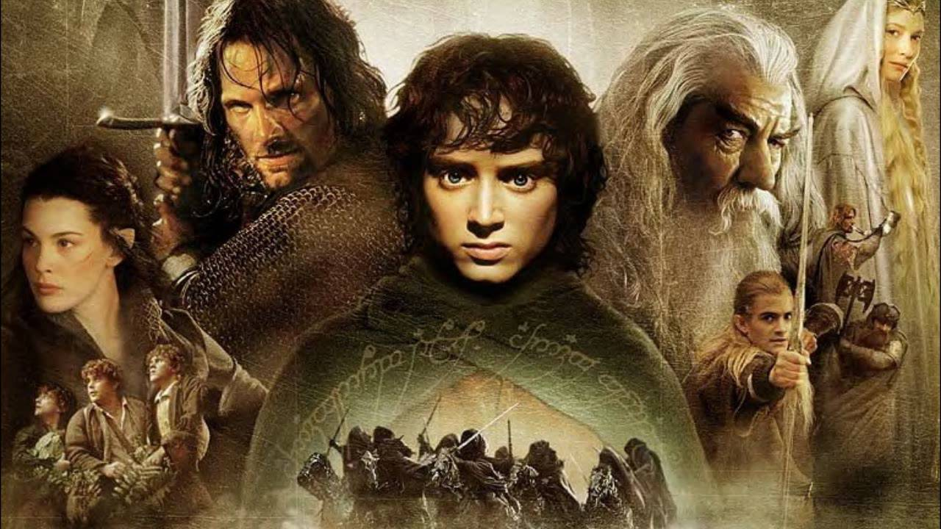
Supernatural
Making life choices
Courage
Survival

Slide 11

Graphic Novel
Facing violence
Family relationships
Courage

