Slide 1
Under Pressure:The Positives and negatives of sports
By: Alec McAuley

Slide 2
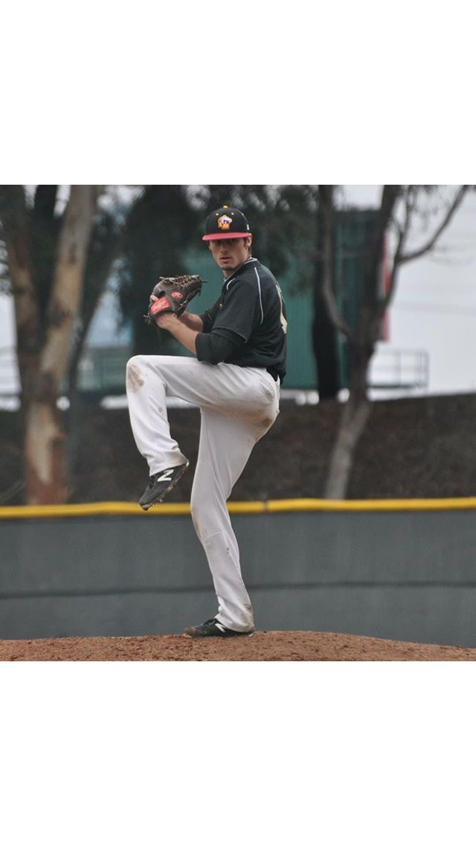
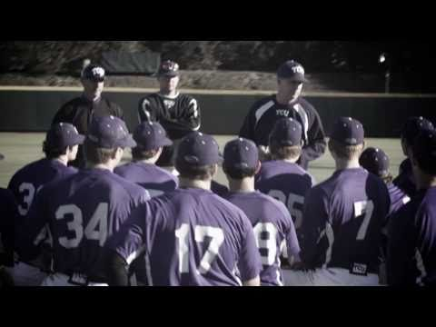
Introduction to the Unit

Slide 3

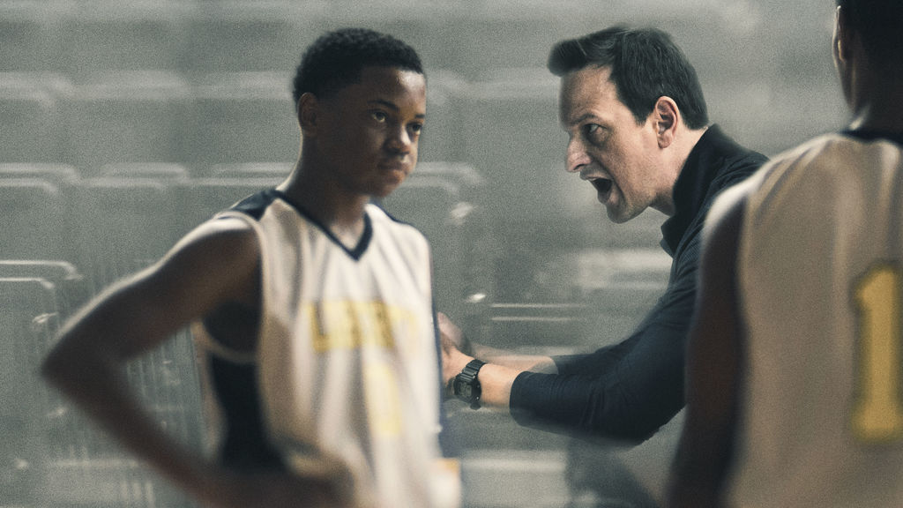
Launching the unit

Slide 4

Center piece work

Slide 5

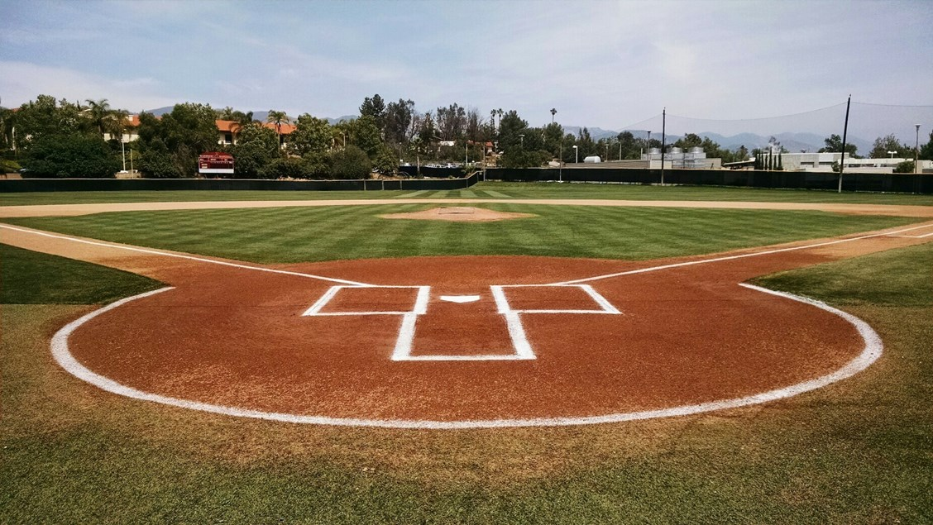
Extending the unit

Slide 6
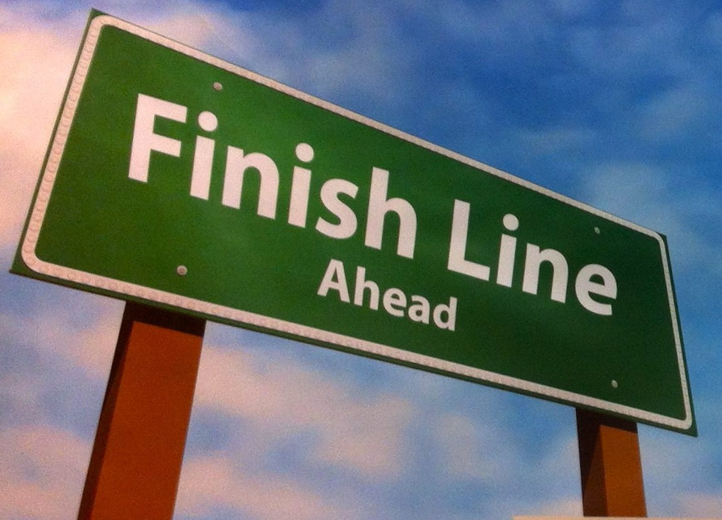
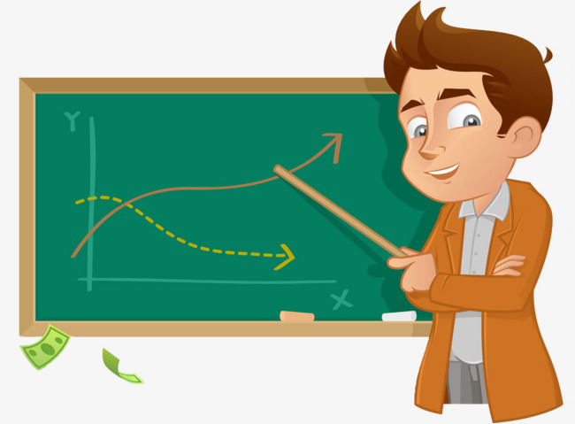
Final assignment

Slide 7
Similar novels
Whale Talk by Chris Crutcher
Ball Don't Lie by Matt De La Pena
Slam by Nick Hornby
Gym Candy by Carl Deuker
High Heat by Carl Deuker

