Slide 1
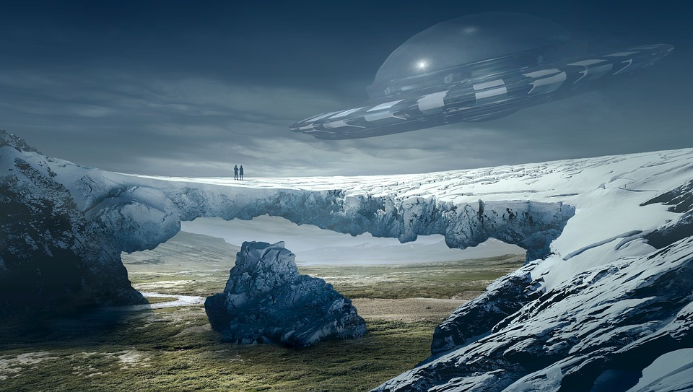
Surpassing the Ordinary,
With the Extraordinary

Slide 2
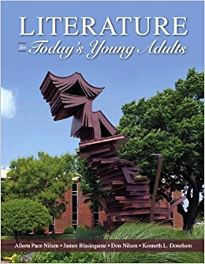
Point of the Extraordinary
“Perhaps more than any other form of literature, fantasy refuses to accept the world as it is, so readers can see what could have been (and still might be), rather than merely what was or must be.” (LfTYA 102).

Slide 3
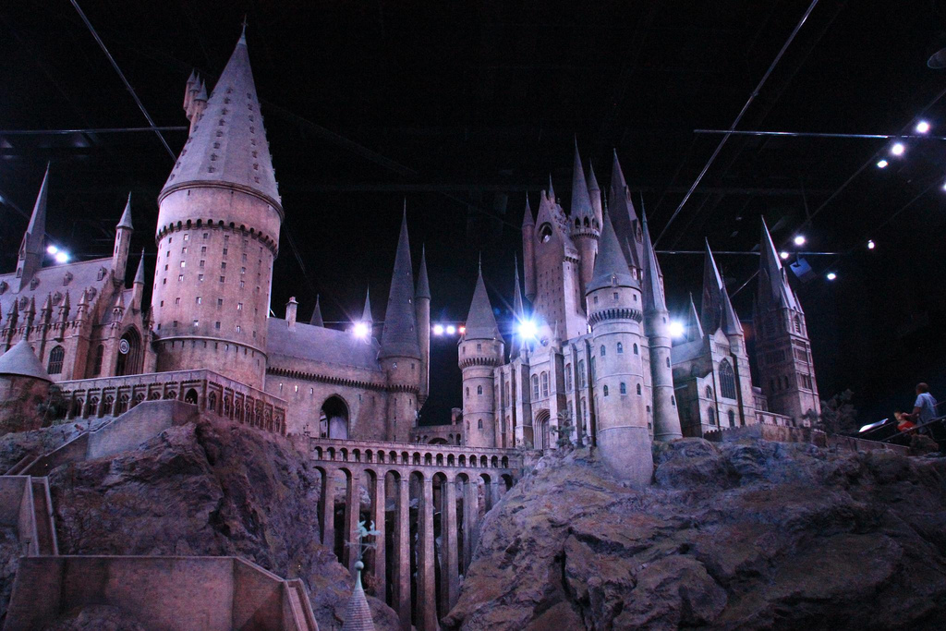
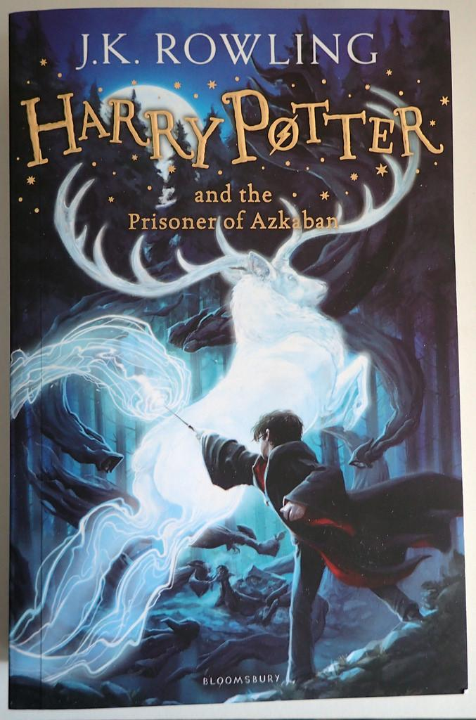
Fantasy: The World Apart
Fantasy gives readers a world that is so unlike their own, yet it is so similar to it. Perhaps that is why we want to be like Harry. In many ways we can be.

Slide 4
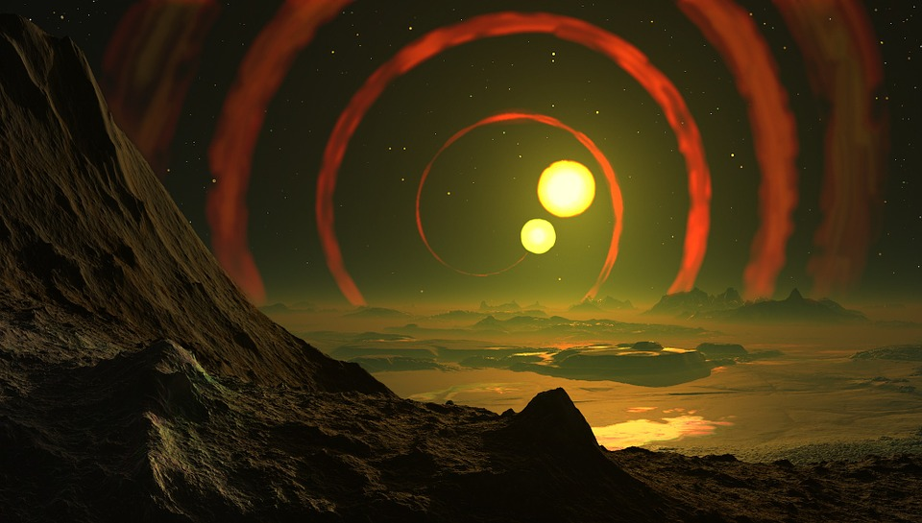
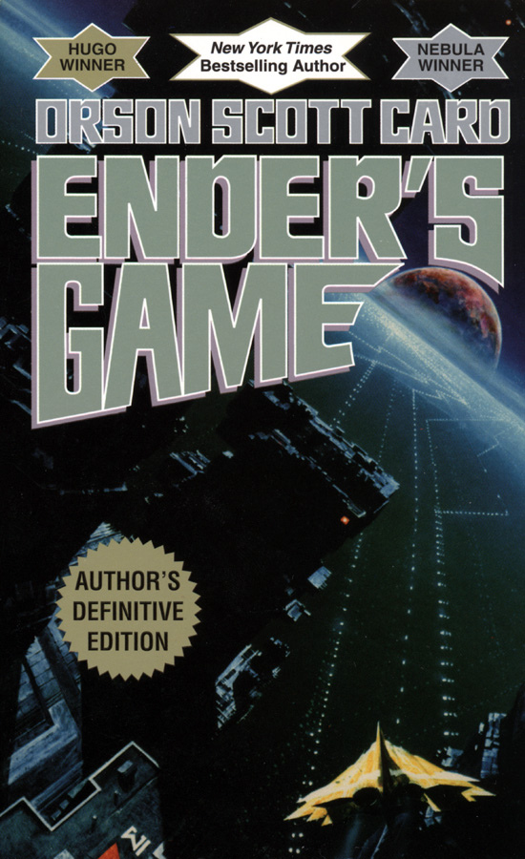
Science Fiction: The Space Around
Never “A World of Wonder” so much as it is “A Universe of Possibilities”.
A step closer to our reality, verging on the edge of the plausible and desired.

Slide 5
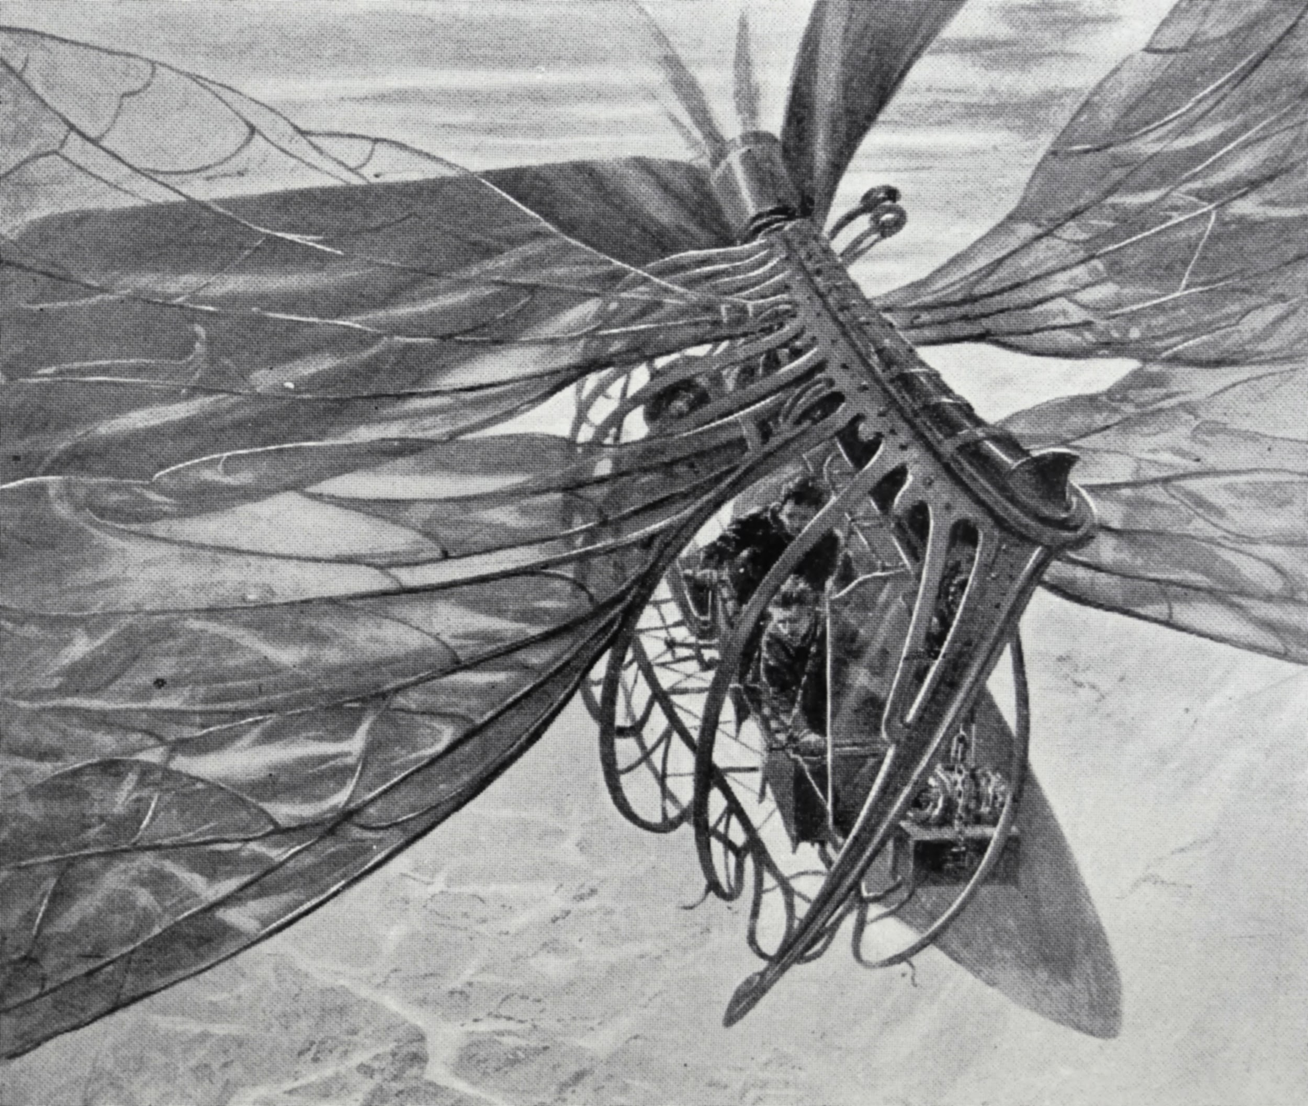
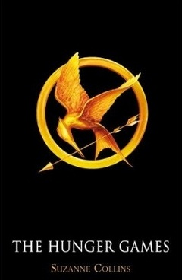
Dystopia/Utopia: The One Inside
In fictional worlds full of Chaos or a strange sense of Peace, readers learn what it means to be human. Our Humanity comes out the most when others need it, and is blocked in times when no one does.

Slide 6
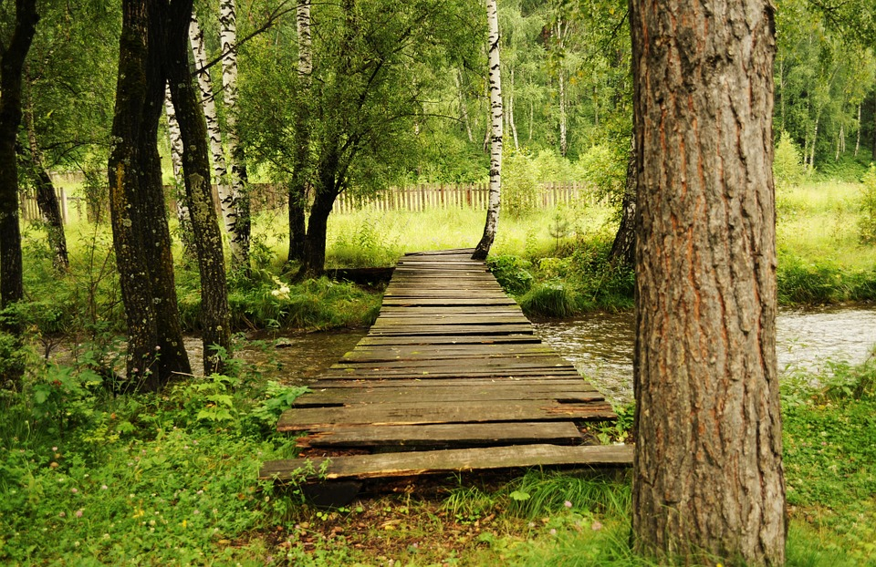

The “Bridge” Fiction Writers Makes
Sometimes, our greatest inspirations for writing fiction, comes from our non-fictional lives. It is also there that we find what makes characters the ones we root for...Courage.

