Slide 1
We’re All Mad Here
Ending the Stigma Around Mental Illness

Slide 2
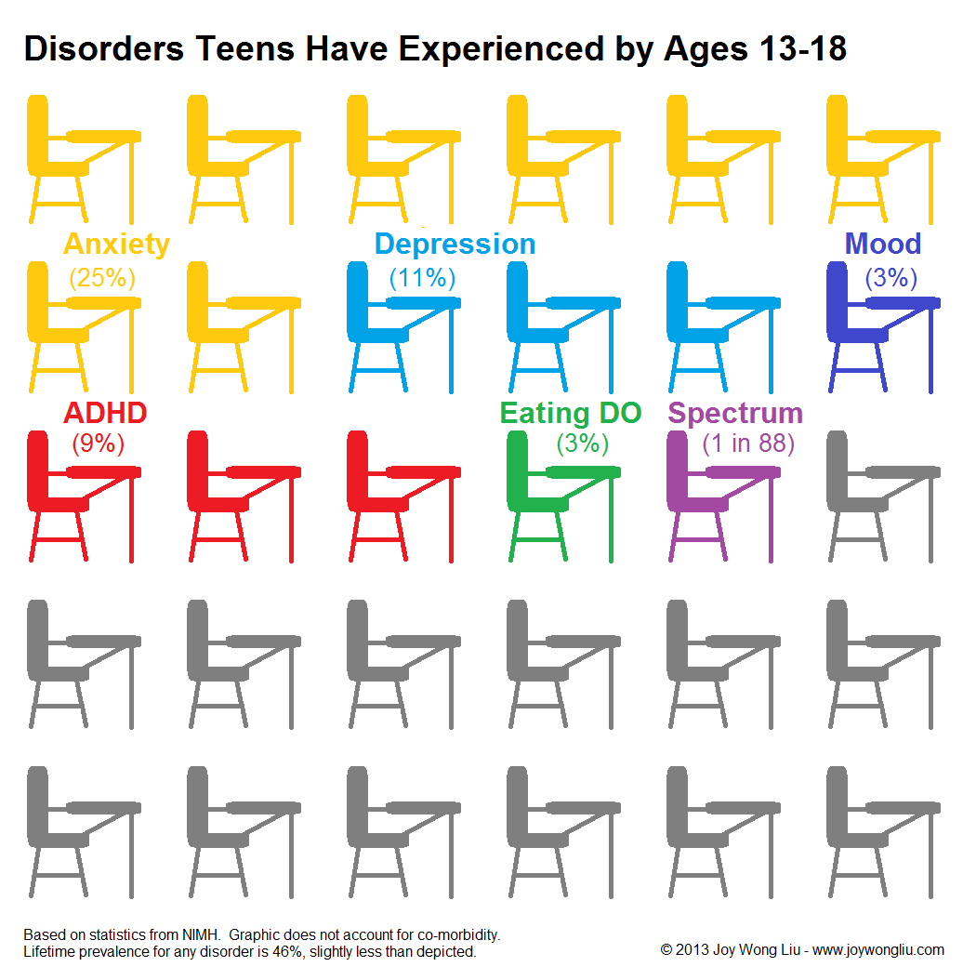
Rational
Statistics are showing that more and more students are experiencing mental illness yet schools still fail to address the issue
Schools talk about sex ed, drug and alcohol awareness, and physical health but not mental health
The only time mental health is brought up, perpetuates the fear
“Good teachers save lives”

Slide 3



Launching the Unit
What does mental illness look like?
Respecting Others’
Beliefs
Journals

Slide 4

The Unit
Individual YA Novels
Final Paper
“The Yellow Wallpaper”

Slide 5

Reflection
Wrap up the unit as a class
Information on where to seek help will be provided
Stress an open-door policy school-wide

