Slide 1

The
The Hero’s Journey

Slide 2
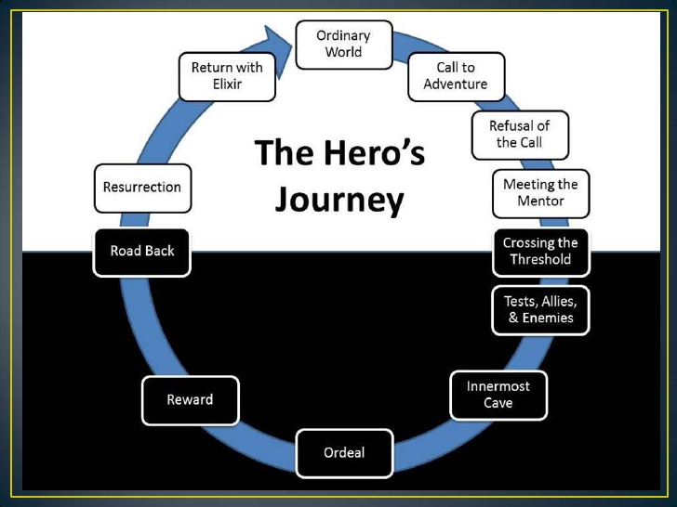
Image Source https://strayedwild.wordpress.com/the-heros-journey/

Slide 3
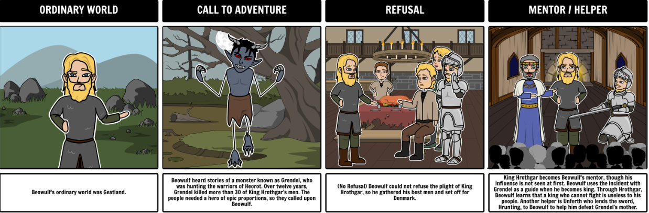
Beowulf and the Hero’s Journey

Slide 4
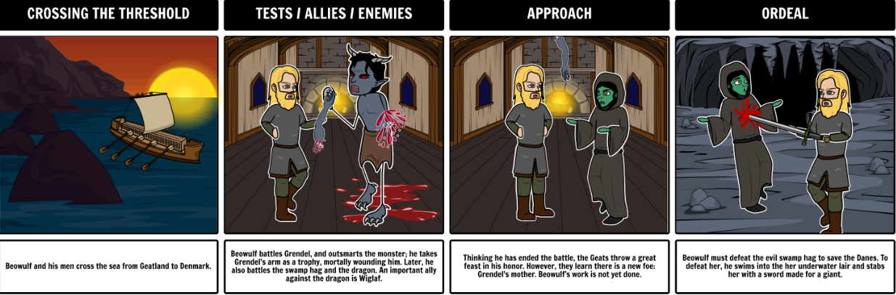

Slide 5
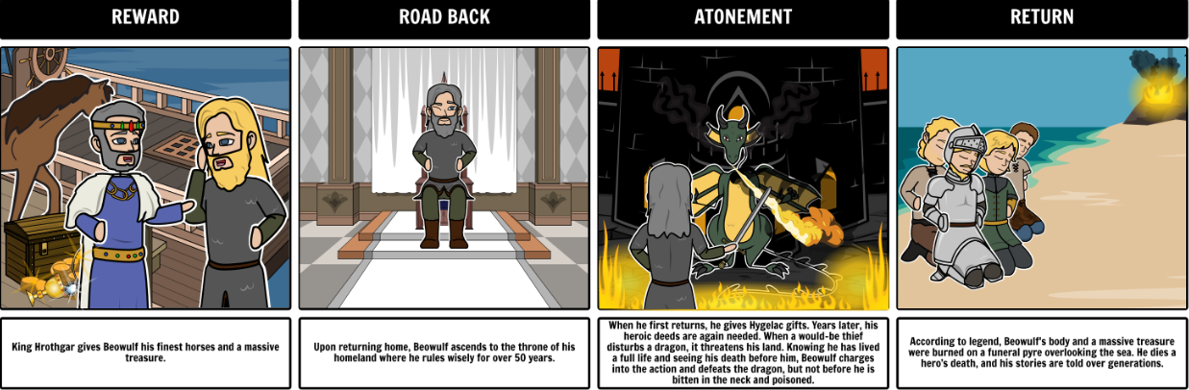
Art/Story Board provided by Rebecca Ray
http://www.storyboardthat.com/teacher-guide/beowulf

Slide 6
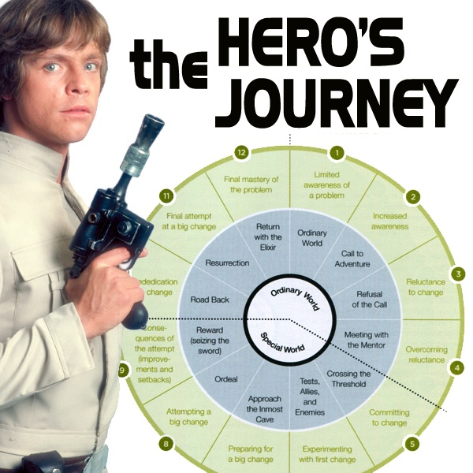
Image Source https://paradelle.wordpress.com/tag/heros-journey/

Slide 7



Slide 8
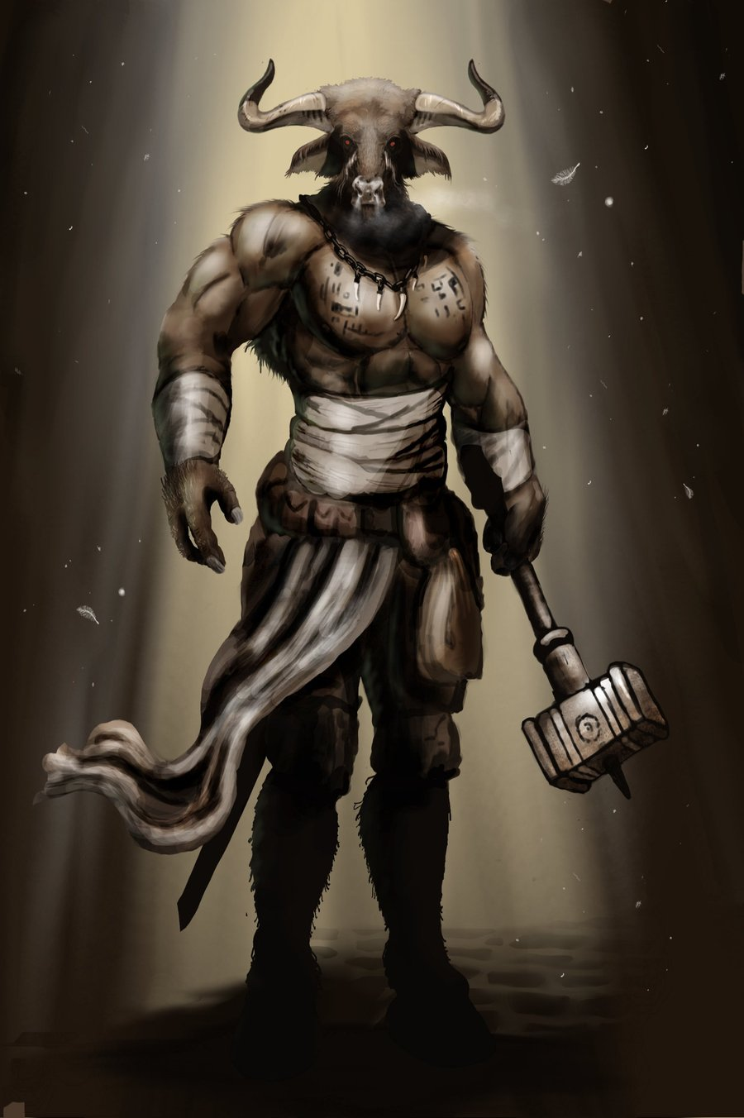
Failing to Answer the Call
King Minos’s mistake
Image source
http://animal-dream.com/minotaur.html

Slide 9



