Slide 1
Female Roles in Literature
Stephanie Visaya

Slide 2


1999
2012

Slide 3

“Sit Still, Look Pretty” - Daya
https://www.youtube.com/watch?v=uPHKkewD1G0

Slide 4
“Sit Still, Look Pretty”
Could dress up
To get love
But guess what?
I'm never gonna be that girl
Who's living in a Barbie world
Could wake up
And make up
And play dumb
Pretending that I need a boy
Who's gonna treat me like a toy
I know the other girlies wanna wear expensive things
Like diamond rings
But I don't wanna be the puppet that you're playing on a string
This queen don't need a king
Oh, I don't know what you've been told
But this gal right here's gonna rule the world
Yeah, that is where I'm gonna be because I wanna be
No, I don't wanna sit still, look pretty
You get off on your nine to five
Dream of picket fences and trophy wives
But no, I'm never gonna be 'cause I don't wanna be
No, I don't wanna sit still look pretty
Mister Right could be nice for one night
But then he wanna take control
And I would rather fly solo
Then Snow White
She did it right
In her life
Had seven men to do the chores
'Cause that's not what a lady's for
The only thing a boy's gonna give a girl for free's captivity
And I might love me some vanilla but I'm not that sugar sweet
Call me HBIC

Slide 5
Why is appealing to young girls important?
Back to the exeter qualities Literature for Today’s Young Adults:
“Characters who reflect experiences of teen readers, something that is not found in much of the literary canon, especially when it comes to strong female protagonists.”
Young girls, particularly ages of 10-14 at highest risk for suicide according to NPR.
Need for resources such as books, music, and movies to help them through the struggles of becoming a young adult.

Slide 6

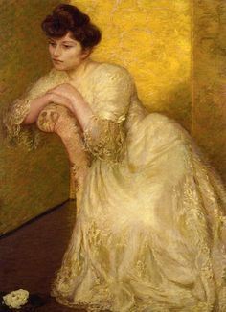
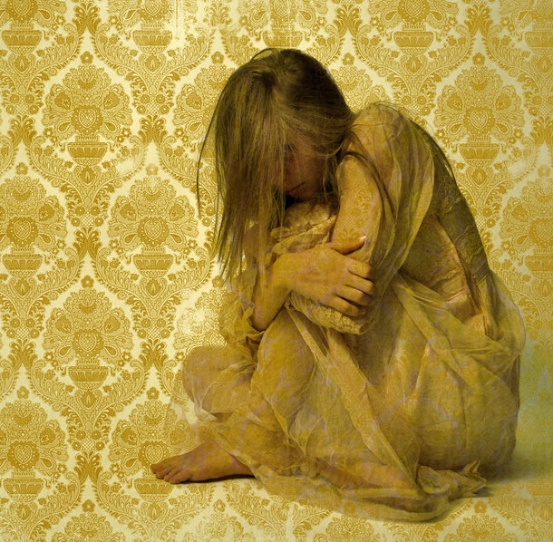
Looking at the Literary Canon
1892

Slide 7

Literary Canon
Themes of:
Immigration
  Culture
  Language
Female roles
  Stereotypes of girls
  Silence
1976

Slide 8
Literary Canon
The House of Mirth - Edith Wharton 1905
Theme of female roles in American society early 1900’s.
The Awakening - Kate Chopin 1899
Theme of female role in American society late 1800’s.
Anything by Jane Austen late 1700’s early 1800’s.

Slide 9
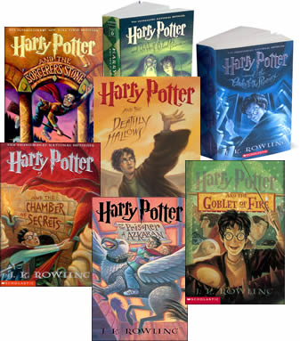


Relating to Students
1960
2008
1997-2000’s

Slide 10
Relating to Students - Book Talk presentations
Allana: The First Adventure - Tamora Pierce
Themes of gender stereotypes, patriarchal society, bullying. (Fantasy genre)
The Secret Life of Bees - Sue Monk Kidd
Theme of finding female identity without female role model.
Other examples:
White Oleander - Janet Fitch 1999
Themes of teenage struggles such as being an orphan, suicide, sex, drugs.

Slide 11
What about the boys?
Encourage students to use the same principles of Feminist Theory of challenging traditional roles of men.
Have all students write and explore issues of rhetoric:
“Man up!” “Stop being such a girl”
“Be a man!” “Don’t be a pussy”
“Boys don’t cry!” “Don’t be a bitch”
Have them come up with their own examples, and discuss why these are so commonly said. Also have them discuss how these are hurtful, perpetuating stereotypes.

Slide 12
Classroom Writing
Examples in the real world:
First have students write career paths they want to explore.
Then, have students discuss or write about careers they think only men or women can do? Why is this?
Idea starters: Nurses. Presidency. Stay-At-Home-Mom.
Group activity: Each group takes a given career and discusses the gender stereotype behind them, then shares as a class or as a presentation.

Slide 13
Works Cited
Collins, Suzanne. The Hunger Games. Web image.
https://www.google.com/search?q=the+hunger+games&biw=1208&bih=530&source=lnms&tbm=isch&sa=X&ved=0ahUKEwid3JLZsMzQAhUQ1GMKHY_BAe0Q_AUIBigB#imgrc=pjyPGMjUkgdy9M%3A
Cover womanwarrior.jpg. First edition. Author, Maxine Hong Kingston.
https://www.google.com/search?q=the+woman+warrior+by+maxine+hong+kingston&biw=1208&bih=530&source=lnms&tbm=isch&sa=X&sqi=2&ved=0ahUKEwioqbzXsczQAhUY4WMKHQoGCUUQ_AUIBygC#imgrc=6SMkc91Scdxg3M%3A

Slide 14
Island of the Blue Dolphins Paperback – February 8, 2010. Web Image.
https://www.google.com/search?q=island+of+the+blue+dolphins&biw=1208&bih=530&source=lnms&tbm=isch&sa=X&ved=0ahUKEwjzo7OYuszQAhVDzmMKHevaCvoQ_AUIBigB#imgrc=V5BBMD2mD2YlYM%3A
J.K. Rowling. Harry Potter book covers.
https://www.google.com/search?q=harry+potter&biw=1455&bih=638&source=lnms&tbm=isch&sa=X&ved=0ahUKEwipkLqVu8zQAhUL3GMKHTj3DEYQ_AUIBigB#tbm=isch&q=harry+potter+books&imgrc=hWDH13GNzk78dM%3A

Slide 15
Lilla Cabot Perry - The Yellow Screen. George Hitchcock - Calypso. Pintrest.com.
https://www.google.com/search?q=the+yellow+wallpaper+by+charlotte+perkins+gilman&biw=1208&bih=530&source=lnms&tbm=isch&sa=X&ved=0ahUKEwiPgLi7qczQAhXqqVQKHbfqCEAQ_AUICSgE#imgdii=09wWoMPonqOZNM%3A%3B09wWoMPonqOZNM%3A%3Bq2ve8IZrWOyqHM%3A&imgrc=09wWoMPonqOZNM%3A
Speak 1st Edition Cover.jpg. Book cover of 1st edition. Author, Laurie Halse Anderson
https://www.google.com/search?q=speak&biw=1208&bih=530&source=lnms&tbm=isch&sa=X&ved=0ahUKEwiQhYr-qczQAhXmwVQKHQmoC4wQ_AUIBygC#tbm=isch&q=speak+laurie+halse+anderson&imgrc=B0n4vU_Hb77ejM%3A

Slide 16
“The Yellow Wallpaper” Strangertogravity. Wordpress.com.
http://img01.deviantart.net/da71/i/2009/327/f/d/the_yellow_wallpaper_by_fit51391.jpg
"The Yellow Wallpaper". Yellowwp med.jpg. 1899 edition cover. Author, Charlotte Perkins Gilman
https://www.google.com/search?q=the+yellow+wallpaper+by+charlotte+perkins+gilman&biw=1208&bih=530&tbm=isch&source=lnms&sa=X&ved=0ahUKEwj8oN6Mp8zQAhUIh1QKHa4HCWMQ_AUIowIoAQ#imgrc=6fhVnlcjXii0bM%3A
Wasserman, Robin. The Book of Blood and Shadow. Web.
https://www.google.com/search?q=speak&biw=1208&bih=530&source=lnms&tbm=isch&sa=X&ved=0ahUKEwiQhYr-qczQAhXmwVQKHQmoC4wQ_AUIBygC#tbm=isch&q=speak+laurie+halse+anderson&imgrc=B0n4vU_Hb77ejM%3A

