Slide 1
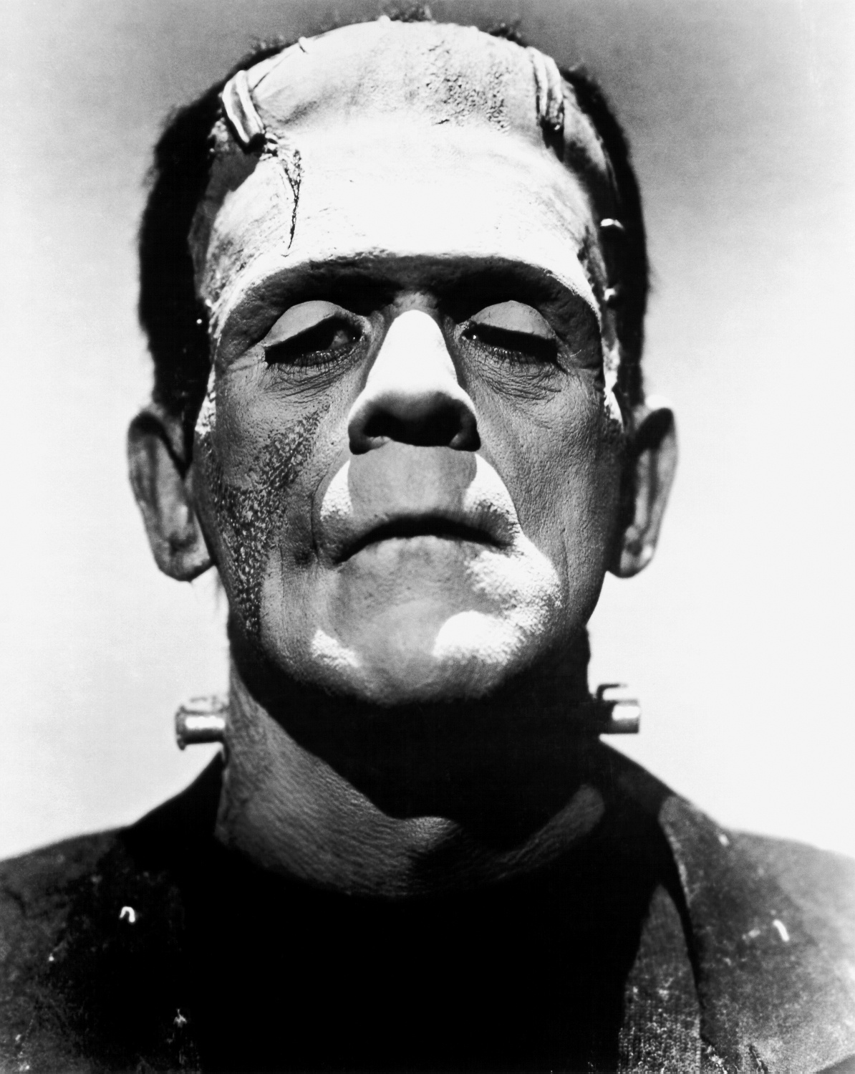
Notes:
What is this… thing’s name? This person? This monster?

Slide 2
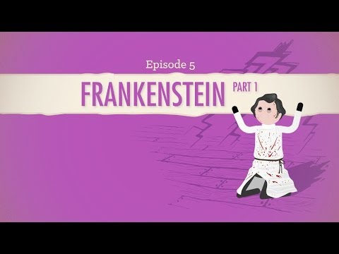
John Green: Man or Machine?

Slide 3
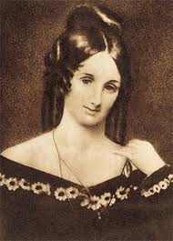
Mary Shelley
Mother of Science Fiction
Paragon of Horror
Awesome Woman

Slide 4

Romanticism and Gothicism
How and Why Romanticism and Gothicism Got Started and How it Still Affects Literature

Slide 5
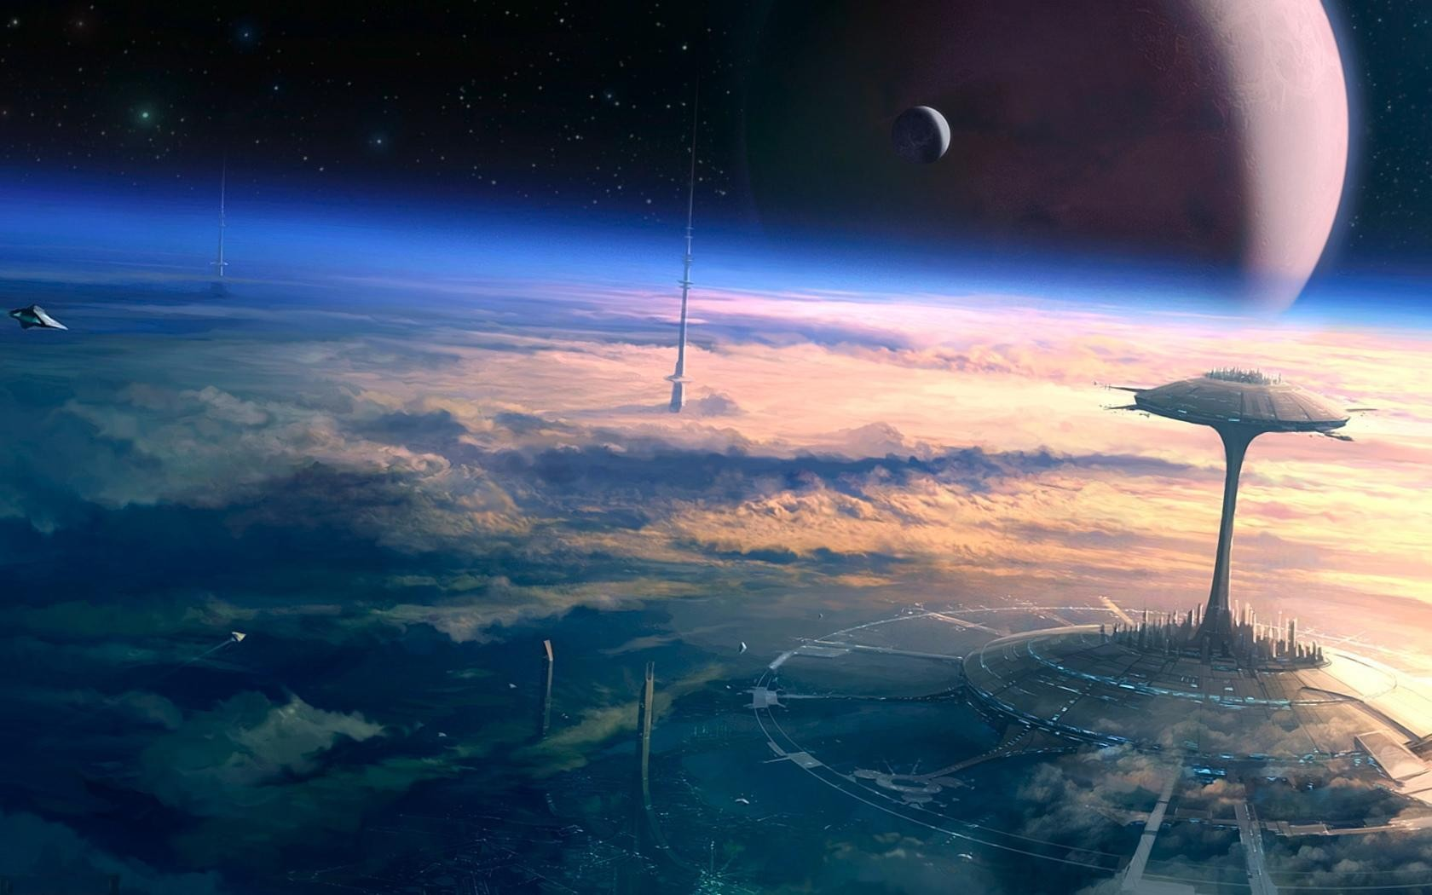
Science Fiction
Why Science Fiction is Important

Slide 6
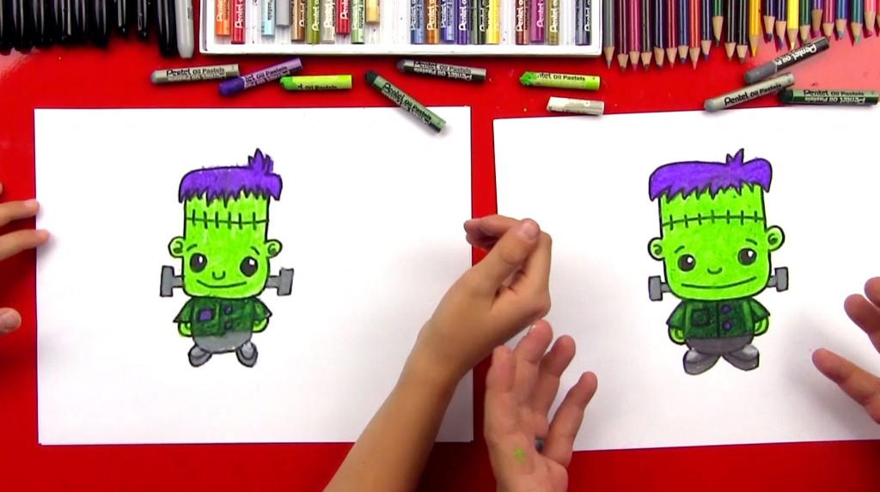
The Assignments
1: In-Class Essay
2: Take-Home Essay

Slide 7
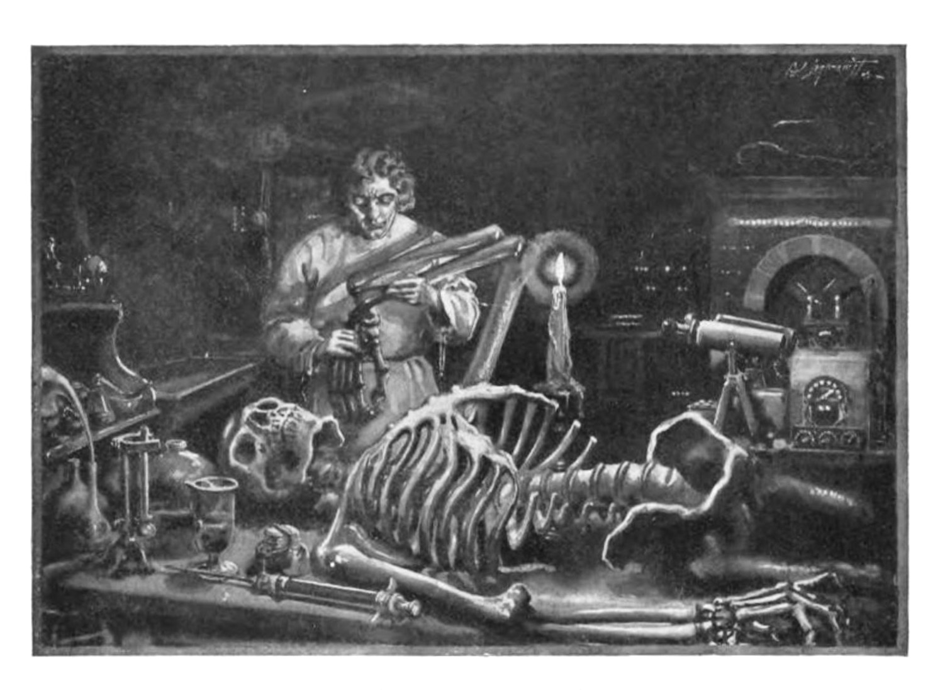
The Assignments
(cont.)
3: Creative Work
4: Group Project

Slide 8

The Reading Journal
Five quotes per week
Short quote analysis on each -- One to two sentences maximum.
Can be done during SSR/SSW
Students have the option to replace some of their quotes with a reference to Frankenstein they found in popular media
Helps them find connections and applications.

Slide 9
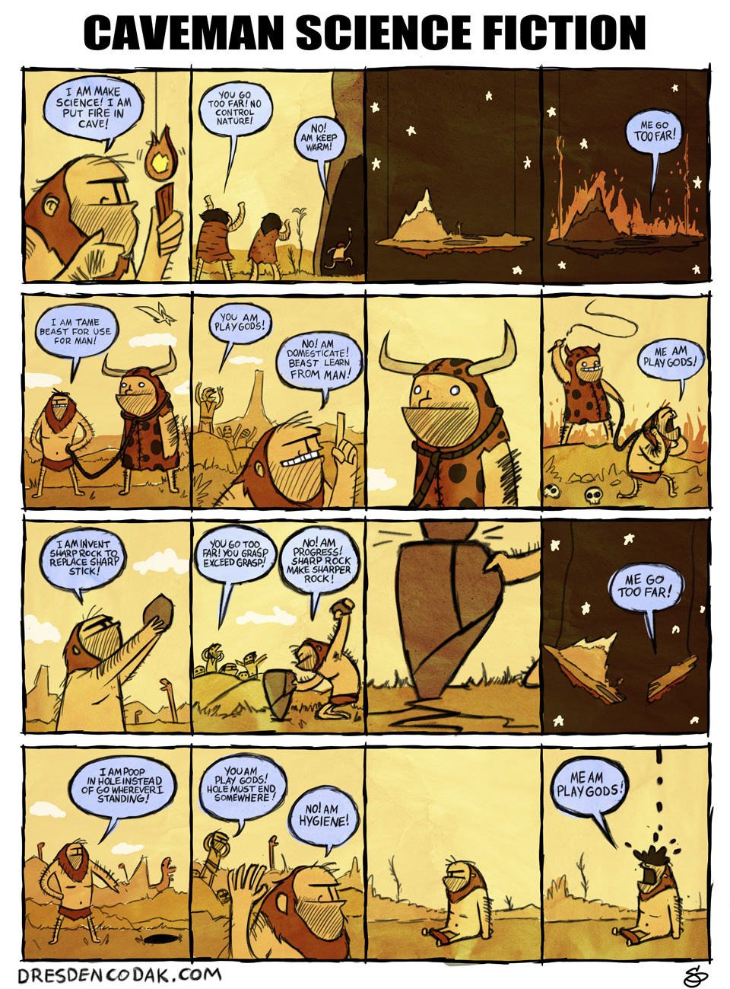
Additional Resources
Short Stories
  Lost Little Robot by Isaac Asimov
  The Tell-Tale Heart by Edgar Allen Poe
Books
  City of Ember by Jeanne DuPrau
  Wintersmith by Terry Pratchett
Music
  Pursuit of Happiness by Kid Cudi
  The Rake’s Song by The Decemberists
Poetry
  Rime of the Ancient Mariner
  Jonathan Swift and Lady Montagu
Film
  The Nightmare Before Christmas
  2001: A Space Oddysey
Misc.
  Dresden Codak by Aaron Diaz

Slide 10
Additional Resources
Short Stories
  Lost Little Robot by Isaac Asimov
  The Tell-Tale Heart by Edgar Allen Poe
Books
  City of Ember by Jeanne DuPrau
  Wintersmith by Terry Pratchett
Music
  Pursuit of Happiness by Kid Cudi
  The Rake’s Song by The Decemberists
Poetry
  Rime of the Ancient Mariner
  Jonathan Swift and Lady Montagu
Film
  The Nightmare Before Christmas
  2001: A Space Oddysey
Misc.
  Dresden Codak by Aaron Diaz

