Slide 1
Young Adults Finding Purpose through Philosophy
Unit of Study by Emma Jenny

Slide 2
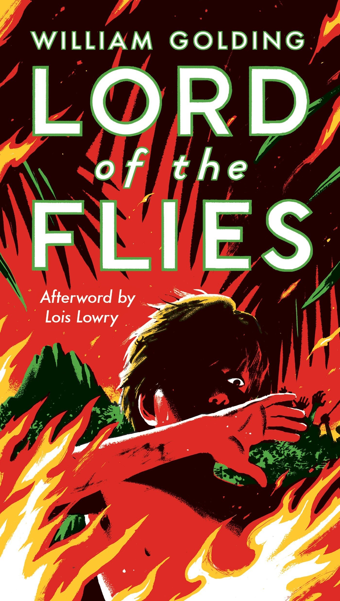
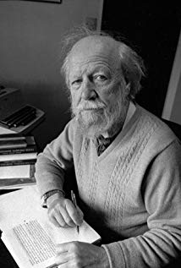
Lord of the Flies
Background of William Golding
Summary of novel
Authors and philosophers alike attempt to answer existing questions including morality, free will, death, politics, and existence itself
Centerpiece by William Golding

Slide 3
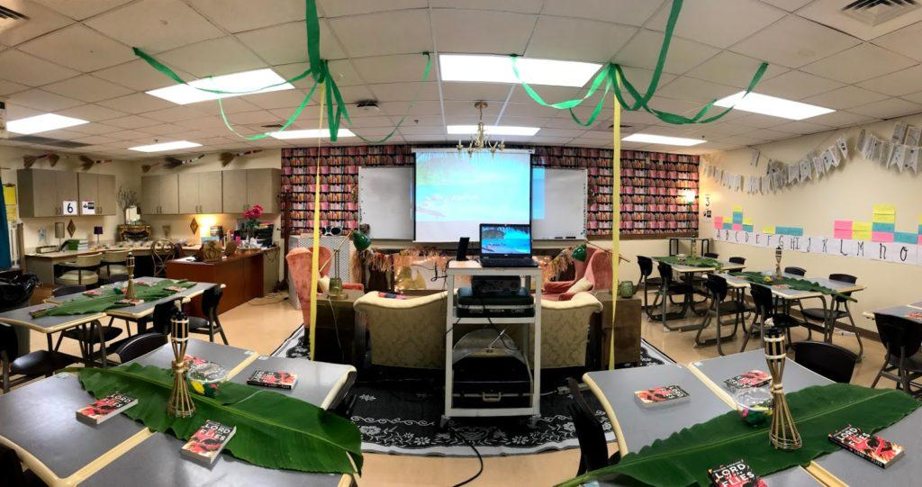
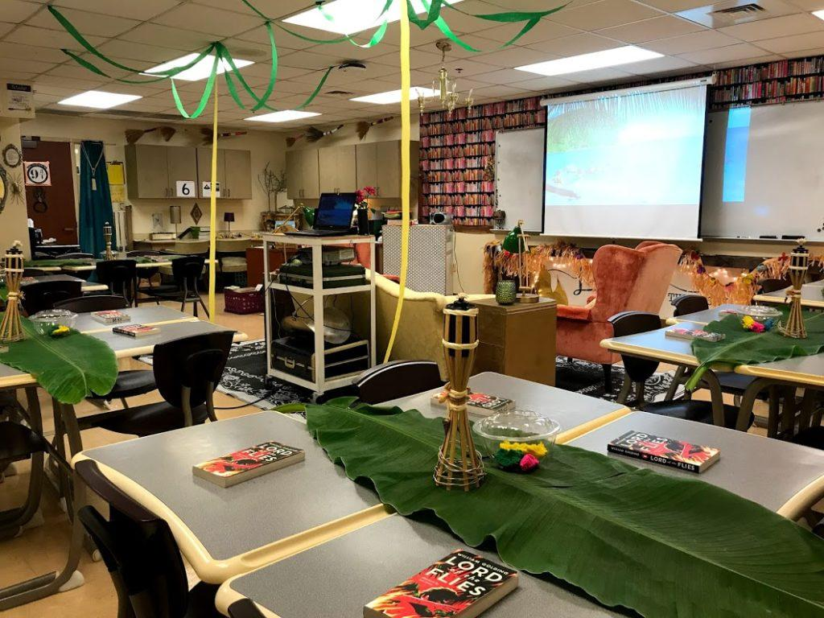
Introduction to Unit
SCENARIO EXERCISE:
If you were stranded on an island and allowed to have anything you need to survive, list 3 things you could not live without and why (no cell phones work because there is no service).
Would your new community have laws? If yes, list 3 main laws and a sentence explaining why each law is essential. If not, give a brief rationale explaining why the absence of laws would be beneficial on an island.
Would you elect a leader of your community? Why or why not?
Would you assign roles and responsibilities to your peers stranded on the island? If yes, what would these roles be? If not, why not?
How would you try to signal passing ships or planes for help?
Source: https://buildingbooklove.com/lord-of-flies-introduction-and/
Source: https://buildingbooklove.com/lord-of-flies-introduction-and/

Slide 4
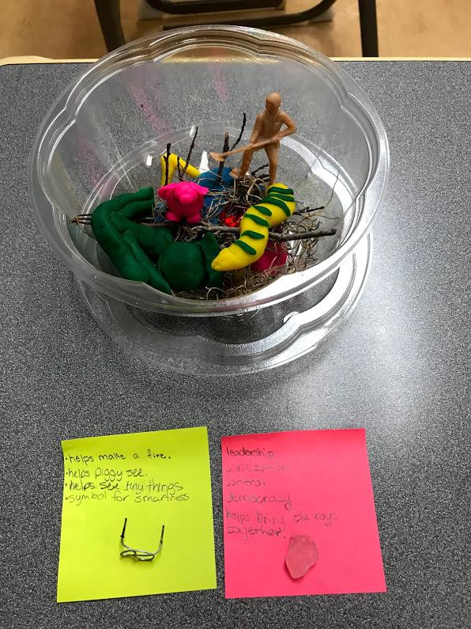
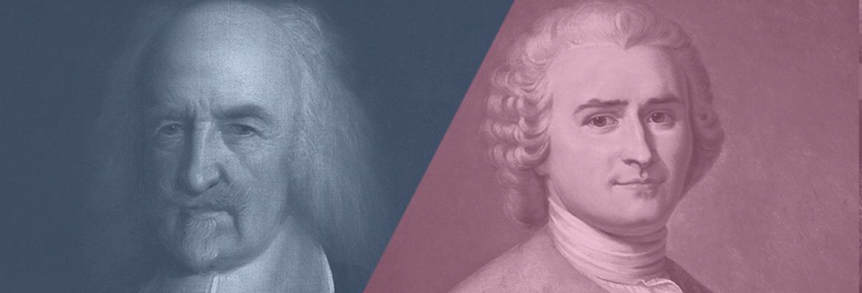
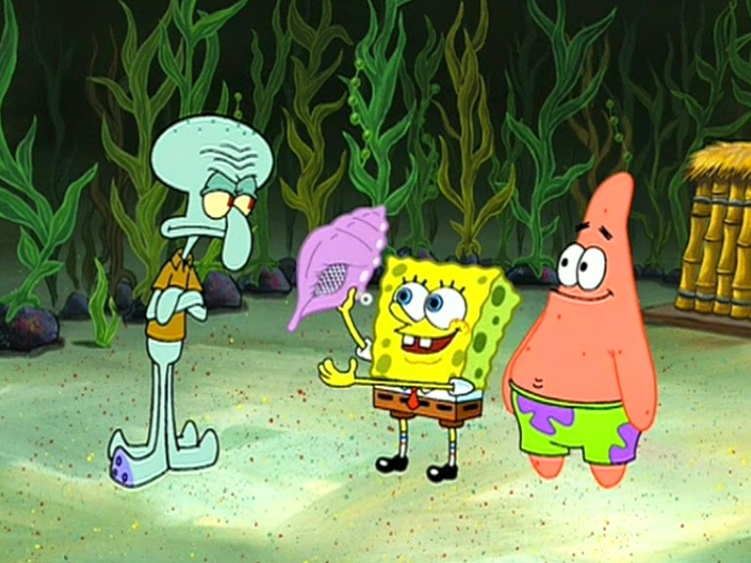
During the Unit: Journal Entries
Microcosm Activity
Rosseau v. Hobbes
Character Playlist
Gender Roles
Spongebob and the Magic Conch
Source: https://buildingbooklove.com/lord-of-flies-introduction-and/
Source: https://iai.tv/articles/hobbes-vs-rousseau-are-we-inherently-evil-or-good-auid-1221
Source: http://spongebobsquarepants15marathon.blogspot.com/2014/07/club-spongebob.html

Slide 5
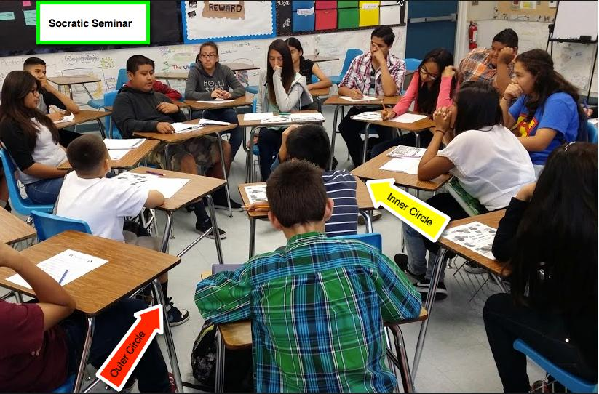
During the Unit: Socratic Seminar
Source: http://jscho791.weebly.com/socratic-seminars.html
In the Lord of the Flies, the boys are introduced to a concept of living without rules or laws, and it ultimately falls apart. However, societies with too many laws in place, such as North Korea or prison, are miserable to live in. Would you rather live in a society with too many laws or no laws at all? Are laws more harmful than helpful to society?
Golding suggests that evil naturally exists inside all of us as humans. Are people automatically born evil, good, or both?

Slide 6
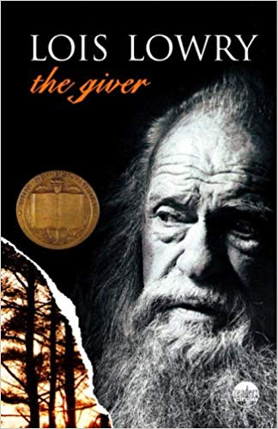

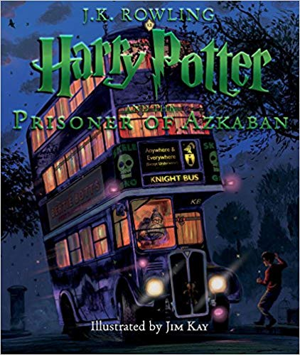
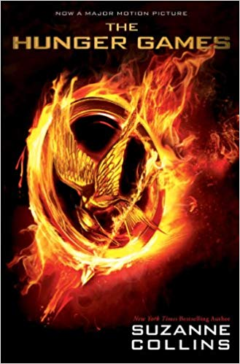
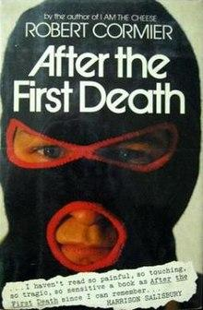

Continuing the Unit
Source: https://www.amazon.com/Giver-Lois-Lowry/dp/0385732554
Source: https://www.amazon.com/Scar-Island-Dan-Gemeinhart/dp/1338053841
Source: https://www.amazon.com/Harry-Potter-Prisoner-Azkaban-Illustrated/dp/0545791340/ref=sr_1_1?crid=3QK4XC3H6C1ER&keywords=harry+potter+and+the+prisoner+of+azkaban&qid=1574742142&s=books&sprefix=Harry+Potter+and+the+p%2Cstripbooks%2C192&sr=1-1
Source: https://www.amazon.com/Hunger-Games-Movie-Tie/dp/0545425115
Source: https://en.wikipedia.org/wiki/After_the_First_Death
Source: https://www.amazon.com/Witness-Karen-Hesse/dp/0439272009/ref=sr_1_1?crid=3TCXDQQLPOKX5&keywords=witness+karen+hesse&qid=1574742175&s=books&sprefix=witness+k%2Cstripbooks%2C180&sr=1-1

Slide 7
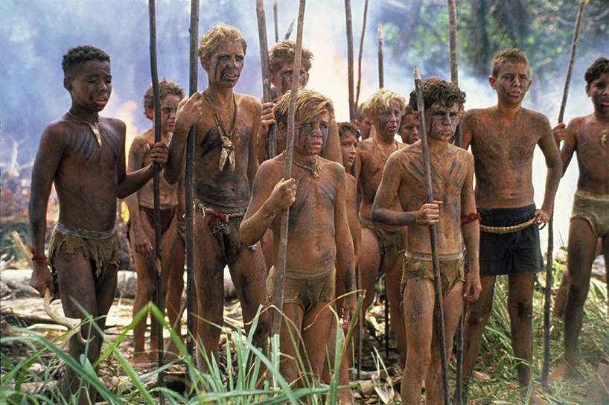
Concluding the Unit
Extra Credit: Movie Viewing
Final Project: Presentation
Students will divide into groups and present similarities and differences between the Lord of the Flies and the YA novel in a 7-10 minute powerpoint
They will be required to include overlapping philosophical concepts and include one journal entry from each novel in their presentations
Source: https://www.flare.com/tv-movies/lord-of-the-flies-remake/

