Slide 1
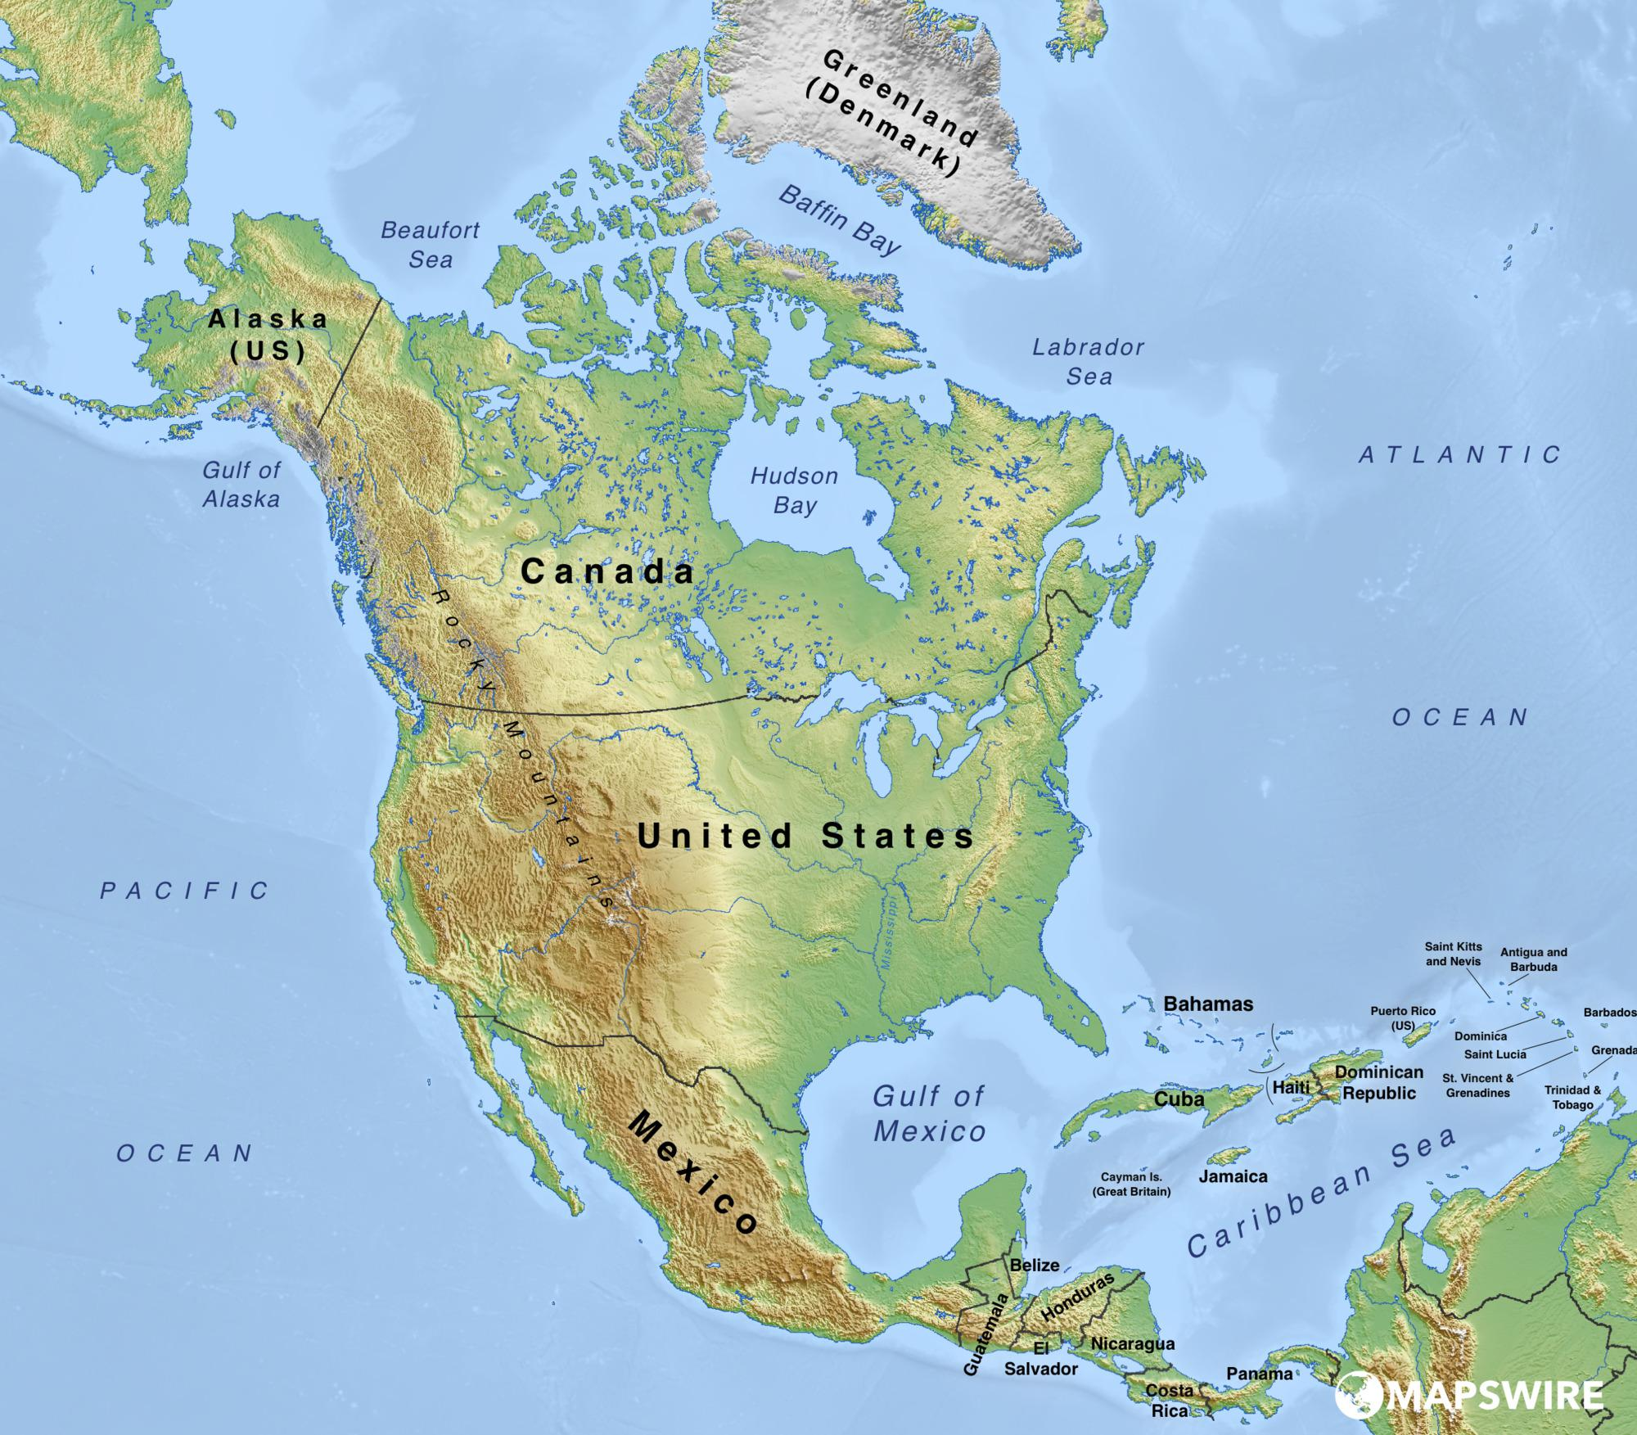
Journey of Empathy
Rodrigo Garcia Padilla
Dr. Mary Warner
English 112B

Slide 2
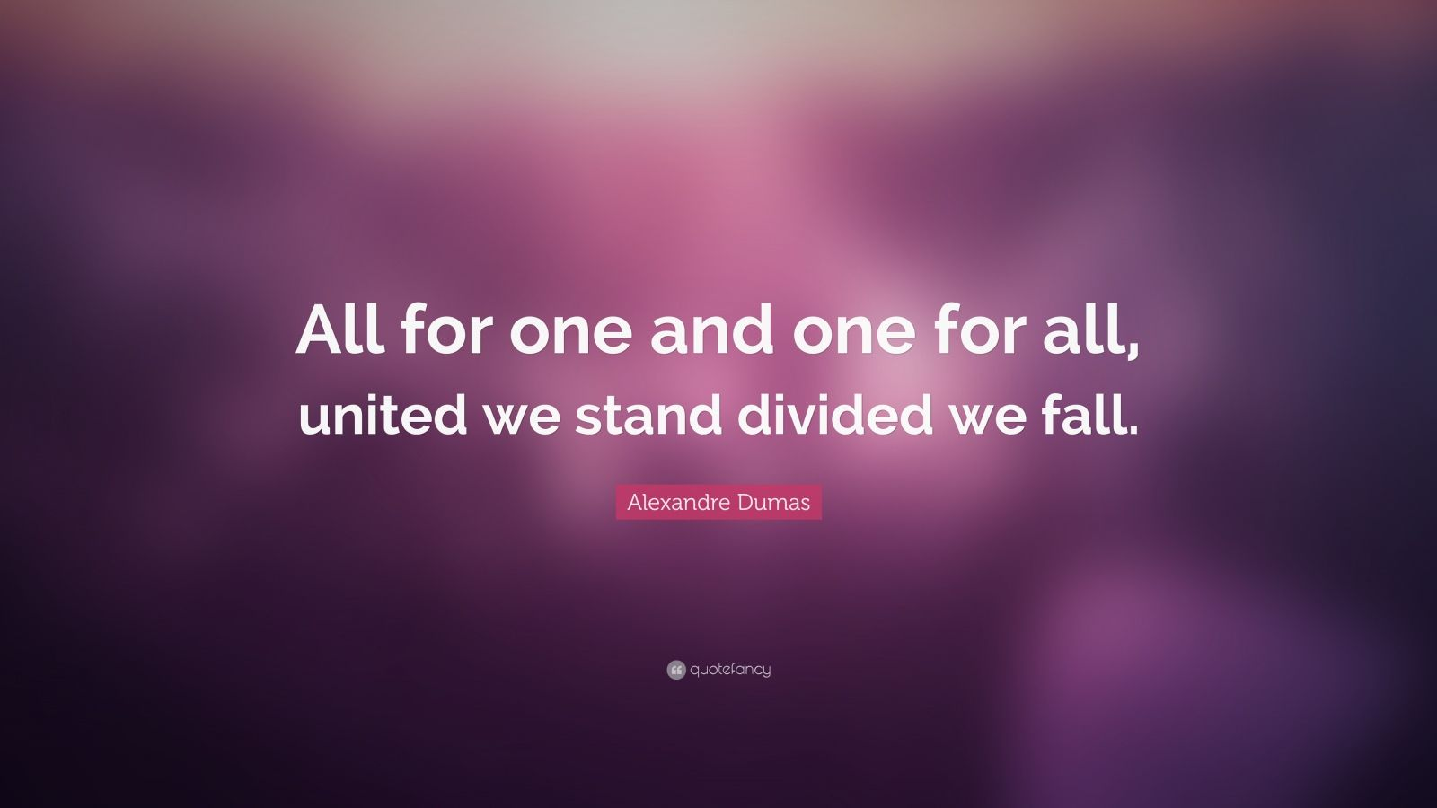

Slide 3
Coming Together Through Experience
“There are some things you can’t share without ending up liking each other, and knocking out a twelve-foot mountain troll is one of them.”
JK Rowling, Harry Potter and the Sorcerer’s Stone
“You never really understand a person until you consider things from his point of view… Until you climb insides of his skin and walk around it.”
Harper Lee, To Kill a Mockingbird

Slide 4
Essay Writing
“For in Calormen, story-telling (whether the stories are true or made up) is a thing you’re taught, just as English boys and girls are taught essay writing. The difference is that people want to hear the stories, whereas I never heard of anyone who wanted to read the essays.”
CS Lewis, The Chronicles of Narnia: The Horse and His Boy

Slide 5


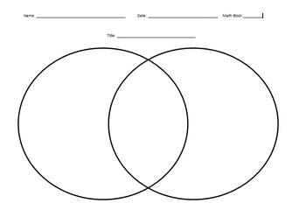
Journey of Difference & Explanatory Essay

Slide 6
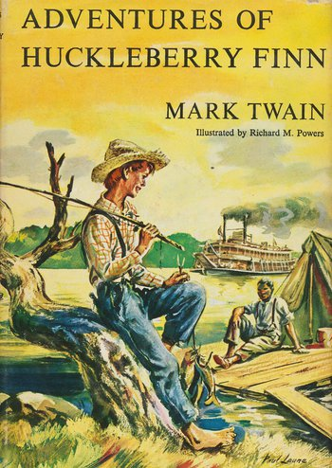
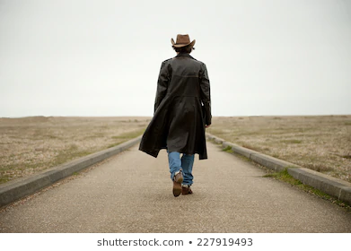


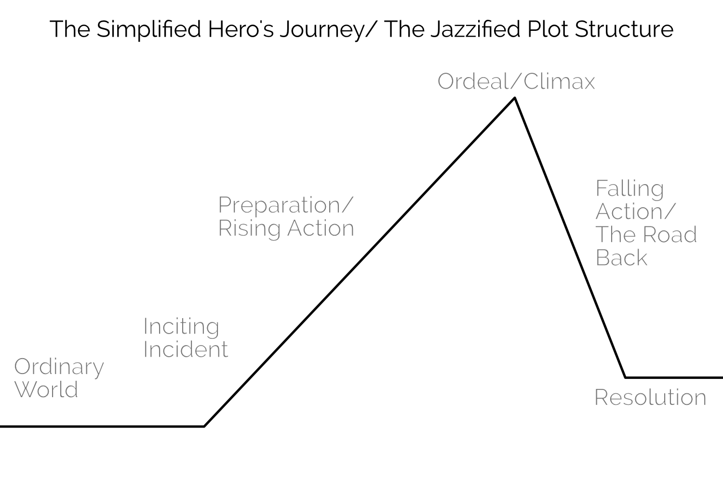
Journey of Discovery & Personal Narrative
Students can choose any of the 3. Place bets on which wins.

Slide 7

Friday’s
United
Classroom
Karma
If entire class gets 70%+ on reading check quizzes and turns in Quote Logs, then they don’t have to turn in anything and get an instant 100%

Slide 8
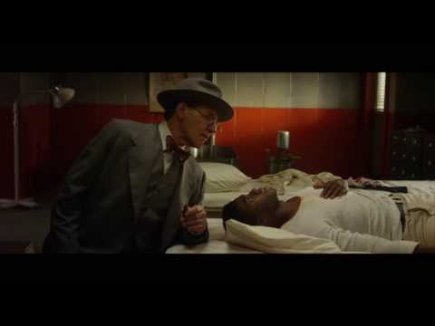
Sample of F.U.C.K. Day Discussion Starter
https://www.youtube.com/watch?v=hwaLBeDQCWc&t=0s&index=140&list=LLY7KY8t_sHDqGMEiD3eQJIQ
Compare Mr. Rickey to Atticus Finch.
Discuss whether Mr. Rickey is motivated by guilt or empathy.
Why is seeing a “little white boy” pretend to be Jackie Robinson important? How can someone like Jackie Robinson help fight against prejudice?

Slide 9
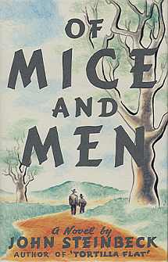


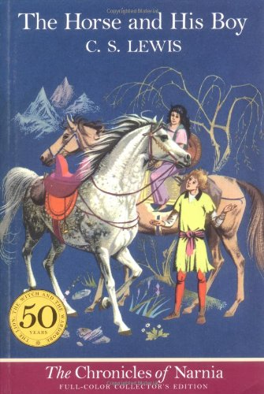
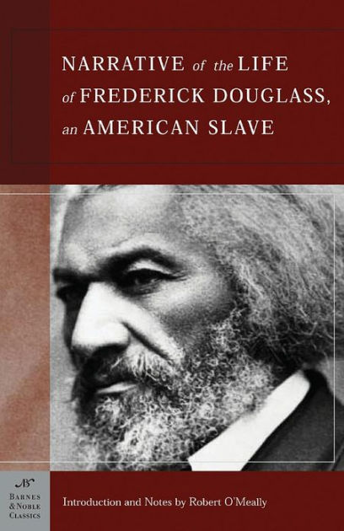

Journey of a Dream & Argumentative Essay

