Slide 1
Unit of Study
By: Marmar Mirways

Slide 2
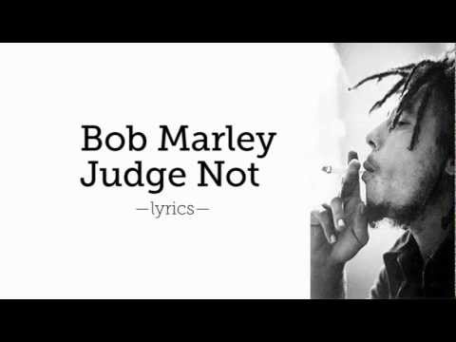
Clue...

Slide 3
Perspective Change
Rationale
Young adults- one viewpoint
Survival and loss
Novels that deal with perspective changes help young adults to…
“[teens] need to understand the wise saying, ‘Do not judge a person until you have walked a mile in his moccasins’” (AITSFM 169)
The novel shows the theme that…
Back in high school…
Uninspiring teacher…
No excitement
Started to read a novel titled…
Liked the way that Twain portrays…
Helped me understand…

Slide 4
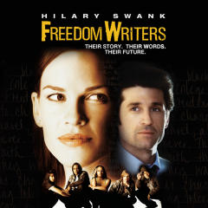
Introducing the Unit…
Movie
Freedom Writers
The movie follows the story of…
Journal entries...
Watching this movie will help…
https://www.amazon.com/Freedom-Writers-Hilary-Swank/dp/B00AEFY17E

Slide 5
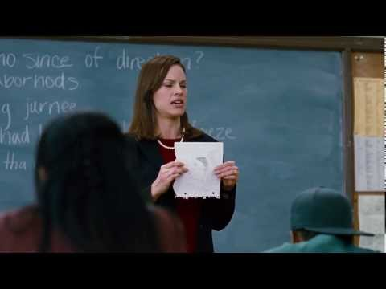

Slide 6
In Class Activity
Quick write
How has this movie changed the way you view others around you?
Has this movie encouraged you in some way or form?
Have the students also keep a journal…
Through these journal entries…

Slide 7
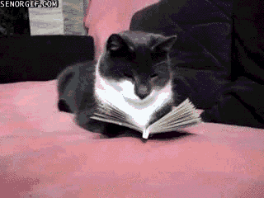
Book Pairings
https://media.giphy.com/media/8O6EY0lahfInC/giphy.gif

Slide 8
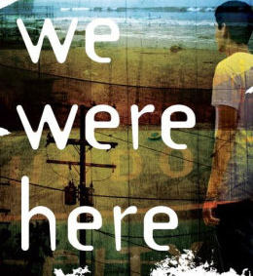
Novel No.1
Journal idea…
All three characters are…
Relates to Huckleberry Finn…
Dialect...
https://www.barnesandnoble.com/w/we-were-here-matt-de-la-pe-a/1109694116#/

Slide 9
In-Class Activity
1.
Do the characters change as a result of events in the story? If so, how?
2.
Why do you think Mong decides to commit suicide? Find supporting evidence in the book.
3.
What is the symbolism behind Mong’s necklace and why does he give it to Miguel? Find supporting evidence in the book.
4.
What kind of bond do Miguel and Rondell have? What event makes them bond more?

Slide 10
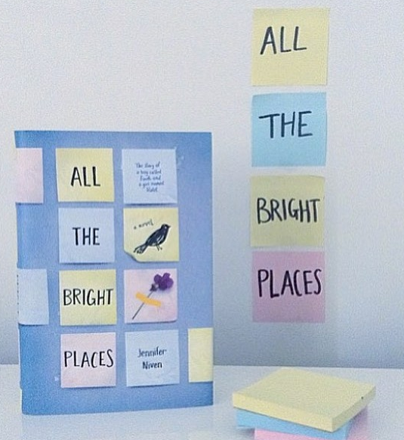
Novel No.2
Gives insight to…
Includes some sort of…
“Germ”
Post-it notes…
Suicide is a…
Reading this novel is a great way to…

Slide 11
The process is easy...
Introduce unit in a fun way (movie).
Delve into the main book
Wrap up with similar themed books, movies, songs, etc.
Song about being judgmental → Judge Not- Bob Marley

Slide 12
Thanks!
Works Cited
“Freedom Writers.” The Showdown, YouTube, 10 Oct. 2013, www.youtube.com/watch?v=HU_BueZZNd8.
Marley, Bob. “Judge Not.” YouTube, 10 Oct. 2013, www.youtube.com/watch?v=HU_BueZZNd8.
Warner, Mary L. “Books about Facing Death and Loss.” Adolescents in the Search for Meaning: Tapping the Powerful Resource of Story, Scarecrow Press, 2006, pp. 169-195.

