Slide 1

Gabi, A Girl in Pieces
By Isabel Quintero
Book Talk by Guadalupe Rodriguez

Slide 2
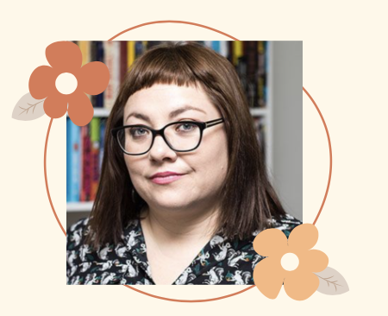
Isabel Quintero
ABOUT THE AUTHOR:
Before becoming a well known writer, Quintero attended San Bernardino California State University where she received both her B.A and M.A in English. Afterwards, she worked various education related jobs such as being an AVID tutor, a substitute, and even an English high school teacher.
Quintero prides herself in being the daughter of Mexican immigrants. Her Mexican roots are visible in her works such as in Ugly Cat and Pablo and My Papi Has a Motorcycle. Her books have been awarded the California Book Award Gold Medal, Morris Award for Debut YA Novel, and other various awards.
https://theauthorvillage.com/presenters/isabel-quintero/

Slide 3
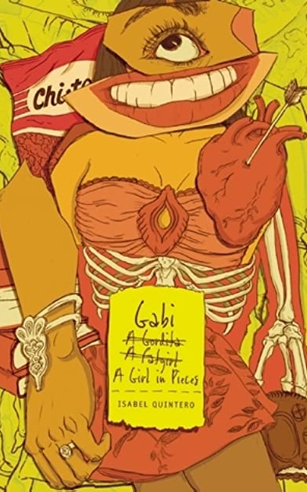
SUMMARY OF THE NOVEL
Gabi navigates her senior year of high school while simultaneously juggling her love life, her meth addict father, and her best friends’ problems all while being in a strict Mexican household. Her pregnant best friend Cindy and her gay best friend Sebastian have to figure out a way to overcome the societal rules of Mexican culture which frowns upon sexually active teens and anybody that might be part of the LGBTQ+ community. The closer Gabi’s graduation day approaches the more she realizes that she must balance the social customs of being both Mexican and American in order to figure out who she is and where she fits in.

Slide 4
“My dad is a drug addict. A meth addict— as in crazy and desperate and never mentally here. But no one in our house ever says those words: drugs, addict or meth. It’s like we are forbidden to use them. My mom says, “Tu papa anda mal.” As if he just has the flu and a bowl of chicken noodle soup will fix him right up. But he’s an addict and has been since I was a little kid. I remember when I was in elementary school, he would ask to borrow money all the time. I think even then I knew what it was going towards, but I gave it to him anyway. What was I supposed to do? He’s my dad.”
Page 29

Slide 5

Analysis of Mexican Taboos
QUOTE 1
It is important to note that Gabi talks about her father’s meth addiction relatively early on in the novel which emphasizes how big of an issue this truly is to her. She feels as if everyone else including her mother simply sweeps her father’s addiction under the rug. If nobody acknowledges and talks about his addiction then there is no way he will be receiving any type of help. Gabi has always known about his problem, but now that she is older she is coming to terms with how problematic it is to pretend this battle doesn’t exist.

Slide 6
“But tía Agi felt sick and said things like “Cochinos! Que asco! You should be ashamed of yourselves!” And they were. She sent Sebastian to a psychologist to talk him out of being gay (I guess she’s not as understanding as we thought). And yesterday she sent for a priest who threatened him with God— of course, because everyone knows that the mission that God has left for his worshippers is to hate people and damn them to hell. Finally, she forbade pink shirts, satchels and guy friends who would tempt them with their sinful penises. He is only allowed to talk to me and Cindy because maybe we could make him straight. Maybe she hoped we’d show him our mighty vaginas and fuck the gay out of him.”
Page 66

Slide 7
LGBTQ+ acceptance
QUOTE 2
Sebastian’s tia, Agi, catches him and his boyfriend, Pedro, making out in his room which unleashes her homophobia. She goes from being the “cool” and “accepting” tia to completely mistreating Sebastian for his sexual identity. She even goes as far as calling them “cochinos” which is a very hurtful Spanish term that translates to dirty.
This quote is important because it depicts the cruel reality of persons of color that are part of the LGBTQ+ community. They are met with backlash from their families and sometimes even forced to attend conversion therapies that are known for using barbaric techniques. It is ironic that in Mexican culture families would prefer Y/A to be hypersexual as long as they’re heterosexual.

Slide 8
“She’s a walking contradiction-she wants me to be a strong woman and not let any man tell me what to do, but she also wants me to be obedient and behave like a nice young lady (whatever the hell that is): a virgin, I am sure, but what else? A good cook? A good reader? Someone who can make tortillas with one hand tied behind her back? Being a virgin can’t be the only thing that makes you a “nice young lady” because I know plenty of girls who are virgins, but could never be called nice-young-anythings because they are straight-out spawn of Satan.”
Page 275

Slide 9
Being a “nice young lady”
QUOTE 3
Gabi starts questioning what it truly means to be a nice young lady considering her own mother constantly contradicts her meanings of this. Sometimes she tells Gabi to be independent and other times she tells her to be submissive.
This quote highlights the constant struggles of young women trying to meet the expectations of others. Being a virgin is one of the biggest indicators of a pure lady in Mexican culture, yet this seems like an unjust expectation of young women and not men.

Slide 10
Text Complexity
The qualitative complexity of this book is much higher than the suggested quantitative level. The Dale-Chall Formula suggests this book for fifth graders, but I would suggest this book to be better understood by 10th-12th graders because of the heavy themes and raunchy language that is used. There are many explicit scenes regarding sex, drugs, and body issues that 5th-6th graders would not be mature enough to comprehend.
Dale-Chall Formula
Raw score 1.6492
Adjusted Score: (3.6365 + 1.6492)
Final Score: 5.3
New Dale-Chall Readability Index:
Grade level: Grades 5 - 6
Qualitative Complexity: 10th-12th graders

Slide 11
Teaching this novel in classrooms
Diary Entries
Read Gabi’s selection of poems
Create a zine
Write short poems
This book is written with dated diary entries. Students can emulate Gabi’s diary by keeping a small notebook where they simply write about their day.
In the novel, Gabi gets exposed to poetry through her poetry class and Martin. Students can analyze the same poems Gabi gets exposed to. Eg: The Rape of the Lock by Alexander Pope, “Tonight I Can Write” by Pablo Neruda, “A Red, Red Rose” by Robert Burns, Shakespeare’s Sonnet 130,
Gabi expresses her hatred of how womens’ bodies are oversexualized through her zine. Students can create their own zines about social issues they care about.
Gabi deals with her emotions by writing poetry about loved ones that have passed, her crushes, and even simply food she loves. Students can write their own short poems about either loved ones or food.

Slide 12
Adolescents in the Search for Meaning: Tapping the Powerful Resource of Story
Chapter 4: Real-life experiences
Chapter 5: facing loss & death
Chapter 6: Identity
Gabi and her friends struggle with navigating their last year of high school. In particular, Gabi also struggles living in a dysfunctional family where her father is absent and her aunt takes the “father” role.
Gabi faces her father’s death which deeply impacts her. She learns to openly mourn her father’s and grandfather’s passing by writing letters and poetry about them.
Sebastian deals with the consequences of coming out as gay to his homophobic family. He struggles with deciding if his openness about his identity is worth losing his family.

Slide 13
Why teens should read this book?
Something for everybody..
Gabi, A Girl in Pieces covers a wide range of subjects such as sexuality, body image issues, sexual assault, peer pressure, friendship, and teen pregnancy. This novel could resonate with many students considering there is something for everybody to be interested in.
Humor and teen “slang”..
As mentioned previously, the book heavily relies on humor to alleviate some of the darker themes that are present. Using humor to cope with these heavy topics allows the readers to easily digest this book. There is also common teenage “slang” that makes the tone more lighthearted and funny.
Finding oneself like Gabi..
Gabi struggles with finding herself while juggling her personal life and simultaneously trying to pursue a higher education. Gabi’s experiences can resonate with high school students that feel the stress of trying to juggle everything in their lives.

Slide 14
Thank you!

