Slide 1
The Blade design
Tutorial

Slide 2
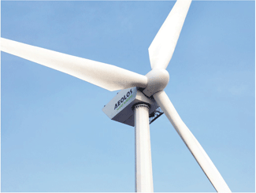
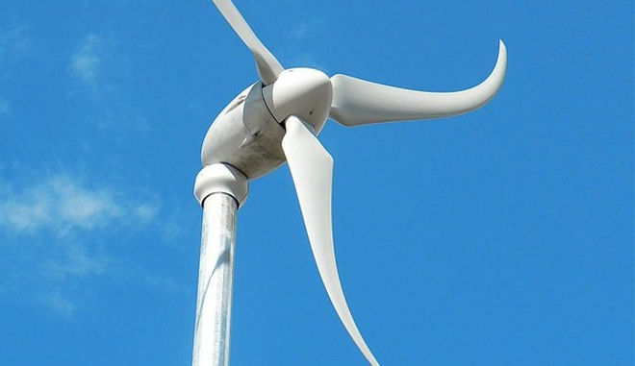
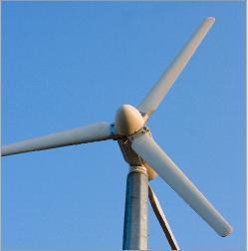
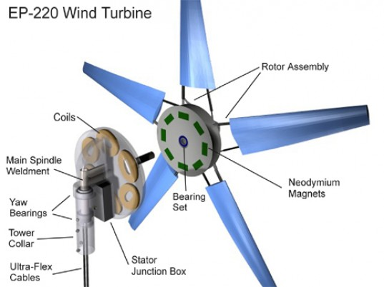
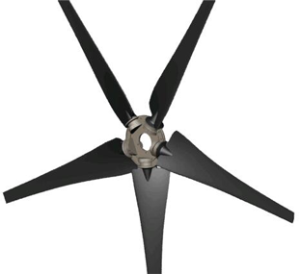
Various Blade designs

Slide 3
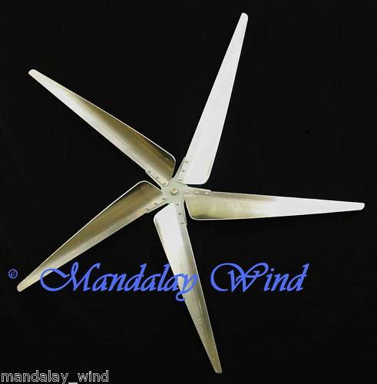
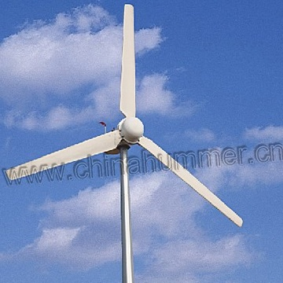
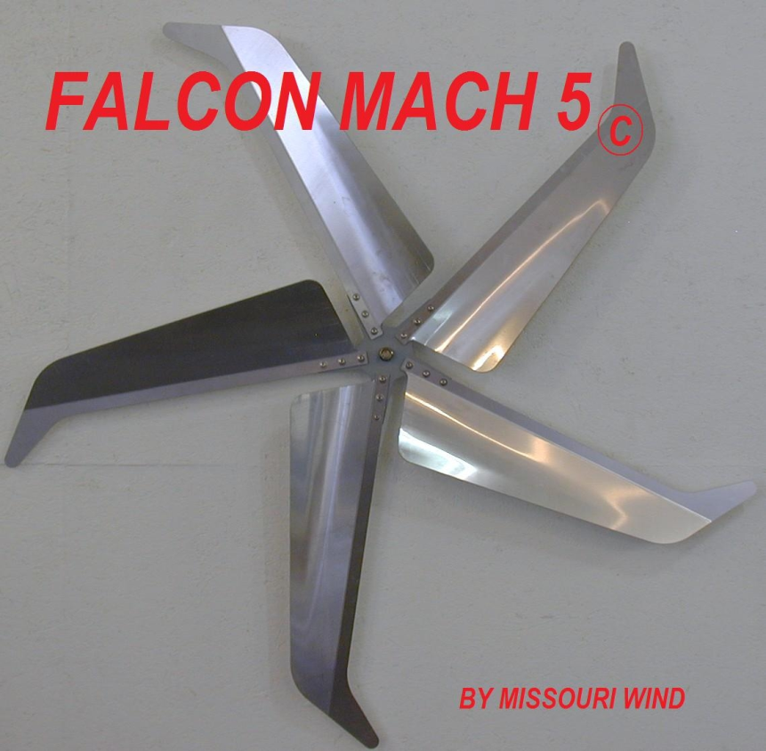

Slide 4
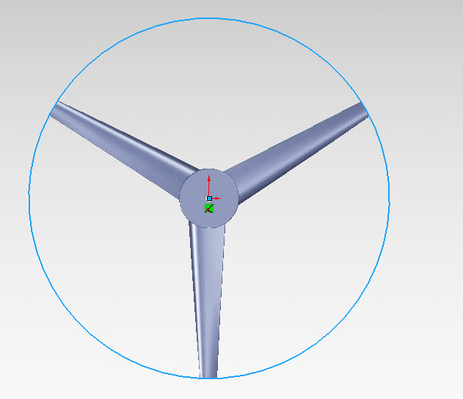
The Blade Shape
Design groups should conduct a thorough search of the Internet to obtain information on wind turbine blade design and efficiency. Based on your research, decide on the number and general shape of the blade.
Constraints:
Total dimension of the turbine blade assembly (diameter of the swept area) should not exceed 6 inches.
The propeller must fit within the 6 inch diameter circle
6 in.

Slide 5

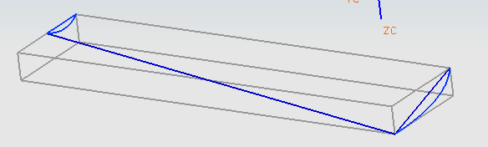
The Blade Shape
Blade length, measured from the edge of the hub, should not exceed 2.5 inch.
Blade height is limited by the thickness of the hub. It should not exceed 0.25 inch.
There are no constraints on blade width (.7 dimension)
Length 2.5 in. max allowed
Height
.25 (hub thickness)
.7 in
Width (up to you)
The tutorial in the following slides is based on the blade geometry and shape shown above.

Slide 6
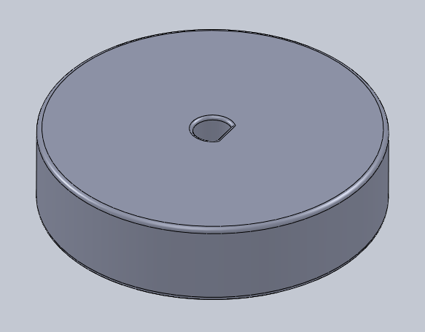
Modeling the Wind Turbine Blade
The hub for the wind turbine blade has been modeled using SolidWorks. Use the following link to download the file “Hub” from Canvas in Wind Turbine Module

Slide 7
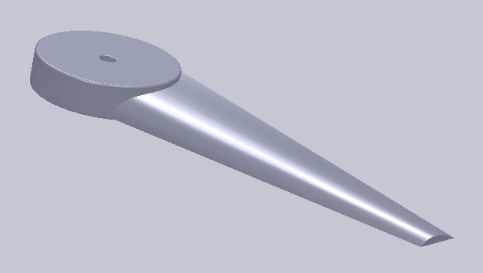
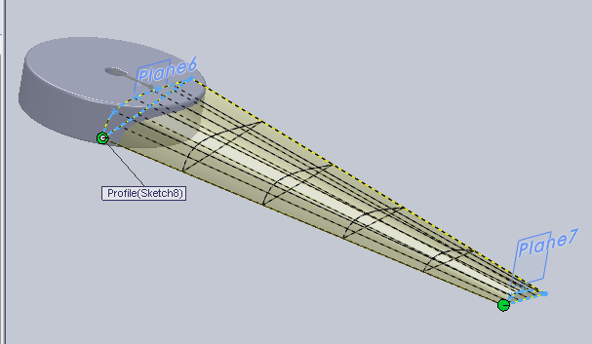

Slide 8
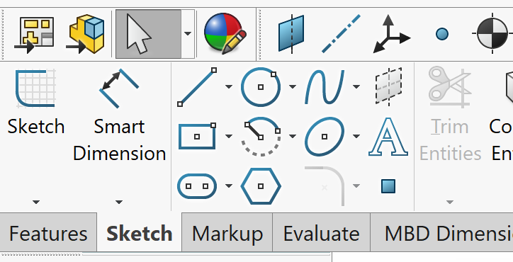
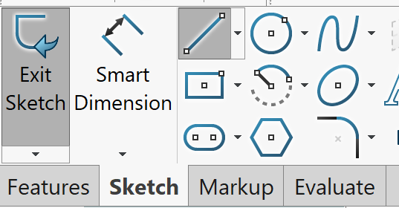
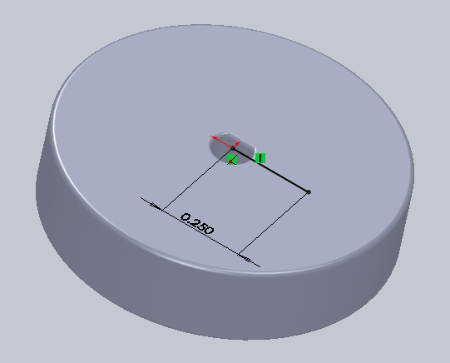
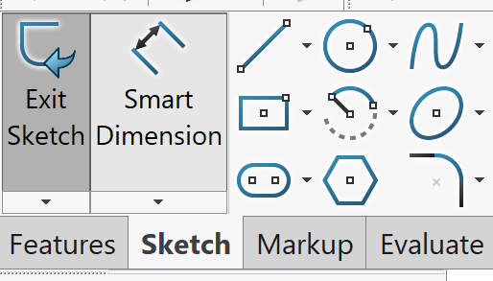
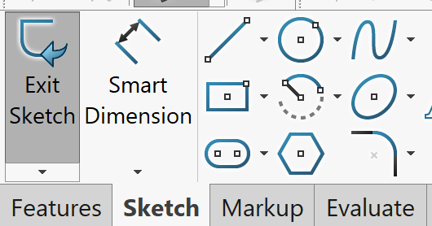
Create the first Reference Plane
Select Sketch and choose the top surface of the hub to draw.
Draw a line from the center
Dimension the line 0.25 inch
Exit the sketch

Slide 9
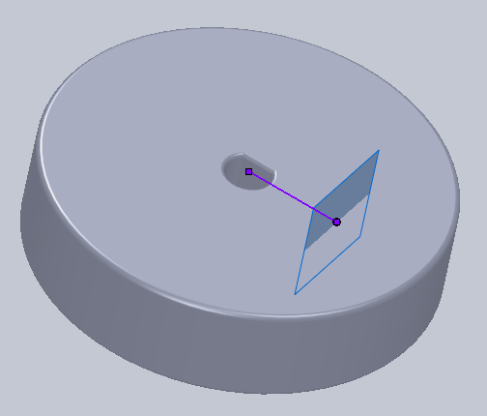
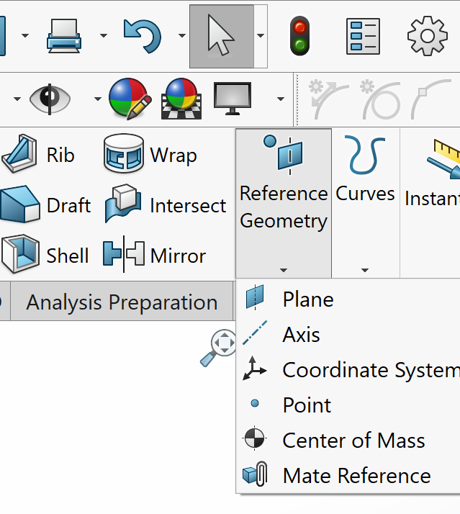
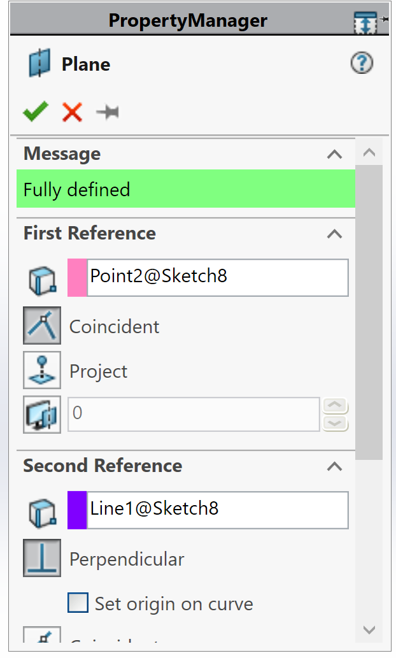
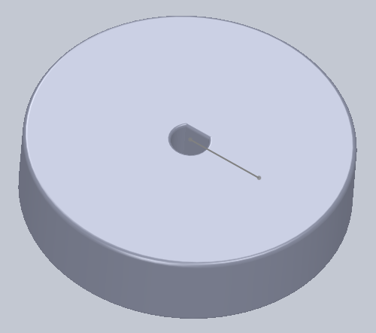
Create the first Reference Plane
In Feature tab, select Reference Geometry option to create a plane, choose the Plane option
The reference plane passes through the point and is perpendicular to the line
Select the end of the line as the first reference.
Select the line as the second reference

Slide 10
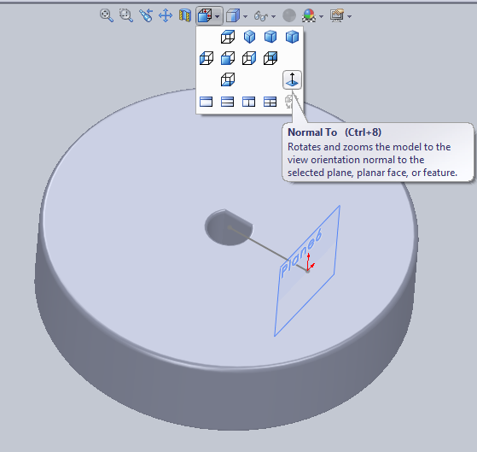
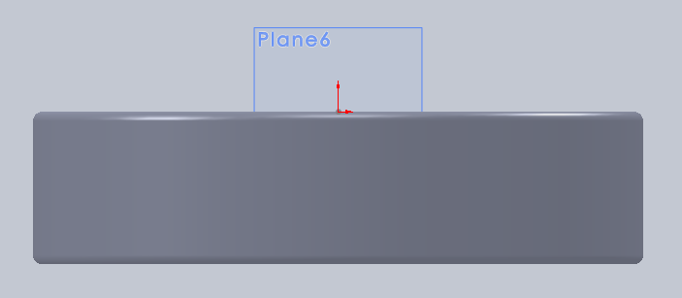
Creating the Blade Profile at the Hub
Select Sketch and choose the first reference plane to draw the blade profile at the hub
From the View Orientation menu choose the Normal To option
Do not be concerned with the size of the reference plane; it is infinitely large.

Slide 11
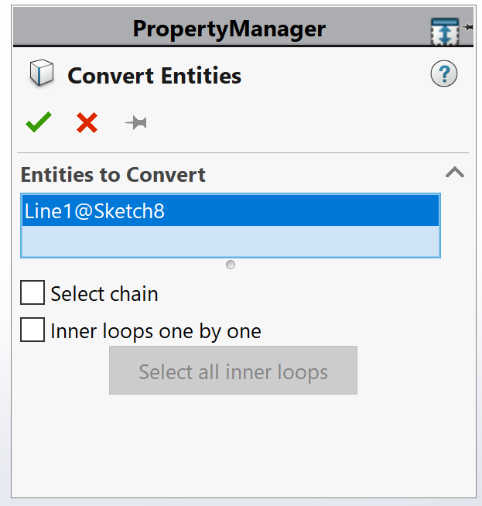
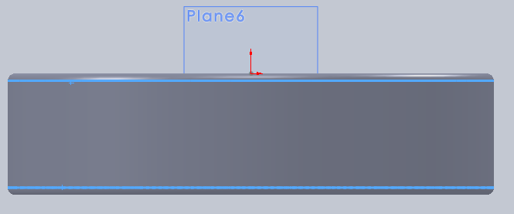
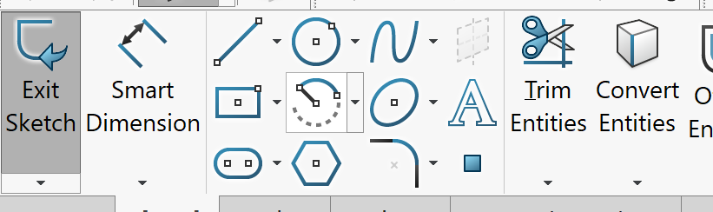
Creating the Blade Profile at the Hub
Select Convert Entities to project the hub onto the sketch plane to use as a reference for drawing the profile. Select the top and bottom edges as shown
Make sure you select edges and not surfaces. Zoom in for better view

Slide 12
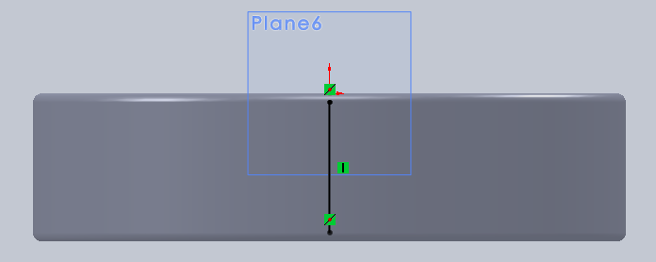
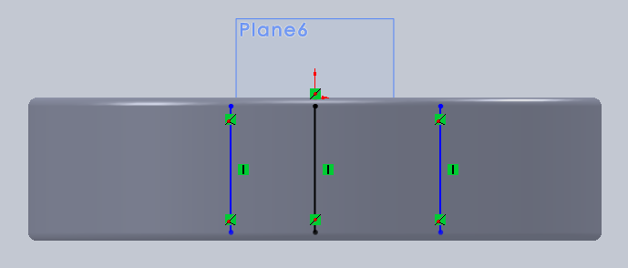
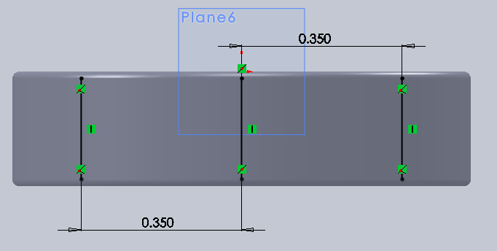
Creating the Blade Profile at the Hub
Draw a vertical line from the midpoints of the projected lines
Draw two more vertical lines on either side of the previous line
Dimension both lines with respect to the middle line, 0.35 inch. The 0.7 inch distance represents the width of the blade at the hub. (This is a design variable; you may choose a different value.)

Slide 13
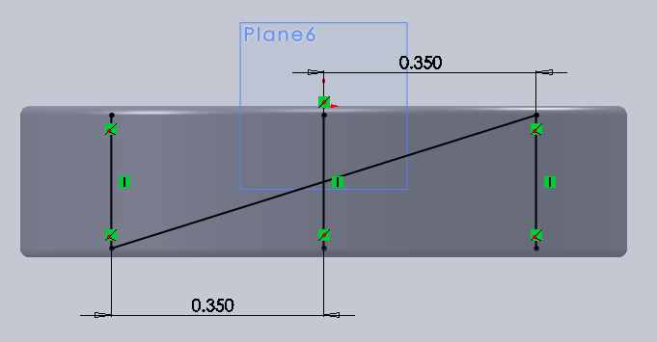
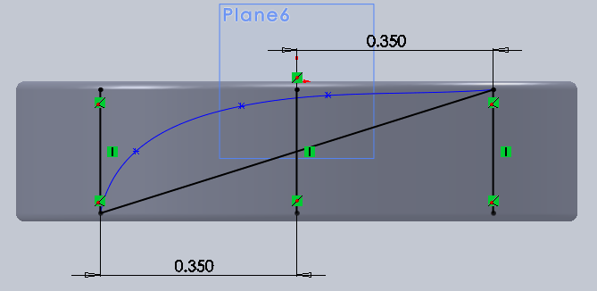
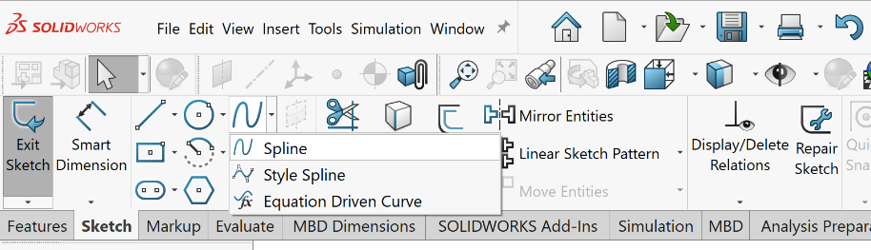
Creating the Blade Profile at the Hub
The profile is constructed within the 0.7” by 0.25” envelope
Construct a diagonal line
0.25
0.7
Use the spline command to draw the curved portion of the profile
Pt. 2
Pt. 4
Pt. 5
Pt. 3
Pt. 1
In this design, 5 points are selected. The end points of the diagonal line must be included in your point selection. The location of other points are up to you and will determine shape of the profile, which in turn will affect the power output.

Slide 14
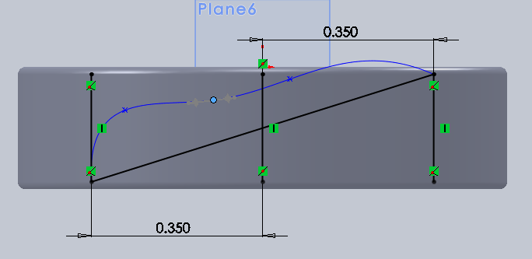
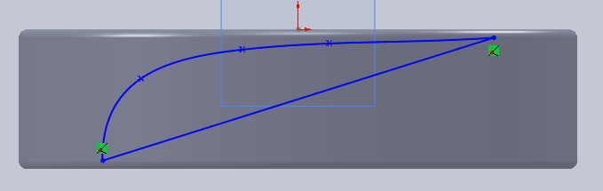
Creating the Blade Profile at the Hub
Make sure the curve does not protrude beyond the surface of the hub
The shape of the spline curve could be modified by selecting any point and dragging it to a new position
Delete all construction lines before exiting the sketch

Slide 15
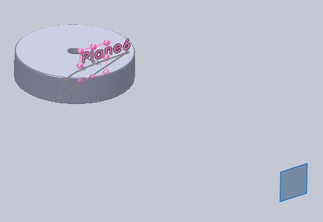
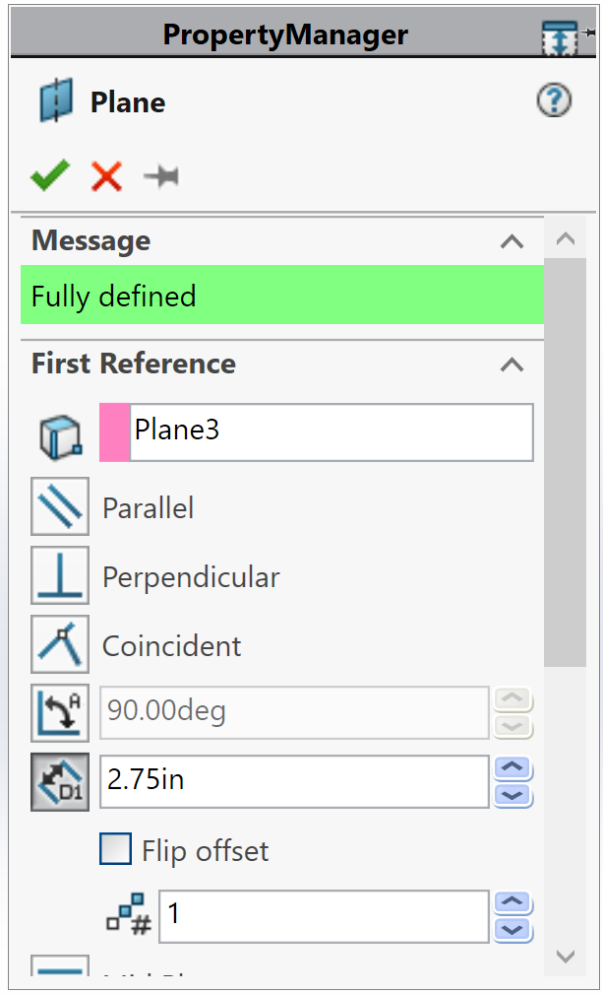
Creating the Blade Profile at the Tip
Create the second reference plane to draw the tip profile
2.75 in.
Select reference plane option, select the first reference plane and enter the distance between the tow planes, 2.75 inch.
Reference plane to draw the tip profile
This arrangement will create a blade sweep area of 6 inch in diameter. It is the maximum blade size allowed.

Slide 16
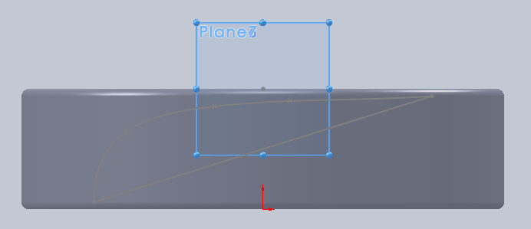
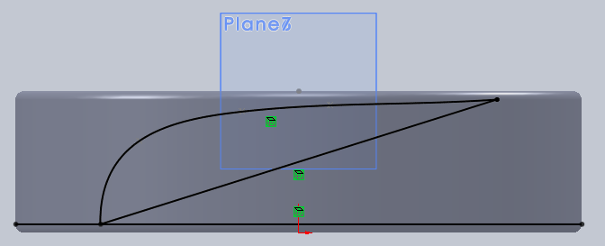
Creating the Blade Profile at the Tip
Select Sketch and choose the second reference plane to draw the tip blade profile.
From the View Orientation menu choose the Normal To option.
Project the blade profile at the hub and the bottom surface into the current sketch plane. This is used as a reference to draw the tip profile

Slide 17
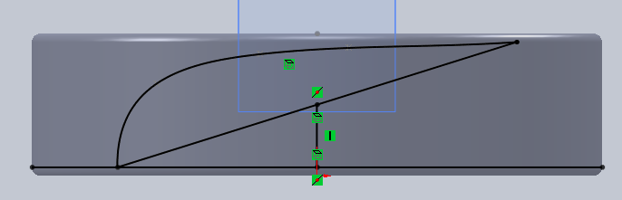
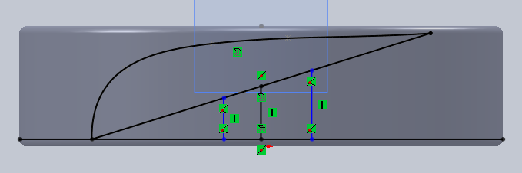
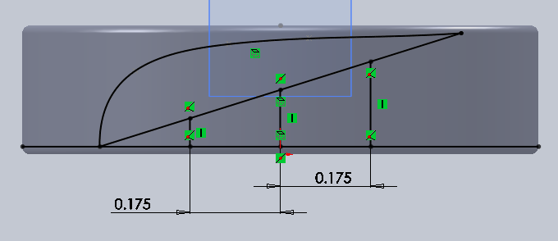
Creating the Blade Profile at the Tip
Draw a vertical line from the midpoints of the projected diagonal line.
Draw two more vertical lines on either side of the previous line
Dimension both lines with respect to the middle line, 0.175 inch. The 0.35 inch represents the width of the blade at the tip, half of the width at the hub. This is also a design variable; you may choose a different value

Slide 18
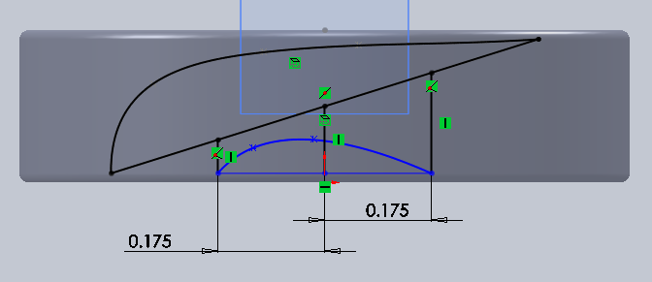
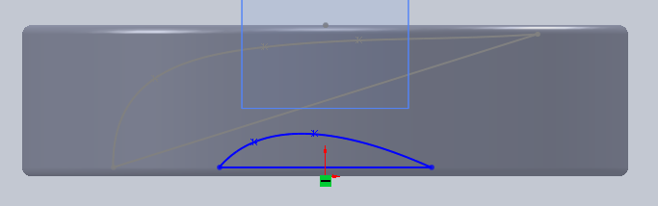
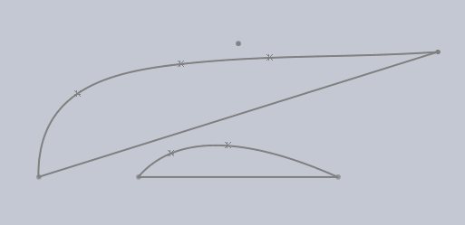
Creating the Blade Profile at the Tip
Use the Spline and line commands to construct the tip profile. Follow the same procedure as the profile at the hub.
Delete all construction lines before exiting the sketch
This shows the two blade profiles, at the hub and at the tip

Slide 19
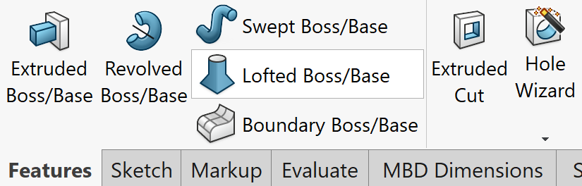
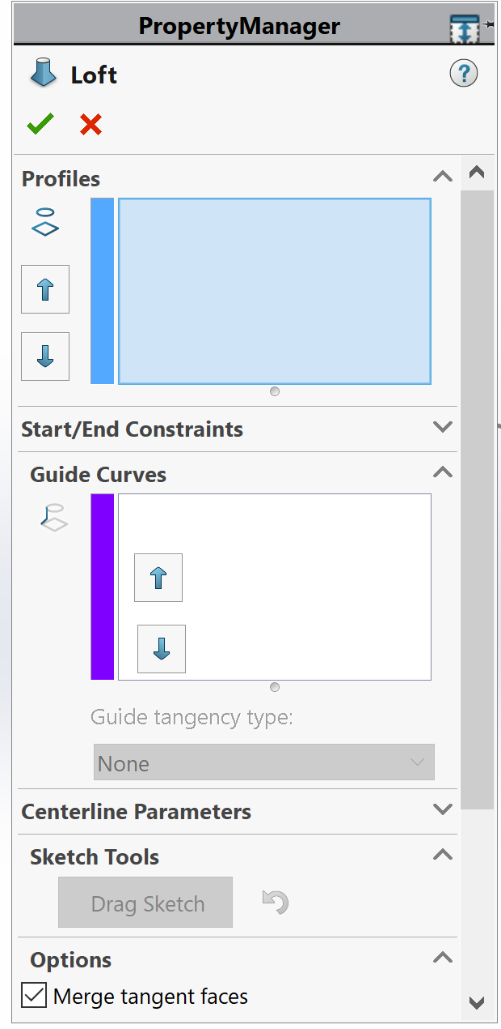
Creating the Blade - Loft
Select the Loft command and choose the two profile
Tip profile
Hub profile
Hub profile
Tip profile

Slide 20
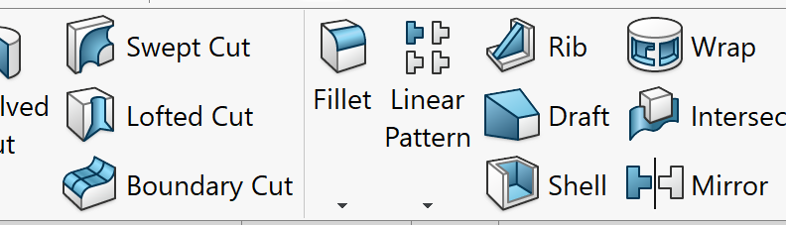
Rounding the Blade Edges – Fillet Command
The blade edges should be rounded in order to obtain a model with clean edges. The 3D printer is not capable of modeling sharp edges.
Select the Fillet command, choose the edges and provide a radius for the fillet.

Slide 21
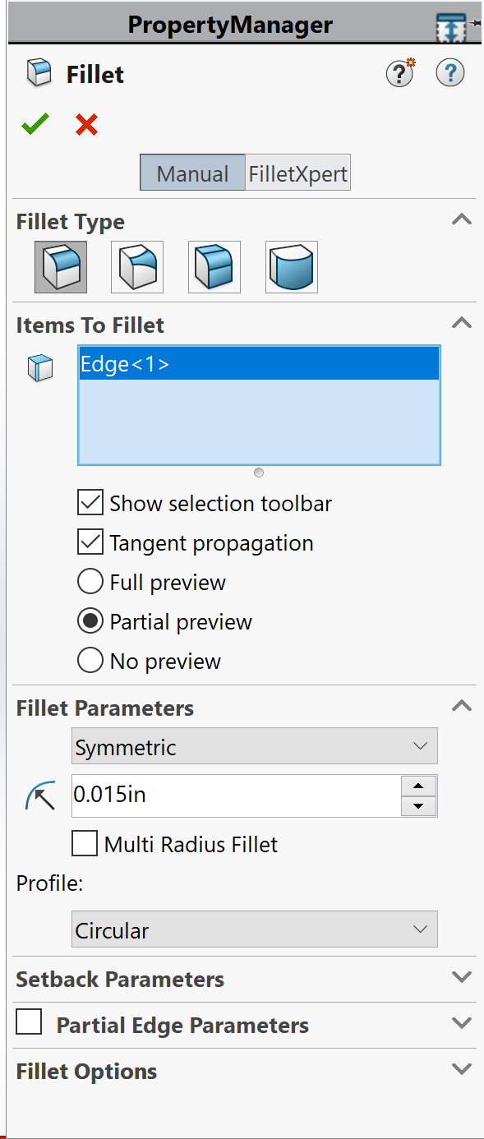
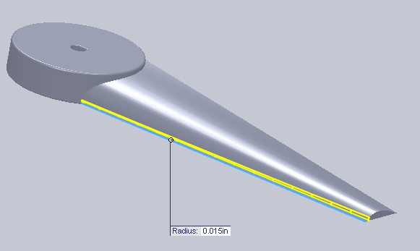

Fillet
Select the front edge
Assign a value of 0.015 inch to the front edge
Select Fillet again and choose the back edge and assign a value of 0.01 inch

Slide 22



Completing the Rotor – Pattern Command
Select the axis of the circular pattern, choose the edge of the circle on the hub
Select the Circular Pattern command
Check the Equal spacing box for full 360 deg.
Choose the number of the blades
Select the blade and the fillets

Slide 23



Embossing the Hub
In order to identify your blade it has to be embossed with your group number and lab. section.
Select Sketch and choose the top surface of the hub. Use the Text command and write your group number (G4) and lab. section number (S8). Make sure the text is not too close to the hole.

Slide 24




While in the sketch, the text can be moved, select the text, select the point , hold the left mouse key down and move the text
The text could follow any curve (edge of the circle)

Slide 25



Embossing the Hub
Extrude the text by 0.025 to 0.03 inch

Slide 26

The Rotor

Slide 27




