Slide 1

Rendering in SW

Slide 2
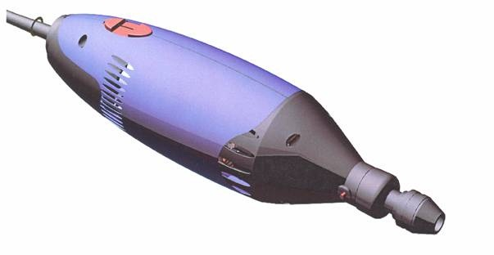
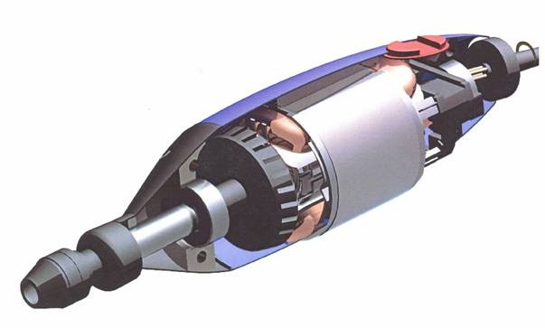
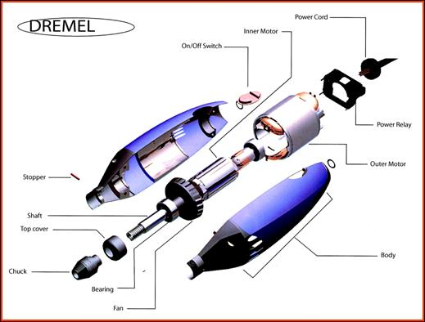
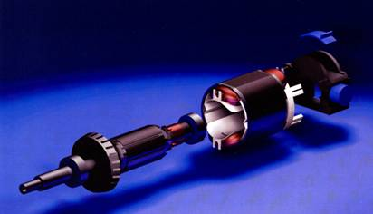

Slide 3
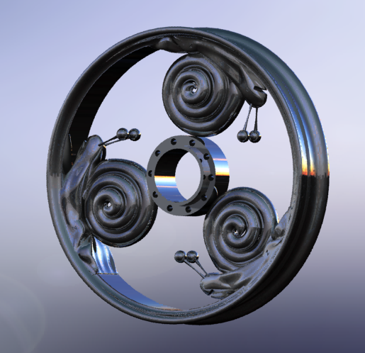

Slide 4
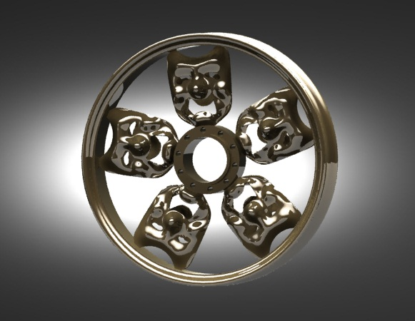

Slide 5
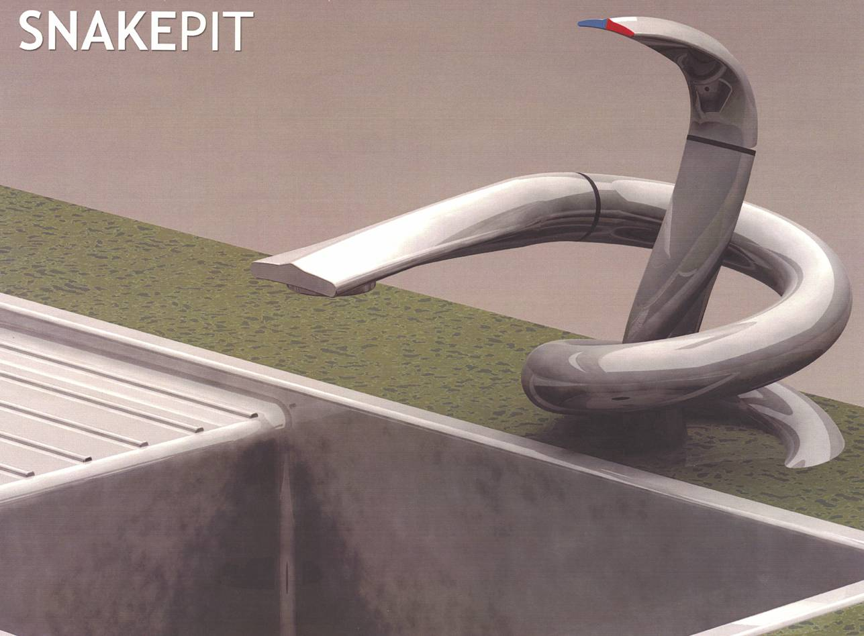
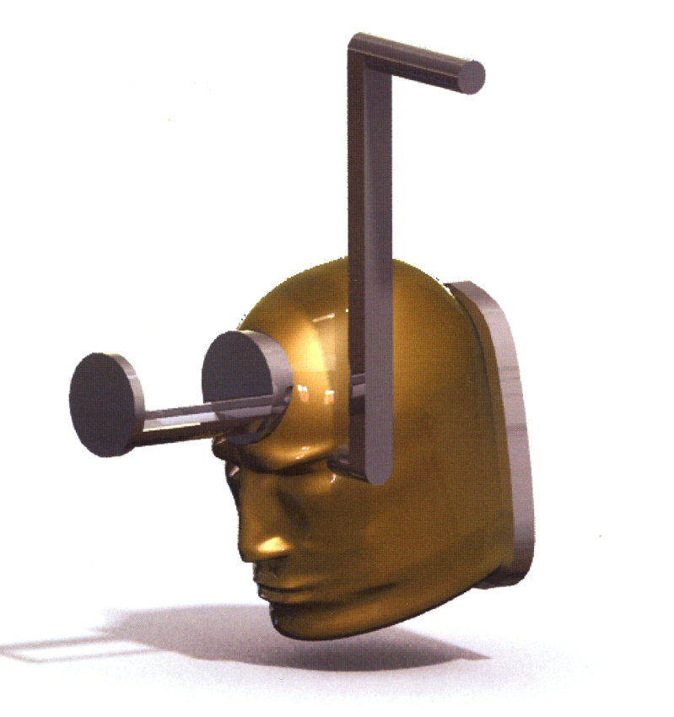

Slide 6
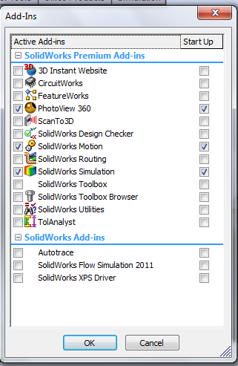
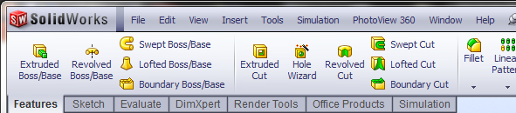
PhotoView 360
Select Tools → Add-Ins → add PhotoView 360
Check to load at start up

Slide 7
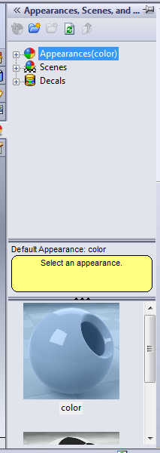
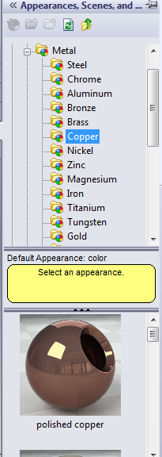
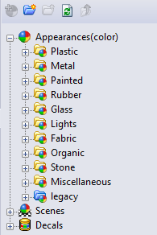
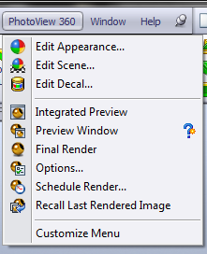
Rendering in SolidWorks
Select material
Rendering Menu
Choose appearance (material)
Apply Appearance (material)
Select Scene or Environment
Choose Lighting

Slide 8
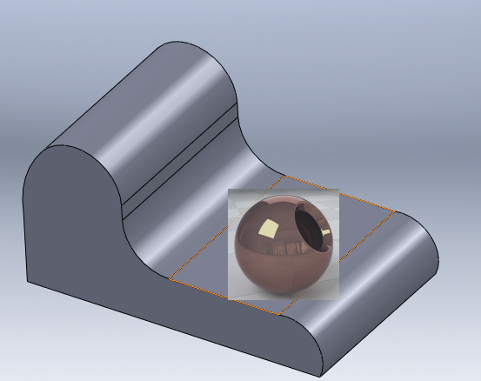
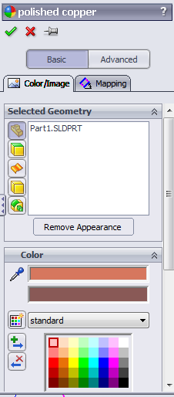
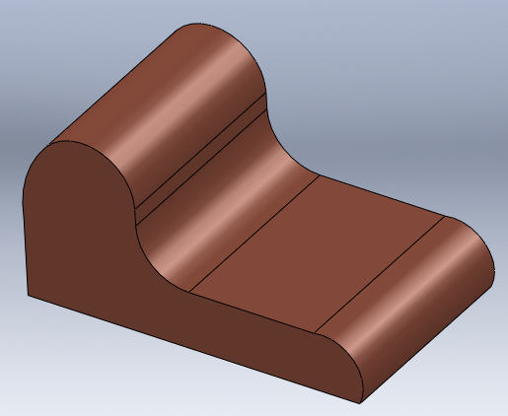
Rendering - Appearance
The selection applies to the part by default. Surface, face and feature can also be selected
Select material
Drag and drop

Slide 9
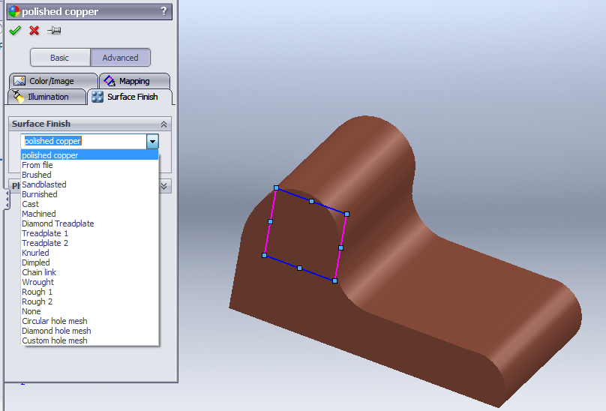
Rendering – Surface Finish
To assign a surface finish: select Advance option and choose a surface finish

Slide 10
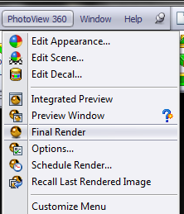
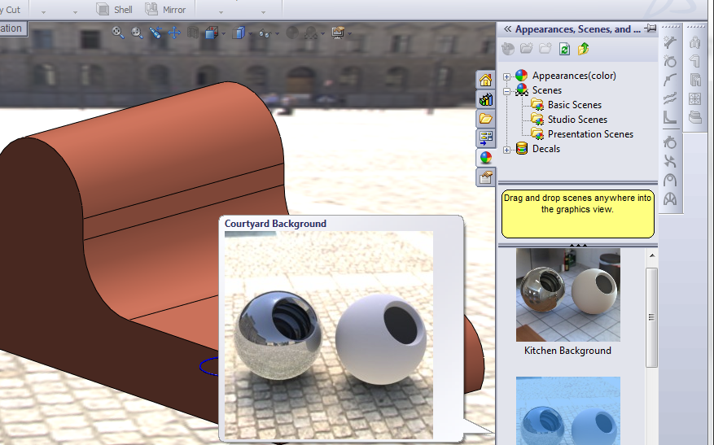
Rendering – Scene (background)
Select Scenes, choose from Basic, Studio or Presentation options, drag and drop in graphics view

Slide 11
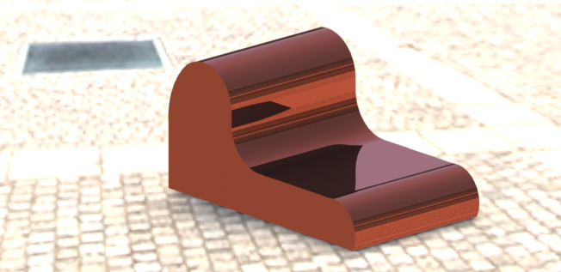
Rendering
Select Final Render

Slide 12
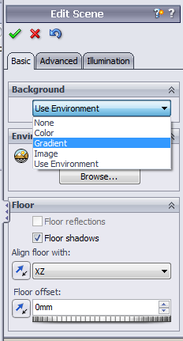
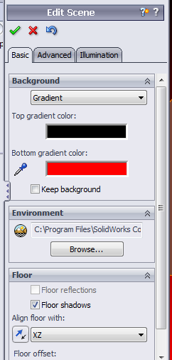
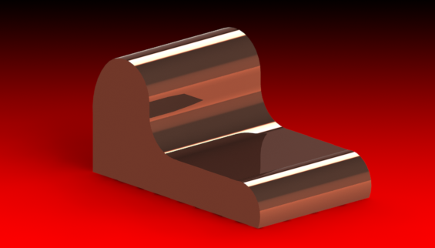
Rendering - Background
Setting a Gradient background

Slide 13
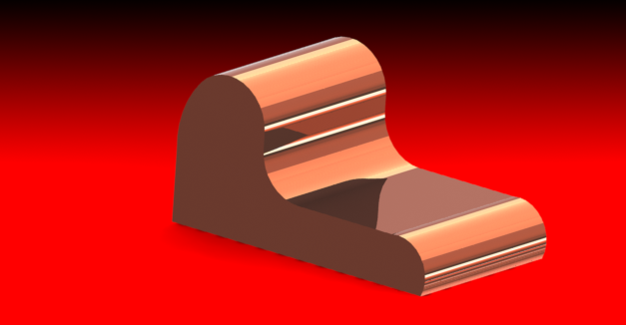
Changing the brightness

Slide 14
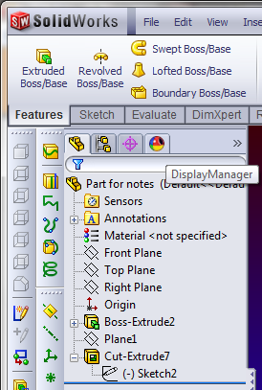
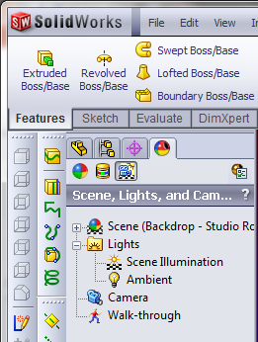
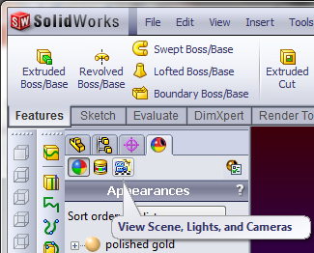
Rendering - Lights
By default, lighting is off in PhotoView. With lights off, you can use the realistic lighting provided by scenes, which is usually sufficient for rendering. You typically need additional lighting in PhotoView to illuminate occluded spaces in the model. But you may need to add lights to emphasize certain features..
Choose Display Manager
Choose View scene, Lights and Cameras

Slide 15
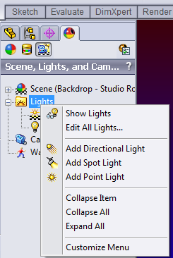
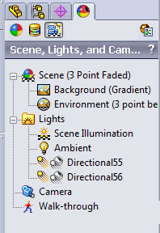
Rendering - Lights
Right click on Lights and select from the menu to edit or add lights

Slide 16
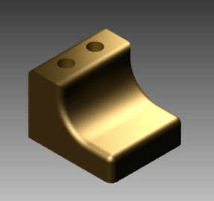
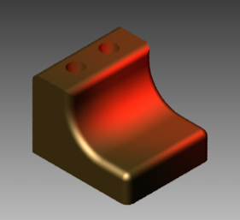
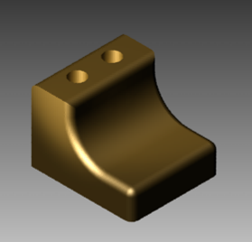
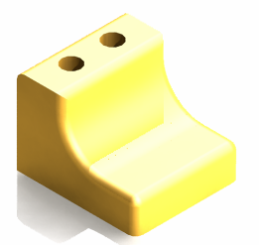
Rendering – Lights
Front above right
Wide red spot
Front left spot
Multiple

Slide 17
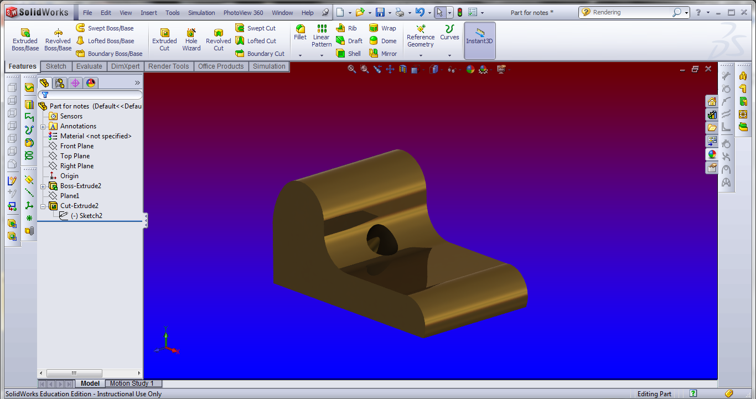
Previewing Renders
PhotoView provides two ways to preview renders: in the graphics area (Integrated Preview) and in a separate window (Preview Window). Both methods help you assess changes quickly before performing a full render. Because updates are continuous, you can experiment with controls that affect rendering without fully understanding the purpose of each control. When you are satisfied with the settings, you can perform a full render.
You can preview a rendering of the current model within the SolidWorks graphics area.

Slide 18
Rendering
The PhotoView Preview window is a separate window from the main SolidWorks window.
The window maintains the aspect ratio set in the PhotoView Options Property Manager when you resize the window.

Slide 19
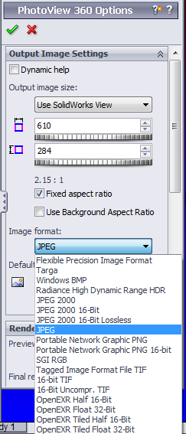
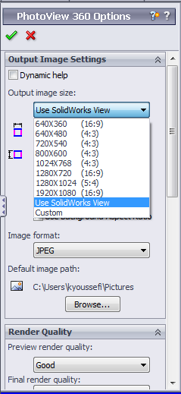
Render Image Size and Format
Before performing the Final Render, edit the Options to choose image Size and image Format

Slide 20
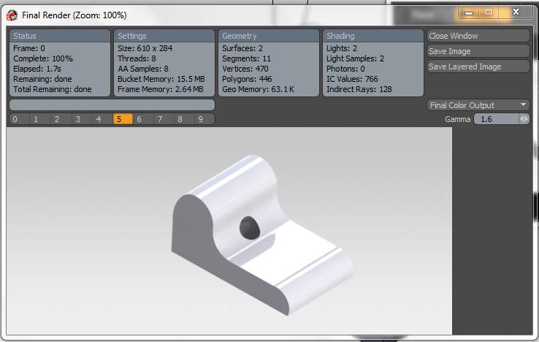
Final Render
Select Final Render option after rendering is finished
Save image

