Slide 1
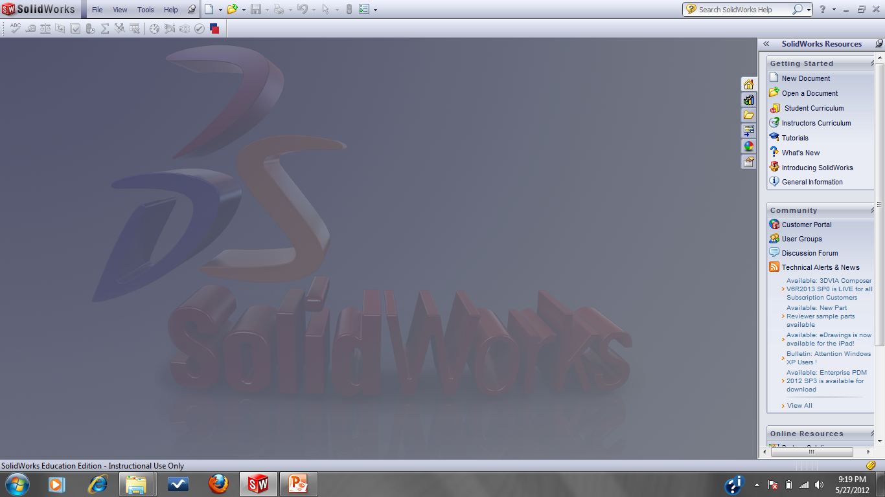
SolidWorks
Select File

Slide 2
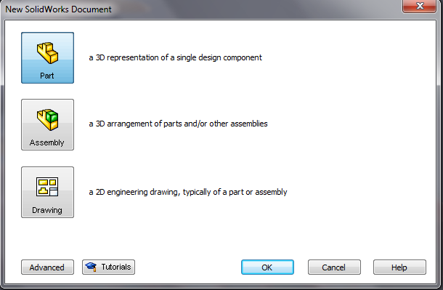
Part Modeling
Select File → New → Part (already selected)

Slide 3
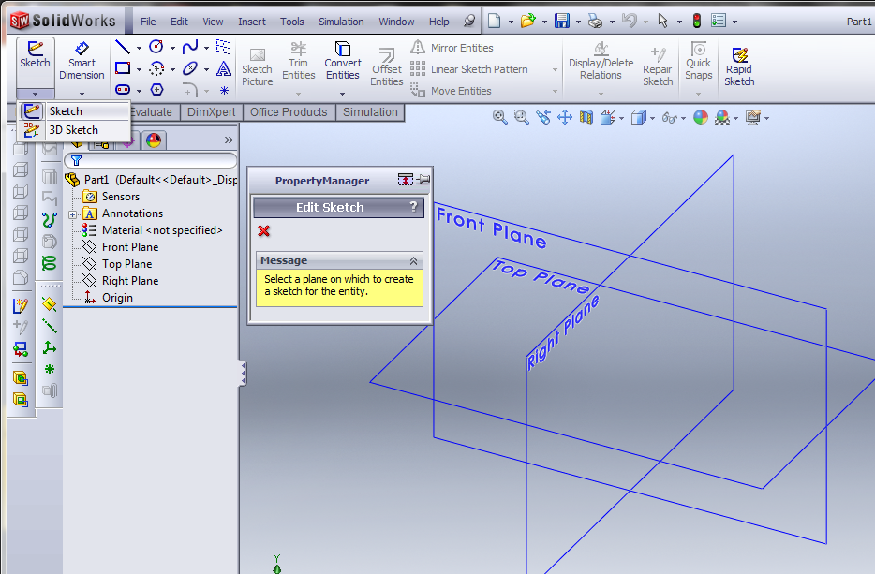
Sketcher Layout

Slide 4
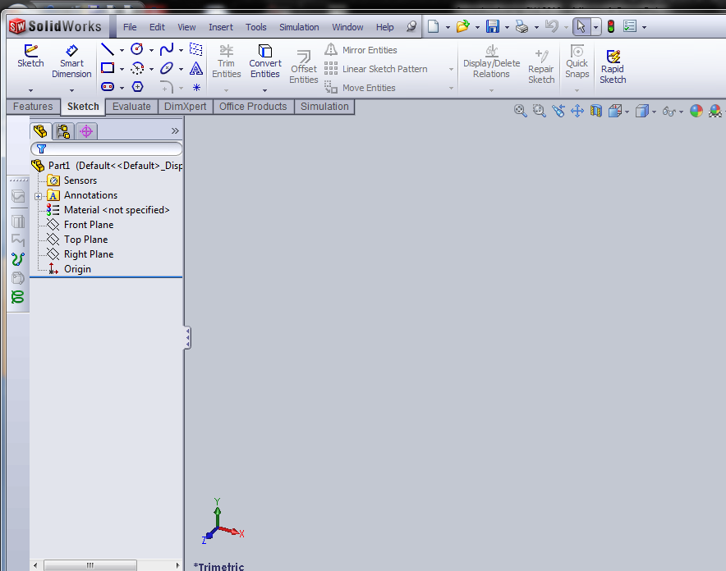
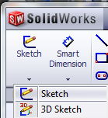
Select Sketch and choose Sketch (2D)

Slide 5
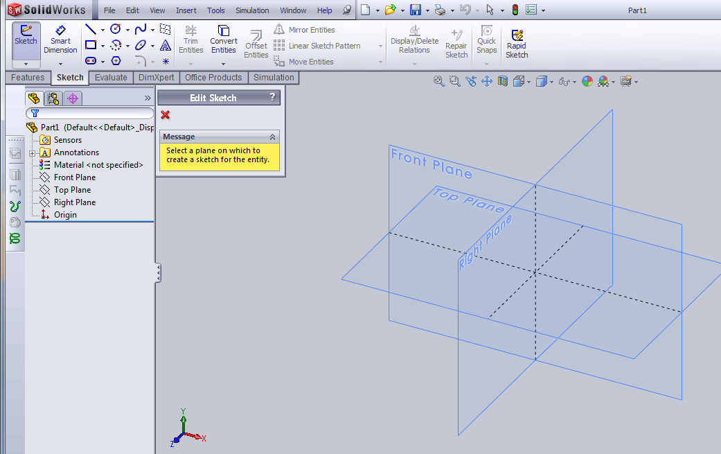
Start Sketching
Sketch tools
Part manager, keeps track of all your work (modeling)
Principle planes

Slide 6
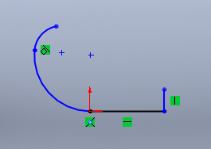
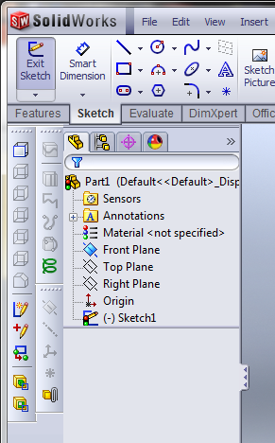
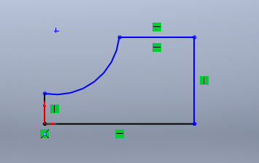
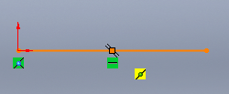
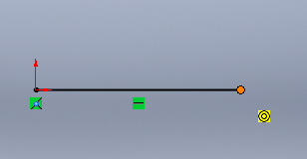
Sketching
Tangent
Draw using the sketch tools
Feedback from sketcher, vertical and horizontal
Origin (0,0)
Midpoint
Make sure the new line snaps to the end of the previous line (indicated by the large circle), do not guess the location

Slide 7
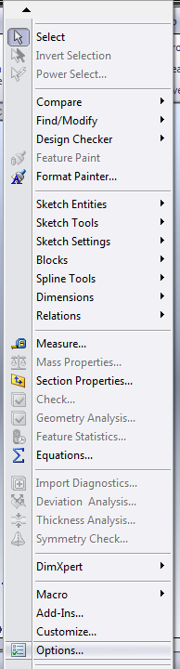
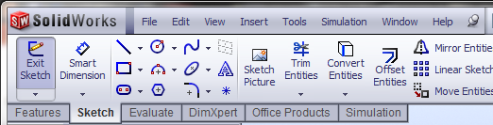
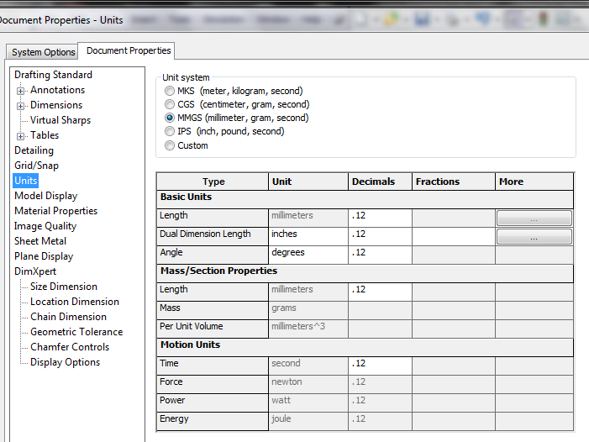
Assigning Units
To assign units, select Tools and then Options
Select Document Properties, Units and choose the Unit system desired

Slide 8
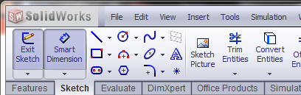
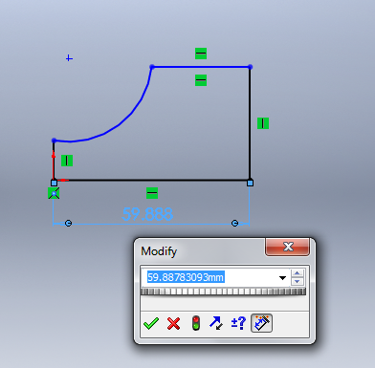
Dimensioning
To dimension, select Smart Dimension, click on the line, drag to a desired location, click again and enter value
To edit dimension, double click the value and enter the new value

Slide 9
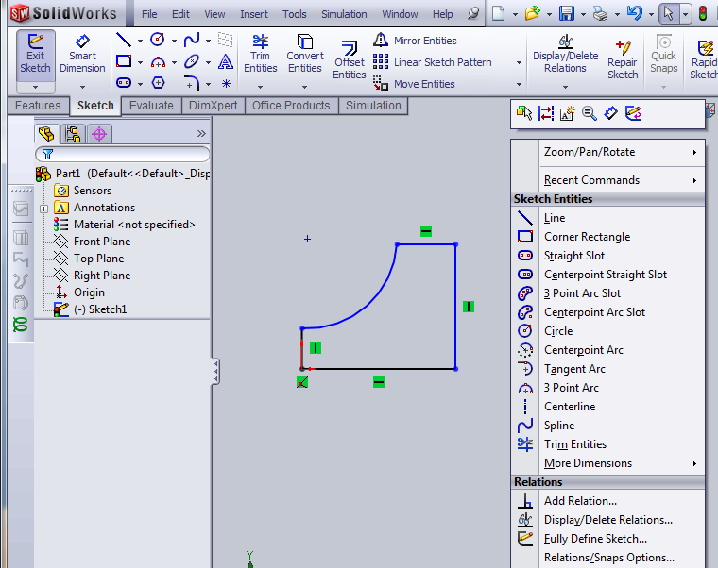
Making a Solid from the Sketch
Exit sketch
Right click for other option like dimensioning

Slide 10
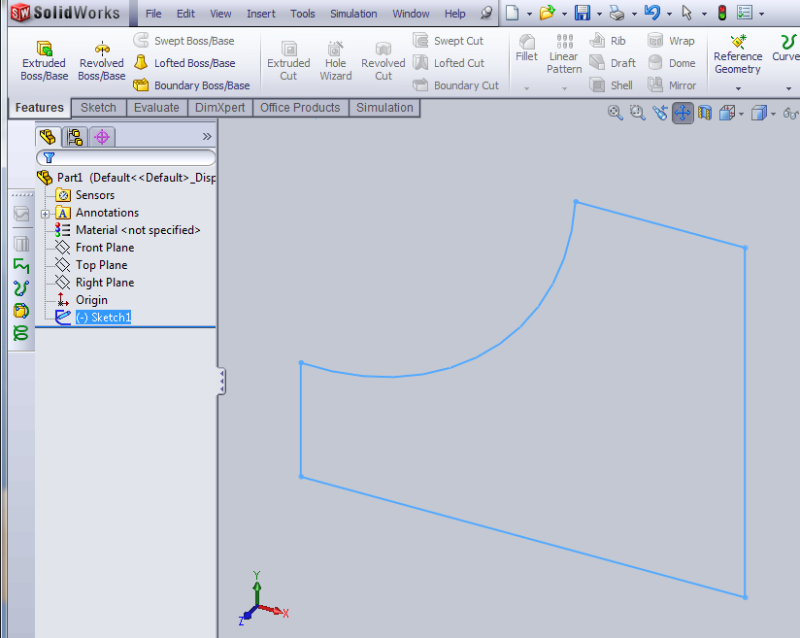
Features
Select Features

Slide 11
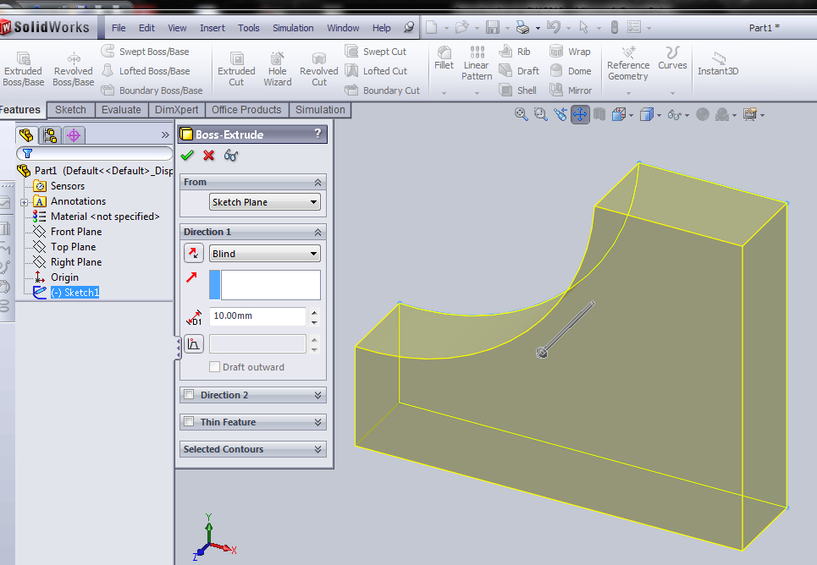
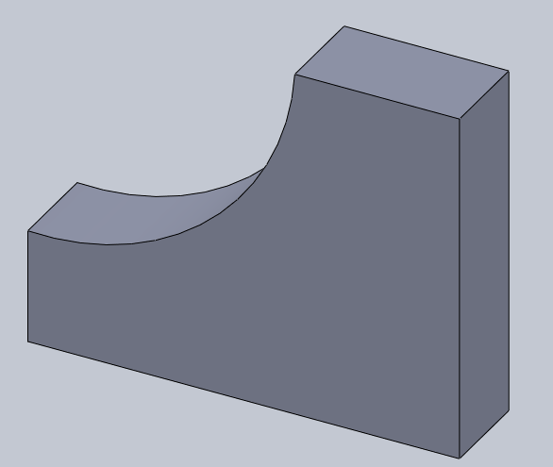
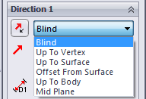
Extrusion, select Blind and assign a thickness
Select thickness

Slide 12
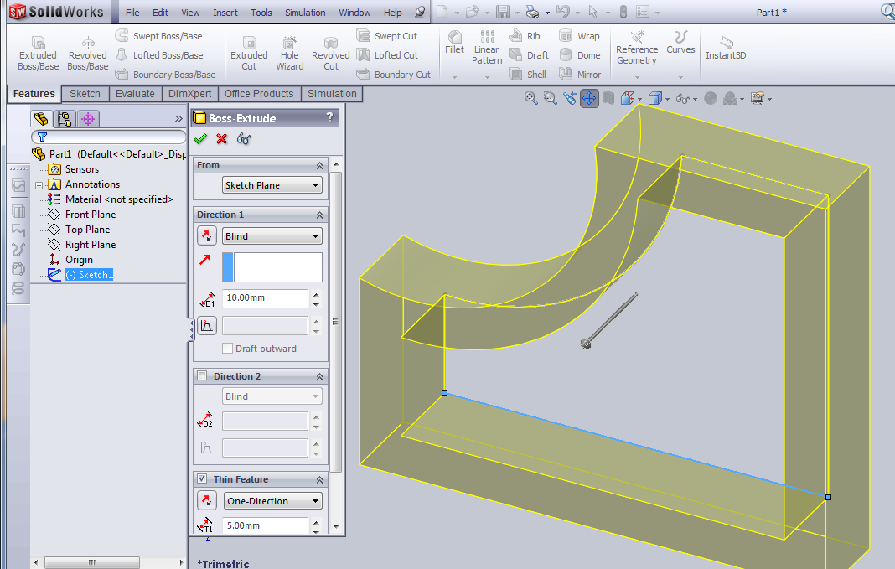
Hollowing out as you Extrude
Thickness
Thin feature in Extrusion

Slide 13
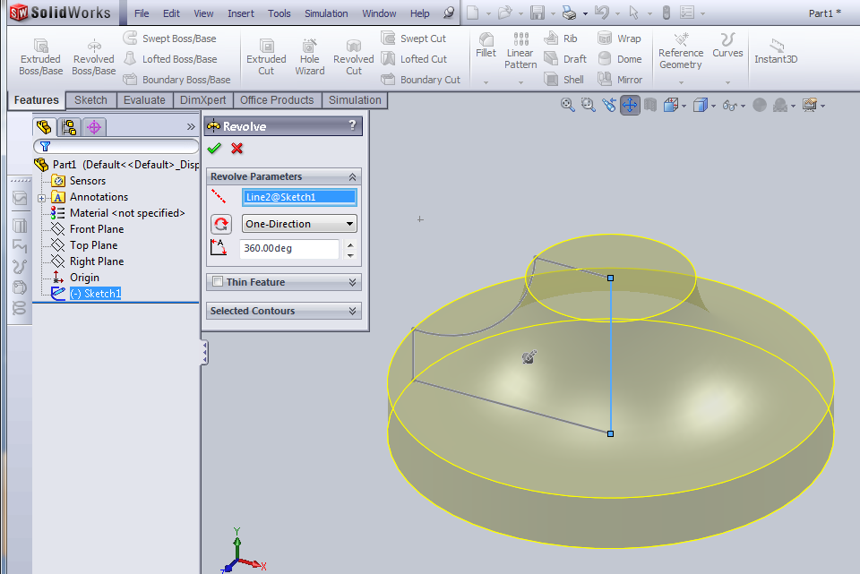
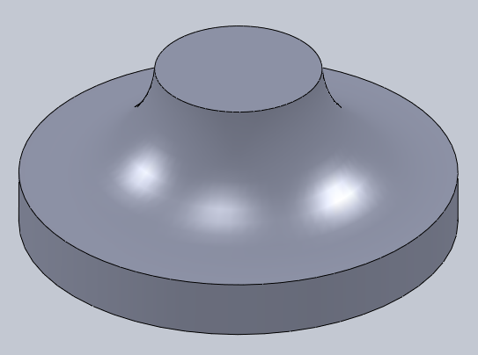
Revolve, select axis of rotation and amount of rotation
Select a line to revolve about
Select the Revolve option

Slide 14
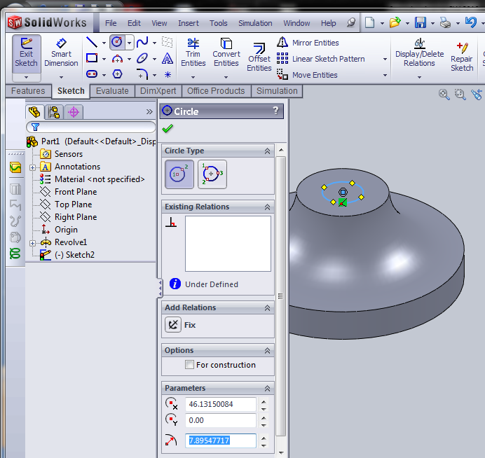
To make a hole at the top, select Sketch, select top surface and draw a circle

Slide 15
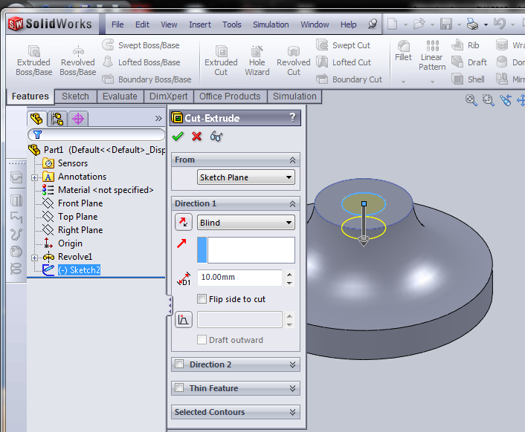
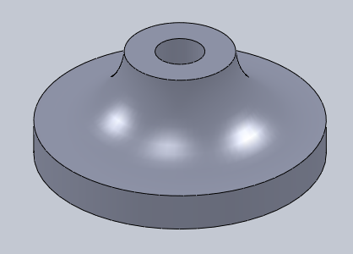
Select Extruded Cut option

Slide 16
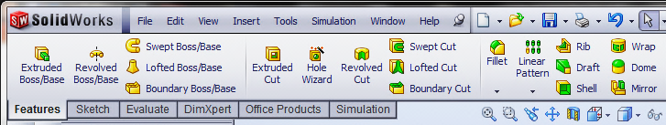
Features
Fillet (round edges)
Feature Menu
Pattern (circular and linear)
Solid making commands, a two dimensional sketch is needed
Applied features, no need for a sketch
Extrude – create (unite or join)
Sweep – create (unite or join)
Extrude – cut (subtract)
Sweep – cut (subtract)
Revolve– create (unite or join)
Loft (sweep and blend)– create (unite or join)
Revolve – cut (subtract)
Loft (sweep and blend – cut (subtract)

Slide 17


Display Menu
Zooms the model to fit the screen
Displays the previous view
Display style
Shaded view with edges shown
Zooms to a specified area by opening a window
Shaded view
Scrolls the view, Pan
Solid not shaded
Solid with hidden lines shown
Wireframe
To rotate the model on the screen: hold the middle mouse button down and move the mouse

