Slide 1
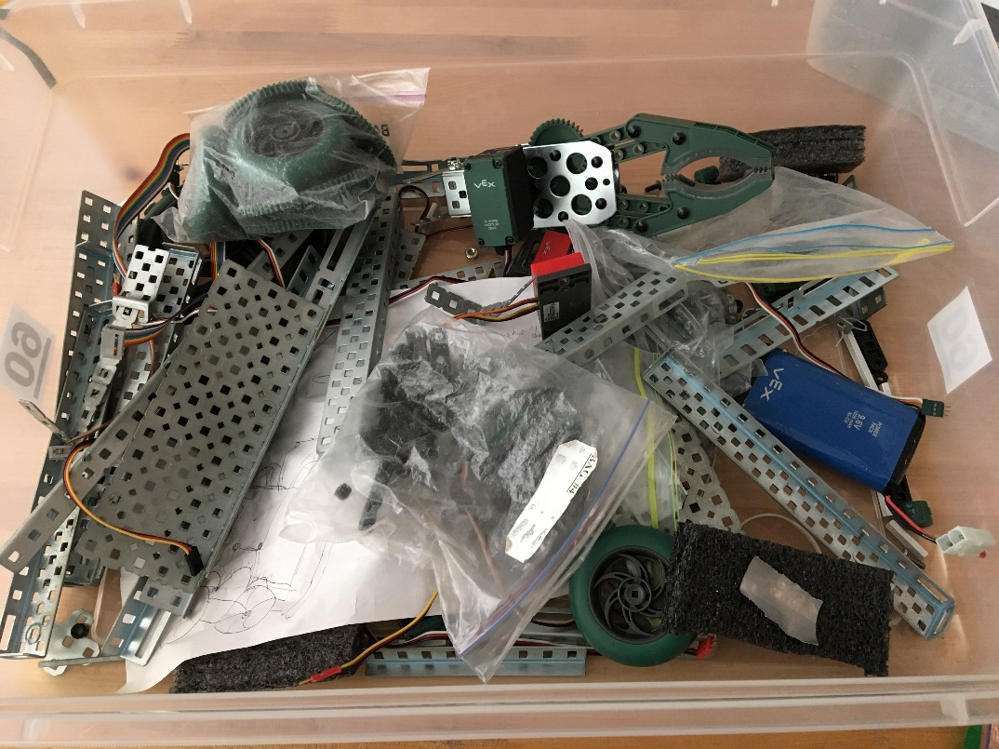
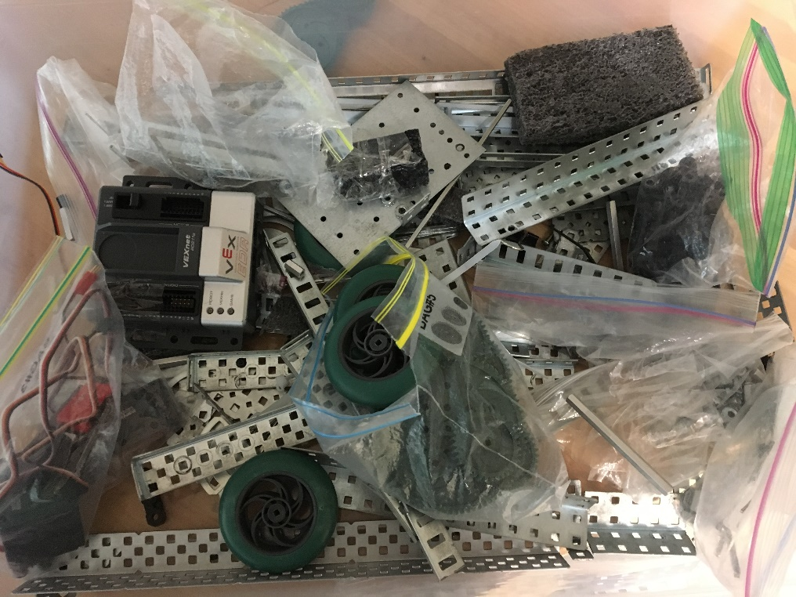
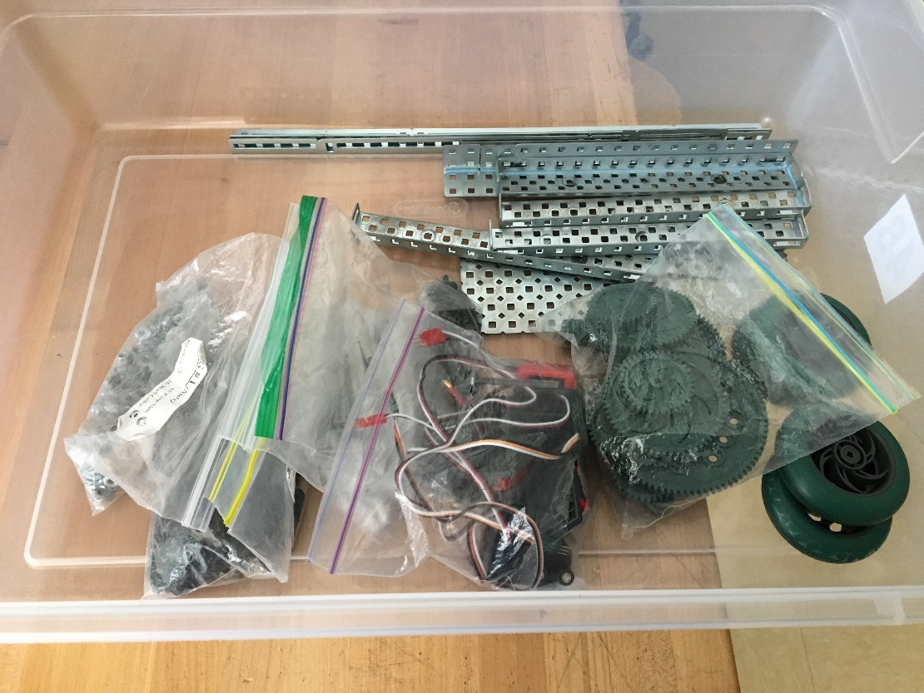
NOT GOOD
NOT GOOD
Too many pieces!
GOOD

Slide 2
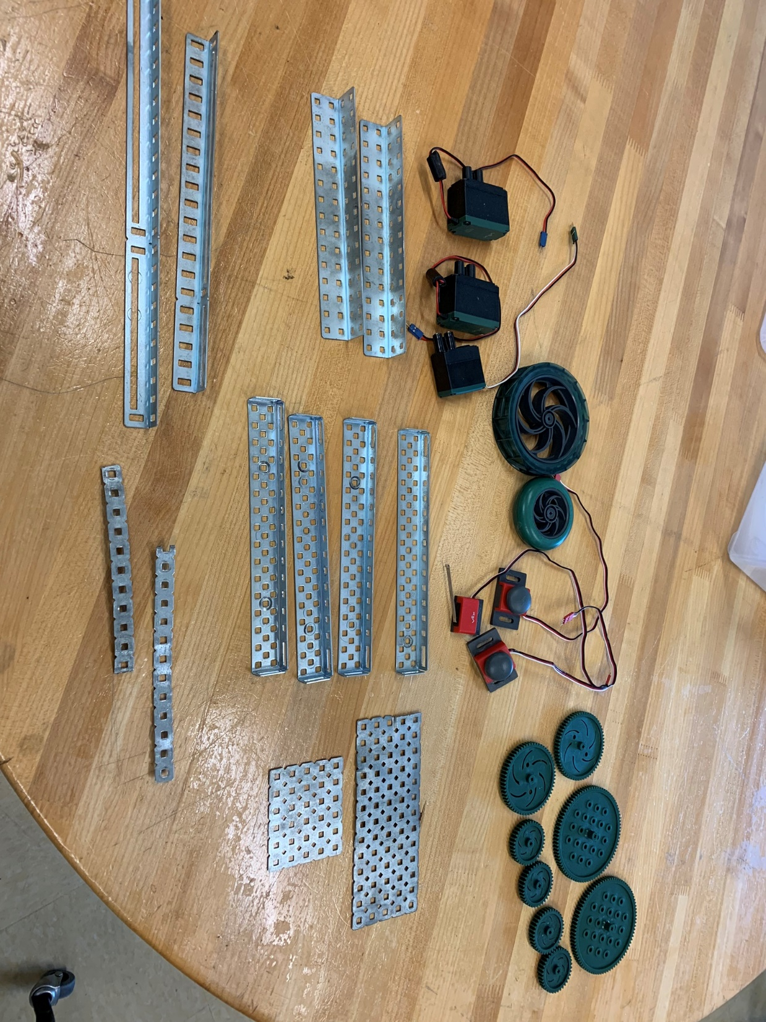
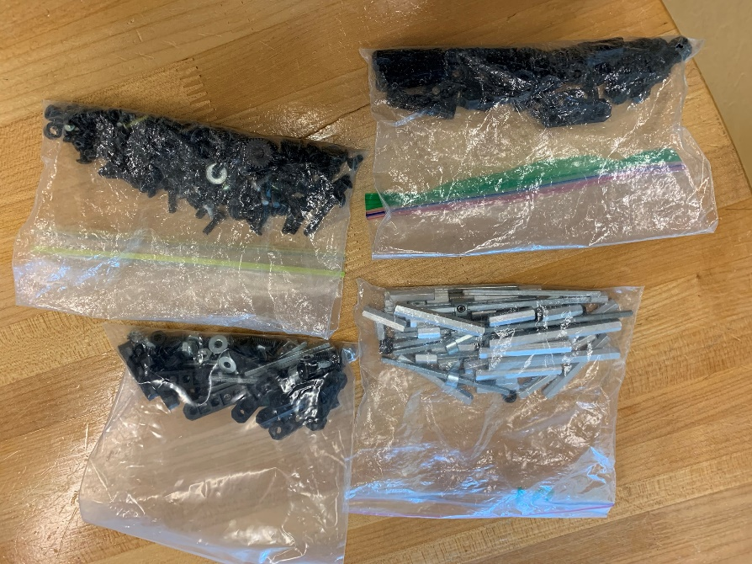
What should be inside the box
Metal structures and components
3 to 4 bags of screws, collars, nuts, washers, spacers, ….

Slide 3
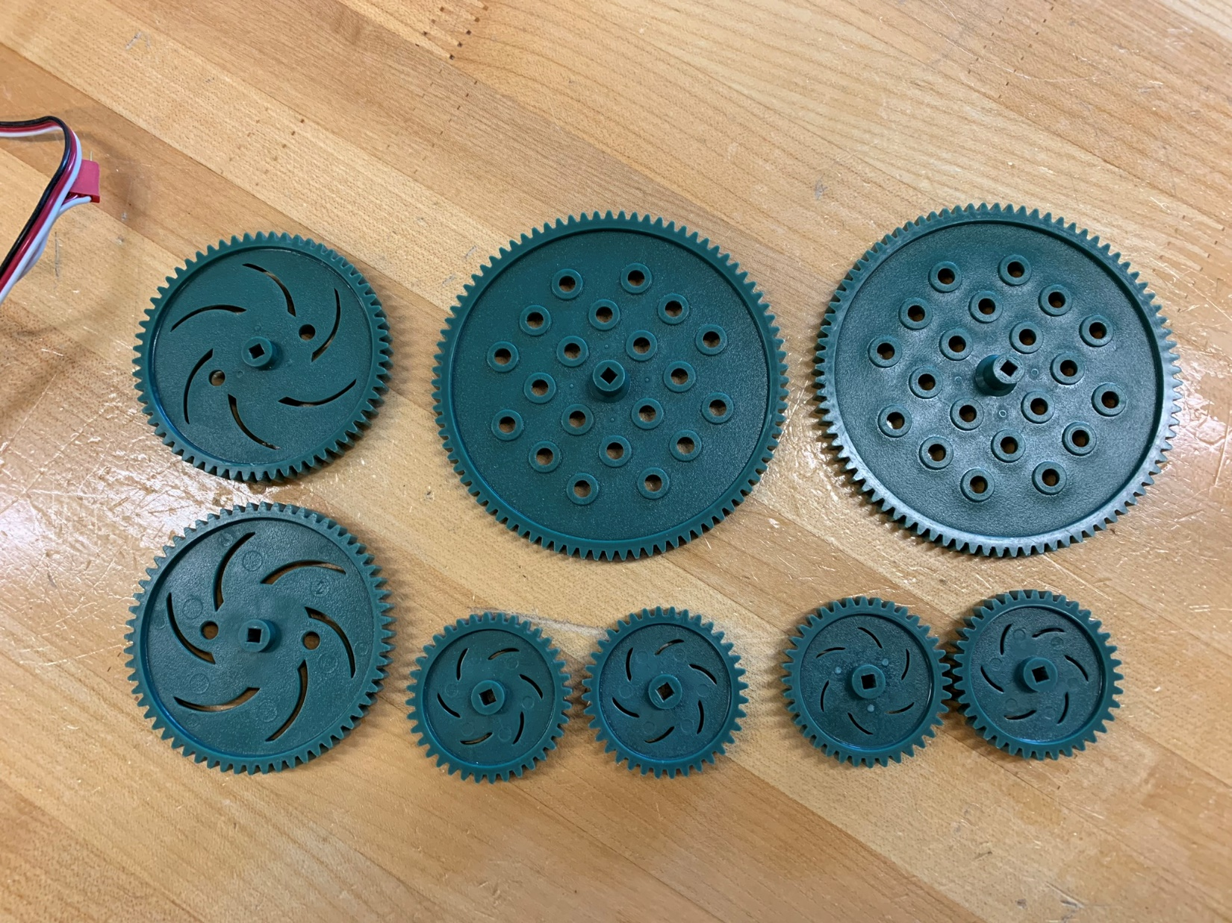
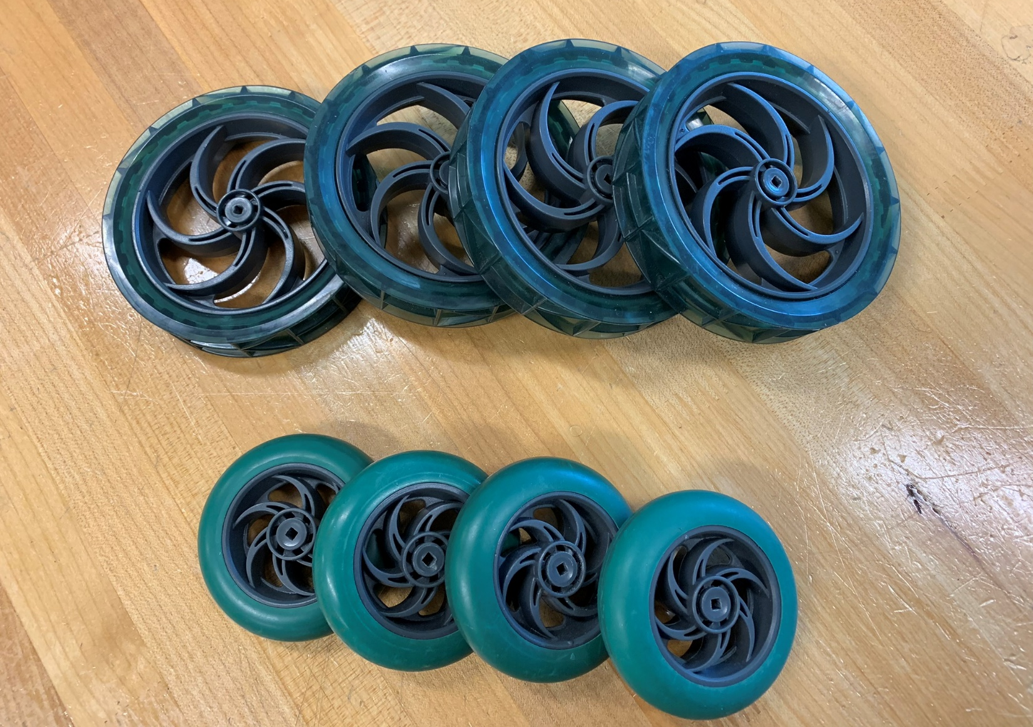
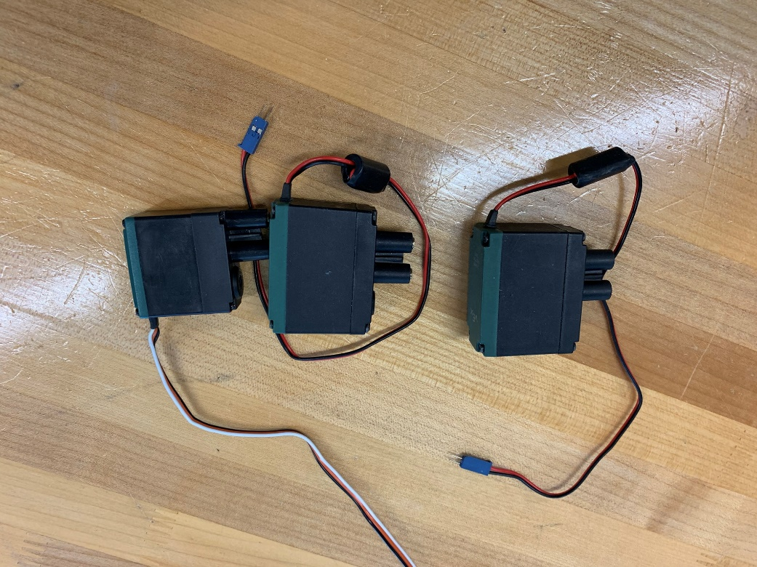
Gears
Wheels (one set of 4)
120 teeth (2)
60 teeth (2)
36 teeth (2)
3 continuous motors or 2 cont. motors and a servo
Limit switch (1) & Bumper switch (2)

Slide 4
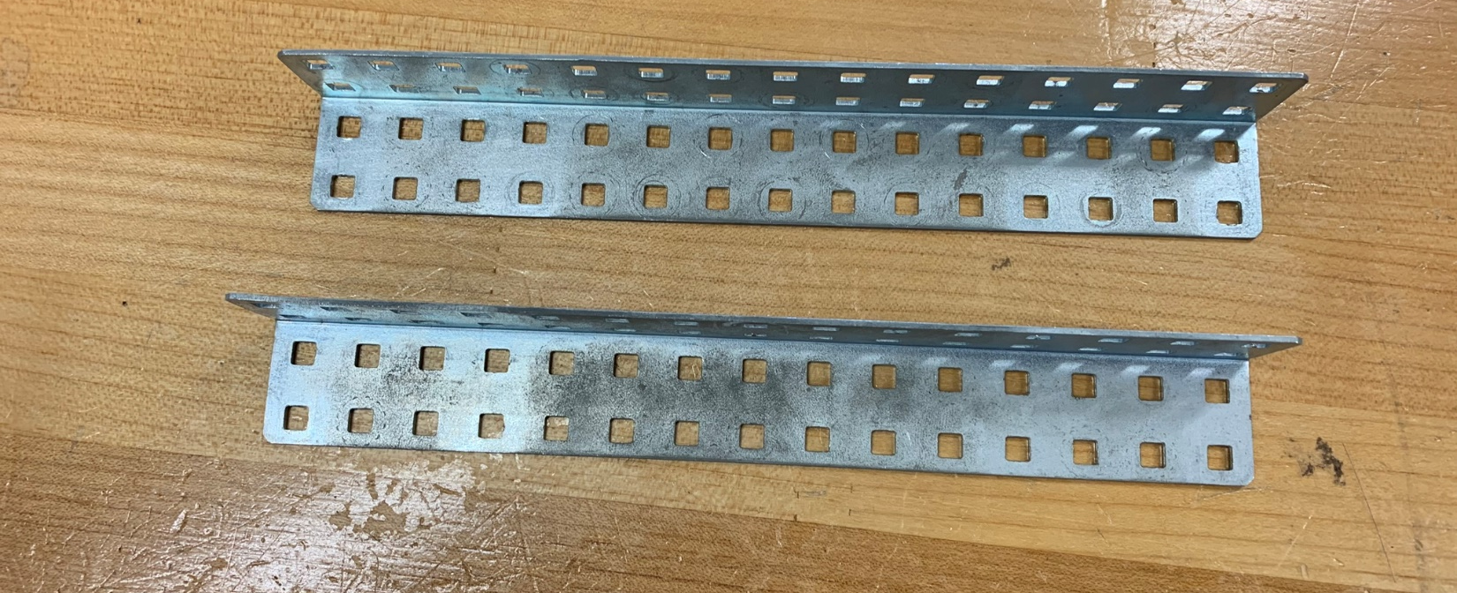
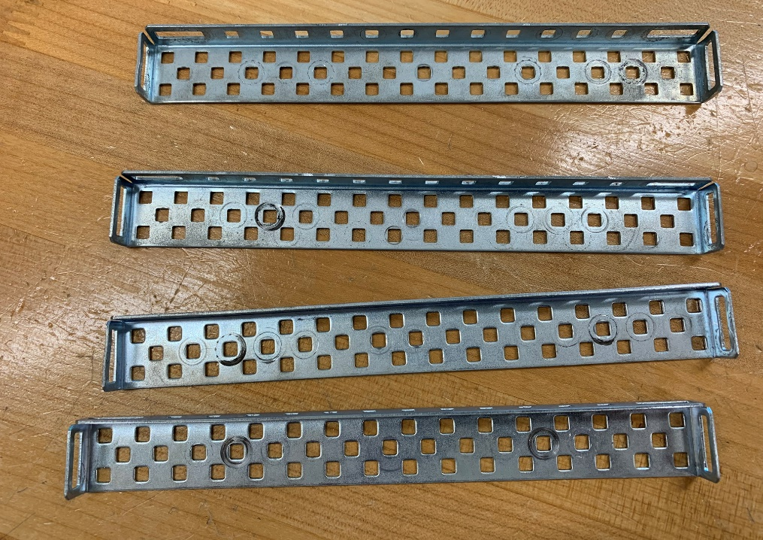
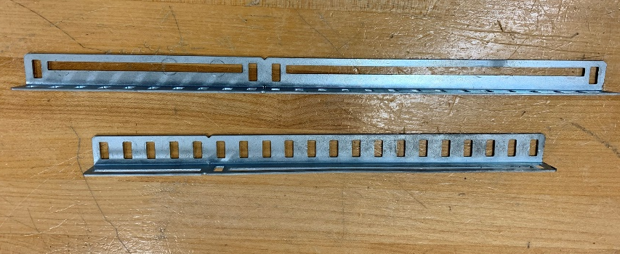
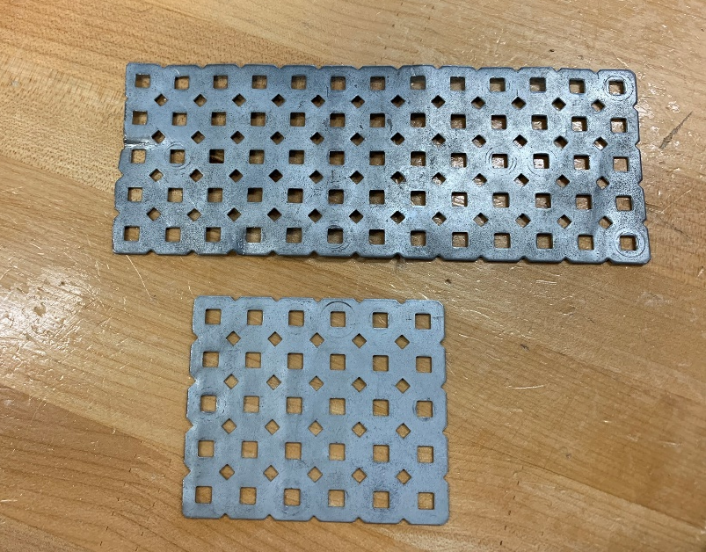
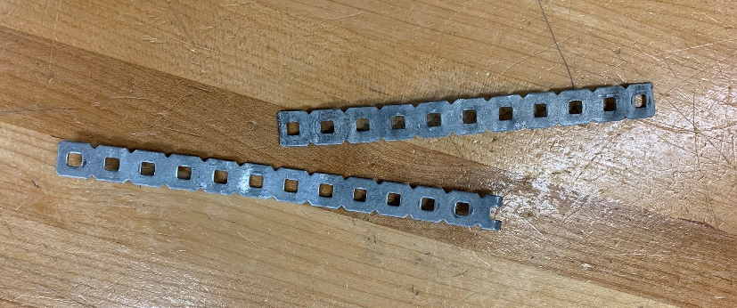
Metal parts
Chassis bumper (2)
Chassis rail (4)
Angle long bar (2), any length
Long bar (2), any length
Plate full size(1), half size (1)

