Slide 1
Construction of Reference Planes

Slide 2
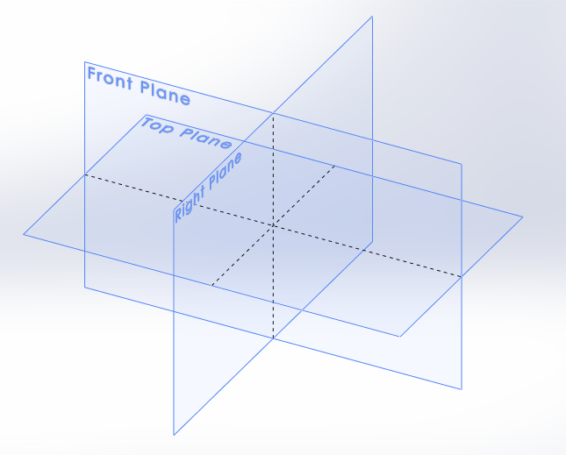
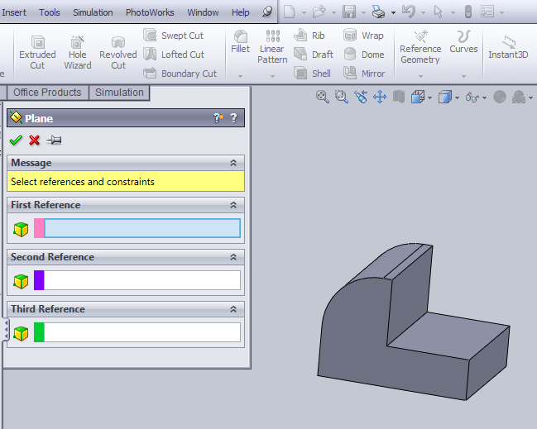
Principal planes (front, top, right side)
Any flat surface of the object could be used as a sketch plane

Slide 3
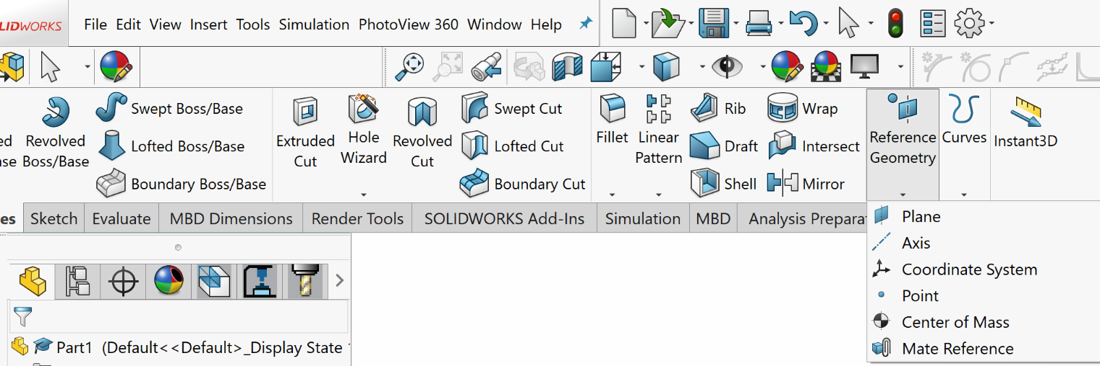
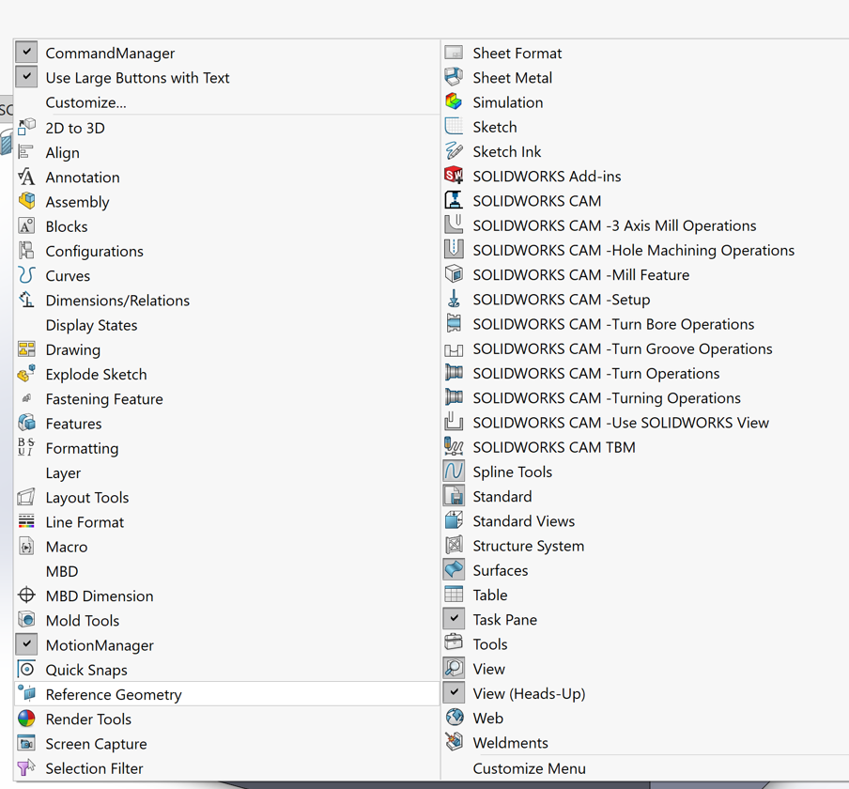
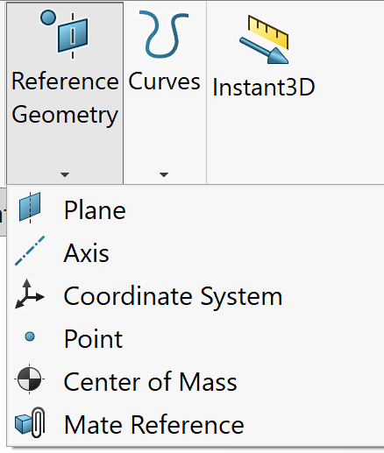
Creating reference (Datum) planes
Reference plane
Right click in the menu area and select Reference Geometry

Slide 4
Reference Features
The reasons you may need Reference features
To locate a sketch for a new feature where a model surface is not available; construct a reference plane to sketch.
To establish a plane or an edge for dimensioning; construct reference plane or reference axis.
To provide a point for rotating or an axis for revolving features or patterns; construct reference point or reference axis
To establish an intermediate position that is required to define other reference plane; construct a reference plane

Slide 5
Constructing Reference Planes
A plane can be uniquely defined by:
Selecting three points
Selecting two parallel lines
Selecting two intersecting lines
Selecting a point and a line

Slide 6
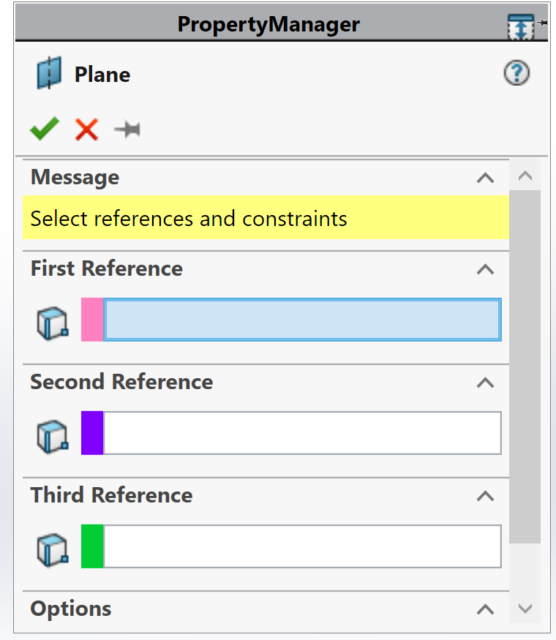
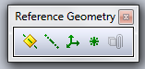
Reference Plane
Reference plane is a rectangular plane that is tied to the model parametrically and is infinitely large. There is no limit on the number of reference planes and they can be used to create new sketches for feature operations.

Slide 7
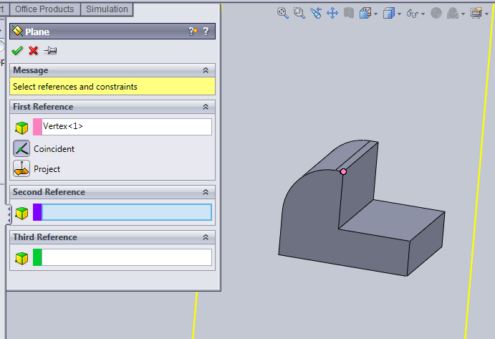
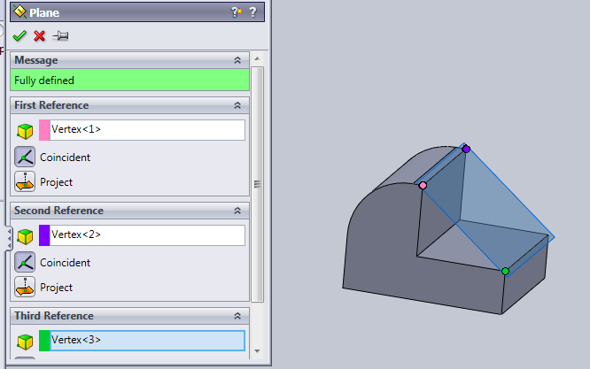
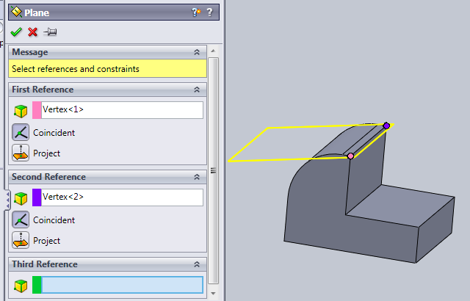
Select three points to create a reference plane
1st point
Green indicates that the plane is fully defined.
2nd point
3rd point
A unique plane is passing through the three points

Slide 8
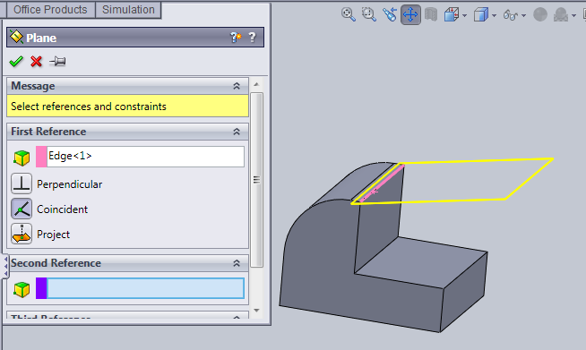
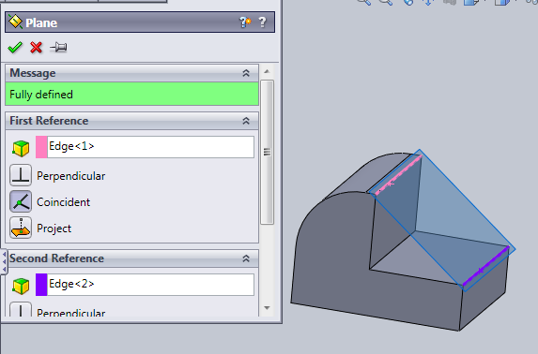
Line (Edge) 1
Specify two lines to construct the plane
Line (Edge) 2

Slide 9
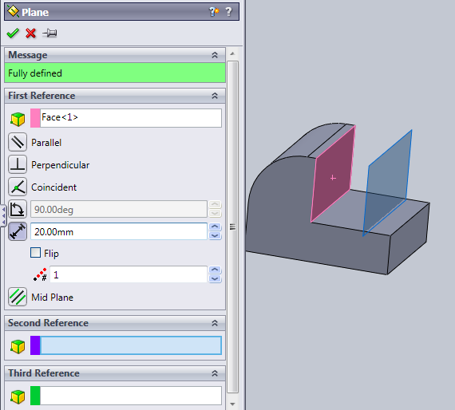
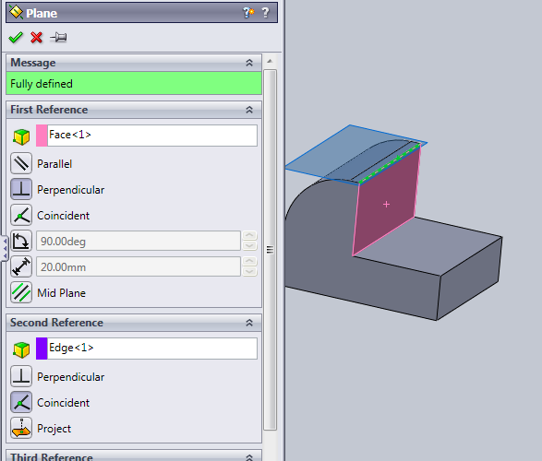
Parallel plane with a specified offset (20 mm)
Select a face and specify the offset
Perpendicular to a plane and thru a selected line

Slide 10
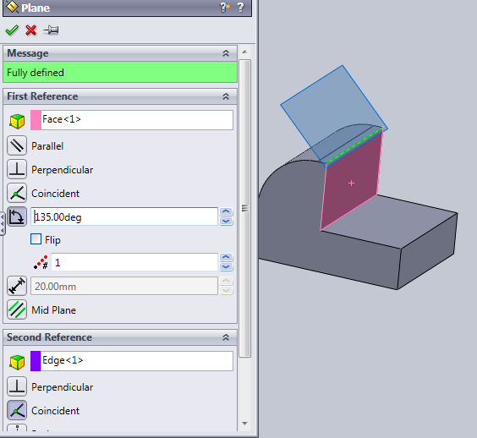
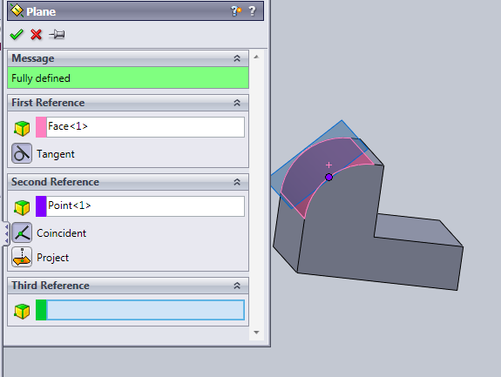
Reference plane at a specified angle with respect to another plane
Reference plane tangent to a curve at a specified point

Slide 11
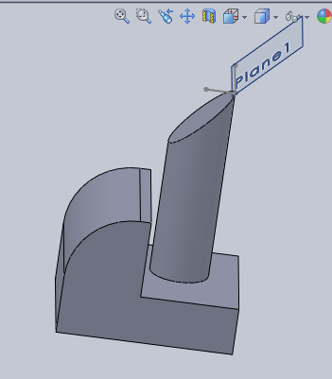
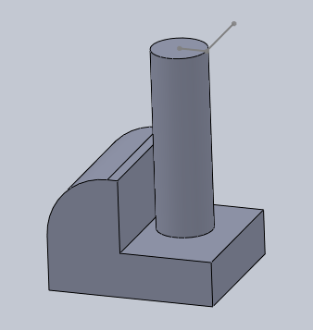
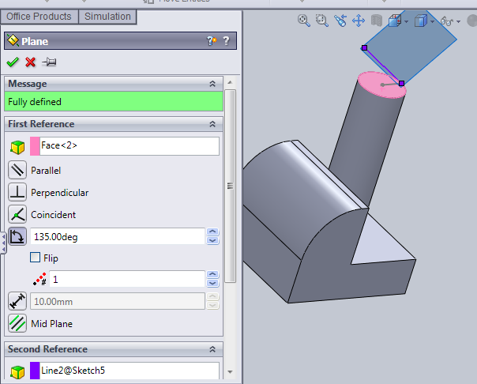
A
Cut an object at a desired location (point A) with a specified angle
Cutting plane
A
Line thru A
Select the top plane as a sketch plane and locate point A. Pass a line thru point A
Top surface
Create a reference plane (cutting plane) by selecting the top surface and the line passing thru A

Slide 12
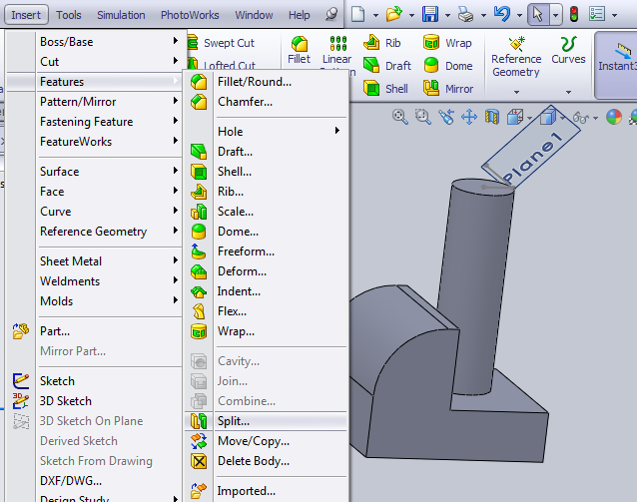
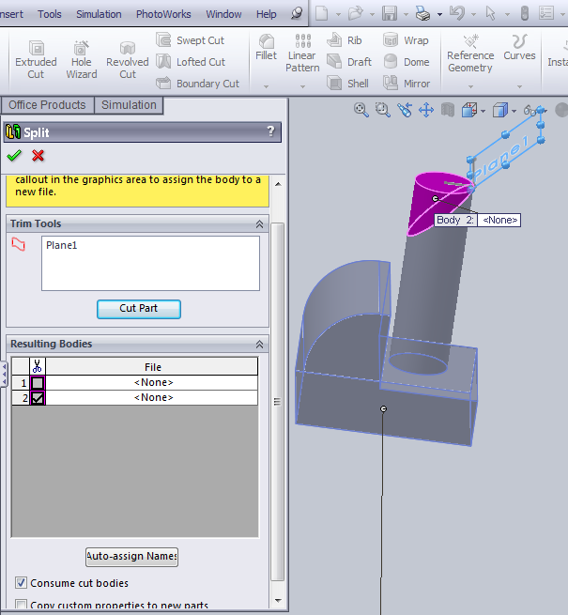
Select cutting tool (plane) and cut the part (cylinder). Choose the section to erase.

