Slide 1
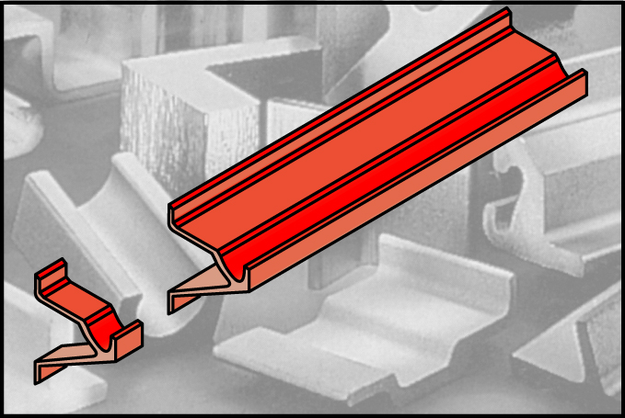
Manufacturing Process - Extrusion
Parts have a uniform (constant) cross section

Slide 2
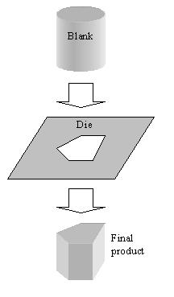
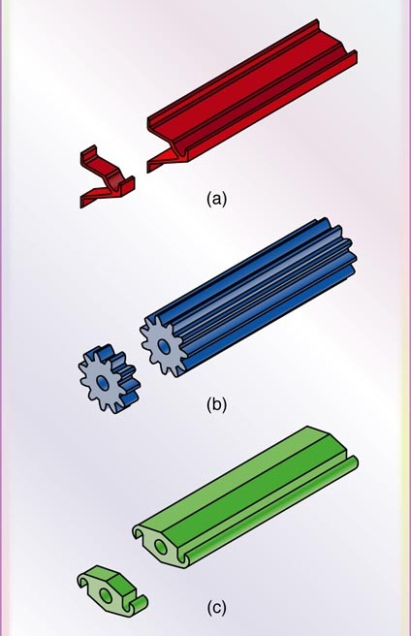
Extrusion
Material (billet), hot or cold, is either pushed or pulled through a die. The long piece can be cut to a desired thickness

Slide 3
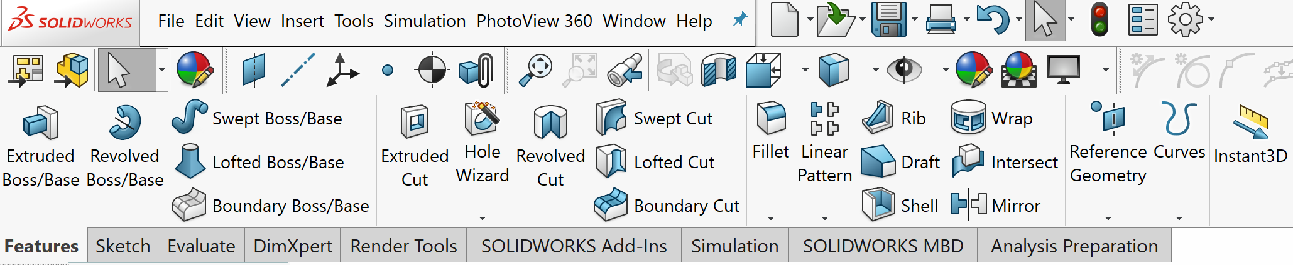
Extrude Command in SolidWorks
Adds material
Removes material

Slide 4
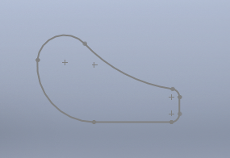
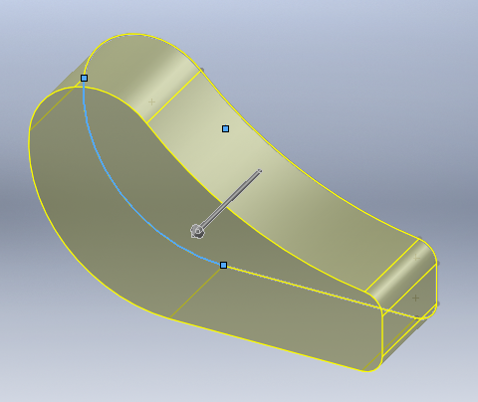
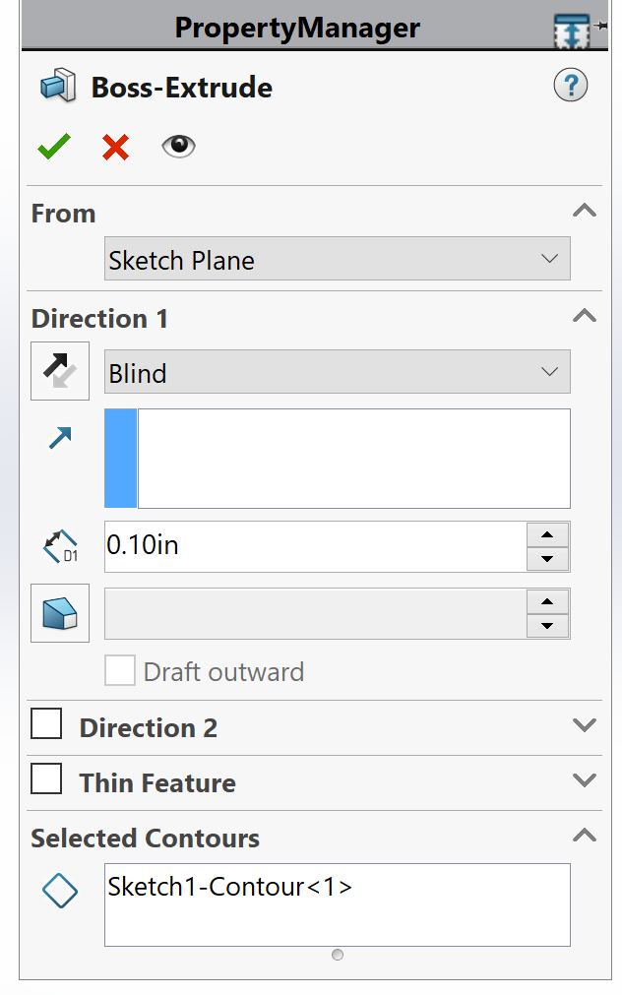
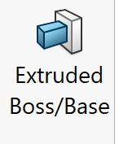
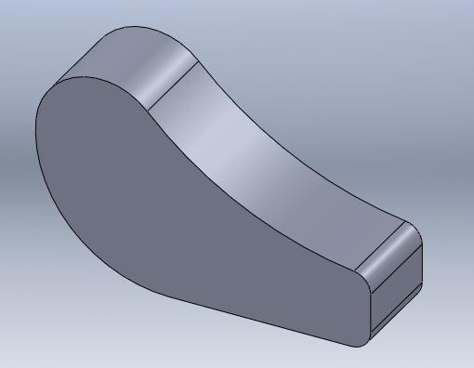
Extrusion
Preview of the solid, there is a problem with the sketch if the preview does not appear, most likely the sketch is not continuous
Create a 2D sketch
Select the sketch
Select Extruded Boss/Base
Choose Blind and enter the thickness and accept

Slide 5
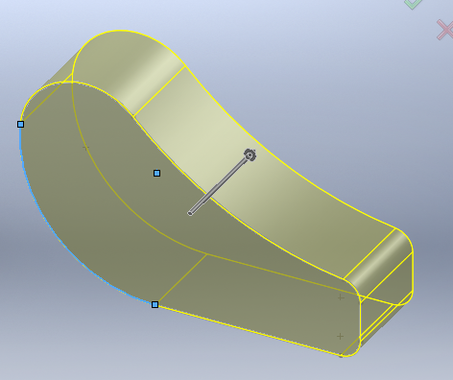
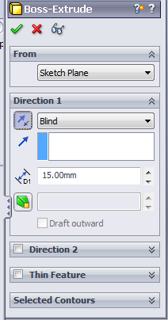
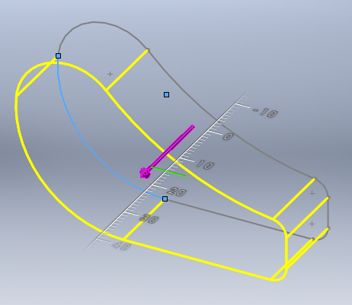
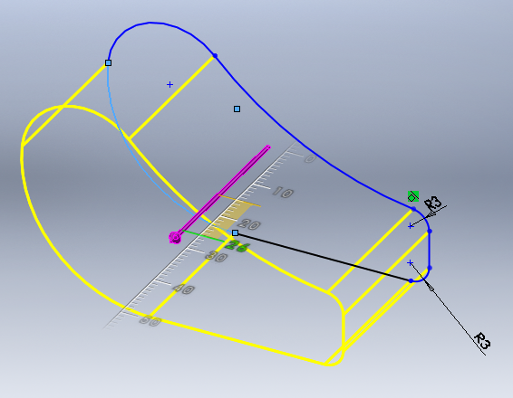
Extrusion
Click to change the direction of the extrusion
Click on the arrow and drag to change the thickness using the scale on the screen
On screen scale

Slide 6
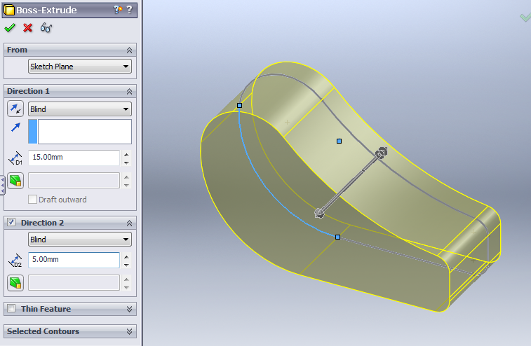
Extrusion
Two directions could be used for extrusion: direction 1 (15 mm), direction 2 (5 mm)
thickness5 mm
thickness15 mm

Slide 7
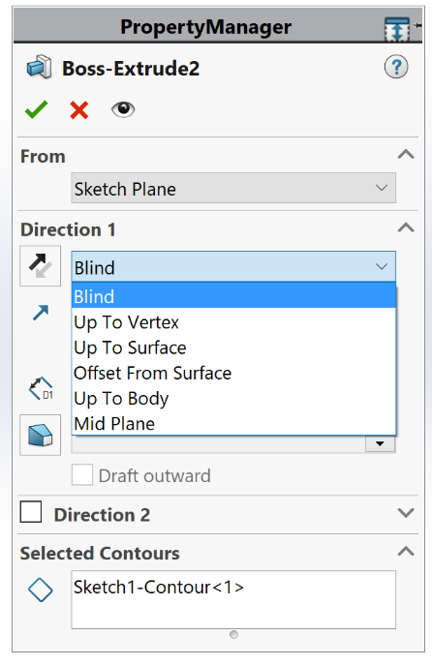
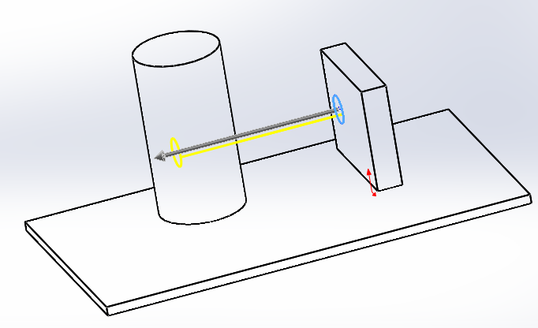
Extrusion

Slide 8
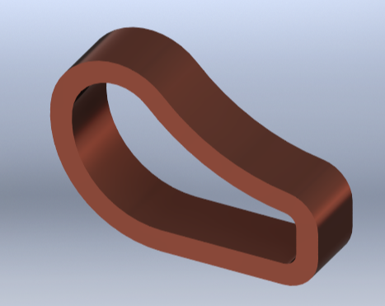
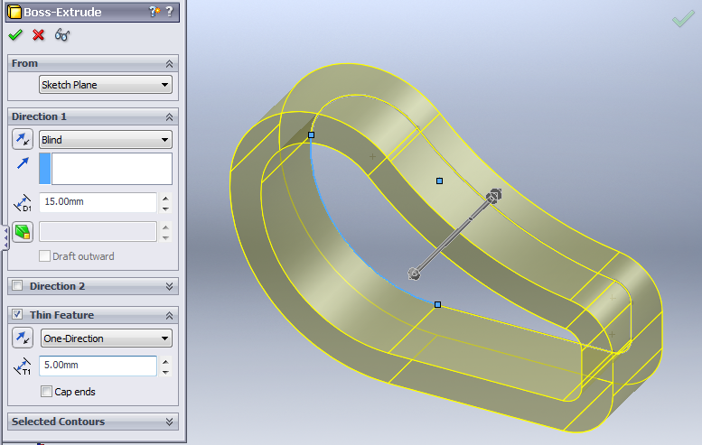
Extrusion
The part can be hollowed out by selecting the Thin Feature option and assigning a value for the wall thickness
Copper material rendered
5 mm wall thickness

Slide 9
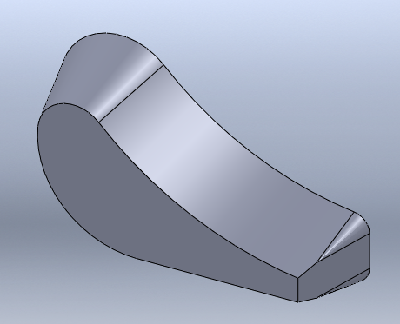
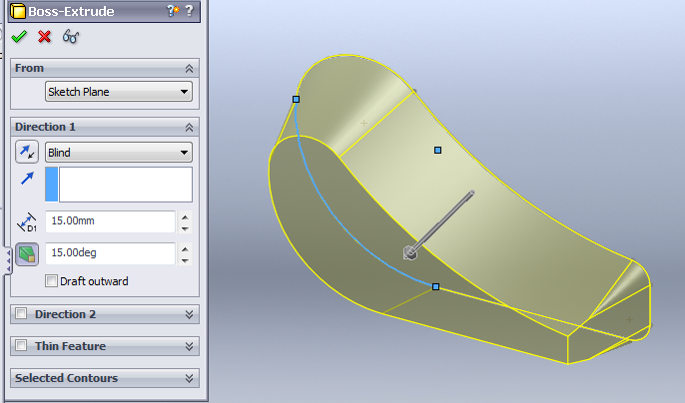
Extrusion
To taper the extrusion: select the taper option and assign the desired taper angle in degrees, 15 degrees.
No taper

Slide 10
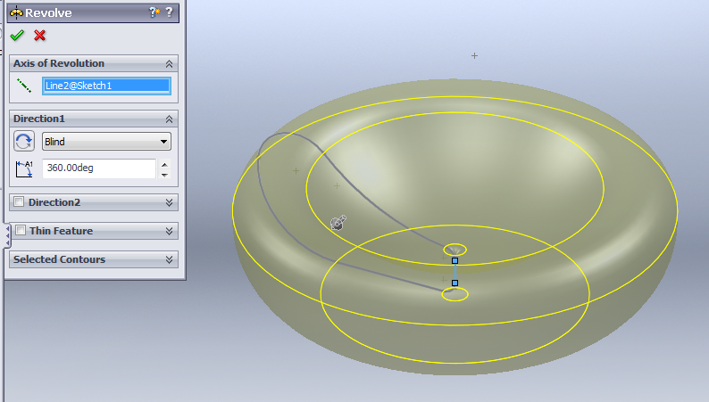
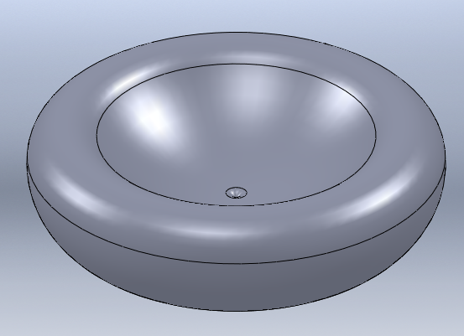
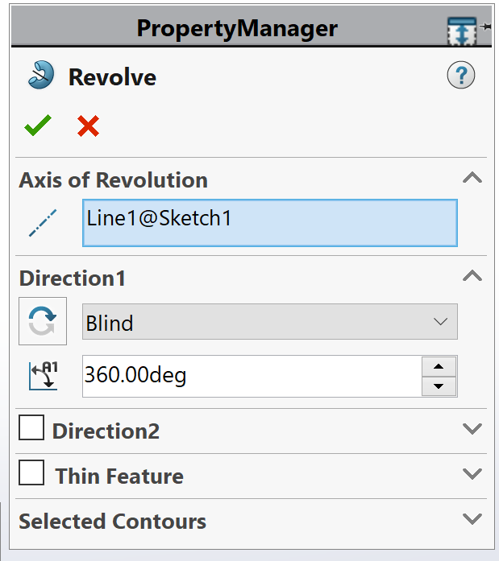
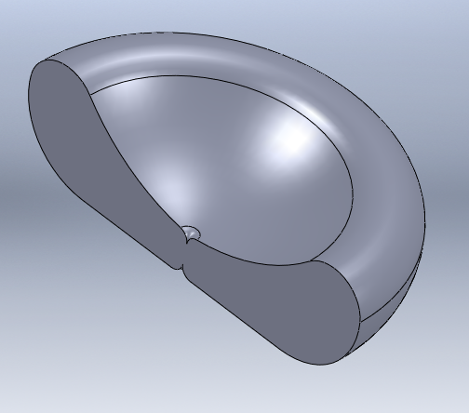
Revolve Command
Select the revolve command, choose the axis of rotation and the amount of rotation in degrees. The axis of revolution could be any line in the sketch.
360 deg. revolution
Sketch
Axis of rotation
180 deg. revolution

Slide 11
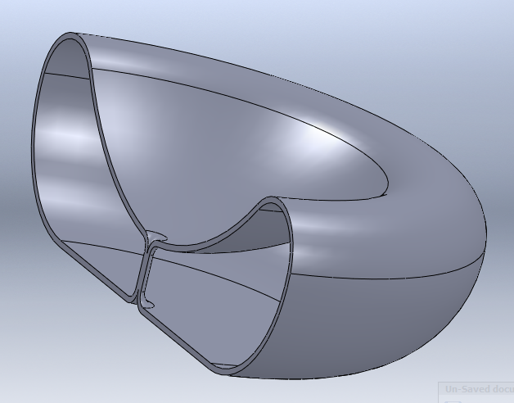
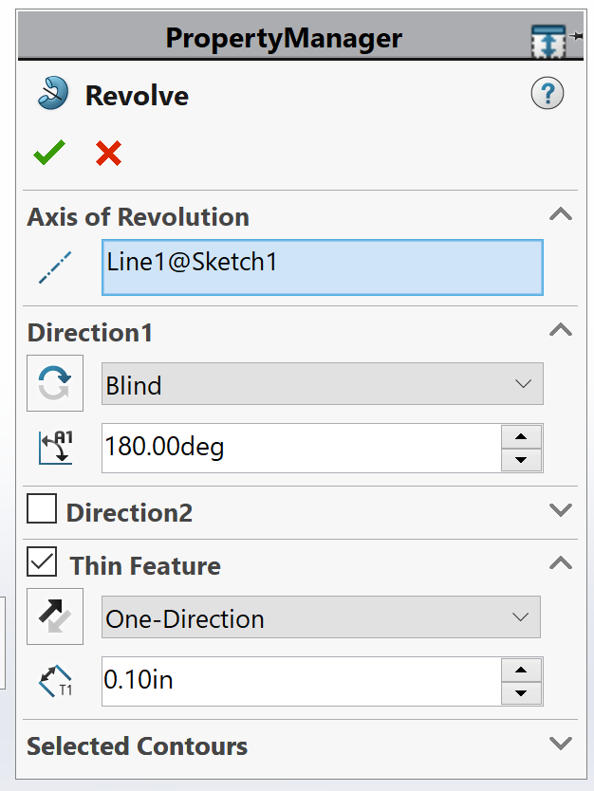
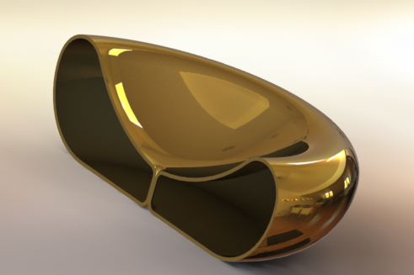
Revolve
The part can be hollowed out by selecting the Thin Feature option and assigning a value for the wall thickness
Rendered model

