Slide 1
Aerospace Engineering Department 1987 – 2021
Dr. Nikos J. Mourtos
Chair

Slide 2
AE Department History
1985: Dean Pinson asks Dr. Desautel to develop
AE Program + AE Department
1987: AE Department + BSAE Program open
  @ the time: only AE Program from Seattle to Boulder to Los Angeles
  Dr. Mourtos: 1st tenure-line faculty member hired
1989: first (transfer) students graduate w. BSAE degrees
  Dr. Hunter: 1st full-time lecturer hired
1991: BSAE ABET accreditation; ~ 400 majors
1992: MSAE Program open; emphasis on satellite subsystems

Slide 3
Program Distinctives
Innovative, broad curriculum supported by state-of-the-art laboratories.
Philosophy: broad treatment of AE subjects integrating analysis, computation, design + experimentation supported by wide-ranging hands-on laboratory experience and projects.

Slide 4
BSAE Program – 350 students

Slide 5
MSAE Program – 90 students
Advanced Math / Numerical Methods (6 Units) | AE 200 | Engineering Analysis of Aerospace Systems
 | AE 269 | CFD
MSAE Core (12 Units) | AE242 / AE243 / AE 245 / AE 246 / AE247 | Astrodynamics / Aircraft D&C / Spacecraft D&C / Trajectories
 | AE 250 / AE 251 | Aerospace Structures & Materials
 | AE 262 / AE 264 / AE 265 / AE 280 | Aerodynamics / Hypersonics
 | AE 267 | Propulsion
Focus Area (6 Units) | AE 210 | Space Systems Engineering
 | AE 271 (GWAR) / AE 273 (GWAR) | Aircraft Design
Thesis/Project (6 Units) | AE 295 A&B or AE 299 | Project / Thesis
Areas in which students with non BSAE degrees must take prerequisite courses | Aerospace Structures
 | Aerodynamics
 | Flight Mechanics
 | Aerospace Propulsion
 | Aerospace Vehicle Dynamics & Control

Slide 6
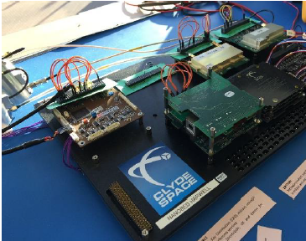
Space Systems Engineering – Nanobed
Lab to be certified for
microsat manufacturing & testing

Slide 7
Space Systems Engineering – Ground Station

Slide 8
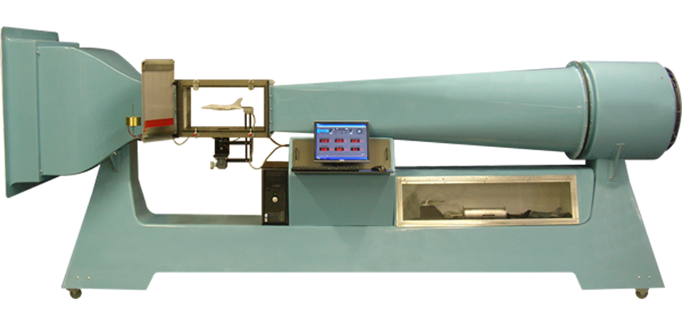
Aerodynamics – Subsonic Wind Tunnel

Slide 9
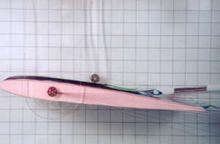
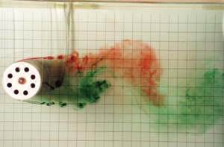
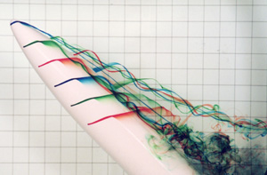
Aerodynamics – Flow Visualization

Slide 10
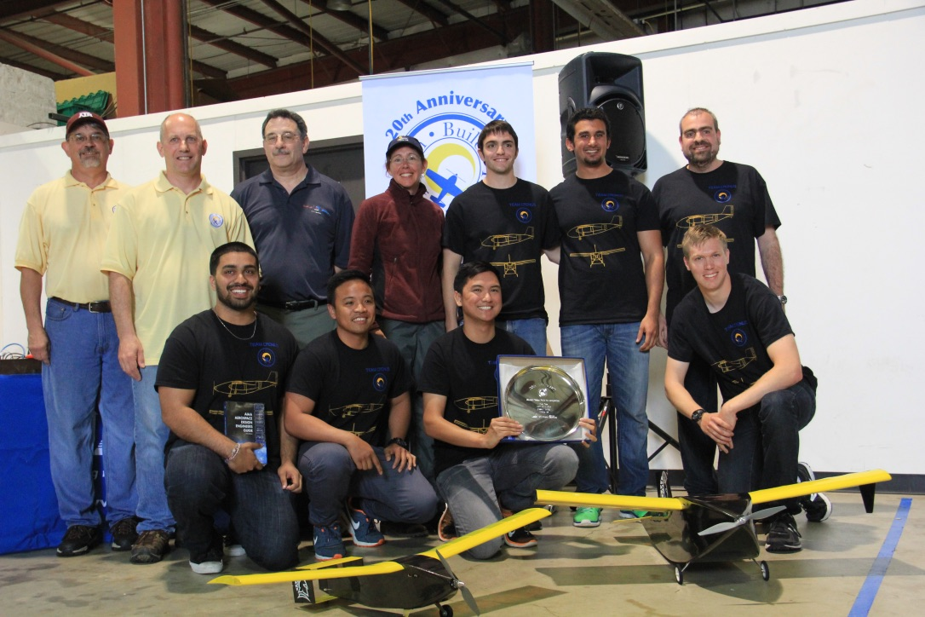
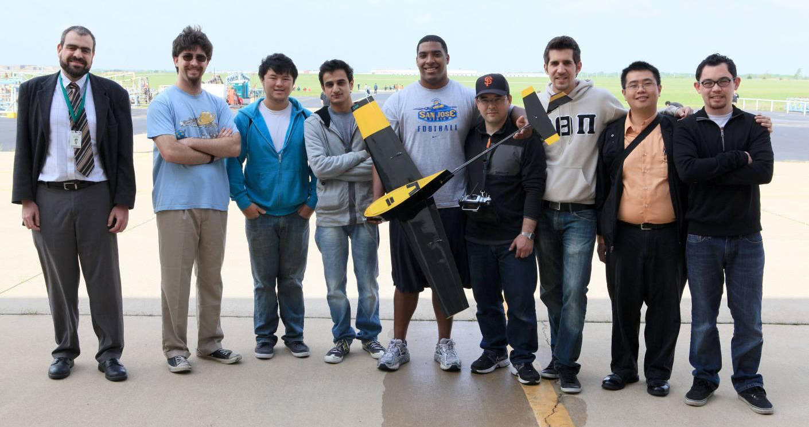
1st Place, AIAA Design–Build–Fly: 2012 & 2016

Slide 11
Rocketry
HARP Team after launch – November 2018

Slide 12
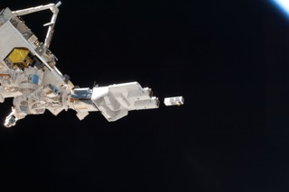
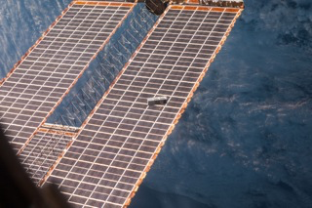
Tech Ed Sat
8 missions launched to ISS 2012 – 2019
3P-2
3P-1

Slide 13
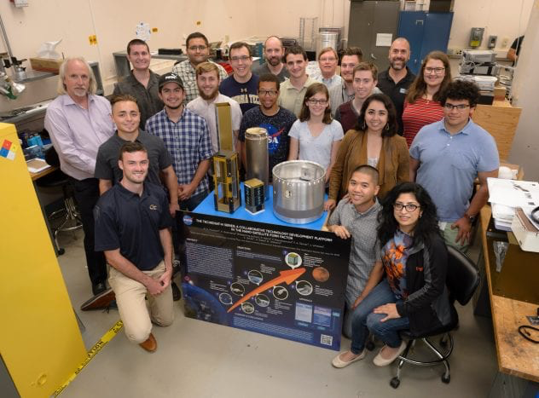
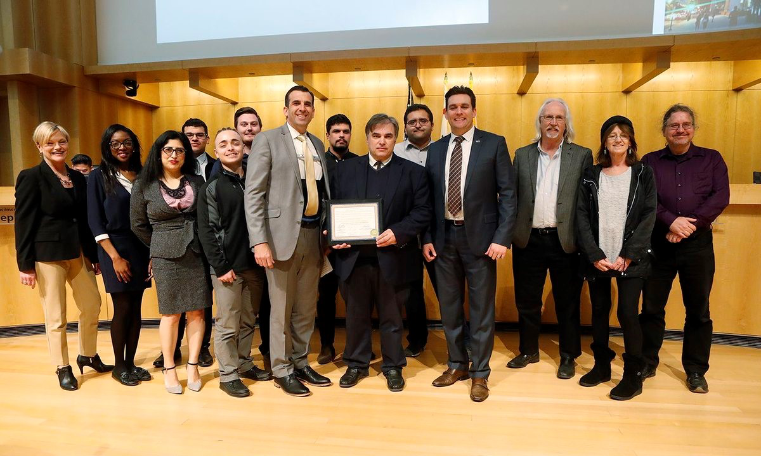
San Jose City Council Commendation
February 26, 2019
TechEdSat Team, headed by Dr. Papadopoulos & Dr. Murbach (NASA Ames RC), received commendation for the launch of 8 Technology Education Satellites.

Slide 14
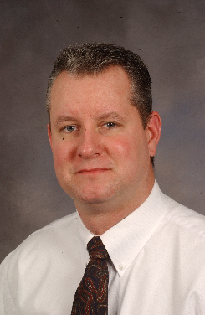
Alumni
Gonzalo Mendoza
Manager, Innovation - Cessna
BSAE 1998
Dr. Wade Huebsch
Professor, Aerospace Engineering
West Virginia University
BSAE 1992
Anima Patil-Sabale
NASA engineer & aspiring astronaut
MSAE 2010
Jay Westerwelle
Mission Operations Manager
Space Systems Loral
BSAE 2014

Slide 15
Alumni Comments
The size of the AE department makes it feel like a family. I spent years working alongside fellow students, who became good friends. Many of them found jobs in the AE industry within the Silicon Valley. Being at the heart of Silicon Valley, the Department sets students up for networking opportunities that will help them in the future. I also got to know my professors fairly well. That directly shaped my success when one of them put me in contact with a past student, who was at an organization with open job positions.
Aaron Mazzulla BSAE (2012, MSAE (2015), NASA Ames RC Systems Engineer
The deliberately open-ended real-world scenarios at SJSU help build solid aerospace engineers who know how to find practical solutions to complex, imperfect problems.
Tara Samuels MSAE (2017), Ph.D. Embry Riddle (2022), NASA Ames RC Engineer
The curriculum and teaching style in AE allowed me to approach new projects and solve problems differently that others I work with. I am better equipped to take the initiative sooner than others, solve real problems by thinking outside the box, and appreciate success and failure in stride. Additionally the program enhanced the team skills I already had from previous experiences, allowing me to find more efficient ways of interacting with co-workers to accomplish my goals.
Jae Westerwelle BSAE (2014), SSL Mission Operations Manager

Slide 16
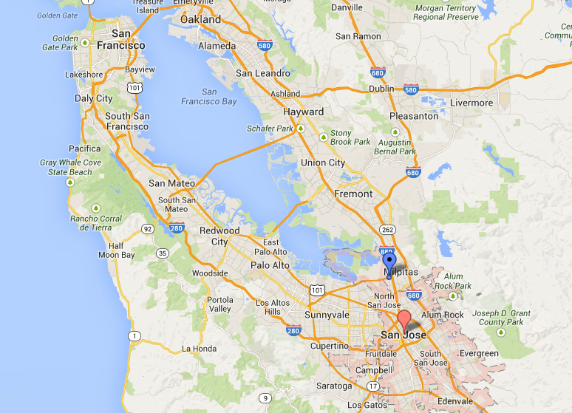







A
Aerospace Companies in the San Francisco Bay Area

Slide 17
More information ?
Dr. Nikos J. Mourtos, Chair
Office: Engr. 272A
(408) 924-3867 nikos.mourtos@sjsu.edu
Website: www.sjsu.edu/ae/

